Slide 1
Crayke Chronicle
Issue: #2 Term: Autumn Date: 15 September 2023
FOLLOW YOUR PATHWAY AND WE GROW TOGETHER WITH CONFIDENCE
You did not choose me, I chose you that you might go and bear fruit, fruit that will last so that whatever you ask in my name the Father will give you. John 15:16
Respect Friendship Forgiveness Determination

Slide 2
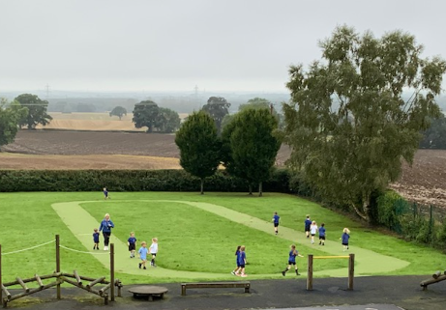
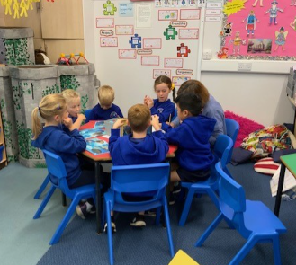
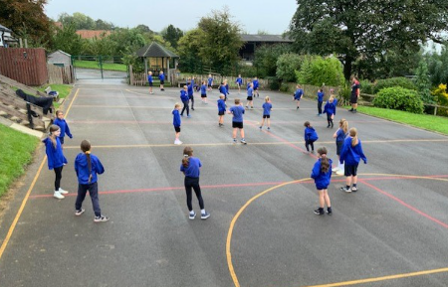
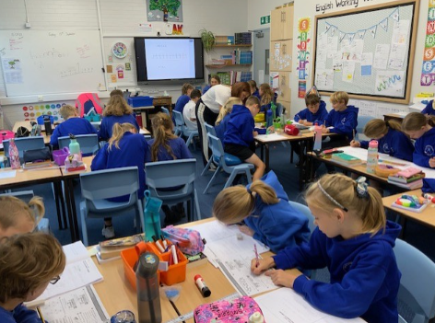
News From School This Week

Slide 3
News From School This Week
At the beginning of the academic year, it’s important to refresh our drive for high levels of attendance at school.
It can be confusing sometimes to know whether your child can attend school or not, if they are a little under the weather. This guide may help: https://www.nhs.uk/live-well/is-my-child-too-ill-for-school/
This week, the attendance for each class was above national average which is absolutely fantastic – please support us in keeping it that way!
If you would welcome a further discussion about whether or not to send your child to school, please do contact the school office.

Slide 4
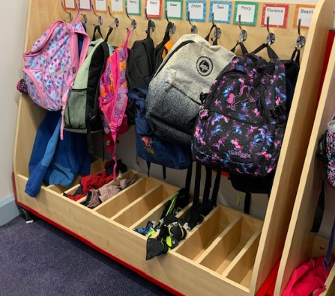
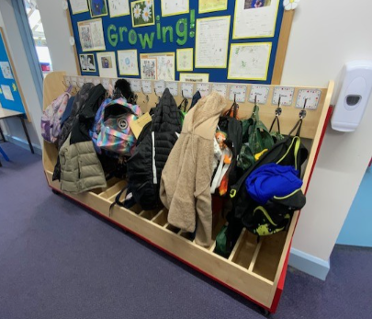
News From School This Week
I have never known such excitement about cloakrooms, but we were all a but giddy when our mobile peg units arrived this week! Thank you to Mrs Rayner for masterminding this project and to the Di Walker Foundation for the hugely generous donation which has made this possible.
Not only has this made the corridors far tidier, relocating the pegs will enable us to use the former cloakroom area to create a multi-purpose learning space for children of all ages to use. Mrs Rayner has put together this wish list of items; we’d be ever so appreciative if anyone could contribute to our exciting plans for this: https://www.amazon.co.uk/hz/wishlist/ls/29NDTVB03U58Z?ref_=wl_share
Thank you for the donations already received!

Slide 5
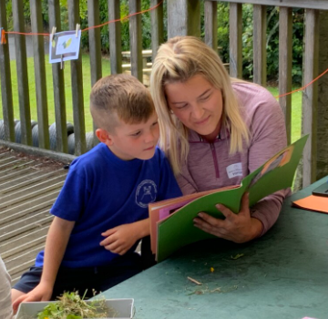
Upcoming Events
Open Afternoon – Tuesday
We would like to offer all parents and carers the opportunity to visit school during our Open Afternoon next week. The session will begin at 1:45pm with a welcome from me about our school vision, ethos and priorities for the forthcoming academic year. From 2pm until 3:20pm the classrooms will be open for parents and carers to see their child/ren’s classrooms in action, to meet the school staff and to find out about what the children are learning in school. Each of the class teachers will lead a short presentation during this time about how you can support their child with learning at home, specifically reading, during the afternoon. Tiddlywinks OOSC Crayke will also be joining us to share information about the new provision.
In order to help us plan for this event, we would be grateful if you could complete this short online form to indicate whether you are joining us or not, if you haven’t done so already. https://forms.office.com/e/VFfUVr863V
We hope that you are able to join us!

Slide 6
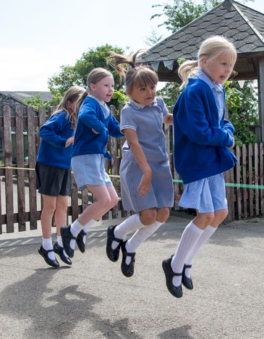
Upcoming Events
National Fitness Day – Wednesday
‘Your Health is for Life’
Wednesday 20 September is National Fitness Day. This year the theme aims to encourage people of all ages, abilities and backgrounds to recognise and celebrate the lifelong physical and mental benefits of being active.
We will be encouraging children to be extra active during playtimes on Wednesday. There will be a lunchtime disco on the top playground.
Mrs Helfferich

Slide 7
Upcoming Events
Year 5/6 Football Tournament – Easingwold Primary
We have been invited to send a team to Easingwold Primary after school on Monday 16 October, running from 3:45pm – 6:00pm. Mr Palmer will be working with the team and a member of school staff will accompany the children but we do require parents to transport children to Easingwold Primary and then take them home afterwards. We know that many children are interested in this opportunity and on this occasion it won’t be possible to take them all. In the first instance, please can parents complete this survey to give us an expression of interest and confirmation of availability. https://forms.office.com/e/kTFMm0nJ79 Thank you

Slide 8
Awards in School This Week
 | Apple | Beech | Holly | Oak
Stars of the Week | Evelyn Dobreva | Josh Griffin-Miles | Elijah Brown | Ted Clark
 |  | Henry Robinson | Frankie Grainger | Cyrus Saeedi
Gold Awards for Sport | Dianta Simpson | Lucia Grant | Elise Fenton | Asa Champion
Headteacher Awards Random Act of Kindness | Gem Champion |  | Nancy Barrett

Slide 9
Team Points
Team | Points
Red | 846
Blue | 845
Green | 1316
Yellow | 1010
Well done Green team!
School Council have been tasked with focussing on making further developments to our team point system this term, including coming up with some new names and some more meaningful rewards for the winning team. I can’t wait to see what they come up with!

Slide 10
PE Kits next week
 | Monday | Tuesday | Wednesday | Thursday | Friday
Beech |  |  |  | X | X
Holly |  | X |  |  | X
Oak |  |  |  | X | X
Apple: Children in Apple Class need to bring their Forest School kit in each Monday. Please send their PE kit in on Monday as children will change for PE in school. They will bring PE kits home for washing periodically.
Please ensure that on PE days, the children wear their hoodies, school jumpers or cardigans alongside white or blue t-shirts and black or navy shorts or jogging bottoms.

Slide 11
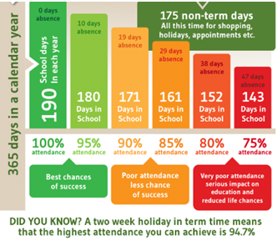
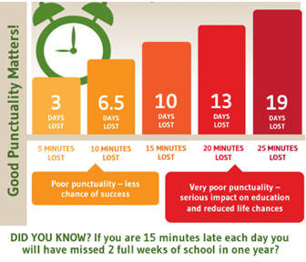
Attendance and Punctuality
This week’s attendance figures: 97.3% School Target: 96%
 | Attendance | Punctuality
Apple | 100% - well done! | 0 lates
Beech | 97.7% | 1 late
Holly | 96.3% | 2 lates (1 child)
Oak | 96.9% | 0 lates

Slide 12
Extra Curricular Clubs - Autumn
Some clubs have limited capacity and places will be allocated on a first come first served basis. In the event of a club being fully booked, your child’s name will be added to a waiting list and you will be advised if a place becomes available. Booking is not required for before school or lunchtime clubs. For after school clubs run by school staff (in red type; denoted with *) please email Mrs Bacon on admin@crayke.n-yorks.sch.uk to book a place.
Before School:
After School:
Club | Day and Time | Group
Run a Mile | Monday, Tuesday Thursday & Friday 8:30am | All welcome – parents and carers included!
More clubs to follow including Coding and Netball!
Day | Club
Monday | Craft* (£10 pay via ParentPay) 3:30 – 4:15pm Years 1 – 6 Mrs Seligman
Tuesday | Indoor Multi-Sport (fee paid direct) 3:30 – 4:30pm Years 1 – 6 Mark Cromack
Wednesday | Junior Duke* (£10 pay via ParentPay) 3:30pm – 4:15pm Year 3/4 Mrs Helfferich
Thursday | Chess* (no charge) 3:30pm – 4:15pm Year 1 - 6 Mrs Seligman

Slide 13
Save the Date!
Family Bingo
Saturday 21st October
3-6pm
Crayke Sports Hall - hosted by CHASA.
All welcome, ticket details and more info to follow.
The CHASA Team

Slide 14
Tiddlywinks OOSC Crayke
We’ve had another great week at Tiddlywinks and registered several more children onto our books!
We’re looking forward to sharing more details with you about our provision at the Open Afternoon next Tuesday.
Please remember to use our new email address: crayke@tiddlywinks-childcare.co.uk to contact us as the old one is not frequently checked. Thank you!

