Slide 1
Crayke Chronicle
Issue: #3 Term: Autumn Date: 22 September 2023
FOLLOW YOUR PATHWAY AND WE GROW TOGETHER WITH CONFIDENCE
You did not choose me, I chose you that you might go and bear fruit, fruit that will last so that whatever you ask in my name the Father will give you. John 15:16
Respect Friendship Forgiveness Determination

Slide 2
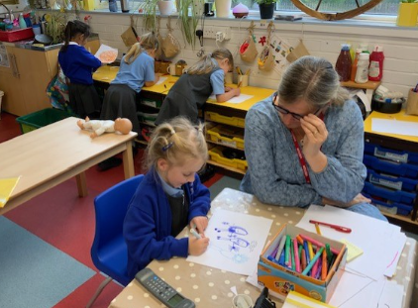
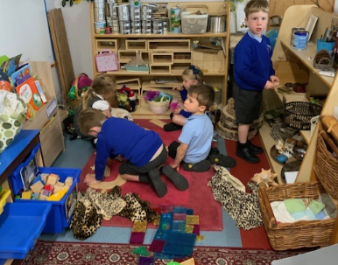
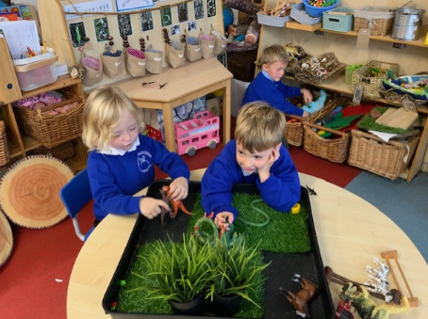
News From School This Week
A snapshot of learning from across the week… please use these photographs as an opportunity to talk to your children about what they have been learning!

Slide 3
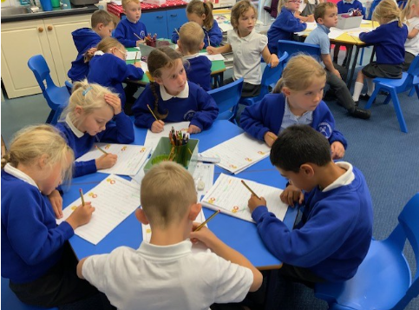

Slide 4
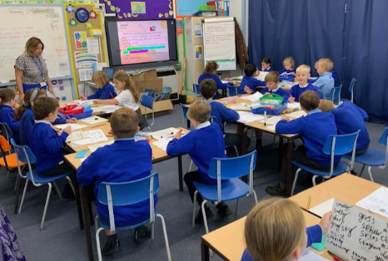

Slide 5
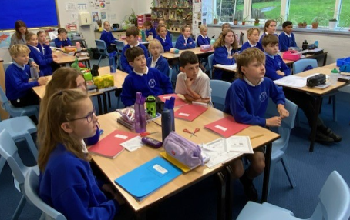

Slide 6
News From School This Week
School Council
We are delighted to announce that this year’s School Council representatives are….
Year Group | Representatives
Reception – represented by Y5 | Joah
Year 1 | Pippa and Constance
Year 2 | Gem and Isla
Year 3 | India and Eva
Year 4 | Isla and Dexter
Year 5 | Felicity and Zhdan
Year 6 | Toby and Sienna
The representatives were voted by their peers and I’m sure they’ll do us proud!

Slide 7
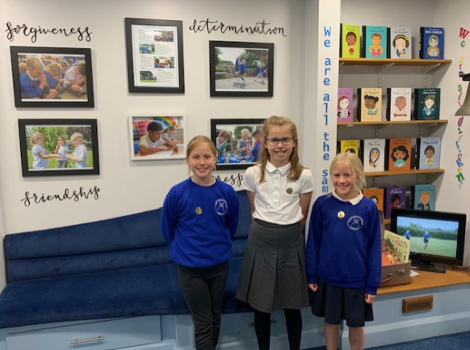
News From School This Week
Open Afternoon
It was wonderful to welcome so many parents and carers into school this week. Thank you for joining us and learning about how to support your child/ren in school this year. Adults were greeted at the door by these gorgeous friendly faces!

Slide 8
News From School This Week
Wonka Bars Fundraiser (Also see the CHASA section for more information)
Once again, a reminder of how wonderful our parents are and how lucky we are to have you! There was so much excitement in school this week about who the winners of the Golden Tickets would be. A huge well done to Percy, Olive, Elise and Penelope – enjoy your prizes!
We want to get more people involved in the life of the school this year – please do contact me if you would like to be involved.

Slide 9
News From School This Week
Staffing Update
We have welcomed Mr Palmer into school this term to work predominantly in Holly Class, during Mrs Shirley’s absence.
Our advertisements to recruit a Teaching Assistant and Learning Mentor at the end of the summer term were sadly unsuccessful. We have re-advertised this week in the hope that we will be more fortunate this time round. If you know of anyone who may be interested in applying please do ask them to get in touch.

Slide 10
News From School This Week - APPLE
Stay and Play
We would like to give you the opportunity to join us for a “Stay and Play” session from 9am on one of the following dates:
Tuesday 10 October; Tuesday 17 October; Tuesday 24 October
Please contact Mrs Bacon to book your slot.
Forest Schools
Just to confirm that Forest Schools will now be on a Friday afternoon. Please ensure children have their kits in school. Thank you

Slide 11
News From School This Week - BEECH
Phonics Drop In Sessions
A reminder to book your appointment with Mrs Bacon to come into school to see a Year 1 Phonics session from 9am on one of the following dates:
Thursday 28 September; Thursday 5 October; Thursday 12 October

Slide 12
News From School This Week - HOLLY
Netball
A final reminder that if you would like your child to participate in this after school club, please complete this survey by the end of Monday. https://forms.office.com/e/3xNn0Gtc2E As it stands it is not financially viable for us to provide this opportunity without more children signing up.
Harvest Experience – St Cuthbert’s Church
On Monday 2 October children will be participating in a local visit to church to undertake activities relating to Harvest. As this falls under our local visits arrangements we do not require specific consent but should you require any further details please do not hesitate to contact me.

Slide 13
News From School This Week – HOLLY (cont.)
Harvest Service Wednesday 4 October – Led by Holly Class
This year Holly Class will be leading our Harvest Service, on the theme of Thankfulness. Parents and carers of children from all classes are warmly welcomed to join us by meeting us at church at 11am.
Thirsk Sculpture Garden Visit – Thursday 12 October
Parents and carers should have received the letter regarding this educational visit earlier this week. Please contact us if you require any further information.

Slide 14
News From School This Week - OAK
Netball After School Club
A final reminder that if you would like your child to participate in this after school club, please complete this survey by the end of Monday. https://forms.office.com/e/3xNn0Gtc2E As it stands it is not financially viable for us to provide this opportunity without more children signing up.
Football Tournament Monday 16 October 3:45pm – 6:00pm
So far 7 children have signed up for this opportunity. There is one space available, which will be filled on a first come first served basis - https://forms.office.com/e/kTFMm0nJ79 The team have been offered the opportunity to have some after school training led by Mr Palmer on the following dates: 27 September, 4 October and 11 October from 3:30pm – 4:15pm

Slide 15
News From School This Week – OAK (cont.)
WYOOFT
We are looking forward to taking the children to Easingwold Parish Church next Friday 29 September for a WYOOFT workshop – a hands on technology and music experience. Almost all parents have completed the consent form – if you have not yet done so please complete here: https://forms.office.com/e/6m4XQ5HyVR
Robinwood
On Monday children will be bringing home their luggage labels, and a souvenir order form. We will also be emailing details with final reminders about the visit.
Harvest Experience – St Cuthbert’s Church
On Monday 2 October children will be participating in a local visit to church to undertake activities relating to Harvest. As this falls under our local visits arrangements we do not require specific consent but should you require any further details please do not hesitate to contact me.

Slide 16
News From School This Week
National Fitness Day 20 September
Unfortunately, the rain postponed our playground disco on Wednesday but the sun came out for us on Thursday enabling us to get active.

Slide 17
Out of School Activities
If your child takes part in Parkrun, martial arts or any other active clubs, we would love to celebrate their successes in school. Please email any photos to chelfferich@crayke.n-yorks.sch.uk
It has been great to see so many of our children taking part in the Easingwold Parkrun, keep up the great running.

Slide 18
Awards in School This Week
 | Apple | Beech | Holly | Oak
Stars of the Week | Sylvia Hunsdale | Tabi Copley | Leo Bunker-Barnes | Zhdan Kovalchuk
 |  | Letty Wilkinson | Eva Copley | Percy Ollive
Gold Awards for Sport | Lance Ward | Louise Keaney | Wynter Brierley | Isla Howland
Headteacher Awards Random Act of Kindness | Duke Gains |  | Olive Beeson

Slide 19
Team Points
Team | Points
Red | 643
Blue | 840
Green | 1271
Yellow | 880
Well done GREEN team!
School Council have been tasked with focussing on making further developments to our team point system this term, including coming up with some new names and some more meaningful rewards for the winning team. I can’t wait to see what they come up with!

Slide 20
PE Kits next week
 | Monday | Tuesday | Wednesday | Thursday | Friday
Beech |  |  |  | X | X
Holly |  | X |  |  | X
Oak |  |  |  | X | X
Apple: Children in Apple Class need to bring their Forest School kit in each Friday. Please send their PE kit in on Monday as children will change for PE in school. They will bring PE kits home for washing periodically.
Please ensure that on PE days, the children wear their hoodies, school jumpers or cardigans alongside white or blue t-shirts and black or navy shorts or jogging bottoms.

Slide 21
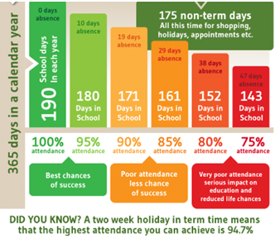
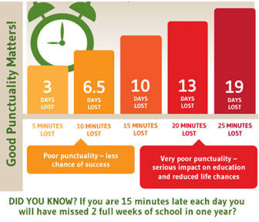
Attendance and Punctuality
This week’s attendance figures: 96.3% School Target: 96%
 | Attendance | Punctuality
Apple | 100% - well done! | 0 lates
Beech | 97.3% | 3 lates (1 child)
Holly | 92.8% | 5 lates (2 children)
Oak | 97.3% | 1 late

Slide 22
Extra Curricular Clubs - Autumn
Some clubs have limited capacity and places will be allocated on a first come first served basis. In the event of a club being fully booked, your child’s name will be added to a waiting list and you will be advised if a place becomes available. Booking is not required for before school or lunchtime clubs. For after school clubs run by school staff (denoted with *) please email Mrs Bacon on admin@crayke.n-yorks.sch.uk to book a place.
Before School:
After School:
Club | Day and Time | Group
Run a Mile | Monday, Tuesday Thursday & Friday 8:30am | All welcome – parents and carers included!
Day | Club
Monday | Craft* (£10 pay via ParentPay) 3:30 – 4:15pm Years 1 – 6 Mrs Seligman | Coding* STARTING 2 OCTOBER 3:30pm – 4:15pm Years 3-6 Mr Brown
Tuesday | Multi-Sports (fee paid direct) 3:30 – 4:30pm Years 1 – 6 Mark Cromack
Wednesday | Junior Duke* (£10 pay via ParentPay) 3:30pm – 4:15pm Year 3/4 Mrs Helfferich | Netball (TBC – please complete survey by Monday https://forms.office.com/e/3xNn0Gtc2E ) 3:30pm – 4:30pm Years 3-6 Netball 4 All UK
Thursday | Chess* (no charge) 3:30pm – 4:15pm Year 1 - 6 Mrs Seligman

Slide 23
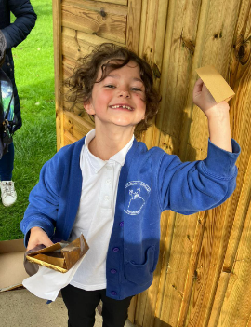
The Wonka Bar competition was a brilliant new initiative which really captured the children’s imaginations and linked with Roald Dahl day superbly. A total of £180 was raised for CHASA. The whole thing was solely organised by Vicki Griffin and Lucy Triffitt – we are hugely grateful for their hard work and dedication to this project. We would also like to express our thanks to Tesco, Morrisons Boroughbridge and Towlers for donating chocolate bars.

Slide 24
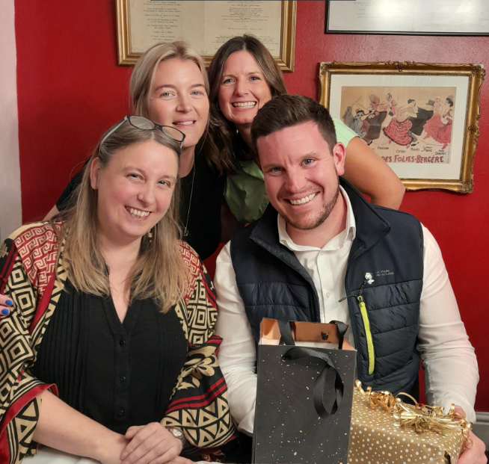
At the AGM last night we expressed our gratitude to our Chair, Jonathan who is stepping down after nearly 4 years in the role.
We are all hugely grateful for his energy, enthusiasm and support over the years. Luckily he is still staying on board in a newly created role as Lotteries and Raffles Manager!

Slide 25
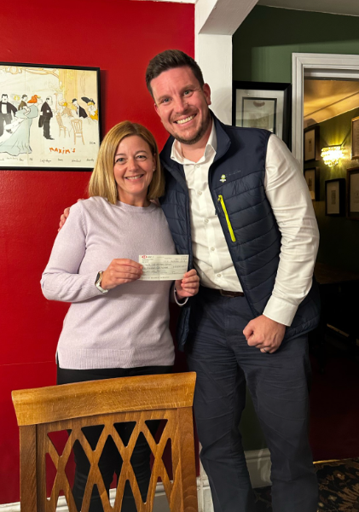
We were thrilled to be able to present Mrs Jackson with a cheque for £6500 from last year’s fundraising efforts. This will be used to provide updated IT equipment – laptops and iPads – for children from all classes across school to be able to use.
Mrs Jackson said “For a small school, we are so fortunate to have so many parents and carers willing to support and fundraise in so many creative ways. This money will make a direct difference to pupils of all ages. On behalf of the pupils, staff and governors, we are immensely grateful for everything you have done and continue to do to support making our school a brilliant place to learn and work. Thank you!”

Slide 26
We are pleased to confirm that this year the CHASA core committee will be as follows:
In addition we have several other people on board supporting with various other aspects of CHASA including year group reps, uniform, tuck shop, communications, community links etc. We are really lucky to have so many willing volunteers – thank you all!
Name | Role | Contact Details
Victoria Cain | Chair | chasa@crayke.n-yorks.sch.uk
Jade Bunker | Vice Chair | chasavicechair@crayke.n-yorks.sch.uk
Rebecca Stubbins | Secretary | chasasecretary@crayke.n-yorks.sch.uk
Tracey Swiers | Treasurer | chasatreasurer@crayke.n-yorks.sch.uk

Slide 27
CHASA are running this month’s Crayke Village Market.
Save The Date: 30/9/23
10:30am - 1:30pm
Please come along and support CHASA - all proceeds from the Cafe go towards our AMAZING school.
Thank You - CHASA Team.

Slide 28
Save the Date!
Family Bingo
Saturday 21st October 2023
3-6pm
Crayke Sports Hall - hosted by CHASA.
All welcome, ticket details and more info to follow.
The CHASA Team

Slide 29
https://www.youtube.com/watch?v=-CUn_80wfSM

Slide 30
Crayke Village Produce Show
The annual village produce show took place last Saturday with some amazing entries from The Dawson’s and Joshua Jefferson. Mabel and Joshua created cucumber tortoises and Sylvie painted a spectacular tortoise. Sheldon, Theo and Tiny Tim were delighted to see the photos. Pippa produced an amazing ring-tailed lemur painting. Next year we will hopefully be able to enter our school eggs.
Well done to everyone who entered.

Slide 31
Tiddlywinks OOSC Crayke
If any parents/carers would like to get in touch with us following Tuesday’s Open Afternoon session, please contact us on:
T: 07796 350623
E: crayke@tiddlywinks-childcare.co.uk

