Slide 1
Crayke Chronicle
Issue: #4 Term: Autumn Date: 29 September 2023
FOLLOW YOUR PATHWAY AND WE GROW TOGETHER WITH CONFIDENCE
You did not choose me, I chose you that you might go and bear fruit, fruit that will last so that whatever you ask in my name the Father will give you. John 15:16
Respect Friendship Forgiveness Determination

Slide 2
In our newsletter this week…
…Find out what the children have been learning by looking at our Gallery
…Read about the comments from the parent survey and the actions we have taken as a result
…Find out which educational visits are planned for your child/ren this year
…Learn about our new initiative “Musician of the Month” and get a sneak preview of the upcoming musicians
…Check the class pages for any information relevant to each individual class
…Find out about upcoming events next week
Our regular items then follow:
…Awards in school
…Team Points
…PE Kits next week
…Attendance and Punctuality
…Extra curricular clubs
…CHASA news
…Solar panel link to Aviva match funding
Have a lovely weekend!

Slide 3
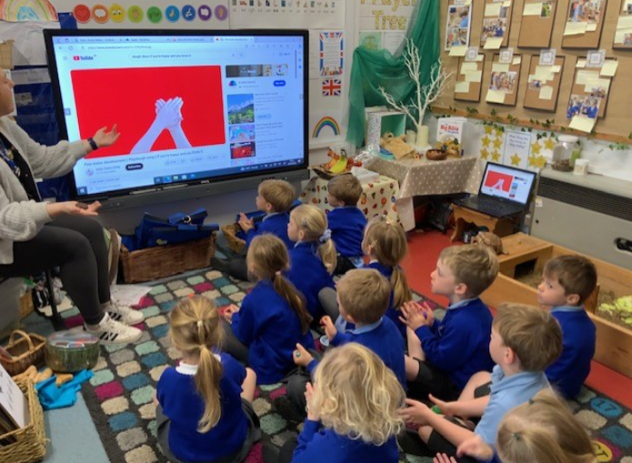
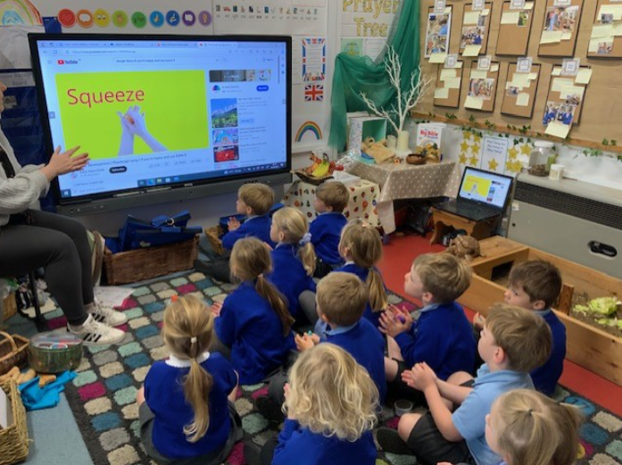
Gallery
A snapshot of learning from across the week… please use these photographs as an opportunity to talk to your children about what they have been learning!
Apple – Dough Disco

Slide 4
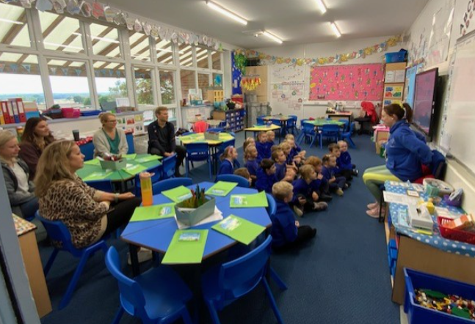
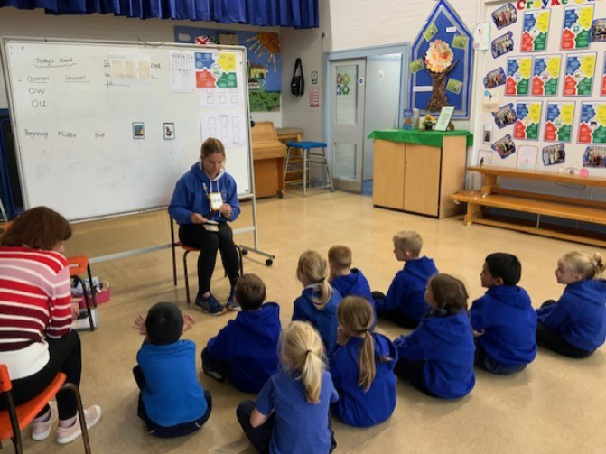
Beech - Phonics

Slide 5
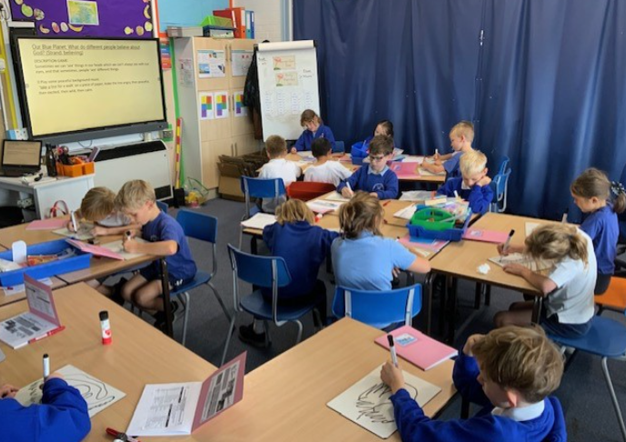
Holly - RE

Slide 6
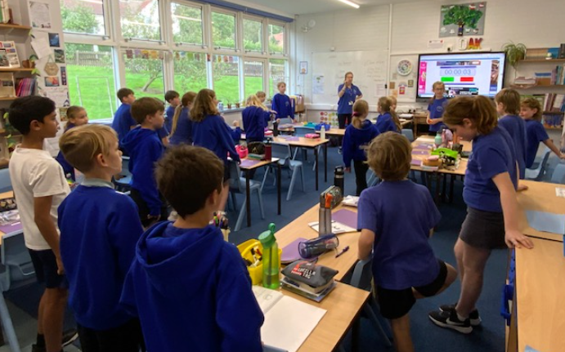
Oak - Spanish

Slide 7
Parent Voice
You asked for… | We have…
Increased levels of information about pupil progress throughout the year | Created interim pupil progress reports to be shared just prior to parent consultation evenings, which will help frame discussions more effectively and provide information around attitudes to learning and effort (October) and attainment (March)
Improvements to homework systems | Refined our arrangements to provide a core focus on reading, spelling and fluency of key maths skills
Increased understanding about how to help your children at home | Developed and refined bespoke reading diaries with a wealth of key information; provided each parent with a paper copy of a reading contract to sign and return to school
Improvements to the school newsletter | Redesigned to be more easily readable; standing items removed and a separate document created; diary dates as a separate attachment and community news also separate, enabling a sharper focus on current news and important relevant information. Development of class pages further enhances opportunities for parents to access relevant information quickly.
A different range of extra curricular clubs including sports and life skills | Netball coach sourced; coding club brought back; Junior Duke (life skills) implemented
Competitive sporting opportunities against other schools | Liaison with local primary schools- planned football tournament in Easingwold and others to follow
Increased understanding about bullying | Planned participation in anti-bullying week (November 2023) to raise children’s awareness,
Improvements to the behaviour of a small minority of pupils | Reminded children and parents about our Crayke Conduct - school rules “ready respectful safe” shared refinements to our behaviour approach “Stepping stones” - in school, during open afternoon and in reading diaries; work with affected children and families as needed; engage support from external agencies where possible; put in place additional support for children who need it most; aim to get parents on board and communicate regularly

Slide 8
Educational Visits and Visitors – plan*
Location | Class/es | Proposed estimated date | Approximate cost
Thirsk Sculpture Garden | Holly | October 2023 | Free workshop – cost of travel £6.00
Robinwood Todmorden | Oak | October 2023 | £265
Castle visit TBC | Beech | Autumn 2023 | TBC
Fun Run | Apple and Beech | October 2023 | Free to parents – funded by school
Crucial Crew | Year 6 | November 2023 | £3 contribution per pupil – school to fund travel
Local walk – farming focus | Apple | November 2023 | Free
Panto at Crayke Sports Hall | Whole School | December 2023 | Free to parents – funded by CHASA
Young Voices – Sheffield Arena | Oak | January 2024 | £25 per person
Dinosaur day | Apple | January 2024 | Free
Cross Country | Holly and Oak | January 2024 | Free to parents – funded by school
Leeds Art Gallery | Oak | March 2024 | Free workshop – cost of travel £11.50
Crayke local walk | Beech | Summer term 2024 | Free
Elvington Air Museum | Apple | July 2024 | TBC
Virtual museum visit | Holly | Summer term 2024 | Free
*This plan may be subject to change but is intended to provide a rough outline regarding expected costs for visits this year.

Slide 9
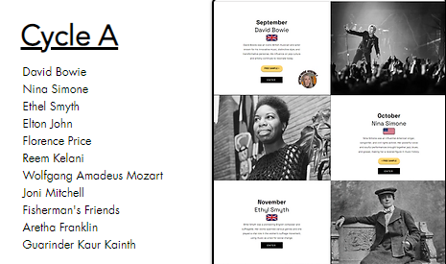
News From School This Week
Musician of the Month
Here’s a sneak preview of the artists which we will be studying during this academic year. The children have loved learning about David Bowie and I am sure that they will be just as enthusiastic about the other musicians.

Slide 10
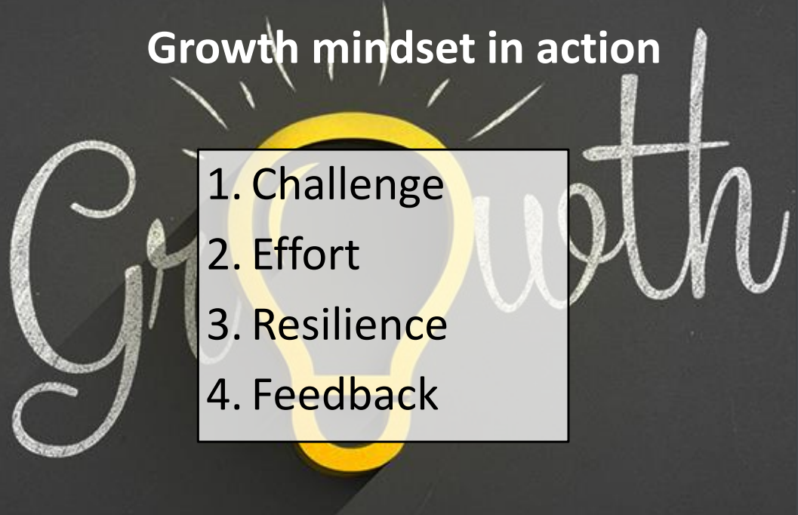
News From School This Week
Crayke Growth Mindset
We had a special focus on Growth Mindset in Collective Worship this week and reminded children about the importance of “keeping on keeping on”, that “practice makes better” and that mistakes are part of the learning process.
We also discussed some “famous failures”, which the children found fascinating.
In this ever changing world, please do take a moment to discuss the importance of having a Growth Mindset with your children.
If you would like any further information or resources on this important topic, please do not hesitate to get in touch.

Slide 11
Class News- APPLE
Stay and Play
We would like to give you the opportunity to join us for a “Stay and Play” session from 9am on one of the following dates:
Tuesday 10 October; Tuesday 17 October; Tuesday 24 October
Please contact Mrs Bacon to book your slot.
Forest Schools
Just to confirm that Forest Schools will now be on a Friday afternoon. Please ensure children have their kits in school. Thank you

Slide 12
Class News - BEECH
Phonics Drop In Sessions
It was lovely to see parents in school yesterday. If you have not yet booked your appointment with Mrs Bacon to come into school to see a Year 1 Phonics session from 9am on one of the following dates:
Thursday 5 October; Thursday 12 October

Slide 13
Class News - HOLLY
Netball
Sadly this cannot proceed on the basis of the numbers currently signed up. The coach has kindly agreed to run a session later in the year and we will look to offer the club again next term.
Harvest Experience – St Cuthbert’s Church
REMINDER: On Monday 2 October children will be participating in a local visit to church to undertake activities relating to Harvest. Please make sure your child has a warm coat and appropriate footwear.

Slide 14
Class News – HOLLY (cont.)
Harvest Service Wednesday 4 October – Led by Holly Class
This year Holly Class will be leading our Harvest Service, on the theme of Thankfulness. Parents and carers of children from all classes are warmly welcomed to join us by meeting us at church at 11am.
Thirsk Sculpture Garden Visit – Thursday 12 October
Parents and carers should have received the letter regarding this educational visit earlier this week. Please contact us if you require any further information.

Slide 15
Class News - OAK
Netball After School Club
Sadly this cannot proceed on the basis of the numbers currently signed up. The coach has kindly agreed to run a session later in the year and we will look to offer the club again next term.
Harvest Experience – St Cuthbert’s Church
REMINDER: On Monday 2 October children will be participating in a local visit to church to undertake activities relating to Harvest. Please make sure your child has a warm coat and appropriate footwear.

Slide 16
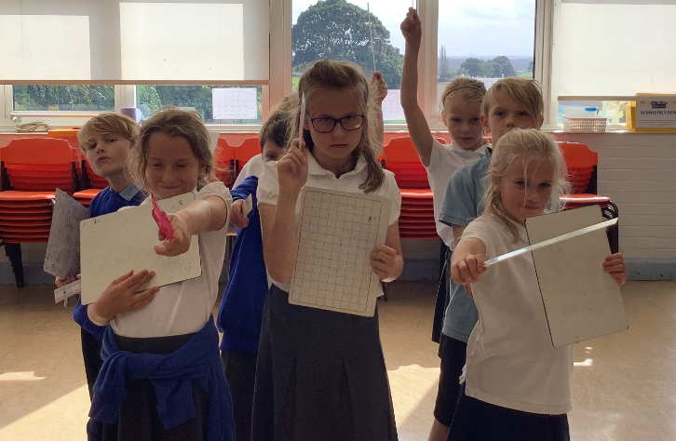
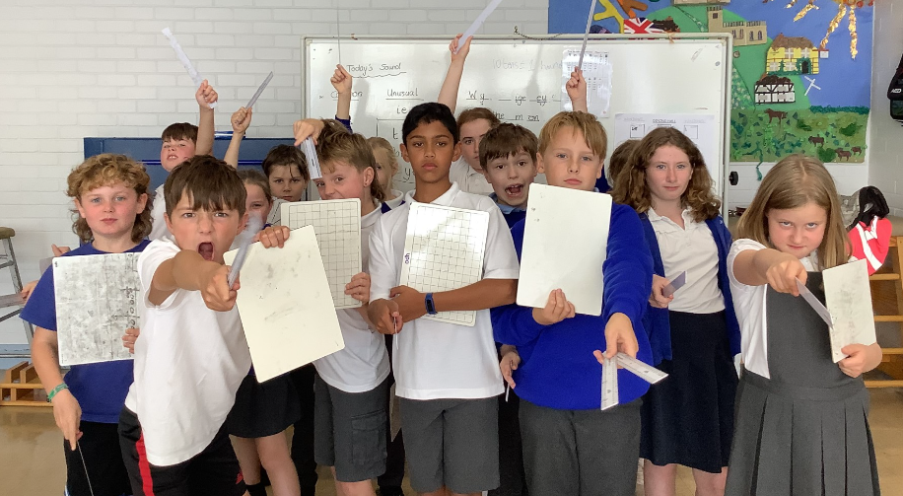
Class News - OAK
In our history lesson, children in Oak class learnt how the much smaller Athenian army managed to defeat the Persian army in the Battle of Marathon. They got to explore the phalanx formation using their shields (whiteboards) and spears (rulers) and how this formation, along with other tactics was crucial to the Greeks success in this famous battle. They were wonderful historians, thinking critically about the tactics of both sides and linking it to their previous learning on Athens and Sparta.
Mrs Rayner

Slide 17
Upcoming events
HARVEST SERVICE – Wednesday 4 October 2023
Parents and carers of children from ALL classes are warmly welcomed to join us at St Cuthbert’s Church for next week’s Harvest Service. This will be led by Holly Class on the theme of Thankfulness.
Please meet us at church for an 11am start.
We look forward to seeing you there.

Slide 18
Awards in School This Week
 | Apple | Beech | Holly | Oak
Stars of the Week | Wilfred Ferreday | Esmond Tsang | Elise Fenton | Arwen Dawson
 |  | Sean Unsworth | Arthur Barrett | Asa Champion
Gold Awards for Sport | Jackson Harker | Jacob Watson | Riley-Mae Simpson | Leonard Liddell
Headteacher Awards Random Act of Kindness | Arabella Hinzpeter |  | Toby Seligman

Slide 19
Team Points
Team | Points
Red | 576
Blue | 1085
Green | 1059
Yellow | 733
Well done BLUE team!
School Council have been tasked with focussing on making further developments to our team point system this term, including coming up with some new names and some more meaningful rewards for the winning team. I can’t wait to see what they come up with!

Slide 20
PE Kits next week
 | Monday | Tuesday | Wednesday | Thursday | Friday
Beech |  |  |  | X | X
Holly |  | X |  |  | X
Oak |  |  |  | X | X
Apple: Children in Apple Class need to bring their Forest School kit in each Friday. Please send their PE kit in on Monday as children will change for PE in school. They will bring PE kits home for washing periodically.
NB: Apple and Beech are attending the Fun Run at Husthwaite on Thursday so need PE kits and a warm coat please.
Please ensure that on PE days, the children wear their hoodies, school jumpers or cardigans alongside white or blue t-shirts and black or navy shorts or jogging bottoms.

Slide 21
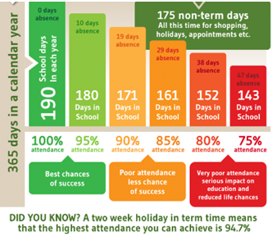
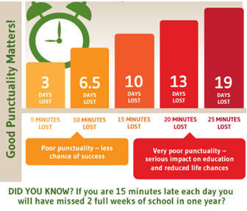
Attendance and Punctuality
This week’s attendance figures: 95.7% School Target: 96%
 | Attendance | Punctuality
Apple | 100% - Wow! What a great start to school life – all present for the whole month!! | 1 late
Beech | 97.7% | 5 lates (5 children)
Holly | 94.1% | 3 lates (3 children)
Oak | 93.5% | 2 lates (2 children)

Slide 22
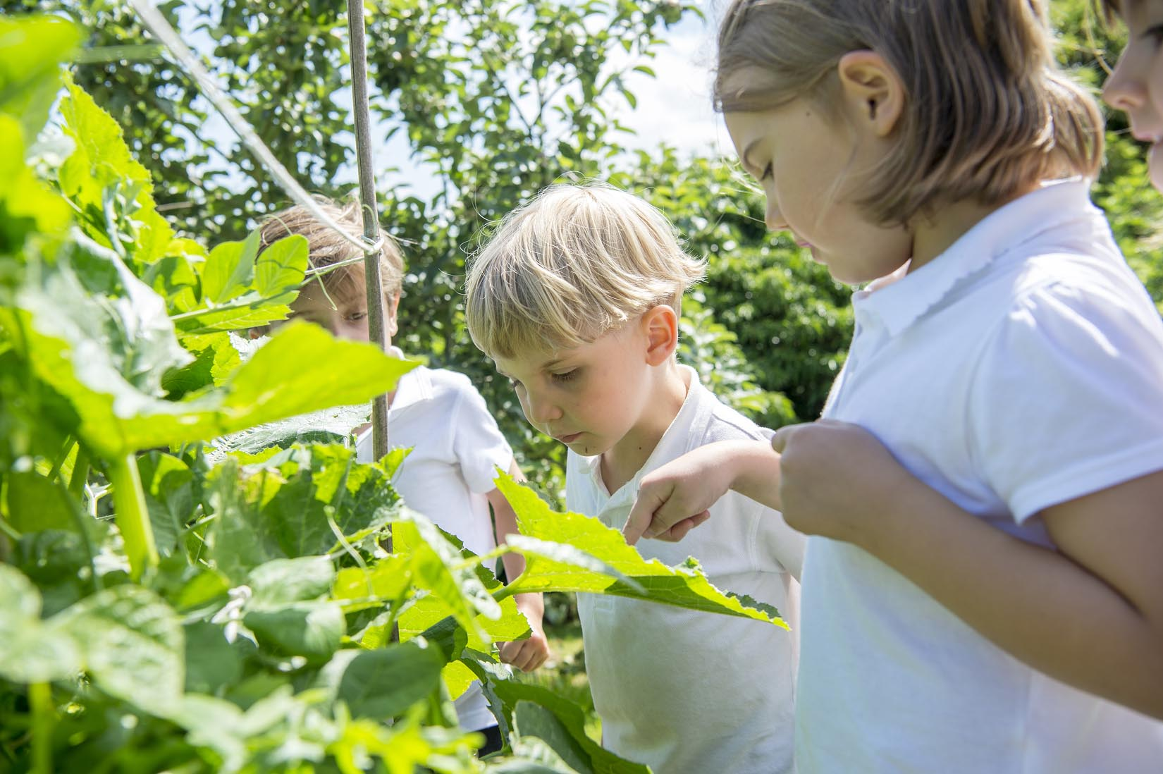
Extra Curricular Clubs - Autumn
Some clubs have limited capacity and places will be allocated on a first come first served basis. In the event of a club being fully booked, your child’s name will be added to a waiting list and you will be advised if a place becomes available. Booking is not required for before school or lunchtime clubs. For after school clubs run by school staff (denoted with *) please email Mrs Bacon on admin@crayke.n-yorks.sch.uk to book a place.
Before School:
After School:
Club | Day and Time | Group
Run a Mile | Monday, Tuesday Thursday & Friday 8:30am | All welcome – parents and carers included!
Day | Club
Monday | Craft* (£10 pay via ParentPay) 3:30 – 4:15pm Years 1 – 6 Mrs Seligman | Coding* STARTING 2 OCTOBER 3:30pm – 4:15pm Years 3-6 Mr Brown
Tuesday | Multi-Sports (fee paid direct) 3:30 – 4:30pm Years 1 – 6 Mark Cromack
Wednesday | Junior Duke* (£10 pay via ParentPay) 3:30pm – 4:15pm Year 3/4 Mrs Helfferich | Football Team practice 3:30-4:15pm Year 5/6 team Mr Palmer
Thursday | Chess* (no charge) 3:30pm – 4:15pm Year 1 - 6 Mrs Seligman

Slide 23
CHASA are running this month’s Crayke Village Market.
Save The Date: 30/9/23
10:30-1:30
Please come along and support CHASA - all proceeds from the Cafe go towards our AMAZING school.
Thank You - CHASA Team.

Slide 24
Save the Date!
Family Bingo
Saturday 21st October
3-6pm
Crayke Sports Hall - hosted by CHASA.
All welcome, ticket details and more info to follow.
The CHASA Team

Slide 25
LAST CHANCE for Aviva to double your donation – offer expires 2 October at 8:20am:
https://www.avivacommunityfund.co.uk/p/solar-panel-funding#start
https://www.youtube.com/watch?v=-CUn_80wfSM

