Slide 1
Crayke Chronicle
Issue: #1 Term: Autumn Date: 8 September 2023
FOLLOW YOUR PATHWAY AND WE GROW TOGETHER WITH CONFIDENCE
You did not choose me, I chose you that you might go and bear fruit, fruit that will last so that whatever you ask in my name the Father will give you. John 15:16
Respect Friendship Forgiveness Determination

Slide 2
News From School This Week
What a wonderful week it has been in school! Welcome back to all our fabulous children and families.
Here’s a summary of things we are excited about this week!
We are delighted to have welcomed 10 brand new families to Crayke; our Reception new starters have all been brilliant and children across school have made a really positive start to the new school year.
A warm welcome to Mrs Chandler who has returned to teaching Holly, to Mrs Peacock who has returned following her maternity leave and to Miss Ford who joins us as a Teaching Assistant.
We are also so excited by the official opening of the Wraparound Club, by the start of children in Holly and Oak learning Spanish, by the installation of the solar panels on the school roof and by the arrival of our hen house to keep our lovely chickens safe on the field!
Read on to find out more!

Slide 3
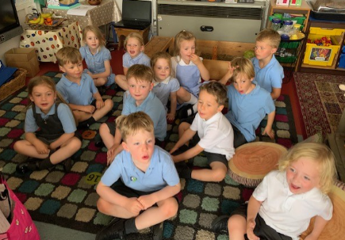

Slide 4
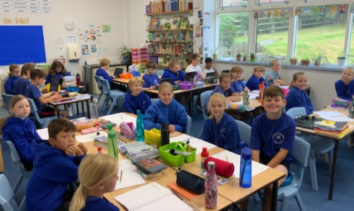
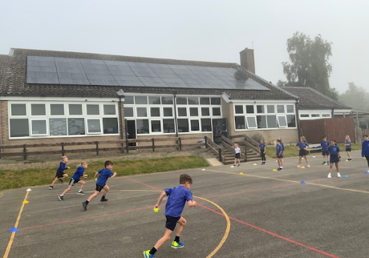
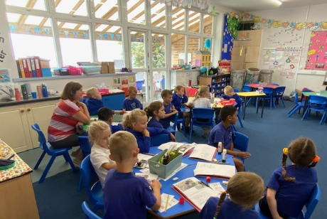
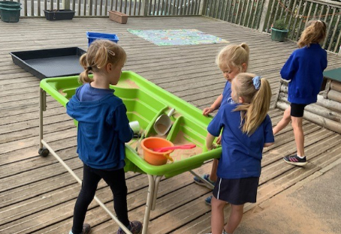

Slide 5
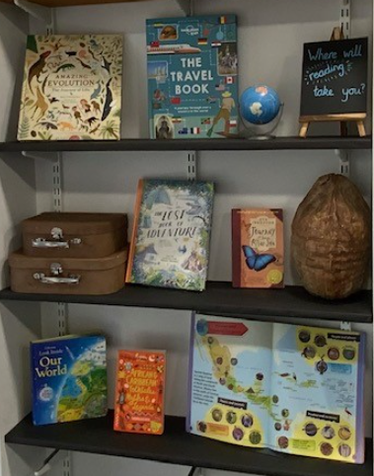
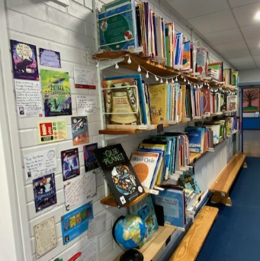
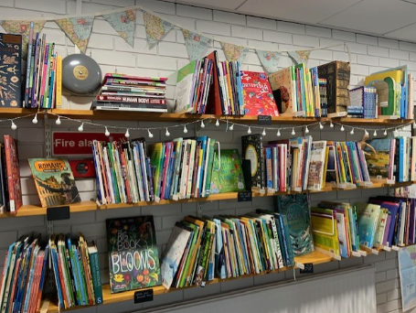
Curriculum Update
Staff have been working really hard over the summer to refresh and update their classrooms and shared areas in school. Mrs Rayner has done an amazing job of creating a library area in the corridor, it has been transformed! Children in Key Stage 2 are excited by the chance to have a regular browse and to be able to borrow books from our new library.

Slide 6
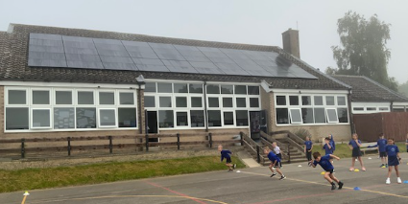
Solar Panel Installation News
We are delighted to inform parents/carers that a bank of 50 solar panels was installed on the school roof during the holiday. We wanted them up and generating as soon as possible. The beautiful weather this week has meant that we have generated enough electricity to meet our needs. In the evenings and weekends we will be exporting much needed green energy to the National Grid for the next 25 years.
Installation was only made possible through a capital deficit grant from North Yorkshire Council. This will have to be paid back over several years. To pay it off more quickly and free up money for other green initiatives our fundraising project will continue through the autumn term.
We have been fortunate in getting a great offer from Aviva. They will match fund any donations to our appeal up to £250 until 2 October. If you would like to support and double your donation please visit https://www.avivacommunityfund.co.uk/p/solar-panel-funding
Do you work at Aviva or know someone who does? Their staff are given £40 to support a charity and the company will match fund this. That's £80 per person funded by Aviva and it would be nice if some of it could support our appeal. Please contact me at chairofgovernors@crayke.n-yorks.sch.uk for more details.
So, a year ago we decided it was time to reduce the school's carbon output. Since then we have converted all our lights to LEDs and installed a 20Kw photovoltaic panel generation system. The children and staff have been doing their best to minimise energy use in school. When funds allow we would like to upgrade the loft insulation which is well below modern standards and replace our old hot water boiler.
The children are concerned about the future impact of climate change on their lives. I feel we must do what we can, even in small ways, to reduce our carbon footprint. Thank you for your support in making this possible.
Hugh Porter
Chair of Governors

Slide 7
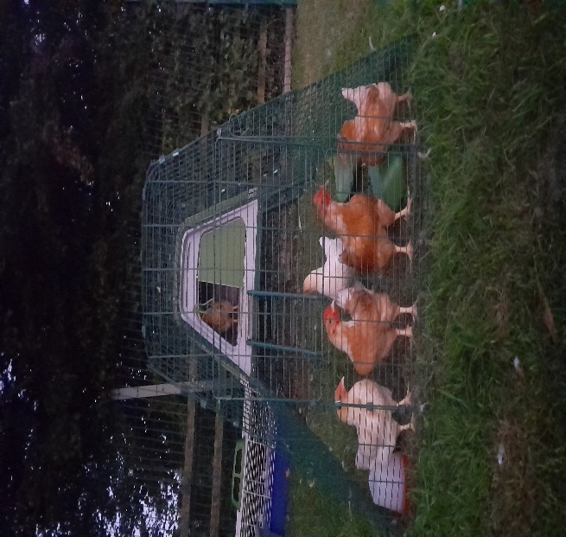
Chick Update
Message from Mrs Helfferich
The ‘chicks’ are now happily living outside on the school field.
They caused great excitement on Tuesday, the children could not believe how big they have become. We have 4 girls and 2 boys; One of the boys may have to come and join my hens and goats.
Thank you to the Shepherd family for donating the hen hutch. Thank you to James Jefferson for delivering it.
I will be looking for monitors to help me clean out the hutch and feed/water the hens.

Slide 8
Upcoming Events
Please refer to the attached Dates for your Diary document which outlines the upcoming events in school each month. New dates are added in red.
Next week, parents of children in Oak are invited to the school hall at 9:05am on Monday for a meeting about the upcoming residential to Robinwood.
We are also excited to launch our Sports for School event during a special assembly for the children on Wednesday when the name and details about our visiting athlete will be revealed.

Slide 9
Homework Update
As promised at the end of last term, staff have considered the views from the parent survey and as part of our training day on Monday, we discussed plans for the forthcoming academic year.
This year, we aim to focus on reading, spellings and key maths facts. This will form the basis of our core homework offer this year. This will allow enhanced time for you as families to enjoy reading together and talking about the books you read. Spelling lists are provided on the attached “Standing Items” document. Parents are encouraged to download the 1 Minute Maths App to support with maths fact learning and practice – see “Standing Items”.
Further details about reading and homework expectations will be provided at our Open Afternoon on Tuesday 19 September at 2pm, to which all parents and carers are warmly welcomed.

Slide 10
Reading Update
Message from Mrs Dobson
Beech Class Reading Books - All children will be coming home TODAY with their reading diary and a sharing book. Reading practice books will be given out next Friday 15 September.
There is also a 'Reading Guide’ for all parents to read and sign; this includes further information about when books will be changed.
Any questions, please ask!
Thanks,
Mrs Dobson

Slide 11
Awards in School This Week
 | Apple | Beech | Holly | Oak
Stars of the Week | The whole class! | Isabelle Kay | Scarlett Woodhouse | Sienna Jagger
 |  | Arabella Hinzpeter | India Ward | Sam Stubbins
Gold Awards for Sport | Ottilie Hinzpeter | Zephie Brown | Isla Grant | Alice Unsworth
Headteacher Awards – Settling in Stars | Sylvia Hunsdale |  | Isla Howland

Slide 12
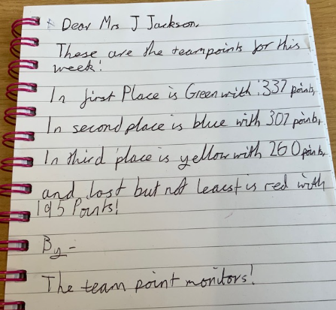
Team Points

Slide 13
PE Kits next week
 | Monday | Tuesday | Wednesday | Thursday | Friday
Beech |  |  |  | X | X
Holly |  | X |  |  | X
Oak |  |  |  | X | X
Apple: Children in Apple Class need to bring their Forest School kit in each Monday. Please send their PE kit in on Monday as children will change for PE in school. They will bring PE kits home for washing periodically.
Please ensure that on PE days, the children wear their hoodies, school jumpers or cardigans alongside white or blue t-shirts and black or navy shorts or jogging bottoms.

Slide 14
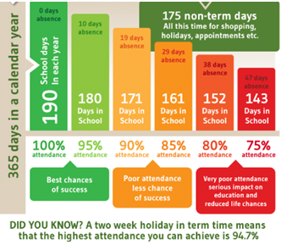
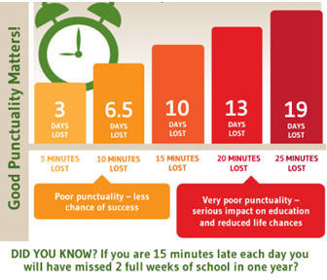
Attendance and Punctuality
This week’s attendance figures: 95.2% School Target: 96%
 | Attendance | Punctuality
Apple | 100% - well done! | 0 lates
Beech | 98.3% | 2 lates (2 children)
Holly | 94.1% | 2 lates (2 children)
Oak | 90.4% | 0 lates

Slide 15
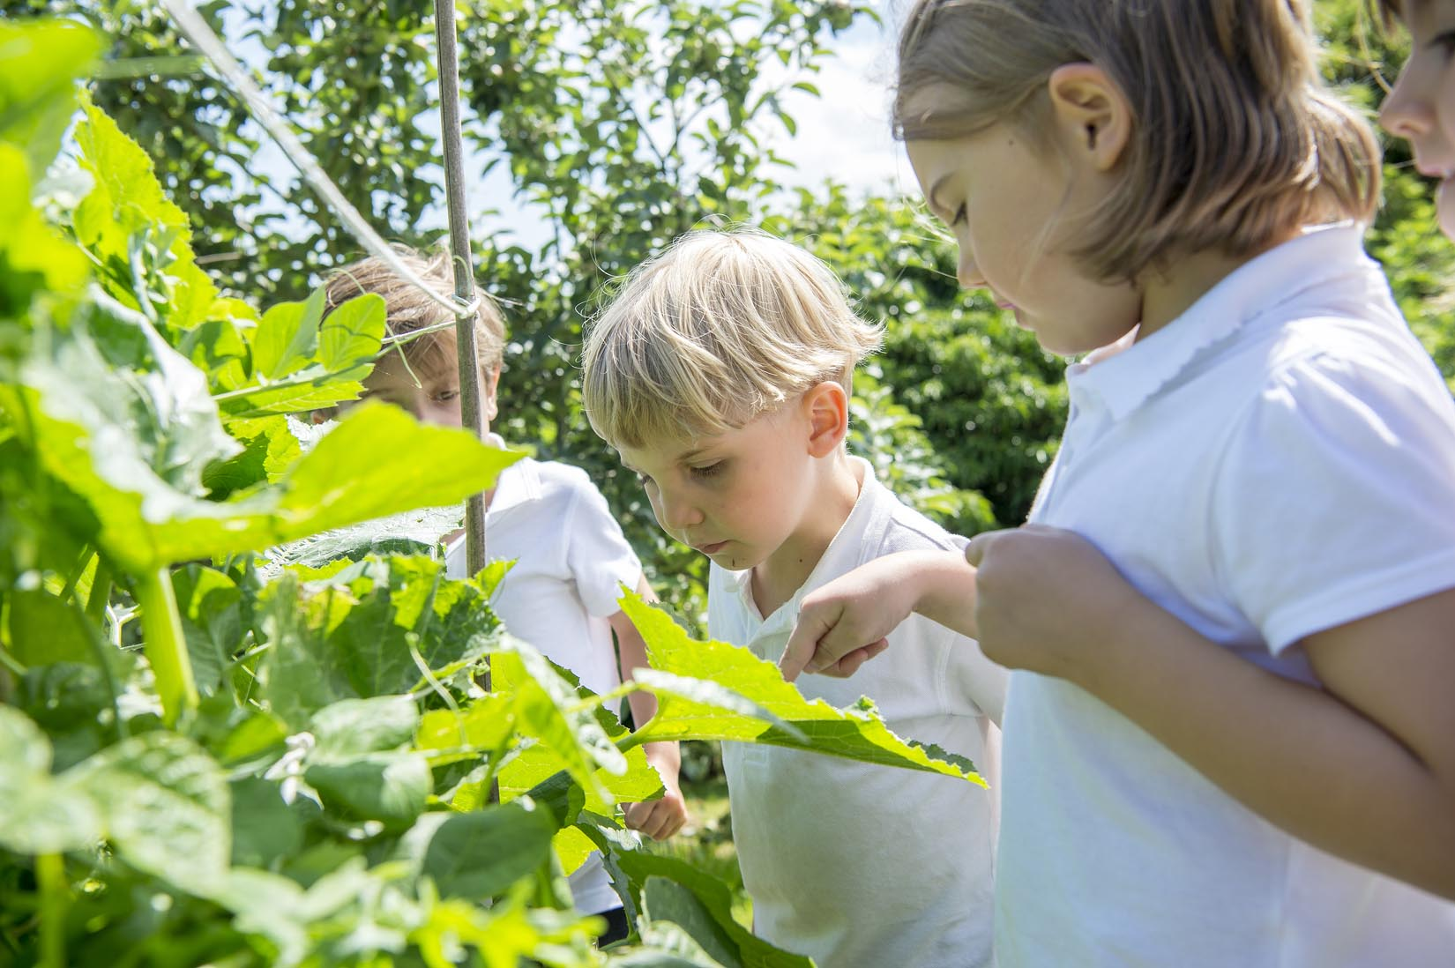
Extra Curricular Clubs
Clubs will resume w/c 18 September 2023. Further details will follow next week about the booking process and systems.

Slide 16
New parents/carers welcome evening at the Durham Ox - Thursday 21st September at 7pm - hosted by CHASA
Reception new starter parents/carers: Please come and join us at the Durham Ox, Crayke, for a complimentary drink and nibbles. It will be a great opportunity to meet other new parents and members of the CHASA team (Crayke Home And School Association).
CHASA AGM – Thursday 21 September 8:30pm
All parents and carers are warmly welcomed to join us for the CHASA AGM which will be held at 8:3pm on Thursday 21 September at the Durham Ox.
The CHASA Team

Slide 17
Parking - Reminders
A reminder at the start of the academic year to please be considerate of local residents when parking your car to drop or collect your children.
You are encouraged to use the Sports Hall for parking and to walk up to school. This avoids congestion along the road outside school.
The layby is in regular use by the school bus and for deliveries so is NOT to be used by parents other than by prior agreement with the Headteacher.
Thank you for your support with this important matter.

Slide 18
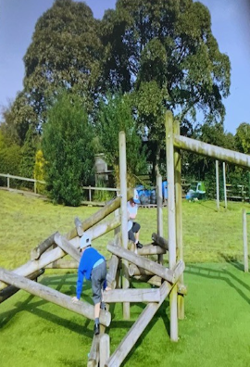
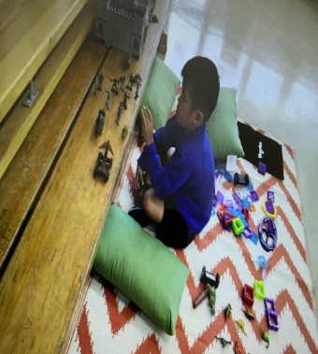
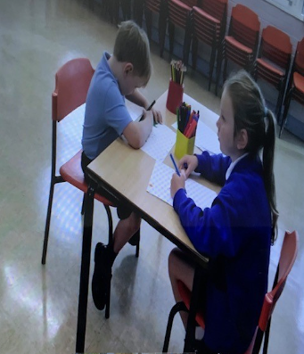
Tiddlywinks OOSC Crayke
We are thrilled that Tiddlywinks OOSC Crayke is now officially in business! Children have enjoyed getting to know the new staff members, playing with the new toys, books and games and being outside.

Slide 19
Community News

