Slide 1
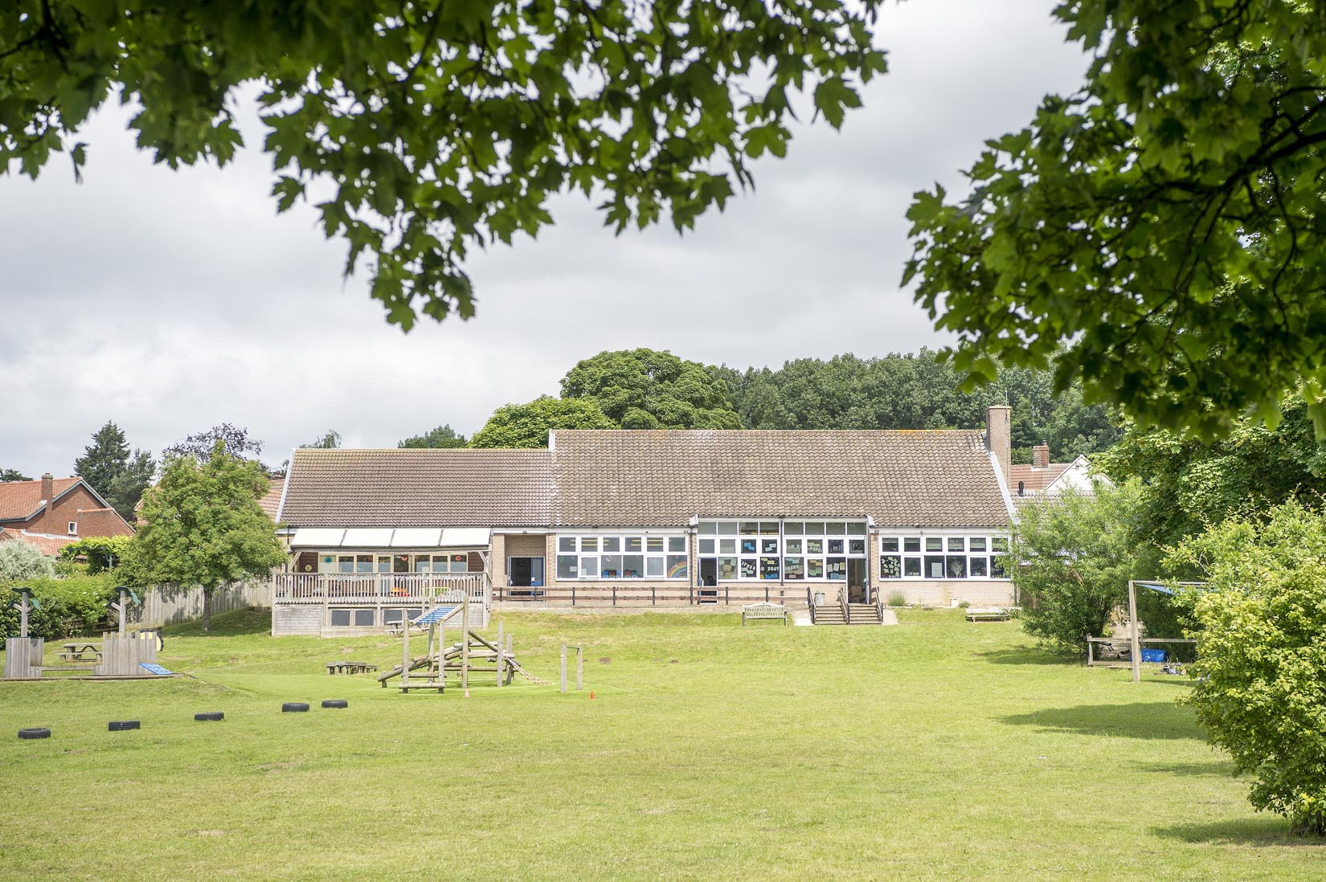
Crayke CE Primary School
Autumn Term 2023
Crayke Chronicle - Standing Items

Slide 2
Our Safeguarding Team
At Crayke, we have three members of staff and a governor who make up our Safeguarding Leadership Team. Mrs Jackson is the Designated Safeguarding Lead, which means that she is the lead person responsible for child protection and safeguarding issues. Mrs Rayner and Mrs Helfferich (pending Mrs Chandler’s completion of phased return) are our Deputy Designated Safeguarding Leads (Deputy DSLs); a deputy DSL supports the DSL in their role of safeguarding and child protection. Mr Hugh Porter is our Safeguarding Link Governor. The role of the Safeguarding Governor is to support the DSL as well as to regularly review, ask questions and make suggestions about our safeguarding policies and procedures and to report back to the governing body. All staff at Crayke know that safeguarding is EVERYONE’S responsibility. Find out more on our dedicated website Safeguarding page: https://craykeschool.org/safeguarding/
You can also report any safeguarding concerns to our DSL email: dsl@crayke.n-yorks.sch.uk
Please also be aware that as a school we subscribe to Operation Encompass, whereby we are notified of any incidences of domestic violence where a pupil at our school has been present.

Slide 3
Attendance and Punctuality
Attendance
We strive for high levels of attendance at school. Please try, wherever possible, to book holidays out of term time. The impact of even one day’s absence on your child’s learning is huge. Also, please try to book medical appointments out of school hours if possible as this also minimises the time missed. If your child is very unwell and unable to attend school, please inform the office by phoning 01347 821767 no later than 9:15am. Thank you for your support with this important matter.
Punctuality
It is very important that the children arrive to school on time so that: 1. They take part in all of the learning opportunities for the day with complete focus and without interruption from late arrivals. 2. Teachers can teach the best possible lessons without complete focus and without interruption from late arrivals.

Slide 4
Online Safety
We recognise the importance of online safety and also understand that it is a fast paced, ever changing online world where parents can struggle to keep up with the technical knowledge and understanding demonstrated by their children. The National Online Safety organisation produce regular guides, which we share with parents and carers weekly. These leaflets are also made available on the Online Safety section of our website. Should you wish to access any of the other online safety parent guides available on a whole range of topics including what parents need to know about Amazon Fire Tablets, Google Chromebooks, and ways to champion equality online, please have a look at this weblink: https://nationalonlinesafety.com/guides
Should you wish to access more information about how to support your child/ren with online safety at home, this course is available which explains in detail the risks they might be exposed to and what you can do to support them. https://info.nationalonlinesafety.com/myleene-uk

Slide 5
Cost of Living Crisis – Pupil Premium
We are very aware that costs continue to rise and look set to do so for some time. If you are encountering financial difficulties, we may be able to signpost support. Please get in touch.
If your circumstances have changed and you think your child may be eligible for free school meals, it has never been easier to apply. There is no stigma attached to this, it is not highlighted to the children in any way, and the school gets valuable funding too. If you would like a confidential conversation about whether you may be eligible for free school meals, please do not hesitate to speak to me. To apply directly please use this weblink: https://www.northyorks.gov.uk/free-school-meals

Slide 6
LUNCH MENU AUTUMN TERM 23 | Week 1 Served w/c 4th Sept, 25th Sept, 16th Oct, 13th Nov & 4th Dec | Week 2 Served w/c 11th Sept, 2nd Oct, 23rd Oct, 20th Nov & 11th Dec | Week 3 Served w/c 18th Sept, 9th Oct, 6th Nov, 27th Nov & 18th Dec
Monday | Pizza Diced Potatoes Crunchy Veggie Sticks Lemon Drizzle Muffin Fresh Fruit or Fruit Yoghurt | Pasta Bolognese Bake Broccoli & Sweetcorn Garlic Flatbread Custard Cookie with Fruit & Ice-cream Fresh Fruit or Fruit Yoghurt | Creamy Mac & Cheese Broccoli & Carrots Home baked Garlic Bread Berry Crumble Mousse Pot Fresh Fruit or Fruit Yoghurt
Tuesday | Chicken & Tomato Pasta Peas & Sweetcorn Homemade Garlic Bread Autumnal Fruit Crumble & Custard Fresh Fruit or Fruit Yoghurt | Chicken Burger in a Bun Potato Wedges Peas & Coleslaw Chocolate Sponge & Chocolate Sauce Fresh Fruit or Fruit Yoghurt | Nacho Beef Bake Rice Sweetcorn & Peas Chocolate Berry Brownie Fresh Fruit or Fruit Yoghurt
Wednesday | Sausage & Yorkshire Pudding Mashed Potato Medley of Vegetables Crusty Bread Cheese & Crackers Fresh Fruit or Fruit Yoghurt | Roast Loin of Pork with Apple Sauce & Gravy Boiled Potatoes Carrots & Green Beans Home baked Bread Jam Bun & Cheese Fresh Fruit or Fruit Yoghurt | Roast Chicken, Stuffing & Gravy Mashed Potato Medley of Vegetables Crusty Bread Rice Pudding & Peaches Fresh Fruit or Fruit Yoghurt
Thursday | Chicken Korma & Rice Cauliflower & Green Beans Naan Bread Berry Marble Sponge & Custard Fresh Fruit or Fruit Yoghurt | Mexican Beef Pitta with Rice Medley of Vegetables Home baked Sunflower Seed Bread Toffee Apple Muffin Fresh Fruit or Fruit Yoghurt | All Day Breakfast Home baked Bread Oaty Cookie & Cheese Fresh Fruit or Fruit Yoghurt
Friday | Fish Fingers & Chips with Ketchup Carrots & Peas Sliced Wholemeal Bread Chocolate Orange Mousse Cake Fresh Fruit or Fruit Yoghurt | Battered Fish & Chips with Ketchup Sweetcorn & Peas Crusty Bread Lemon Shortcake Fresh Fruit or Fruit Yoghurt | Fish Star & Chips Peas & Carrots Home baked Wholemeal Bread Fruity Jam Sandwich & Custard Fresh Fruit or Fruit Yoghurt

Slide 7
Solar Panel Fundraising Project
Please visit https://www.gofundme.com/f/solar-panels-for-crayke-primary-school to find out more and/or make a donation.
Please do Gift Aid any donations as it increases its value by 20%. Please share this link far and wide! The donation page includes a fabulous video featuring some very familiar faces.

Slide 8
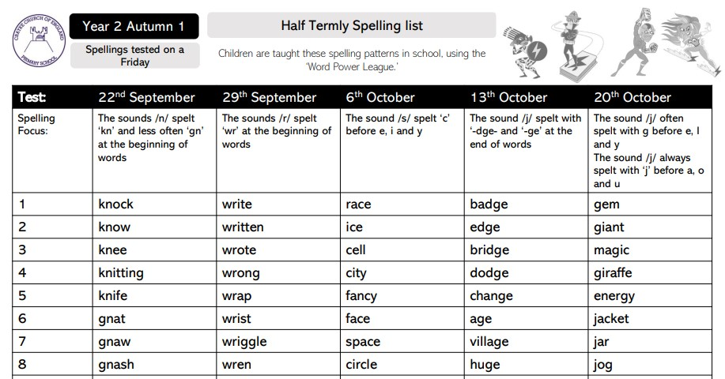
Autumn Term Spelling Lists – Year 2 Autumn 1

Slide 9
Autumn Term Spelling Lists – Year 2 Autumn 2

Slide 10
Autumn Term Spelling Lists – Holly Autumn 1

Slide 11
Autumn Term Spelling Lists – Holly Autumn 2

Slide 12
Autumn Term Spelling Lists – Oak Autumn 1

Slide 13
Autumn Term Spelling Lists – Oak Autumn 2

Slide 14
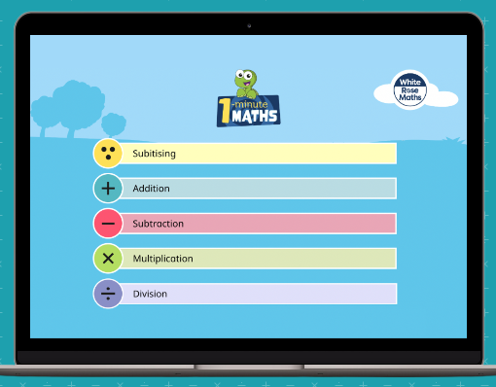
1 minute maths

