Slide 1
Crayke Church of England Primary School DATES FOR YOUR DIARY 2023/2024
FOLLOW YOUR PATHWAY AND WE GROW TOGETHER WITH CONFIDENCE You did not choose me, I chose you that you might go and bear fruit, fruit that will last so that whatever you ask in my name the Father will give you. John 15:16 Respect Friendship Forgiveness Determination

Slide 2
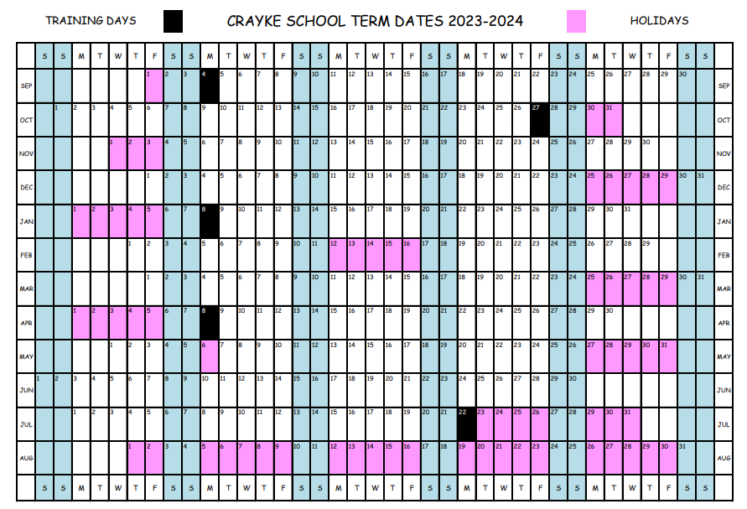

Slide 3
September 2023
Day | Date | Event | Who | Where
Monday | 11 September 9:05am | Robinwood residential meeting | Parents/carers of Y5/6 children | Hall
Wednesday | 13 September | Sports for Schools assembly | All children | Hall
Tuesday | 19 September | Open Afternoon | All parents/carers welcome | School
Thursday | 21 September | Tempest Photography – individuals and siblings | All – pre-school siblings welcome at drop off | Hall
Thursday | 21 September | CHASA welcome meeting 7pm AGM 8:30pm | New starter parents All welcome | Durham Ox
Wednesday | 27 September | Power Down Pete assembly – energy and sustainability | All children | Hall
Wednesday | 27 September | Athlete visit – Sports for Schools | All children | Hall and outside
Friday | 29 September | WOOFYT Science and Music Experience | Oak class | Easingwold Parish Church

Slide 4
October 2023
Day | Date | Event | Who | Where
Monday | 2 October | Harvest themed activities | Holly and Oak | St Cuthbert’s Church
Monday | 2 October | Full Governing Body meeting | All governors | Hall
Wednesday | 4 October 11am | Harvest Festival | All welcome | St Cuthbert’s Church
Friday - Sunday | 6 – 8 October | Robinwood Residential Visit | Oak | Dobroyd Castle Todmorden
Tuesday | 10/17/24 October | Swimming | Oak | Thirsk Leisure Centre
Friday | 20 October | Interim reports to parents | All children | Via pupil post
Tuesday | 24 October | Parent Consultation Evening 1/2 | Parents and carers | Classrooms
Wednesday | 25 October | Community Coffee Morning/Solar panel fundraiser | All welcome | Hall
Wednesday | 25 October | Parent Consultation Evening 2/2 | Parents and carers | Classrooms

Slide 5
November 2023
Day | Date | Event | Who | Where
Tuesday | 7/14/21/28 November | Swimming | Oak | Thirsk Leisure Centre
Wednesday | 8 November | New starter Open Morning | Reception parents – September 2024 | Whole school
w/c Monday | 13 November | Anti-bullying week | All children | All classes
Wednesday | 15 November | Bikeability | Year 6 pupils | Playground and local area
Friday | 17 November | Children in Need | All | School
Friday | 24 November | Flu vaccinations | All who provide consent | Meeting room

Slide 6
December 2023
Day | Date | Event | Who | Where
Tuesday | 5 December | Swimming | Oak | Thirsk Leisure Centre
Friday | 8 December | Travelling Pantomime – CHASA funded event | All children | Sports Hall
Tuesday | 12 December | Nativity Dress Rehearsal | Apple and Beech | Hall
Wednesday | 13 December 9:30am | Nativity Performance 1/2 - parents and carers welcome | Apple and Beech | Hall
Wednesday | 13 December 2:15pm | Nativity Performance 2/2 - parents and carers welcome | Apple and Beech | Hall
Tuesday | 19 December | Christmas Lunch | All children | Hall
Tuesday | 19 December | Christmas Parties | All children | Hall and Classrooms
Friday | 22 December 11am | Carol Service | All welcome | St Cuthbert’s Church

Slide 7
January 2024
Day | Date | Event | Who | Where
Tuesday | 9 January | Young Voices | Oak | Sheffield Arena
Monday | 15 January | Full Governing Body Meeting | All governors | Hall
Wednesday | 24/31 January | Swimming | Holly | Thirsk Leisure Centre

Slide 8
February 2024
Day | Date | Event | Who | Where
w/c Monday | 5 February | Safety Week | All children | Classes
Wednesday | 7/21/28 February | Swimming | Holly | Thirsk Leisure Centre

Slide 9
March 2024
Day | Date | Event | Who | Where
Wednesday | 6 March | Swimming | Holly | Thirsk Leisure Centre
Thursday | 7 March | World Book Day | All children | School
Friday | 8 March | Interim reports to parents | All children | Via pupil post
Tuesday | 12 March | Parent Consultation Evening 1/2 | Parents and carers | Classrooms
Wednesday | 13 March | Parent Consultation Evening 2/2 | Parents and carers | Classrooms
Thursday | 14 March | Skip2BFit - HIIT | All children | Hall/outside
Monday | 18 March | Full Governing Body Meeting | All governors | Hall
Wednesday | 20 March | Crayke’s Greatest Show | Selected representatives | Hall
Friday | 22 March | Easter Egg Hunt | All children | Outside
Friday | 22 March 11am | Easter Service | All welcome | St Cuthbert’s Church

Slide 10
April 2024
Day | Date | Event | Who | Where

Slide 11
May 2024
Day | Date | Event | Who | Where
w/c Monday | 13 May | KS2 SATs | Year 6 children | Classroom
Tuesday | 21 May | Tempest Photography – classes | All children | School

Slide 12
June 2024
Day | Date | Event | Who | Where
w/c Monday | 10 June | Phonics Check | Year 1 | Beech
w/c Monday | 10 June | Multiplication Tables Check | Year 4 | Holly
Wednesday | 12 June 5:30pm | Reception new starter parent meeting | September 2024 new starters | Hall
Monday | 17 June | Full Governing Body Meeting | All governors | Hall
Wednesday | 26 June - am | Reception new starter visit 1/3 | New starters | Apple

Slide 13
July 2024
Day | Date | Event | Who | Where
Wednesday | 3 July - pm | Reception new starter visit 2/3 | New starters | Apple
Friday | 5 July | Sports Day | All children | Outside
Monday | 8 July | KS2 Performance – dress rehearsal | Holly and Oak | Hall
Tuesday | 9 July 2pm | KS2 Performance 1/2 | Holly and Oak | Hall
Wednesday | 10 July am + lunch | Reception new starter visit 3/3 | New starters | Apple
Wednesday | 10 July 6pm | KS2 Performance 2/2 | Holly and Oak | Hall
Friday | 12 July | Sports Day (Reserve) | All children | Outside
Friday | 19 July 11am | Leavers’ Service | All welcome | St Cuthbert’s Church

