Slide 1
Community News – 20 October 2023

Slide 2
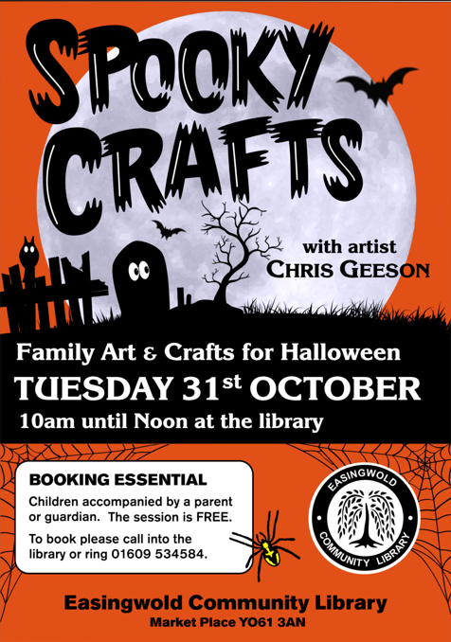

Slide 3
CRAYKE SUSTAINABILITY GROUP 21st OCTOBER 10.30am on the Green There is a church grounds tidy up Saxon burial ground tidy up and planting of cowslips on The Green. Bring your gardening gloves and tools. Even an hour of you time would be appreciated. 18th November save the date The History of Crayke at the village hall

Slide 4
Yorkshire Attractions Booklet
https://yorkshireattractions.org/wp-content/uploads/YAG-Autumn-Voucher-Book-2023.pdf
Please click on the link above for the latest Yorkshire attractions Voucher Booklet – filled with incredible money-saving offers for a wide range of participating Yorkshire Attractions.

Slide 5
Yorkshire Arboretum
Half Term Activities – There’s an autumn theme for this event, with games, crafts and activities about nocturnal animals including making a clay hedgehog. There will be opportunities for exploring the grounds and collecting but also to become creative in the inside space. The café will be open serving drinks and food.
Please book below:
Nature Rangers Day 30.10.23 — Yorkshire Arboretum
We also have events during half term to plant acorns:
Grow Your Own Oak 29.10.23 — Yorkshire Arboretum
Grow Your Own Oak 01.11.23 — Yorkshire Arboretum
Education Officer, The Yorkshire Arboretum
01653 648598
01653 648169

Slide 6
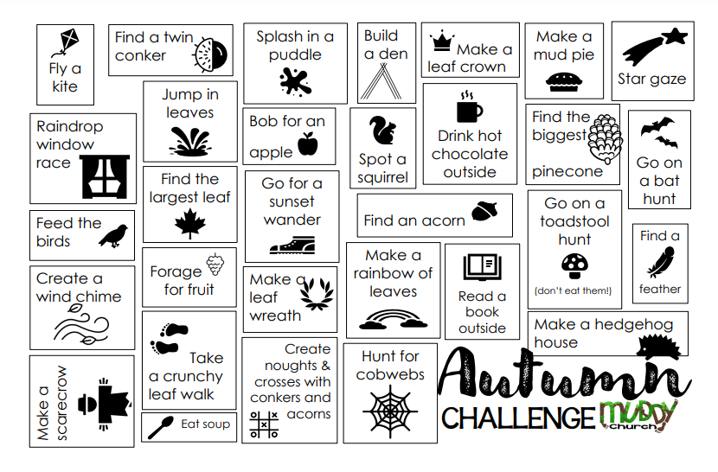
Family Challenge – how many can you do?

