Slide 1
Crayke Chronicle
Issue: #6 Term: Autumn Date: 13 October 2023
FOLLOW YOUR PATHWAY AND WE GROW TOGETHER WITH CONFIDENCE
You did not choose me, I chose you that you might go and bear fruit, fruit that will last so that whatever you ask in my name the Father will give you. John 15:16
Respect Friendship Forgiveness Determination

Slide 2
In our newsletter this week…
…Important news regarding Parent Consultation Evening appointments
…Find out what the children have been learning by looking at our Gallery
…News from school this week including Robinwood Residential, Power Down Pete, Water Safety Workshops and the visit to Thirsk Sculpture Garden
…Check the class pages for any information relevant to each individual class and further news about learning and achievements this week
…Find out about upcoming events next week and later in the half term.
Our regular items then follow:
…Awards in school
…PE Kits next week
…Attendance and Punctuality
…Extra curricular clubs
…CHASA news
Have a lovely weekend!

Slide 3
**Important news** Parent Consultation Evenings
We are aiming for 100% attendance at Parent Consultation Evenings this year!
If you haven’t yet booked an appointment to meet with your child’s class teacher on either Tuesday 24 or Wednesday 25 October please do so via the link provided by text/email earlier this week.
If you haven’t received a text/email please contact Mrs Bacon on 01347 821767 or admin@crayke.n-yorks.sch.uk to make an appointment.

Slide 4
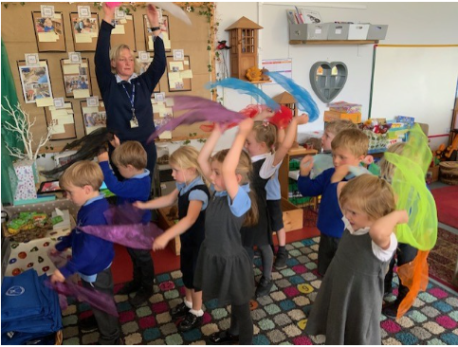
Gallery
A snapshot of learning from across the week… please use these photographs as an opportunity to talk to your children about what they have been learning!
Apple – Squiggle - Using our flappers to strengthen our arms for writing

Slide 5
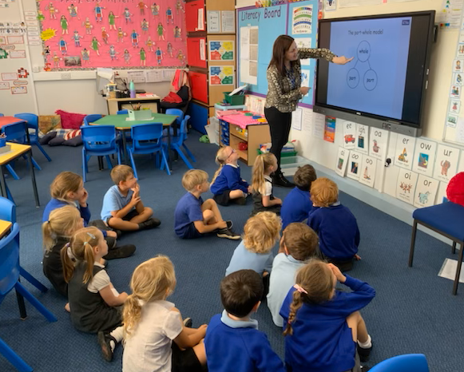
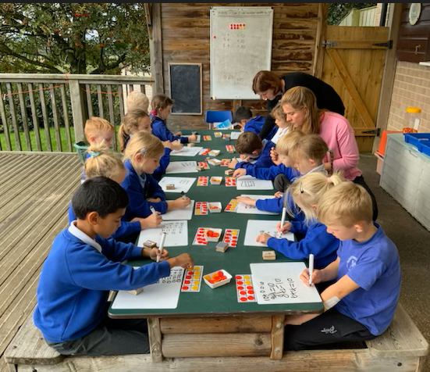
Beech - Maths

Slide 6
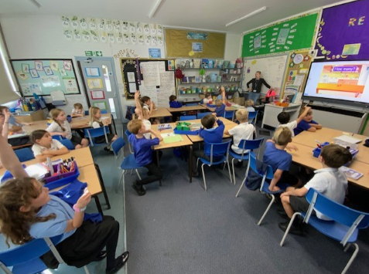
Holly – Spanish

Slide 7
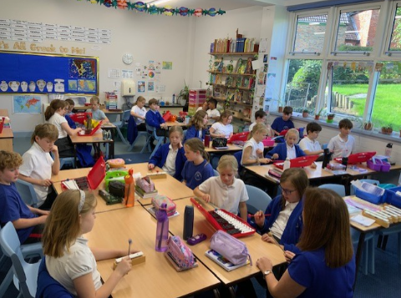
Oak - Music

Slide 8
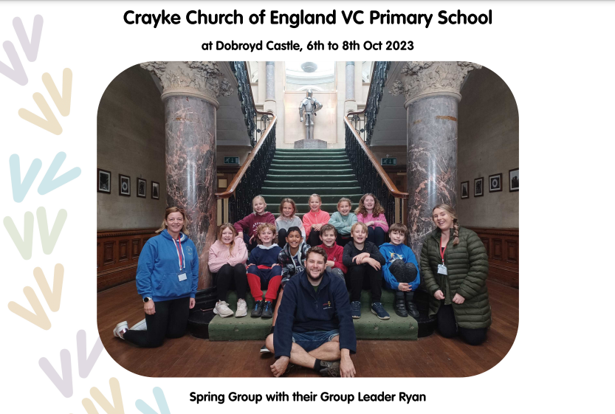
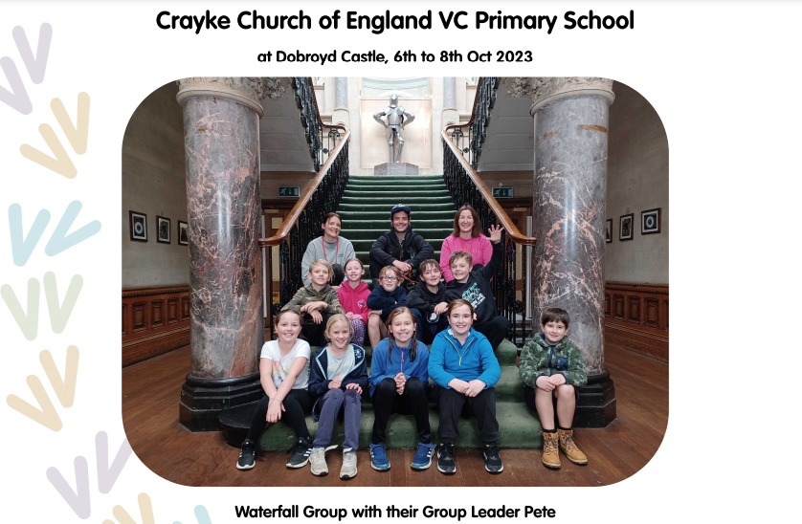
News From School This Week
Robinwood
As always, it was an absolute pleasure to see our children in action on residential last weekend. They were wonderful! Thanks to the staff who made this visit possible – Mrs Rayner, Miss Walker and Mrs Peacock.
The children will be receiving their personalised certificates and group photos in our Achievement Worship this afternoon.

Slide 9
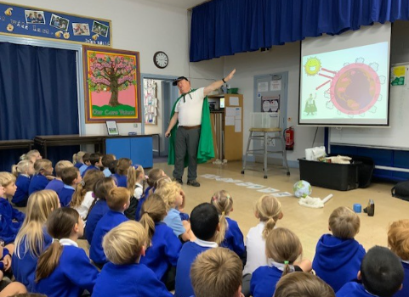
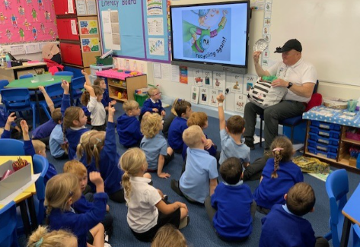
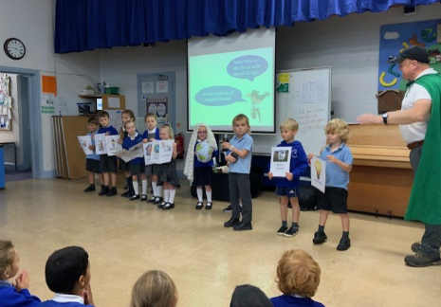
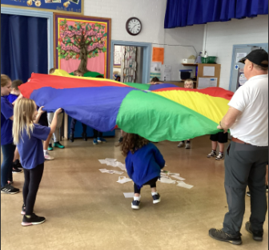
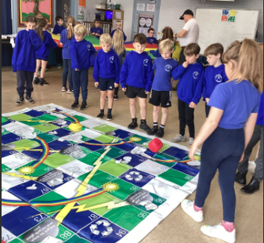
News From School This Week
Power Down Pete
Power Down Pete spent time in school this week talking about how to be more environmentally aware. He talked about pollution, recycling and how to help protect our planet.

Slide 10
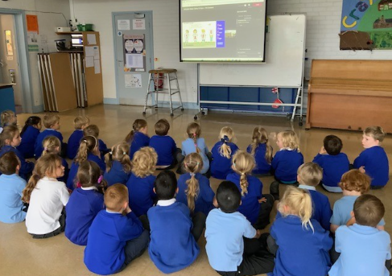
News From School This Week
Water Safety Workshops
In Apple Class we learnt:
“Not to go by the edge of the river.” Mabel
“Don’t ride your bike near the edge of the river.” Wilfred
“Red flag means don’t go in the sea.” Jackson
“Black and white flag means it’s good for surfing. Yellow and red means it’s safe for swimming.” Edmund
Beech Class:
By the end of the session the children could spot a range of ‘water dangers’ and give ideas for how people could be safer near the water.
Key Stage 2:
The children enjoyed learning about how to stay safe in our local area near rivers, canals, reservoirs and at the seaside. We worked together to spot dangers including slippery banks and strong currents. We learnt that we should never swim in a reservoir, what to do in an emergency and tested our knowledge of lifeguard flags.

Slide 11
News From School This Week
Safeguarding Visit from North Yorkshire Senior Education Adviser
Michele Hattersley visited school recently and we have now received her report from the visit. During the day she spoke to parents, pupils, governors and a range of members of staff. We are delighted that her report highlights the following:
“The sample of pupils from Y1 – Y6 reported that they feel safe in school and can talk to any adults if they are worried about something. They know the difference between bullying and falling out and can talk about strategies to help themselves or others.”
“Parents reported that their children are safe in school and highlighted the extensive information provided within the newsletter which helps with safeguarding, especially online safety. They felt that they could talk to any member of staff if they had concerns. A parent of a new pupil felt that there had been good transition arrangements in place and reported that their child had settled well.”

Slide 12
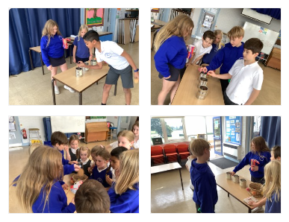
News From School This Week
Pupil Voice – School Council
As part of our project of "How can we improve the team-points system?" School Council wanted to know what the pupils would like as their reward for the winning team. We took the three most popular suggestions from the suggestion box and the ideas that they had gathered from speaking to the children in their class. We invited children to come up and vote for their preferred treat. We found that offering complimentary biscuits really improved voting turnout!
Results:
Extra breaktime: 4 votes
Tasty treat (ice-cream/ hot chocolate): 24 votes
Games session: 20 votes
Miss Walker

Slide 13
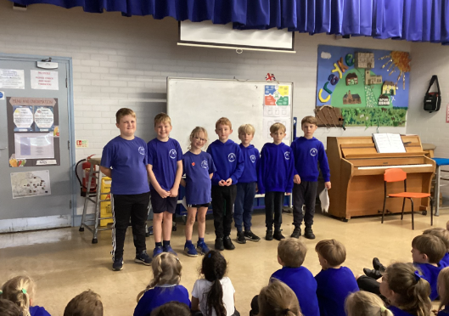
News From School This Week
Pupil Voice – Shed Monitors
During last week’s Achievement Worship it was brilliant to have the Shed Manager and Monitors sharing a pre-prepared speech with the rest of the children.
This speech – all the children’s own work - linked the importance of looking after our playtime equipment with each of our school values.
The speech concluded with a message from the previous monitors passing on their gratitude to the new team for their hard work so far this year.

Slide 14
Class News- APPLE
Stay and Play
We would like to give you the opportunity to join us for a “Stay and Play” session from 9am on one of the following dates:
Tuesday 17 October; Tuesday 24 October
Please contact Mrs Bacon to book your slot.

Slide 15
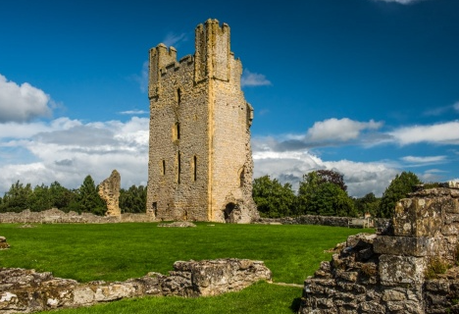
Class News - BEECH
Educational Visit – Helmsley Castle Friday 10 November 2023
I am delighted to confirm that Mrs Dobson has arranged an educational visit to Helmsley Castle on Friday 10 November as their “Fabulous Finish” to their learning about castles.
Even better – this visit is free to parents! CHASA will fund the travel costs and the visit to the castle is free.
Further details including an online consent form will follow shortly.

Slide 16
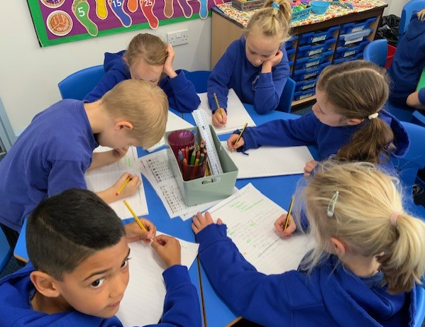
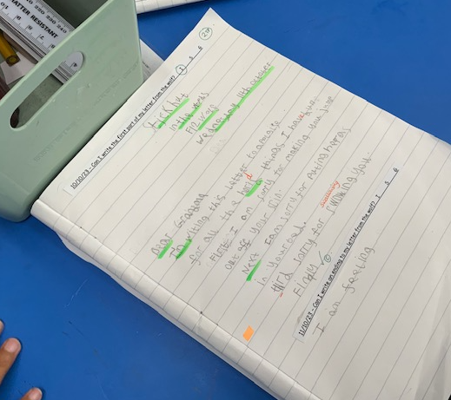
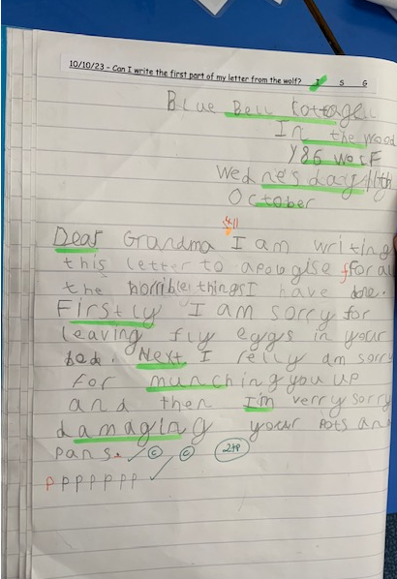
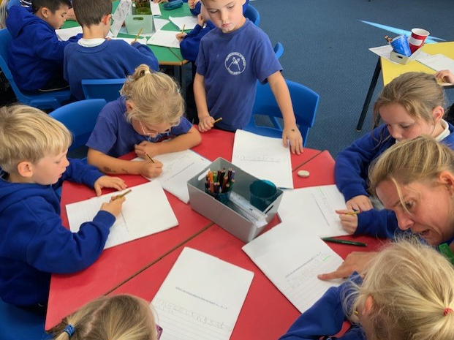
Class News - BEECH
Wonderful Writing
Mrs Rayner (English Subject Leader) and I had the pleasure of visiting Beech class earlier this week to see how the children are getting on in their English lessons. The focus was on using adjectives to write a letter of apology from the Big Bad Wolf to either Grandma or Little Red Riding Hood. We were so impressed with the quality of their writing!

Slide 17
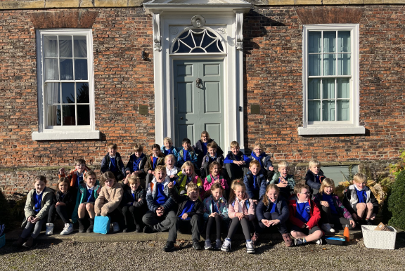
Class News – HOLLY
Educational Visit - Thirsk Sculpture Garden Visit
The weather was very kind to Holly Class and Mrs Chandler reports that they had a really brilliant day. She was very impressed with how engaged the children were and how much they enjoyed the visit.
See next slide for more photos!

Slide 18
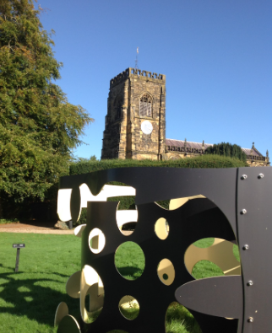
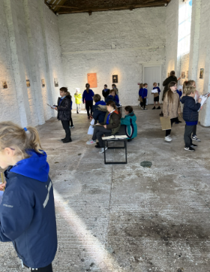
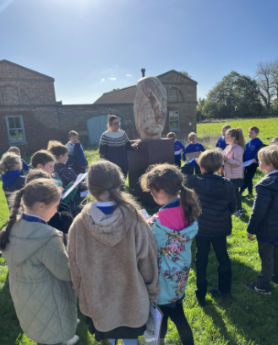
Class News – HOLLY
Educational Visit - Thirsk Sculpture Garden Visit

Slide 19
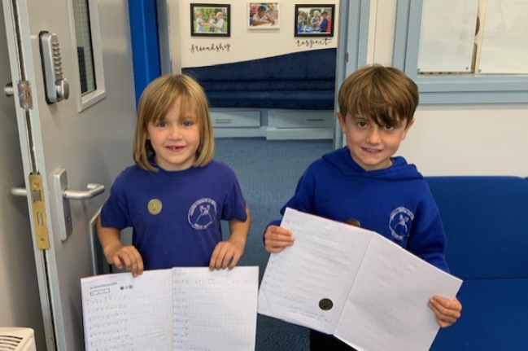
Class News – HOLLY
Two very proud mathematicians!

Slide 20
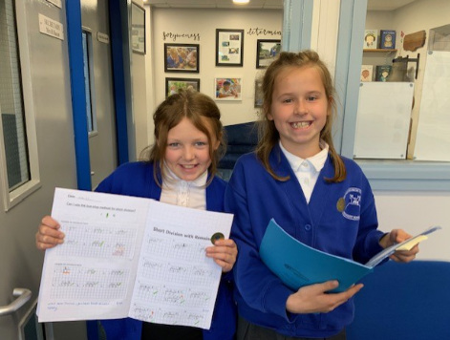
Class News - OAK
Two more very proud mathematicians!

Slide 21
Class News - OAK
Cluster Football Tournament – Easingwold Primary School
On Monday after school, we are taking our football team to play in a competition against 8 other local primary schools!
An email will be sent later today to relevant parents providing further information.
Thank you to Mr Palmer who has supported the team and helped to prepare them by coaching them over the past few weeks after school.
Watch out next week for the results and good luck to the team!

Slide 22
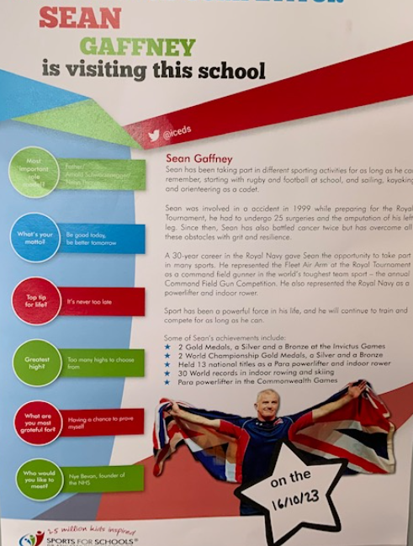
Upcoming events next week – Information for all
We are so excited to welcome Sean Gaffney, Invictus Games winner and professional athlete into school on Monday.
He will work with each class during the afternoon and then lead a whole school assembly at the end of the day to talk about his achievements.
He will also share with the children the difficulties he faced following the amputation of his left leg, but how his resilience didn’t stop him from achieving great things.
This will undoubtedly be a powerful message to our pupils in line with our core values of forgiveness and determination, and also fits well with our work on the Crayke Growth Mindset. We’re so looking forward to his visit!

Slide 23
Upcoming events later in the half term
Parent Consultation Evenings – Offer of support for parents with devices
As parents and carers, you play a crucial role in helping your children to stay safe online. We know that this can be daunting in an ever-changing digital world.
To help you, one of our governors, Pete Wilson, has kindly offered to provide support during our upcoming parent consultation evenings. He will be on hand to help with any questions you may have around setting time limits or restrictions on apps or devices used by your children, on both Tuesday and Wednesday from 4:30pm - 5:30pm.
If you would like to find out more by doing your own research, please visit this website: https://saferinternet.org.uk/guide-and-resource/parents-and-carers

Slide 24
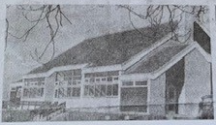
Upcoming events later in the half term
Community Coffee Morning – Save the Date!
To culminate our celebrations marking the 50th anniversary of the school being on this site, we would like to warmly welcome parents and members of the local community to join us for a community coffee morning event, hosted by children in Oak class. This will be held in the school hall on Wednesday 25 October from 9:30am. Further details to follow.

Slide 25
Awards in School This Week
 | Apple | Beech | Holly | Oak
Stars of the Week | Lyuba Hobson | Honor Howland | Lucas Stubbins | Kiera Rosa-Keyter
 |  | Amber Brown | Mabel Dawson | Leonard Liddell
Gold Awards for Sport | Ben Cheetham | Sophy Triffitt | George Ritchie | Aiden Simpson
Headteacher Awards Random Act of Kindness | Edmund Sadler |  | Zhdan Kovalchuk

Slide 26
PE Kits next week
Apple: Children in Apple Class need to bring their Forest School kit in each Friday. Please send their PE kit in on Monday as children will change for PE in school. They will bring PE kits home for washing periodically.
Please ensure that on PE days, the children wear their hoodies, school jumpers or cardigans alongside white or blue t-shirts and black or navy shorts or jogging bottoms.
 | Monday | Tuesday | Wednesday | Thursday | Friday
Beech | X |  |  | X | X
Holly | X | X |  |  | X
Oak | X | X - swim |  |  | X

Slide 27
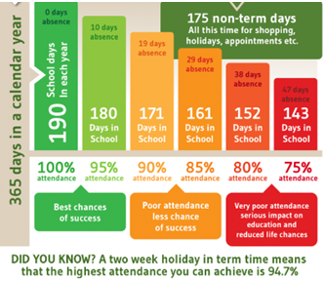
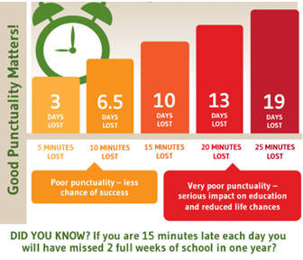
Attendance and Punctuality
This week’s attendance figures: 92% School Target: 96%
 | Attendance | Punctuality
Apple | 98.5% | 0 lates
Beech | 92% | 1 late
Holly | 90.6% | 1 late
Oak | 90.4% | 0 lates

Slide 28
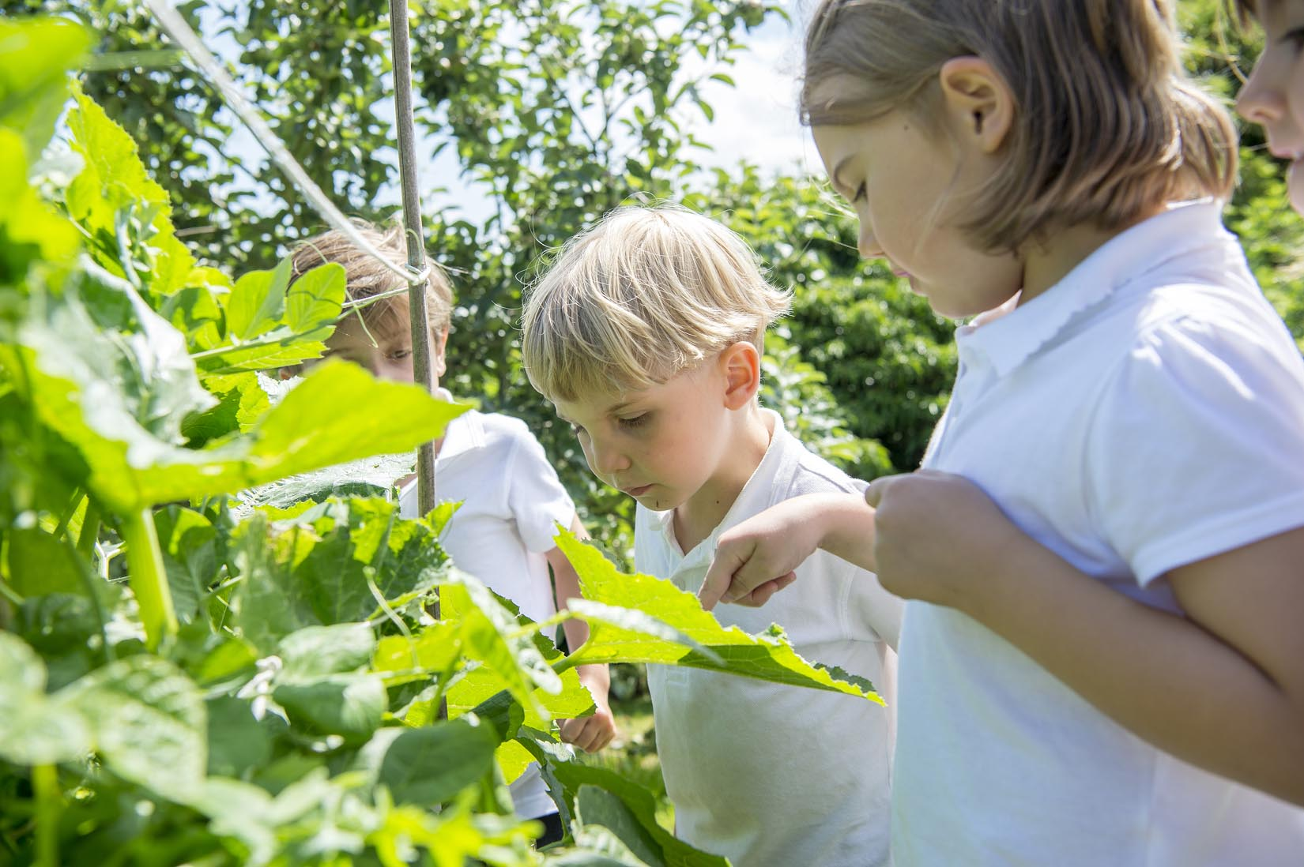
Extra Curricular Clubs - Autumn
Some clubs have limited capacity and places will be allocated on a first come first served basis. In the event of a club being fully booked, your child’s name will be added to a waiting list and you will be advised if a place becomes available. Booking is not required for before school or lunchtime clubs. For after school clubs run by school staff (denoted with *) please email Mrs Bacon on admin@crayke.n-yorks.sch.uk to book a place.
Before School:
After School:
Club | Day and Time | Group
Run a Mile | Monday, Tuesday Thursday & Friday 8:30am | All welcome – parents and carers included!
Day | Club
Monday | Craft* (£10 pay via ParentPay) 3:30 – 4:15pm Years 1 – 6 Mrs Seligman | Coding* 3:30pm – 4:15pm Years 3-6 Mr Brown
Tuesday | Multi-Sports (fee paid direct) 3:30 – 4:30pm Years 1 – 6 Mark Cromack
Wednesday | Junior Duke* (£10 pay via ParentPay) 3:30pm – 4:15pm Year 3/4 Mrs Helfferich
Thursday | Chess* (no charge) 3:30pm – 4:15pm Year 1 - 6 Mrs Seligman

Slide 29
The next CHASA meeting will be on Wednesday 18 October at 7pm. If you are intending to attend, please contact Rebecca Stubbins on chasasecretary@crayke.n-yorks.sch.uk
If you are unable to attend in person, but would like to join virtually, please contact Rebecca who will be able to provide a Zoom link to join.
We look forward to seeing you.

