Slide 1
Crayke Chronicle
Issue: #7 Term: Autumn Date: 20 October 2023
FOLLOW YOUR PATHWAY AND WE GROW TOGETHER WITH CONFIDENCE
You did not choose me, I chose you that you might go and bear fruit, fruit that will last so that whatever you ask in my name the Father will give you. John 15:16
Respect Friendship Forgiveness Determination

Slide 2
In our newsletter this week…
…Important news regarding Interim Reports coming home today with your child
…Find out what the children have been learning by looking at our Gallery
…News from school this week including a staffing update, football team report, school council news, musicians, achievements outside school and more!
…Check the class pages for any information relevant to each individual class and further news about learning and achievements this week
…Find out about upcoming events next week.
Our regular items then follow:
…Awards in school
…Team Points
…PE Kits next week
…Attendance and Punctuality
…Extra curricular clubs (NB: Junior Duke CANCELLED on Wednesday due to Parent Consultation Evenings)
…CHASA news
Have a lovely weekend!

Slide 3
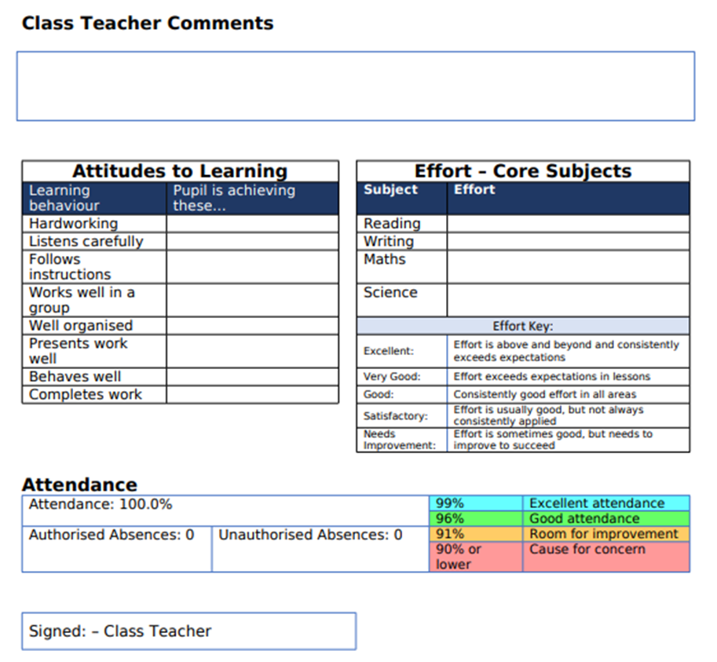
**Important news** Interim Reports
Your child will be bringing home an interim report with them today. This details how well they have settled into the beginning of this academic year and information about their attendance levels to date this term.
We hope that this will be a useful document to show you how well your children are doing and also to help frame discussions at parent consultation evening appointments next week.
If anyone has any feedback about these reports, we would love to hear from you.

Slide 4
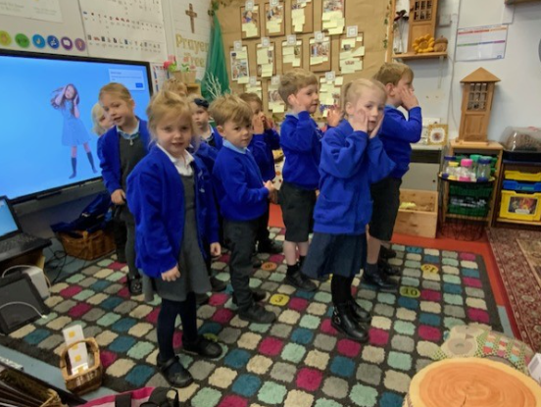
Gallery
A snapshot of learning from across the week… please use these photographs as an opportunity to talk to your children about what they have been learning!
Apple – Wake Up Shake Up

Slide 5
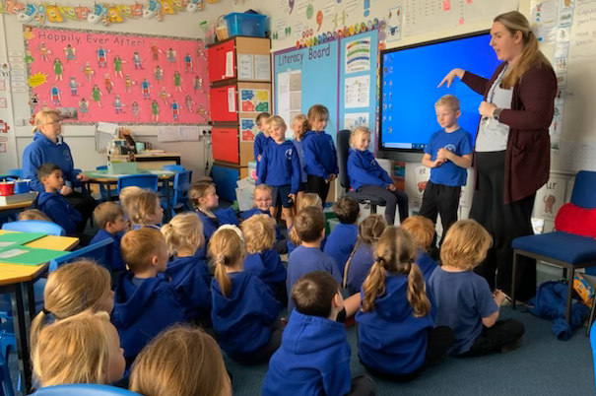
Beech - RE

Slide 6
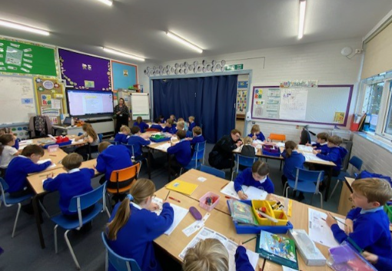
Holly – Vocabulary Ninja

Slide 7
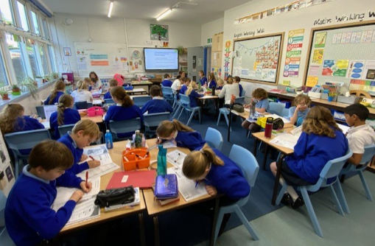
Oak - English

Slide 8
News From School This Week
Staffing Update
We’re excited to be able to share that we are holding interviews next week for a part time Teaching Assistant (based in Oak Class) and a Learning Mentor who will be working across school.
The Learning Mentor is a brand new role to our school. A large part of the remit of the successful candidate is to provide support on a one to one or small group basis for the more challenging students who are having performance, attendance or behavioural issues. This is part of our drive to ensure the highest standards of behaviour and learning for all our pupils, in our continual efforts to make Crayke School a happy and safe environment for all children and adults.
We will keep you updated!

Slide 9
News From School This Week
Fabulous Footballers
An enormous well done to our Y5/6 team who participated in the Easingwold Football Tournament after school on Monday.
Message from Mrs Helfferich:
What an amazing team! This brilliant group played games back to back for over an hour as we didn’t want them to miss out on the visit from Sean Gaffney on the same afternoon. There was some very impressive footwork; everyone played an important part carrying the team through each game. We might not have been the team that scored all the goals but Toby stopped a lot of teams scoring goals. Thank you to Mr Palmer for coaching on a Wednesday and for your encouraging side-line support. Thank you to the parents, I feel we were the most supported school with all of your positive calls. Thank you to Mrs Jackson for tearing yourself away from your laptop to support our team. We are hoping to get some more games booked in.

Slide 10
Book your parents evening slot
We are aiming for 100% engagement in parent consultation evenings this year!
If you have not yet booked an appointment, please expect to hear from Mrs Bacon.
Attending parents’ evening is a really important part of keeping in touch with how well your child is progressing at school. We look forward to seeing you next week.

Slide 11
News from school this week – emails from school going into Junk folder
We are aware that a small number of emails to parents, from a range of different email platforms, are going from the headteacher@ account into junk/spam.
I have contacted NYES Digital and received the following advice:
“If emails are being received into the spam folder of any of your parents, they can navigate to their spam folder, right click on your email and choose "not spam" and it should go into their inbox in future.”
I hope this resolves the issue but please do let me know if it transpires that there are any further issues.

Slide 12
News From School This Week
Sean Gaffney
Sean loved his visit to us as much as we loved having him here! He said that Crayke Primary is one of the nicest schools he has ever been to and the children have worked the hardest of any school he’s been to this year. Sean shared the message that he focused on whether the children worked hard and smiled a lot. They did!
He then went on to talk about sport, saying sport is for everyone and can be enjoyed at any age. He has learnt that you have got to work hard to get better.
He represented the Royal Navy, UK armed forces, Wales and GB in different sports. He does sports because he is good at them; others because he enjoys them. He reminded the children that if they want to be successful they need to learn to lose a lot of the time. He has 15 national championship titles but every time he wins, he will have failed 5 or 6 times beforehand. The secret is hard work.
Isabelle summarised his message so perfectly by saying to him at the end of his visit – “Are you trying to tell us that trying your best is more important than being the best?”
See next slide for some photographs of his visit!

Slide 13
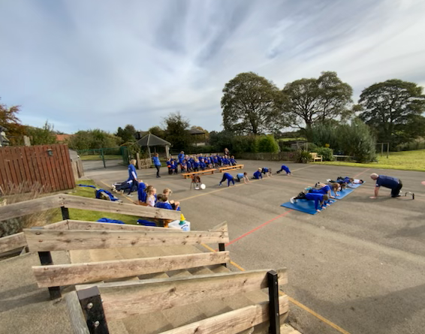
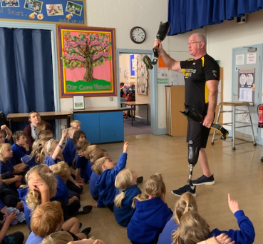
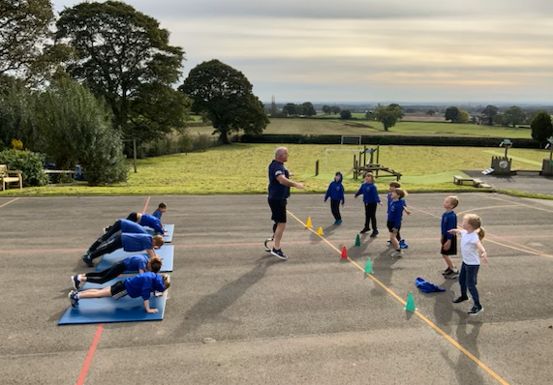

Slide 14
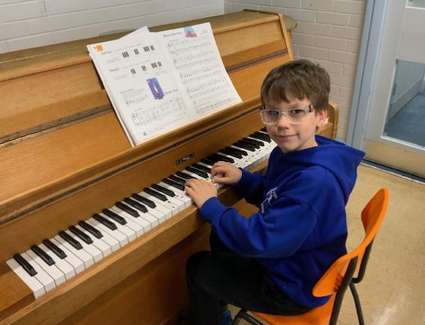
News From School This Week
Musicians
It’s wonderful on a Friday afternoon when, at the start of Achievement Worship, we are treated to a brilliant musical performance from one of our children.
So far this term we have had three children from Holly Class already playing the piano as the other children come into the hall.
Well done children!

Slide 15
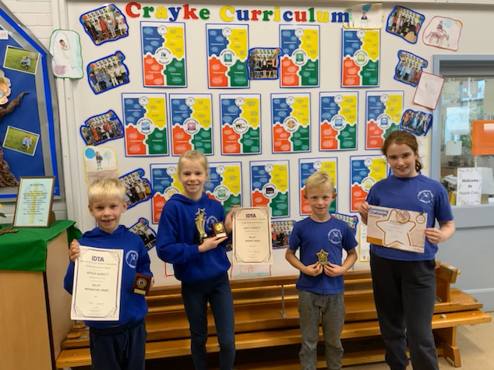
News From School This Week
Celebrating achievements from outside school
Please do share your achievements outside school with us by bringing in certificates, medals and trophies for all the wonderful things you do!
Last week alone we celebrated achievements in ballet, rugby and swimming.
Relevant items need to be brought in on a Friday morning and put on the stool in the hall next to the computer.

Slide 16
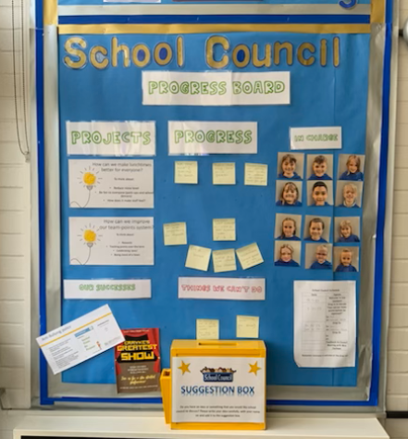
News From School This Week
Pupil Voice – School Council
I had the pleasure of meeting with School Council this week for a catch up session about their work on two ongoing projects they’re undertaking this term. Project 1: Making lunchtimes better for everyone - two sittings School Council agreed there are many benefits to this:
Quieter
Younger children get chance to serve
Lots more time to play outside
More time on the equipment
They had the following suggestions to improve things further:
Maybe look at swapping after half term to mix up groups
Fine diners - stickers would be good to represent this
Project 2: Improve team points system School Council have done a vote where pupils chose appropriate reward - tasty treat at the end of term. Choosing team names is work in progress. Mrs Jackson suggested a music theme for our year of music - may have colour link – School Council to advise at next meeting.

Slide 17
We need a cleaner!
If you know anyone who may be interested in applying for this vacancy, please pass on this link:
https://nycjobs.engageats.co.uk/Vacancies/W/2779/0/407643/20003/cleaner-crayke-school-fc089601

Slide 18
Class News- APPLE
Stay and Play
There’s one more opportunity to join us for a “Stay and Play” session from 9am next Tuesday 24 October. Please contact Mrs Bacon to book your slot if you haven’t already.
Wellness Wednesday
On Wednesday 25 October, we will be having a ‘Wellness Wednesday”. Children are invited to wear their PJs and dressing gowns to school. Please also bring a coat for playtime.
We will be making facemasks, smoothies, learning breathing techniques, doing Yoga and relaxing. It has been a really busy first half term, the children have done so well and have all been superstars.

Slide 19
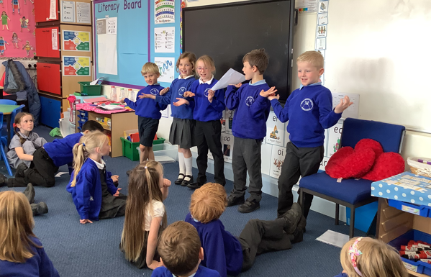
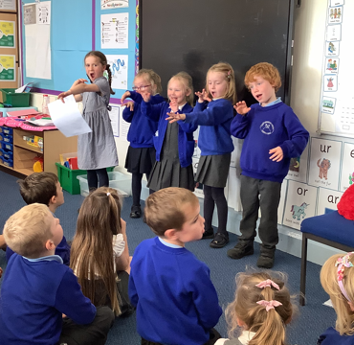
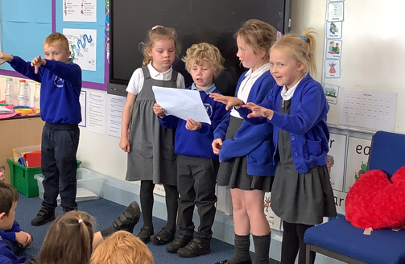
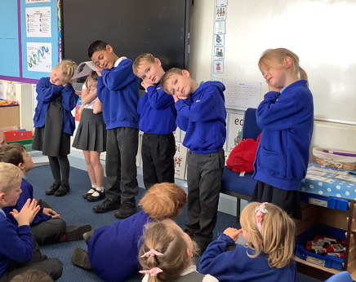
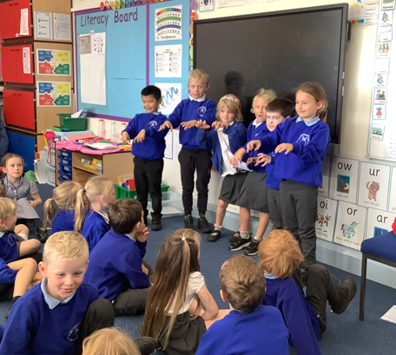
Class News - BEECH
Poetry Performances!
It looks like the children had great fun performing their Dragon poems!

Slide 20
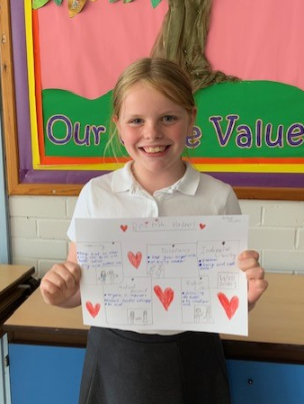
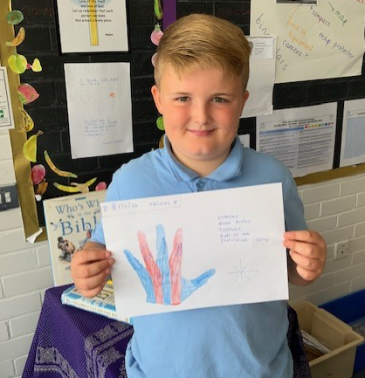
Class News – HOLLY
British Values
Children were producing work this week linked to British Values, using this helpful reminder:
"I Really Do Matter…”
Individual Liberty
Rule of Law
Democracy
Mutual respect / Tolerance of different faiths and beliefs
Well done Holly Class!

Slide 21
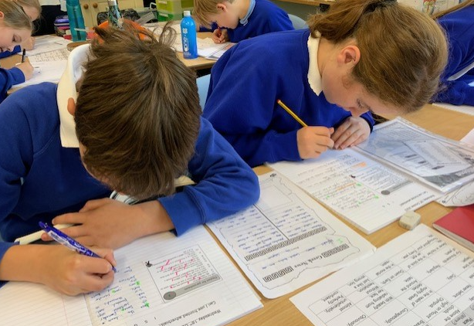
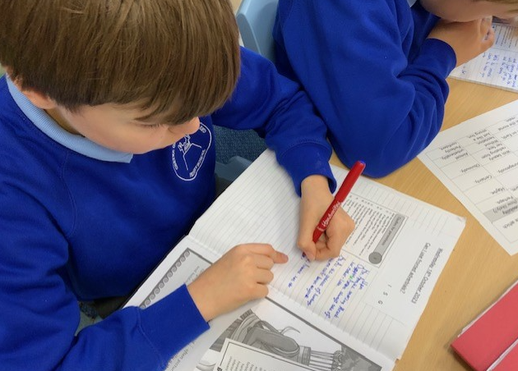
Class News - OAK
Fabulous Fronted Adverbials
It was a pleasure this week to join Oak class for their English lesson learning about fronted adverbials and to talk with them about their attitudes to writing.

Slide 22
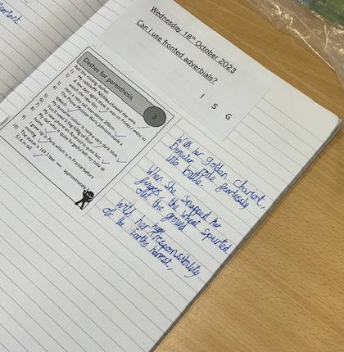
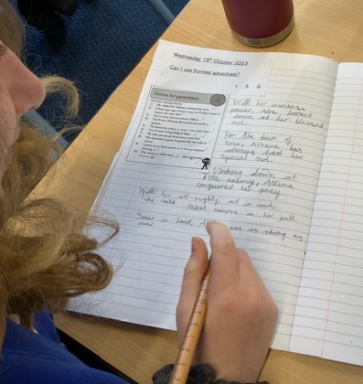
Class News - OAK
Fabulous Fronted Adverbials

Slide 23
Upcoming events next week OAK
As part of Oak Class’s current learning about Ancient Greece, on Monday they will be participating in an exciting “Marvellous Middle” project to create a themed mosaic. We can’t wait to see the outcomes of this!
This project is being run by local artist Sue Kershaw and is being funded by school.

Slide 24
Upcoming events next week
REMINDER: Parent Consultation Evenings – Offer of support for parents with devices
As parents and carers, you play a crucial role in helping your children to stay safe online. We know that this can be daunting in an ever-changing digital world.
To help you, one of our governors, Pete Wilson, has kindly offered to provide support during our upcoming parent consultation evenings. He will be on hand to help with any questions you may have around setting time limits or restrictions on apps or devices used by your children, on both Tuesday and Wednesday from 4:30pm - 5:30pm.
If you would like to find out more by doing your own research, please visit this website: https://saferinternet.org.uk/guide-and-resource/parents-and-carers

Slide 25
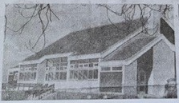
Community Coffee Morning 25 October 2023 9:30am – 11:00am
Upcoming events next week - ALL
We’re hosting a special event to culminate our celebrations marking the 50th anniversary of the school being on this site.
Parents, friends of the school and members of the local community are warmly welcomed to join us for a coffee morning event, hosted by children in Oak class and supported by CHASA.
This will be held in the school hall on Wednesday 25 October from 9:30am. Our chosen charity to support this year is one very close to our hearts - Candlelighters. Proceeds raised from the food and drink sold will go directly to support this local important cause.
Please join us for coffee, cake and live music. There’s even chance to win a raffle prize! If you are unable to attend but wish to provide some support, we would really appreciate donations of cakes or traybakes – thank you.

Slide 26
Awards in School This Week
 | Apple | Beech | Holly | Oak
Stars of the Week | Ava Carvalho | Lucia Grant | Evangeline Wardle | Florence Hindley
 |  | Oliver Warriner | Keenan Lee | Joah Brown
Gold Awards for Sport | Edmund Sadler | Alanna Dawson | Leo Bunker-Barnes | Sophie Sargent
Headteacher Awards Random Act of Kindness | Amber Brown |  | India Ward

Slide 27
Team Points
Team | Points
Red | 1983
Blue | 2120
Green | 5809
Yellow | 8002
Well done YELLOW team!

Slide 28
PE Kits next week
Apple: Children in Apple Class need to bring their Forest School kit in each Friday. Please send their PE kit in on Monday as children will change for PE in school. They will bring PE kits home for washing periodically.
Please ensure that on PE days, the children wear their hoodies, school jumpers or cardigans alongside white or blue t-shirts and black or navy shorts or jogging bottoms.
 | Monday | Tuesday | Wednesday | Thursday | Friday
Beech |  |  |  | X | SCHOOL CLOSED INSET DAY
Holly |  | X
Oak |  | X - swim

Slide 29
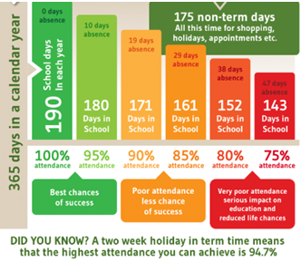
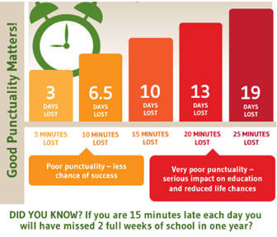
Attendance and Punctuality
This week’s attendance figures: 94.6% School Target: 96%
 | Attendance | Punctuality
Apple | 96.9% | 0 lates
Beech | 94.3% | 4 lates (3 children)
Holly | 93.4% | 3 lates (2 children)
Oak | 95% | 2 lates (2 children)

Slide 30
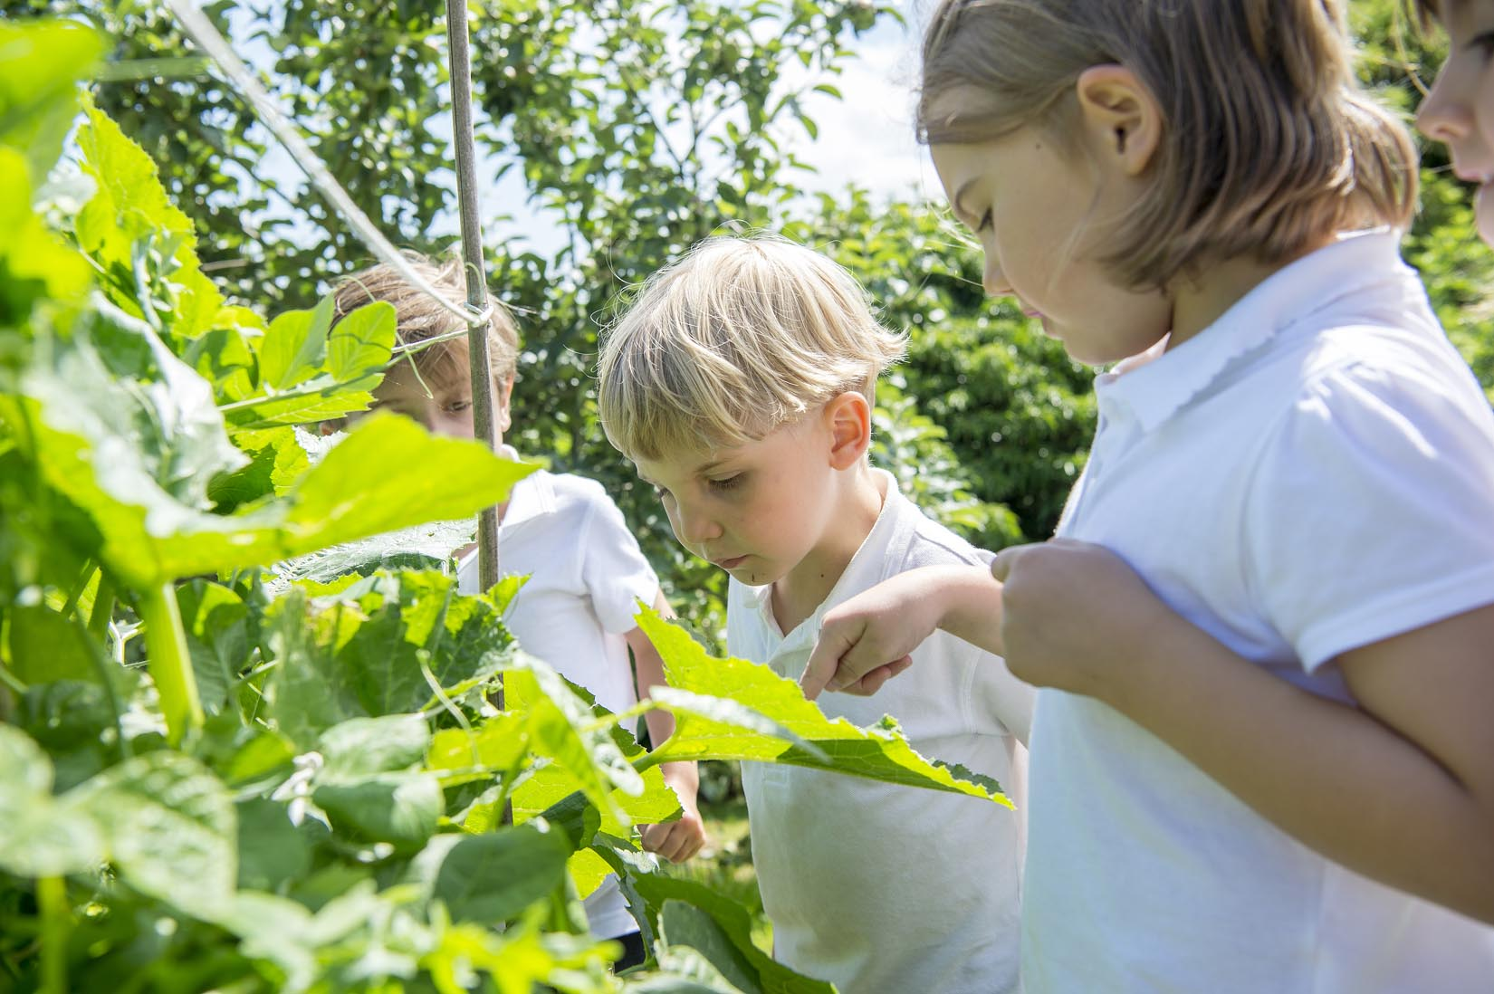
Extra Curricular Clubs - Autumn
Some clubs have limited capacity and places will be allocated on a first come first served basis. In the event of a club being fully booked, your child’s name will be added to a waiting list and you will be advised if a place becomes available. Booking is not required for before school or lunchtime clubs. For after school clubs run by school staff (denoted with *) please email Mrs Bacon on admin@crayke.n-yorks.sch.uk to book a place.
Before School:
After School:
Club | Day and Time | Group
Run a Mile | Monday, Tuesday Thursday & Friday 8:30am | All welcome – parents and carers included!
Day | Club
Monday | Craft* (£10 pay via ParentPay) 3:30 – 4:15pm Years 1 – 6 Mrs Seligman | Coding* 3:30pm – 4:15pm Years 3-6 Mr Brown
Tuesday | Multi-Sports (fee paid direct) 3:30 – 4:30pm Years 1 – 6 Mark Cromack
Wednesday | Junior Duke* (£10 pay via ParentPay) 3:30pm – 4:15pm Year 3/4 Mrs Helfferich
Thursday | Chess* (no charge) 3:30pm – 4:15pm Year 1 - 6 Mrs Seligman
No Junior Duke this week

Slide 32
Dates for your diaries:
Thursday 9 November – non uniform day in lieu of hamper donations for our Rainbow Raffle – further information to follow separately.
Save the Date – Thursday 30 November – Christmas Craft Club spectacular!

