Slide 1
Crayke Chronicle
Issue: #8 Term: Autumn Date: 26 October 2023
FOLLOW YOUR PATHWAY AND WE GROW TOGETHER WITH CONFIDENCE
You did not choose me, I chose you that you might go and bear fruit, fruit that will last so that whatever you ask in my name the Father will give you. John 15:16
Respect Friendship Forgiveness Determination

Slide 2
In our newsletter this week…
…News from school this week including a visit from returning students and a showcase from our charity fundraiser Coffee Morning!
…Check the class pages for any information relevant to each individual class and news about learning and achievements this week
…Governor update
Our regular items then follow:
…PE Kits after half-term
…Attendance and Punctuality
…Extra curricular clubs
…CHASA news
Remember – school is closed tomorrow for staff INSET day. We look forward to seeing you after half term on Monday 6 November. Have a wonderful week off!

Slide 3
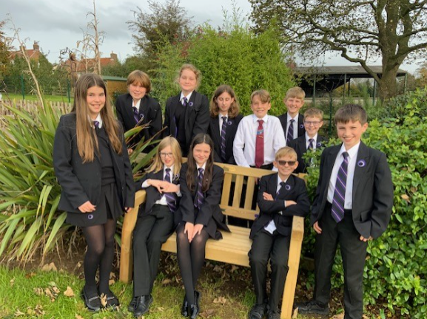
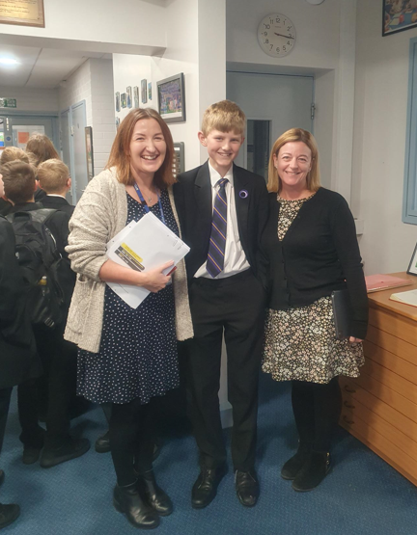
News From School This Week
Year 7 Return!
It was wonderful to see all of our Year 6 leavers back in school on Monday afternoon. They made a special trip to come and visit their newly installed bench, which has been bought with their collective donation from last summer. It’s a gift which will last for many years and we are very grateful. Thanks to the parents who contributed to this and also for arranging for all the leavers to be able to come up to school last week. The children looked fabulous in their new uniform and have certainly grown since July..!
Thanks also must be extended to Mr Unsworth and Sean for skilfully putting the bench together in record time!

Slide 4
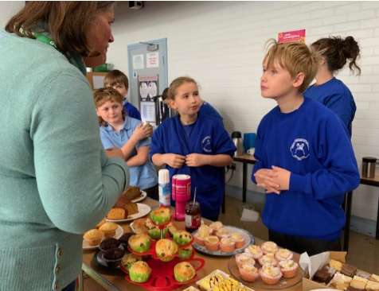
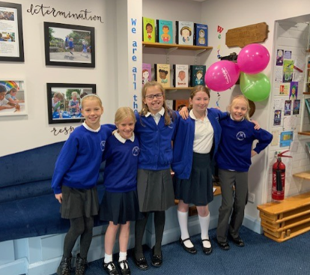
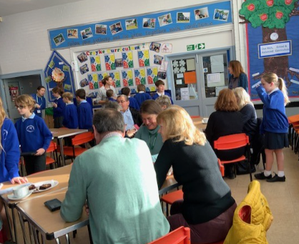
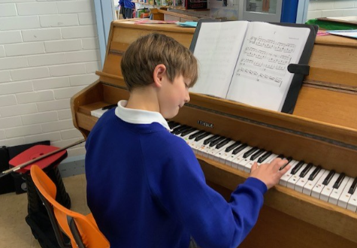
News From School This Week
Community Coffee Morning
It was truly fabulous to welcome parents, grandparents and friends of the school to join us for a celebration of 50 years of the school on its current site in our charity fundraiser for Candlelighters yesterday morning.
An enormous thank you to the many members of CHASA who provided invaluable support for this event – we really couldn’t have done it without you.
The CHASA raffle raised almost £100 for school and we’re eagerly awaiting the total from Candlelighters to be shared with you as soon as possible.
Thanks to everyone who contributed in any way to this lovely event; we are immensely grateful.
More photos on the following slides!

Slide 5
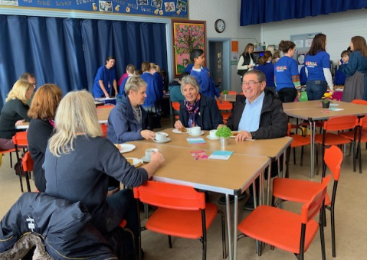
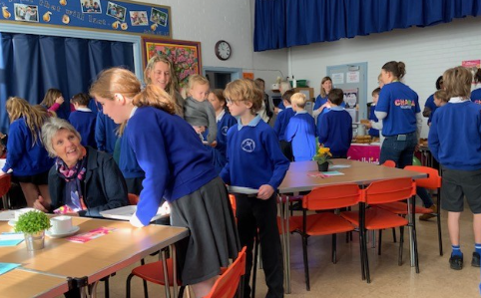
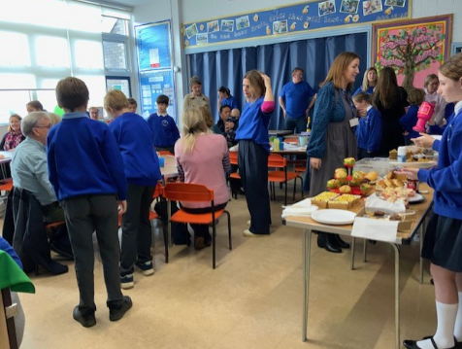
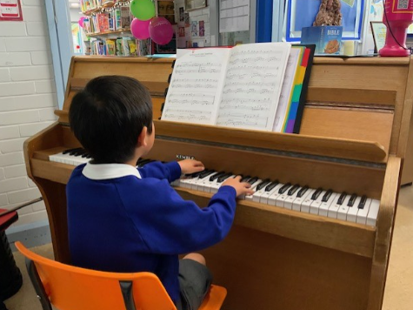

Slide 6
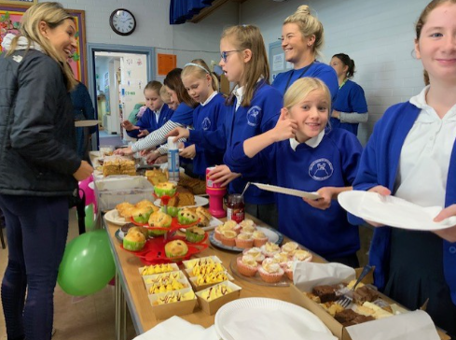
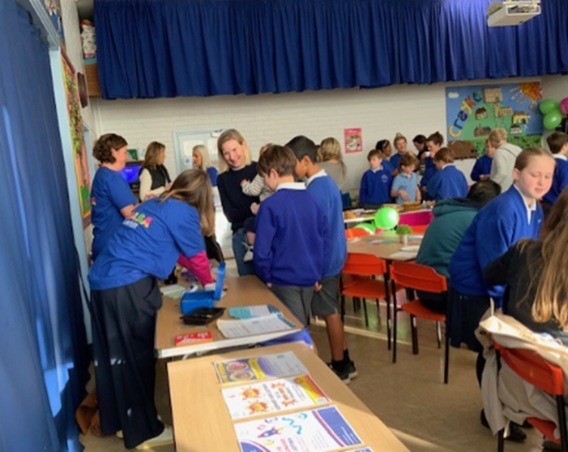
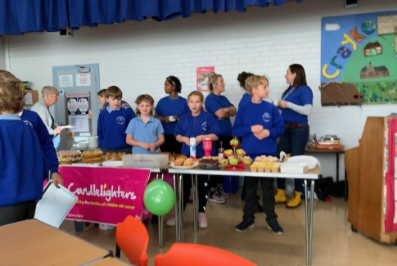
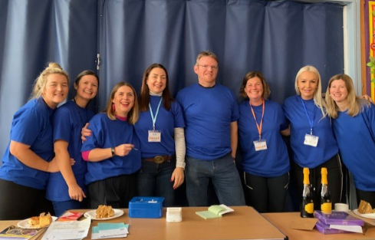

Slide 7
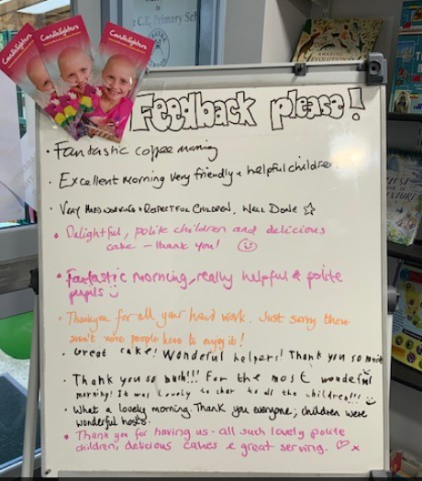
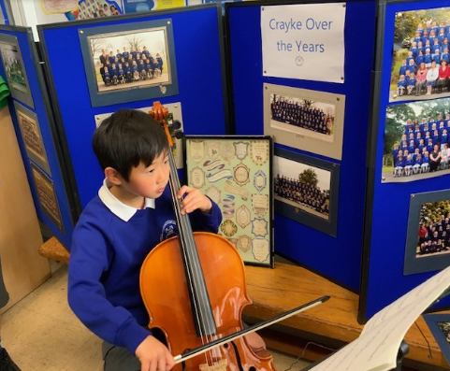
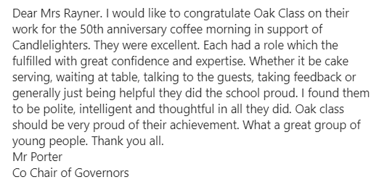
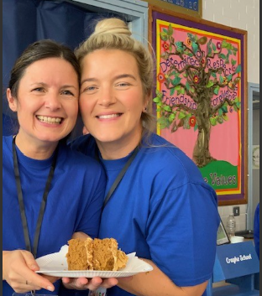
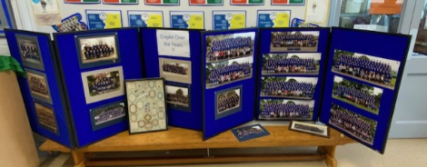

Slide 8
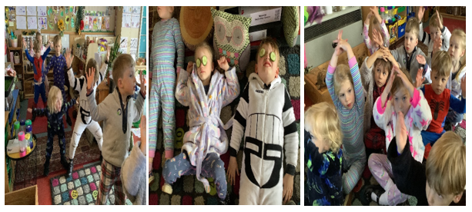
Class News- APPLE
Wellness Wednesday
We had a lovely relaxing afternoon yesterday; we learnt some yoga moves, breathing techniques, put school made facemasks on and chilled out after a very long first half term.
Mrs Helfferich

Slide 9
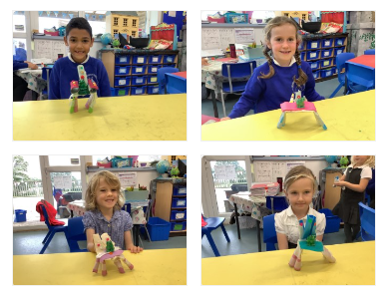
Class News - BEECH
Design Technology
Beech Class have enjoyed making, assembling and decorating their thrones this week. Once we had designed them, we tested their stability by letting our model frog sit on them. We were so impressed with the designs!
Mrs Dobson

Slide 10
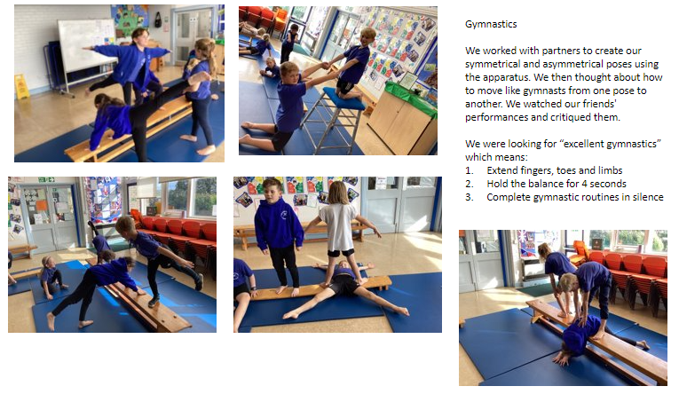
Class News – HOLLY
Miss Walker

Slide 11
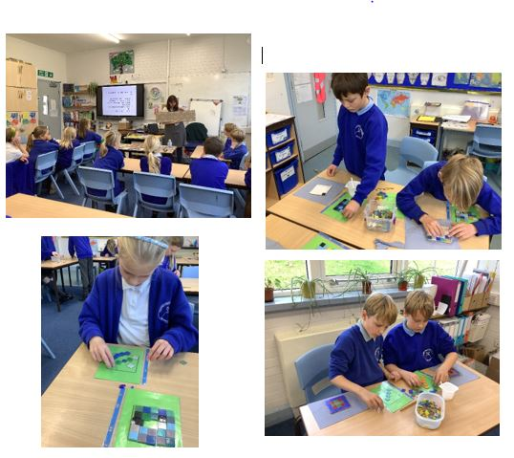
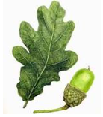
Class News - OAK
Mosaic Workshop
On Monday, Oak Class took part in a Greek Mosaic workshop from local mosaic artist, Sue Kershaw. She taught the children that although the Romans are famous for their mosaics, they actually took their inspiration from the Ancient Greeks. Each child got to make their own mini mosaic, which is going to be permanently displayed in our new Learning Hub to celebrate 50 years of Crayke School being on this site.

Slide 12
Governor Update
This half term governors have:
Attended and participated in the Full Governing Body meeting
Undertaken training including safeguarding updates
In addition, governors have been involved in school life in different capacities including: Mrs Hayes has been involved in our recent staff recruitment exercise, Mrs Lunn has accompanied Y5/6 to swimming and Mr Wilson provided an IT workshop for parents during consultation evenings this week. Miss Griffin has continued to source grants to support our solar panel project – most recently securing £2500 from BUPA. Mrs Willshaw has led collective worship continuing our “Journey through the Bible.” Mr Porter has provided hands on support for the redevelopment of the Learning Hub and has been a dab hand with a paintbrush and screwdriver!
Next half term, we are looking forward to welcoming Link Governors into school to meet with their designated Subject Leaders and gather some pupil voice for different curriculum areas.

Slide 13
PE Kits w/c 6 November 2023
Apple: Children in Apple Class need to bring their Forest School kit in each Friday. Please send their PE kit in on Monday as children will change for PE in school. They will bring PE kits home for washing periodically.
Please ensure that on PE days, the children wear their hoodies, school jumpers or cardigans alongside white or blue t-shirts and black or navy shorts or jogging bottoms.
 | Monday | Tuesday | Wednesday | Thursday | Friday
Beech |  |  |  | X | X
Holly |  | X |  |  | X
Oak |  | X - swim |  |  | X

Slide 14
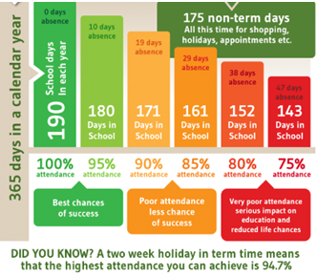
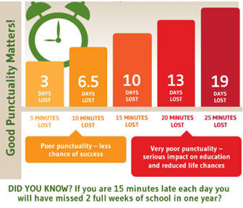
Attendance and Punctuality
This week’s attendance figures (Mon-Thu): 94.9% School Target: 96%
 | Attendance | Punctuality
Apple | 96.2%
Beech | 96.3%
Holly | 94.5% | 1 late
Oak | 93.3%

Slide 15
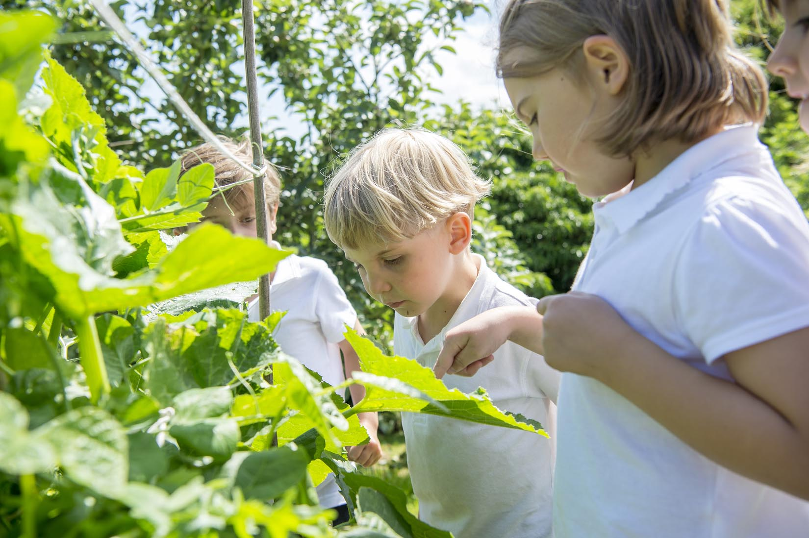
Extra Curricular Clubs - Autumn
Some clubs have limited capacity and places will be allocated on a first come first served basis. In the event of a club being fully booked, your child’s name will be added to a waiting list and you will be advised if a place becomes available. Booking is not required for before school or lunchtime clubs. For after school clubs run by school staff (denoted with *) please email Mrs Bacon on admin@crayke.n-yorks.sch.uk to book a place.
Before School:
After School:
Club | Day and Time | Group
Run a Mile | Monday, Tuesday Thursday & Friday 8:30am | All welcome – parents and carers included!
Day | Club
Monday | Craft* (£10 pay via ParentPay) 3:30 – 4:15pm Years 1 – 6 Mrs Seligman | Coding* 3:30pm – 4:15pm Years 3-6 Mr Brown
Tuesday | Multi-Sports (fee paid direct) 3:30 – 4:30pm Years 1 – 6 Mark Cromack
Wednesday | Junior Duke* (£10 pay via ParentPay) 3:30pm – 4:15pm Year 3/4 Mrs Helfferich
Thursday | Chess* (no charge) 3:30pm – 4:15pm Year 1 - 6 Mrs Seligman

Slide 17
Dates for your diaries:
🗓️ Save The Date 🗓️ CHASA Meeting
Date: Monday 6 November
Time: 4pm
Location: Jean Fahger Meeting Room @ St Monicas Hospital, Long St, Easingwold, York YO61 3JD.
👧👦 Please note children can attend.
Thursday 9 November – non uniform day in lieu of hamper donations for our Rainbow Raffle – further information to follow separately.
Save the Date – Thursday 30 November – Christmas Craft Club spectacular!

