Slide 1
Crayke Chronicle
Issue: #5 Term: Autumn Date: 6 October 2023
FOLLOW YOUR PATHWAY AND WE GROW TOGETHER WITH CONFIDENCE
You did not choose me, I chose you that you might go and bear fruit, fruit that will last so that whatever you ask in my name the Father will give you. John 15:16
Respect Friendship Forgiveness Determination

Slide 2
In our newsletter this week…
…Find out what the children have been learning by looking at our Gallery
…An update from our Governors
…News from school this week including Harvest Service, Made in Yorkshire Craft Festival and my meeting with the Shed Manager and Monitors
…Check the class pages for any information relevant to each individual class and further news about learning and achievements this week
…Find out about upcoming events next week and later in the half term.
Our regular items then follow:
…Awards in school
…Team Points
…PE Kits next week
…Attendance and Punctuality
…Extra curricular clubs
…CHASA news
Have a lovely weekend!

Slide 3
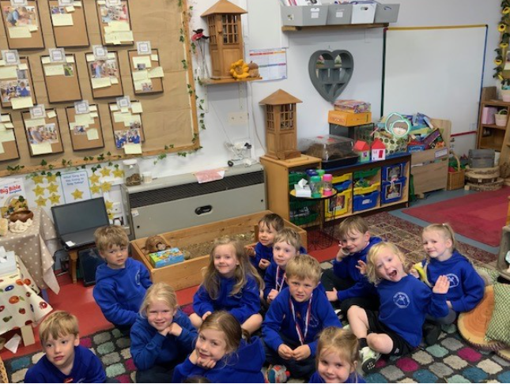
Gallery
A snapshot of learning from across the week… please use these photographs as an opportunity to talk to your children about what they have been learning!
Apple – Snack and Story time

Slide 4
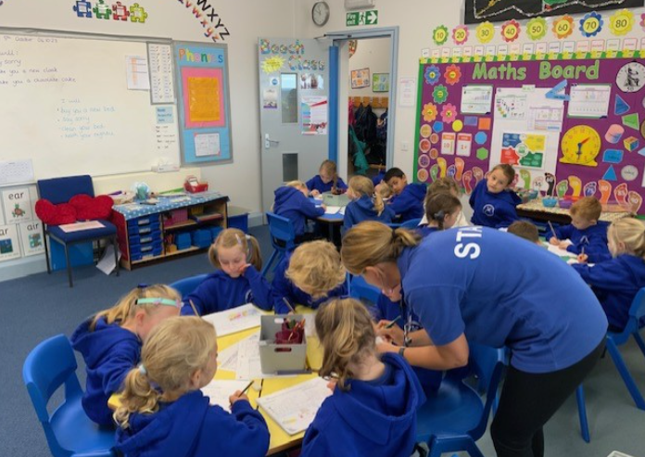
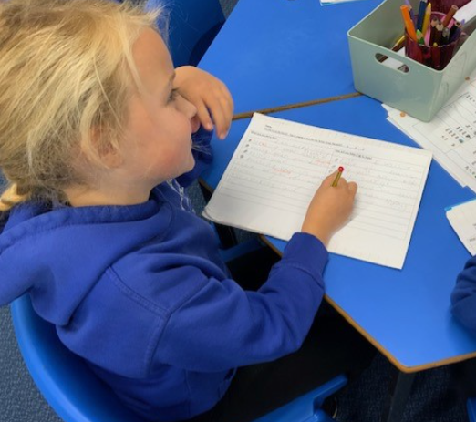
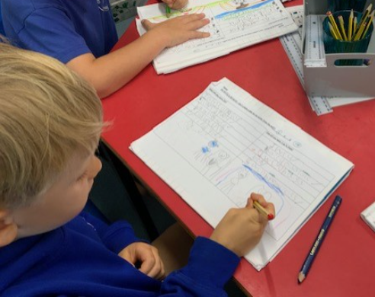
Beech - Literacy

Slide 5
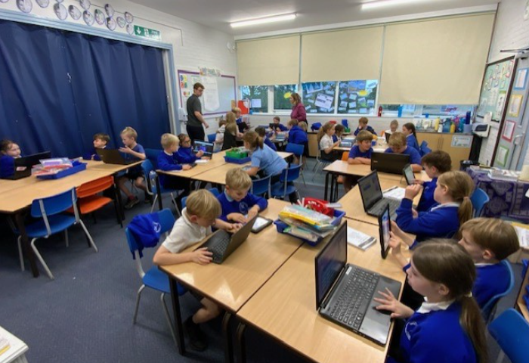
Holly – Maths Times Table Rock Stars

Slide 6
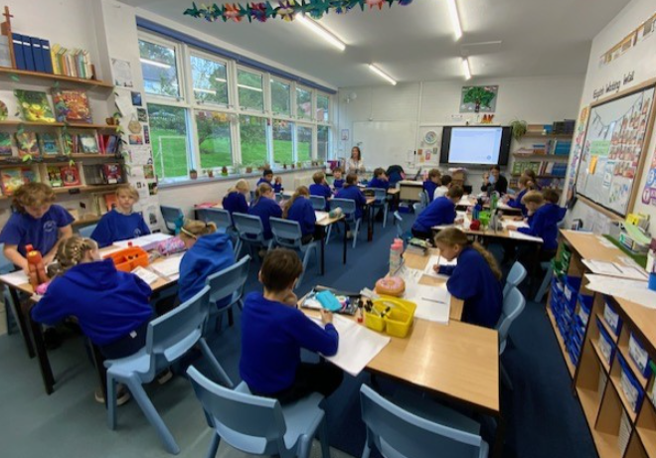
Oak - Maths

Slide 7
News From School This Week
Governor Update
Following our first Full Governing Body meeting of the year earlier this week, I am delighted to welcome two new co-opted Governors to join our fabulous team. Andrea Hayes and Tracey Roberts both bring with them a huge amount of experience, both from the educational sector and elsewhere. They will be enormous assets. This year, the organisation of our Governing Body will be slightly different as we will have two Co-Chairs of the board – Hugh Porter and Andrea Hayes.
As always, I am hugely grateful for the dedication and support provided by our excellent governors and know how lucky we are as a school to have a highly skilled and enthusiastic team who are relentless in their drive to ensure that Crayke school is the best it can be.
If you would like to find out more about our Governors, please do so by visiting their dedicated page on our school website: https://craykeschool.org/governors/

Slide 8
Brilliant Fundraising – Message from the Co-Chairs of the Governing Body
On behalf of the Governing Body, we would like to thank parents and carers for their generous donations to our solar panel appeal. Our many supporters from the school, the community and Aviva have raised over £10000 to offset the cost of installing the panels. The matched funding from Aviva has made a significant difference. Thanks also to members of CHASA who have worked so hard to make this possible. The Aviva offer has now ended but the fundraising continues. We will be focusing on businesses that might support us. If you know of any who are generous in this way please let us know. We would like to reassure parents that funding this initiative has not used money which could be spent directly on the children's education. On the contrary, it will free up finance which can be spent on staff and resources this year and for the next 25 years. The installation cost was funded by capital grants from the Department for Education and North Yorkshire Council plus a small interest free loan from the council. As capital grants they had to be spent on aspects of the building with an emphasis on energy efficiency. The panels will generate up to half our electricity requirement. This will reduce our electricity bills thus freeing up money in our revenue budget which can be used to enhance the children's education. The success of the fundraising means we can pay off our loan and free up capital for our next project. We would like to bring the school's insulation up to modern standards. This will save on our oil bills and further reduce our carbon output. These initiatives, and the LED lights we have already installed, are good for the environment and our finances. We are very grateful for your support in making this possible.
Andrea Hayes and Hugh Porter, Co Chairs of the Governing Body

Slide 10
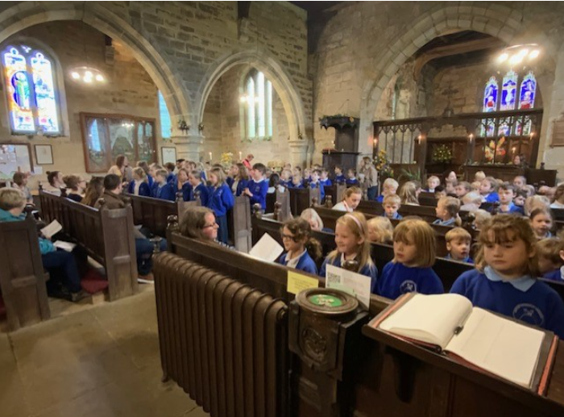
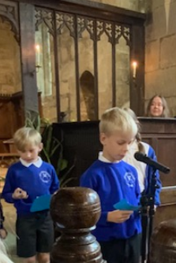
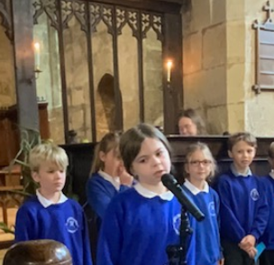
News From School This Week
Harvest Service
It was wonderful to welcome so many parents, carers and friends of the school to join us in our first whole school church event of the academic year. Well done to Holly Class who did a tremendous job in leading our service on the theme of Thankfulness.

Slide 11
News From School This Week
Made in Yorkshire – Craft Festival
We were delighted to be asked to participate in the Made in Yorkshire Craft Festival event.
This will take the form of a collaborative street art installation which will be exhibited in Parliament Street in York from 12-22 October 2023. Miss Walker asked staff to tie this project in with Black History Month and for each class to select an artist to focus on.
The children have been working really hard to create their designs for this cultural event and we’ve included a quick summary on the following slides to show you what they have created and why.
If you would like to visit the event, or find out more about it, please visit their website here: https://madeinyorkshire.org.uk/events/yorkshire-craft-festival-12-22-october-2023/

Slide 12
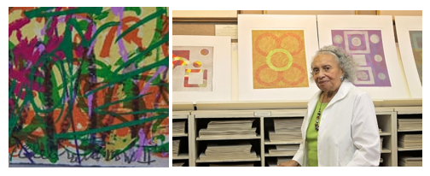
Made in Yorkshire Craft Festival - Apple
We decided to look at Evangeline (EJ) Montgomery. EJ was born on May 2nd 1930 in New York. She was awarded the Women’s Caucus for the Art Lifetime Achievement Award in 1999. She was inspired by nature “It’s nuances and richness of surfaces, textures and brilliant colour whether in plants, water, stone, and incredible variation of life forms”.
She was diagnosed with Parkinson’s Disease which stopped her being able to work with metal so she focussed on printmaking. We felt that her pieces of art were accessible to Apple Class.

Slide 13
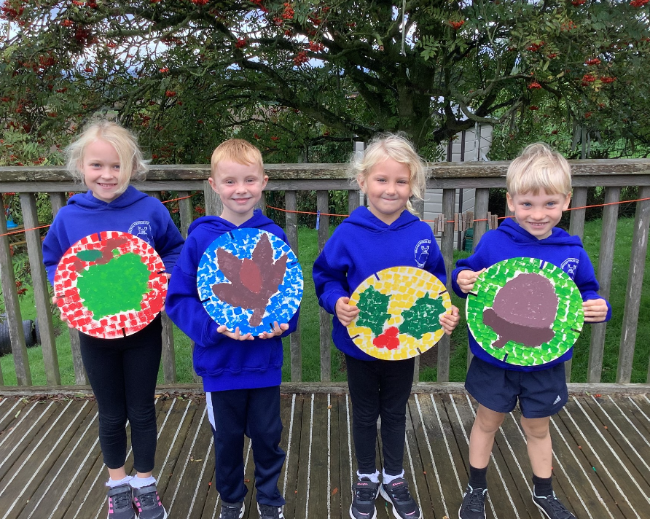
Made in Yorkshire Craft Festival - Beech
To link with black history month, Beech class have chosen the artist Alma Thomas to inspire their discs for the craft festival.
We loved her vibrant colours and printed design.
To show a connection to Crayke school we have designed a disc to symbolise each of our class names and then on the back we are going to create a rainbow swirl similar to one of Alma Thomas's creations.

Slide 14
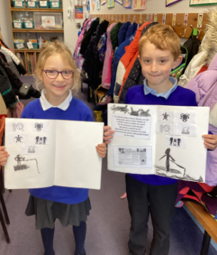
Made in Yorkshire Craft Festival - Holly
In Holly class, we have been inspired by the work of BAME artist, during Black History Month, Kara Walker who creates silhouettes to represent causes she believes in.
The children did a great job of exploring Kara's work and sketching their own silhouettes before we paint environment-based silhouettes on to the art installation.

Slide 15
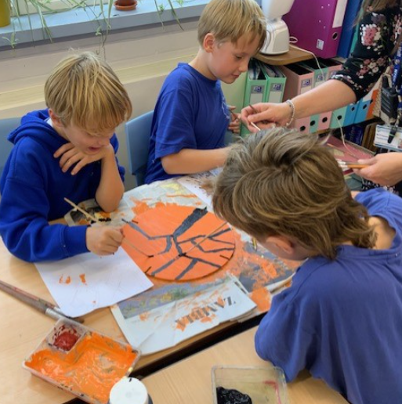
Made in Yorkshire Craft Festival - Oak
Oak Class learnt about the British-Nigerian artist Yinka Shonibare MBE. We watched a video which outlined his background and the difficulties he has faced in his career as a result of both his ethnicity and disability.
Yinka’s work includes photography, dance, sculpture and film - all celebrating many cultures all at once. He strives to represent being a citizen of the world through his work.
Using our discs, we aimed to recreate one of Yinka Shonibare’s pieces entitled Black Gold II.

Slide 16
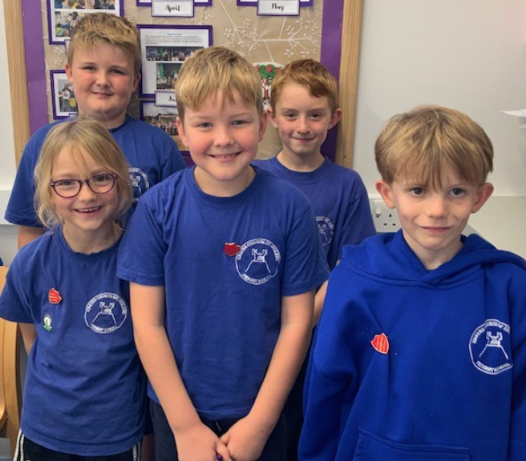
News From School This Week Pupil Voice – Shed and Playtime Equipment
The highlight of my week was, without a doubt, my meeting with our newly appointed Shed Manager and his team of Shed Monitors.
They brought with them a list of things that have been going well since the start of term, including their delight that they had received positive feedback from pupils about the tidiness of the shed.
They also made a request, following pupil feedback, for some new equipment for the shed.
I am delighted with their reliability, enthusiasm and dedication to their important role in our school. Well done team!

Slide 17
Class News- APPLE
Fun Run
A huge well done to our medal winners Ben, Edmund and Wilfred who placed first, second and third respectively! Super running everyone and great cheering for each other. What a way to start the year.
Stay and Play
We would like to give you the opportunity to join us for a “Stay and Play” session from 9am on one of the following dates:
Tuesday 10 October; Tuesday 17 October; Tuesday 24 October
Please contact Mrs Bacon to book your slot.

Slide 18
Class News - BEECH
Fun Run
Year 1/2 built on their success from last year and did absolutely brilliantly in the Fun Run, participating in the first cluster event of the year. Well done to ALL our children and especially to Cameron (GOLD), Isabelle and Alanna (JOINT SILVER), Isla (GOLD), Lucia (SILVER), Honor (BRONZE), Martha (BRONZE), Gem (GOLD) and Reggie (BRONZE) Wow!!
Phonics Drop In Sessions
It was lovely to see parents again in school yesterday. If you have not yet booked your appointment with Mrs Bacon to come into school to see a Year 1 Phonics session from 9am our final date is:
Thursday 12 October

Slide 19
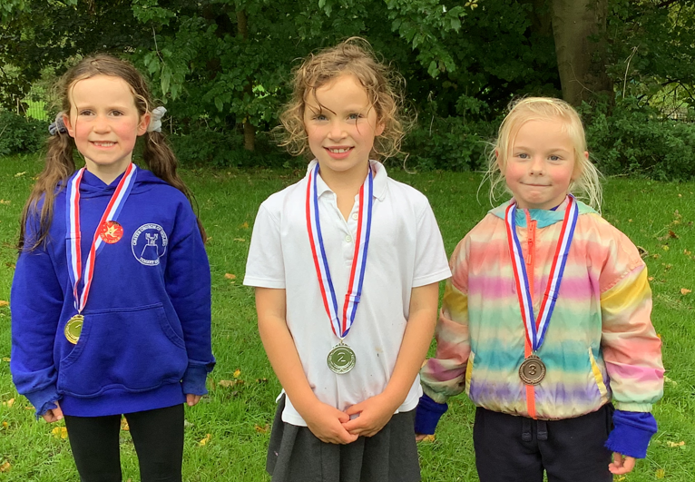
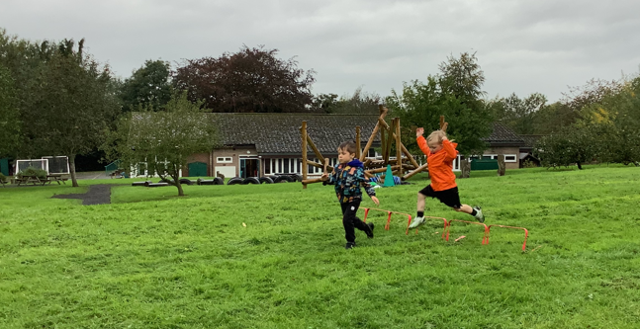
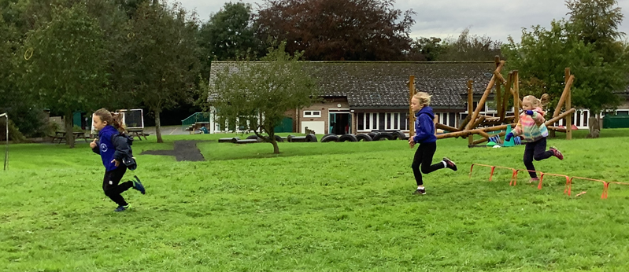
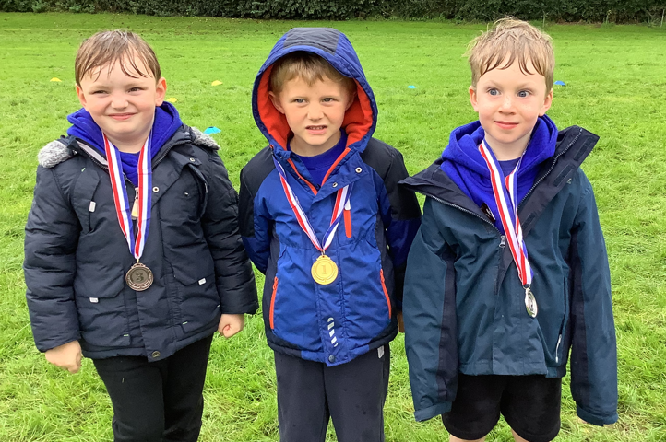
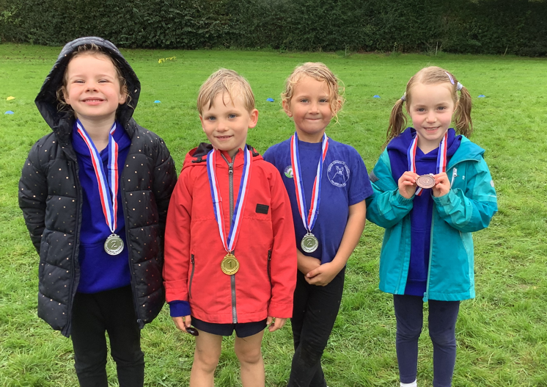
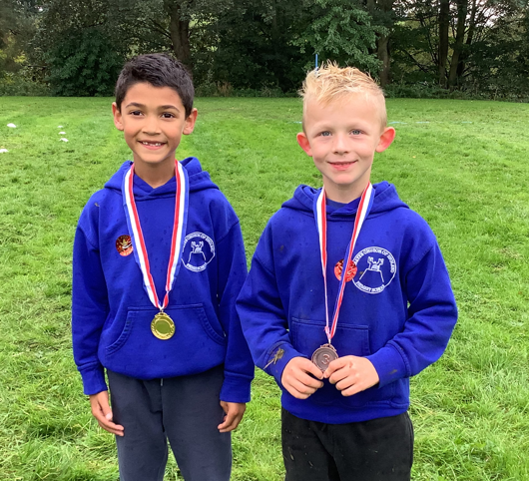
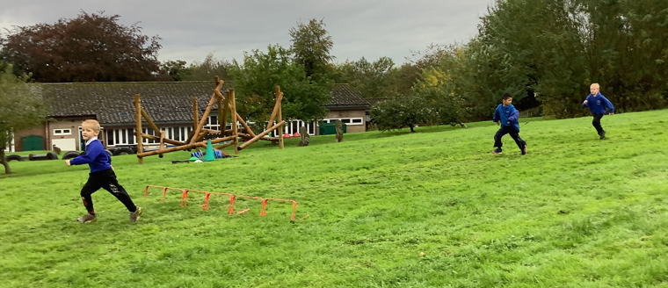
FS/KS1 Fun Run photos

Slide 20
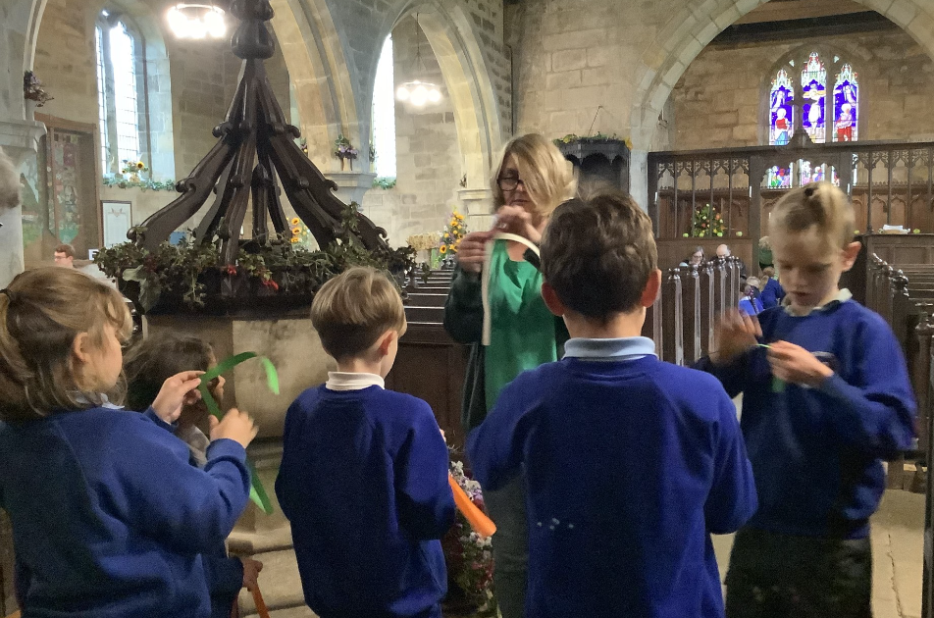
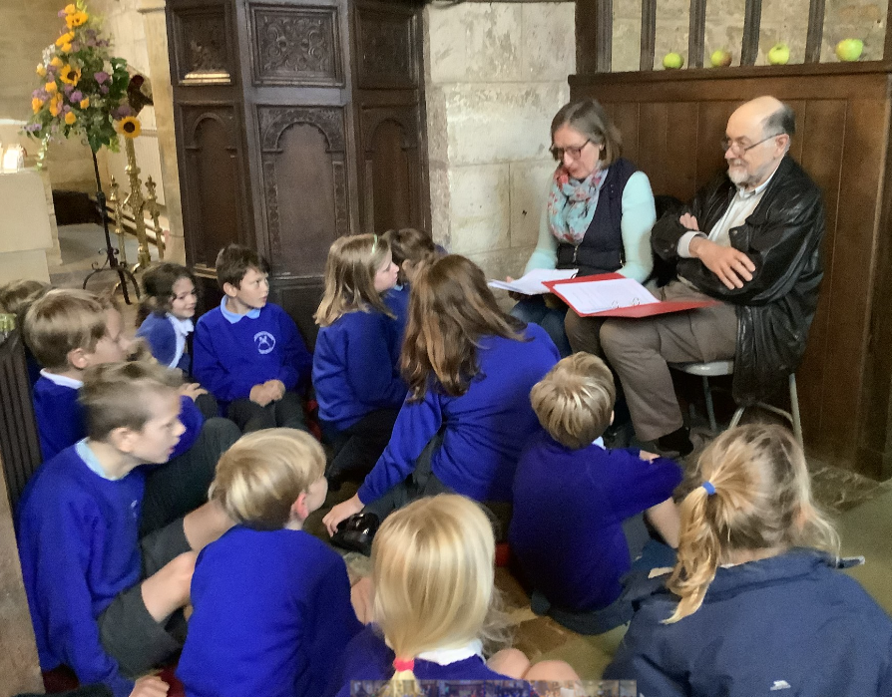
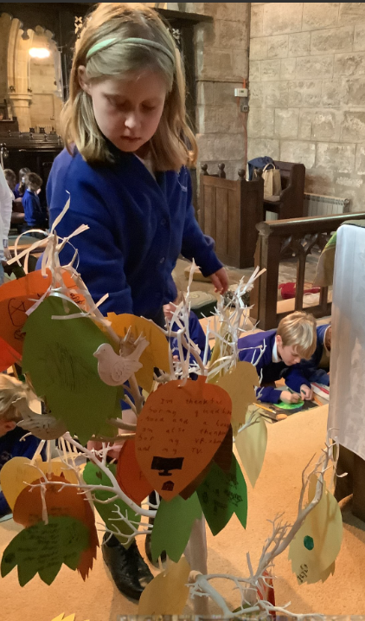
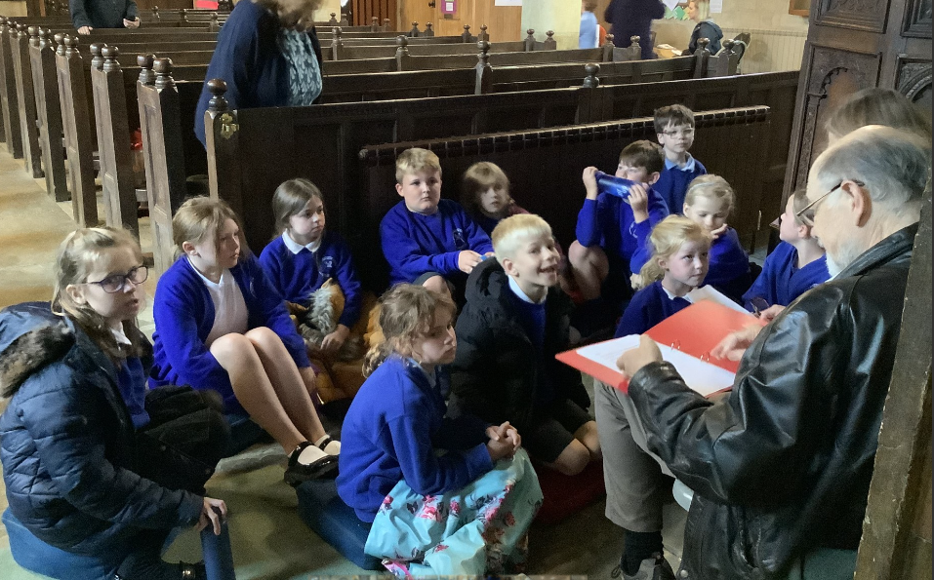
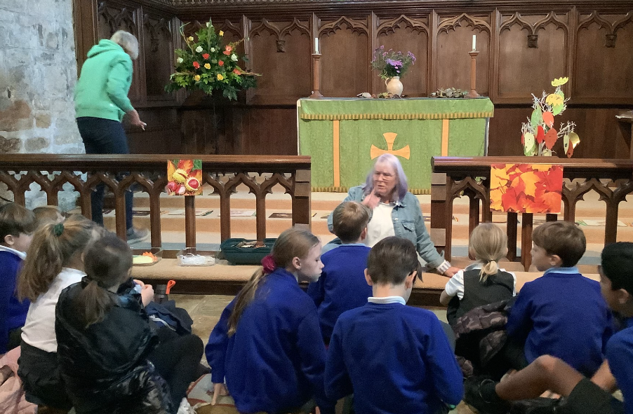
Key Stage 2 Harvest Experience
On Monday afternoon, Holly and Oak Class took part in a Harvest Festival workshop in Crayke Village Church. Run by volunteers, the children heard a bible reading about the 'Feeding of the 5000" before participating in a variety of activities which included everything from making playdough animals to creating leaves decorated with messages of gratitude . We are very grateful to all the volunteers who gave up their time to work with our children who learnt a lot and had a fantastic afternoon.
Mrs Seligman

Slide 21
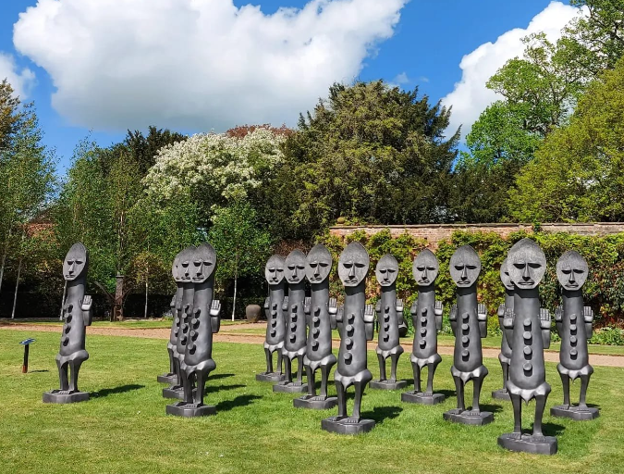
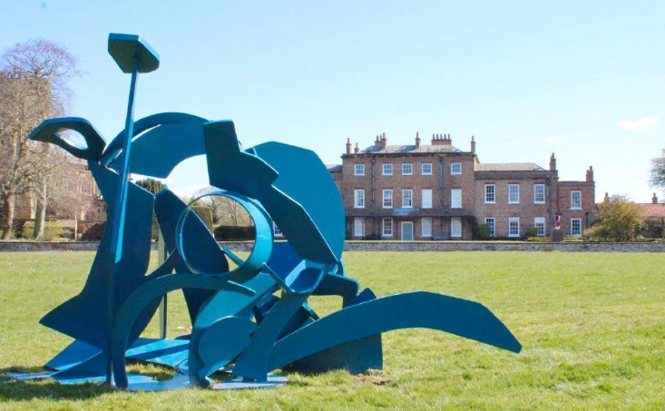
Class News – HOLLY
Thirsk Sculpture Garden Visit – Thursday 12 October
Parents and carers should have now all provided consent for this visit. Please contact us if you require any further information.

Slide 22
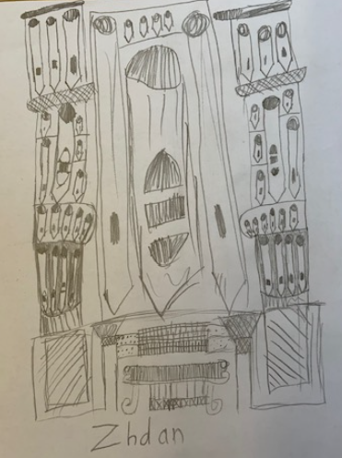
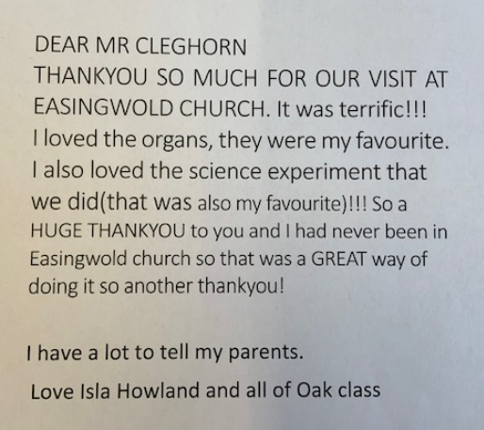
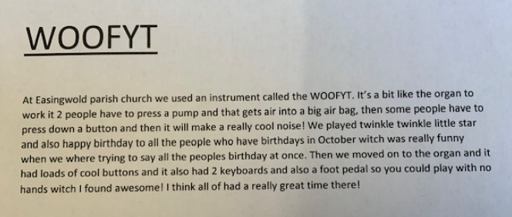
Class News - OAK
Last Friday, Oak class were delightful on our visit to Easingwold Parish Church where they learnt all about different aspects of musical instruments and were treated to the church organ being played just for them! Here’s a summary of the visit from Dylan, alongside a thank you letter from Isla and a beautiful drawing of the organ from Zhdan.
See the next page for some action photos!

Slide 23
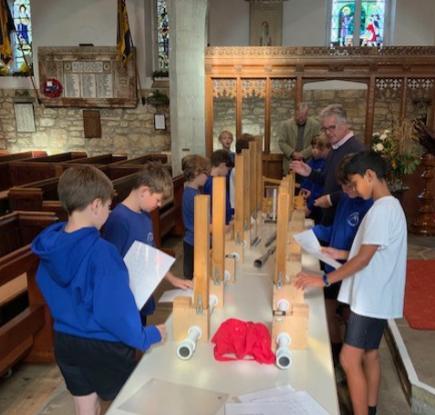
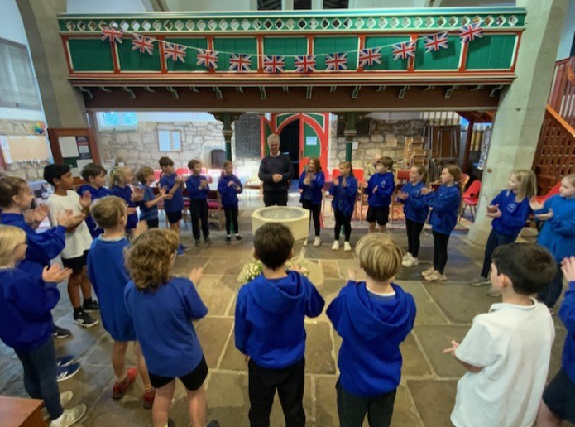
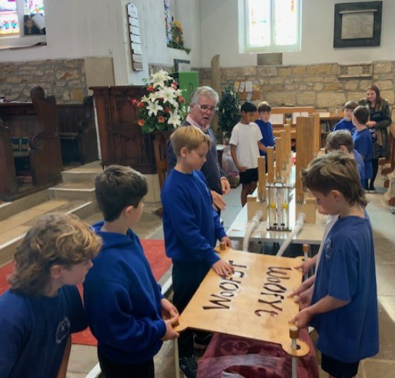
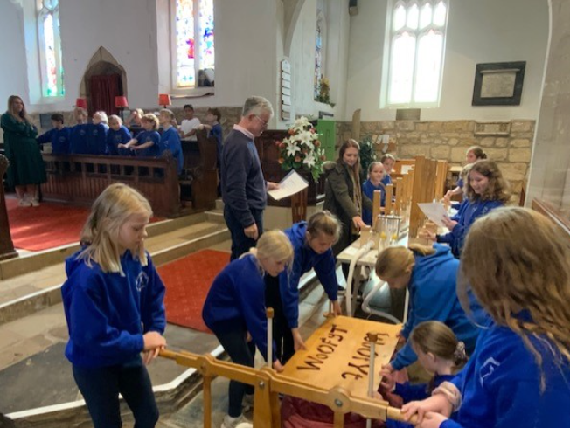
Class News – OAK (cont.)

Slide 24
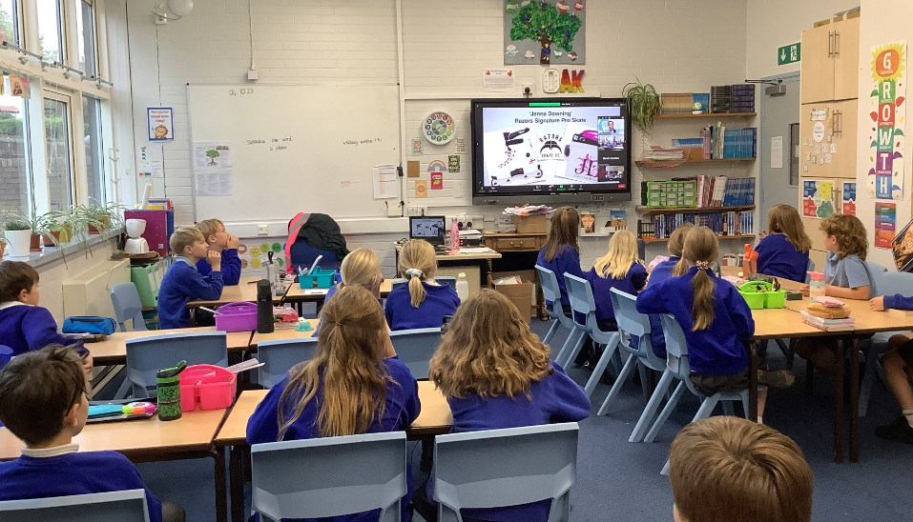
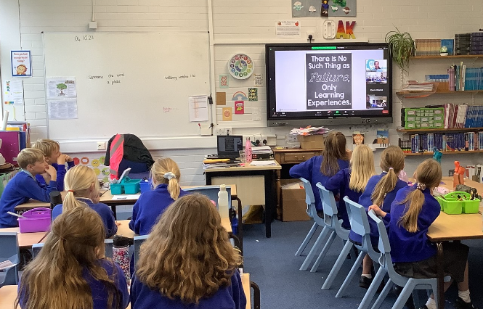
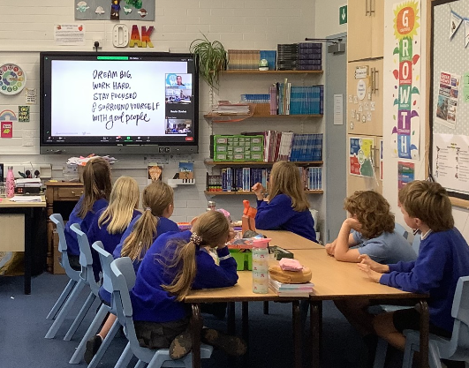
Class News – OAK (cont.)
Oak Class participated in the first of 6 well-being sessions alongside children from other local schools, led by athlete Jenna Downing.

Slide 25
Upcoming events next week – Information for all
It’s another busy week incoming… here’s a summary!
Tuesday: Oak class swimming starts
Tuesday: Power Down Pete assembly and workshops for Apple, Beech and Holly
Wednesday: Water Safety virtual assemblies for all classes
Thursday: Holly class visit to Thirsk Sculpture Garden

Slide 26
Upcoming events later in the half term
You will shortly be receiving further information about how to book your Parent Consultation Evening appointments, for the event happening on Tuesday 24 and Wednesday 25 October. We wanted to give you advance notice that Blue House Bookshop will once again be running a “pop-up bookshop” during the event.
In advance of the appointments, you will be receiving a short written report from your child’s class teacher detailing how they have settled into the new school year and information about their attendance to date. We hope you find this a useful addition to the information you receive about your child’s progress in school.

Slide 27
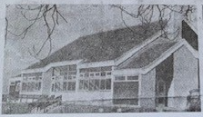
Upcoming events later in the half term
Community Coffee Morning – Save the Date!
To culminate our celebrations marking the 50th anniversary of the school being on this site, we would like to warmly welcome parents and members of the local community to join us for a community coffee morning event, hosted by children in Oak class. This will be held in the school hall on Wednesday 25 October from 9:30am. Further details to follow.

Slide 28
Awards in School This Week
 | Apple | Beech | Holly | Oak
Stars of the Week | Mabel Ankers | Martha Seligman | Joshua Jefferson | Oskar Braidwood
 |  | William Wardle | Elliott Braidwood | Brooke Smith
Gold Awards for Sport | Zeffy Copley | All of Beech Class! | Grant Colman | Ted Clark
Headteacher Awards Random Act of Kindness | Louise Keaney |  | Riley Hunsdale

Slide 29
Team Points
Team | Points
Red | 909
Blue | 1124
Green | 777
Yellow | 1111
Well done BLUE team!

Slide 30
PE Kits next week
Apple: Children in Apple Class need to bring their Forest School kit in each Friday. Please send their PE kit in on Monday as children will change for PE in school. They will bring PE kits home for washing periodically.
Please ensure that on PE days, the children wear their hoodies, school jumpers or cardigans alongside white or blue t-shirts and black or navy shorts or jogging bottoms.
 | Monday | Tuesday | Wednesday | Thursday | Friday
Beech |  |  |  | X | X
Holly |  | X |  |  | X
Oak |  | X - swim |  |  | X

Slide 31
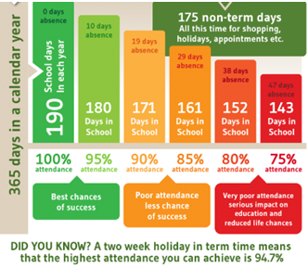
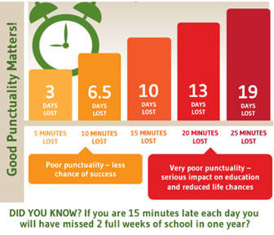
Attendance and Punctuality
This week’s attendance figures: 94.4% School Target: 96%
 | Attendance | Punctuality
Apple | 98.5% | 0 lates
Beech | 98.3% | 2 lates (2 children)
Holly | 94.7% | 1 late
Oak | 87.3% | 0 lates

Slide 32
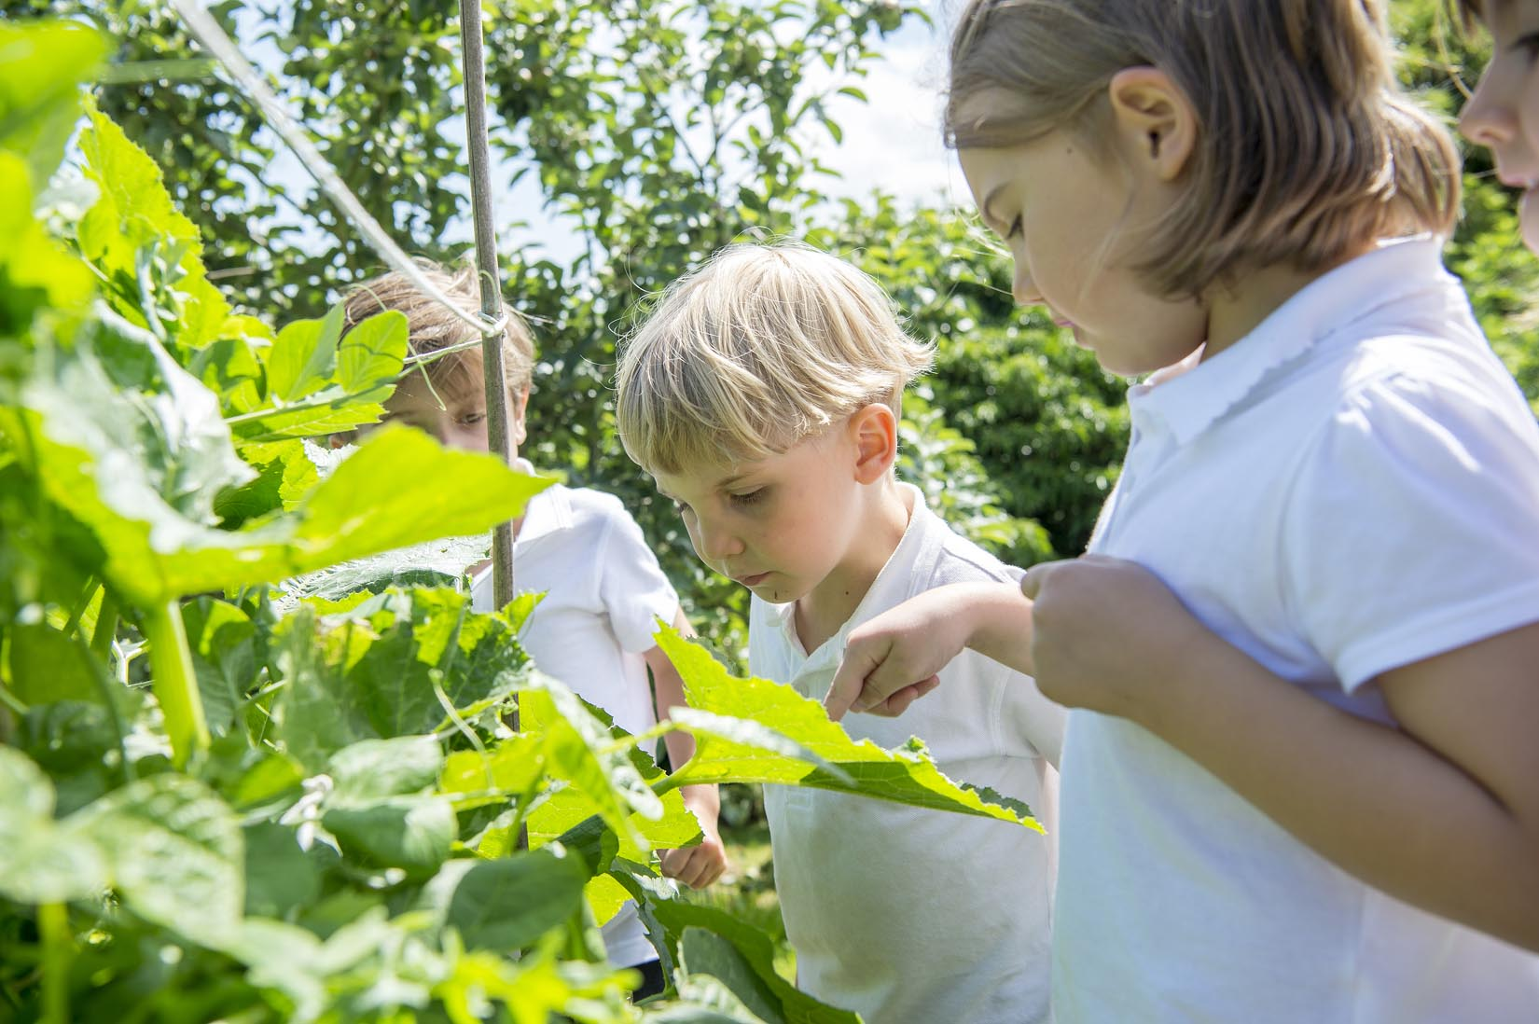
Extra Curricular Clubs - Autumn
Some clubs have limited capacity and places will be allocated on a first come first served basis. In the event of a club being fully booked, your child’s name will be added to a waiting list and you will be advised if a place becomes available. Booking is not required for before school or lunchtime clubs. For after school clubs run by school staff (denoted with *) please email Mrs Bacon on admin@crayke.n-yorks.sch.uk to book a place.
Before School:
After School:
Club | Day and Time | Group
Run a Mile | Monday, Tuesday Thursday & Friday 8:30am | All welcome – parents and carers included!
Day | Club
Monday | Craft* (£10 pay via ParentPay) 3:30 – 4:15pm Years 1 – 6 Mrs Seligman | Coding* 3:30pm – 4:15pm Years 3-6 Mr Brown
Tuesday | Multi-Sports (fee paid direct) 3:30 – 4:30pm Years 1 – 6 Mark Cromack
Wednesday | Junior Duke* (£10 pay via ParentPay) 3:30pm – 4:15pm Year 3/4 Mrs Helfferich | Football Team practice – FINAL one before the tournament 3:30-4:15pm Year 5/6 team Mr Palmer
Thursday | Chess* (no charge) 3:30pm – 4:15pm Year 1 - 6 Mrs Seligman

Slide 33
We were delighted to learn this week that the funds raised from last year’s events have been put to excellent use – an order of 10 laptops and 10 iPads! They will be in school soon and we’re sure that the children will really benefit from them.
We are pleased to be able to contribute to the costs of educational visits and enrichment experiences for children in all classes during the forthcoming academic year.

Slide 34
Please click on the link below to book your tickets for this upcoming event:
https://crayke-home-and-school-association.sumupstore.com/

