Slide 1











NEWSLETTER
AUTUMN 2023

Slide 2






A MESSAGE FROM CHASA
Welcome back to a new school year, we hope you enjoyed the summer holidays. Last year we ended the school year having raised an incredible record breaking £7,500. We are very grateful to all our supporters who attended our fundraisers, made cakes, and/or donated items for our tombolas and raffles, and/or gave their time to help us manage our events. We also received some very generous cash donations last year which helped us achieve this total. With your support we raised enough funds to purchase new IT equipment for the school.
Please see the picture at the end of this newsletter to see how these funds were raised
THANK YOU!

Slide 3
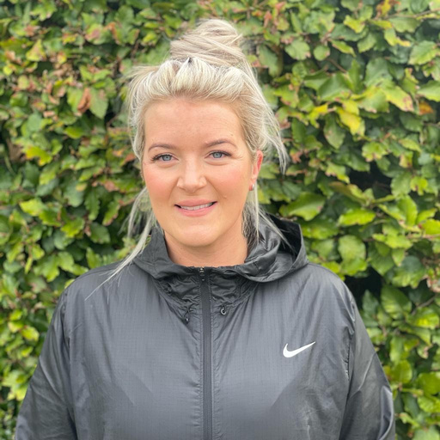
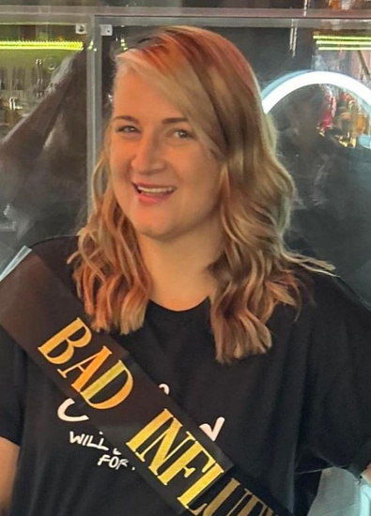
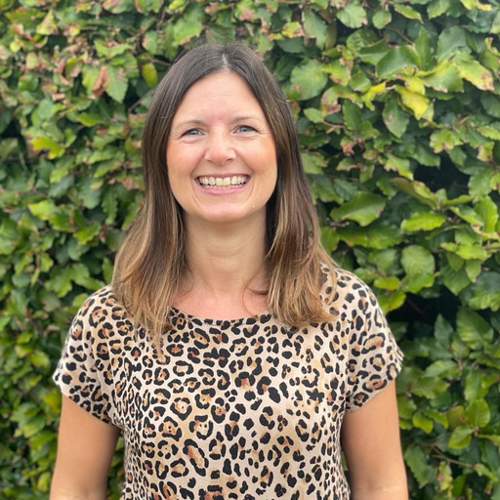

CHASA COMMITEE
CONTACT DETAILS
Victoria
Cain
Jade
Bunker
Tracey
Swiers
Rebecca Stubbins
CHAIR
VICE CHAIR
TREASURER
SECRETARY
chasa@crayke.n-yorks.sch.uk
chasavicechair@crayke.n-yorks.sch.uk
chasatreasurer@crayke.n-yorks.sch.uk
chasasecretary@crayke.n-yorks.sch.uk

Slide 4



This year focus is on supporting the development of
for all children in school.
MUSIC
We would like to support the school in the development of musical expertise within school by enhancing the music curriculum offer and seeking professional musicians to run workshops and demonstrations for the children.
We would like to extend the range of musical resources available for children to use.
We are funding the cost of the coach travel for Oak Class to visit Sheffield Arena for Young Voices!
We are looking to extend the range of instruments available for children to play in school.

Slide 5







Learning music theory and notation enhances mathematical skills in children. Counting beats, understanding rhythm, and recognizing patterns in music contribute to improved mathematical abilities.
Exposing children to various genres of music broadens their cultural knowledge and appreciation of musical styles from around the world.
Musical activities, such as singing, playing instuments and dancing can boost self-confidence and improve self-esteem in children
Music has a positive impact on memory and cognitive development. Learning songs, memorizing lyrics, and understanding musical patterns encourage children to exercise their memory muscles.
Playing and listening to music can help children relax, alleviate stress.
Music helps develop language and communication
skills
MUSIC
Playing and listening to music supports children mental wellbeing
Children learn how to focus when learning music.
Music promotes creativity and imagination. Children often express their emotions and feelings through music, allowing them to explore and develop their own unique ideas.
Studies have shown correlations between music learning and higher test scores in various subjects, such as math, science, and reading.

Slide 6





WE ARE LOOKING FOR NEW MEMBERS!
Over the years we have raised funds to buy many things including books, IT equipment and dining tables for the hall. We also fund books bags for our Reception new starters and hoodies for our Y6 leavers.
With each passing year as Y6 children move onto secondary school, we lose members, and therefore in order to continue organising fun events for the children and their families, we need new members to join us. Please look out for our meeting dates that we will publicise in the school newsletter.
If you are unable to attend meetings but have fundraising suggestions, or can help us at our main events (such as the disco and Summer Fayres) please do let us know. We cannot arrange these events without your help.
CHASA is a group of busy parents and friends of the school who arrange fundraising events (such as fayres, quiz nights, raffles, ice cream Fridays, and discos) throughout the year to generate extra funds to buy resources to benefit the children at Crayke CE Primary School.
CONTACT BECKY STUBBINS ON CHASASECRETARY@CRAYKE.N-YORKS.SCH.UK IF YOU WOULD LIKE TO HELP

Slide 7





CURRENT FUNDRAISING
TUCK SHOP
PRE-LOVED UNIFORM
This early in the term we have yet to organise any fundraising events, however, we have begun our weekly tuck shop after school each Friday. Thank you for supporting us, the children love it and we have raised £100,70 so far!
We have a stock of pre-loved uniform. We love the concept of recycling to do our bit to save the planet; it saves you money and raises money for the school.
If you require any items please contact us. If you have any good quality uniform items that your child has outgrown, please consider donating to our stock (via the school office). We will have a stall available for you to peruse during Parent Consultation Evenings.

Slide 8




HELP US RAISE FUNDS FOR FREE!
Sign up to https://www.easyfundraising.org.uk/causes/craykeceschoolcrayke/ and make Crayke CE School your chosen charity and they will donate a small percentage of your purchase cost to us (at no cost to you).
Just use the app or website every time you shop online.
Hundreds of retailers have signed up including Amazon, Argos, Next, Ebay, John Lewis, M&S, Just Eat, TUI, Trainline and many, many more...
They also give a lump sum to us if accessed to compare and change insurance or utility providers.

Slide 9





Pre- loved Uniform Sale -
Tuesday 24th and Wednesday 25th of October 2023
Bonfire Night Stall @ Crayke Sports Hall-
Sunday 5th November 2023
CHASA Committee Meeting-
early November tbc.
DATES FOR
THE DIARY
Non-uniform Day for Hamper Donations-
Thursday 9th of November 2023
Chocolate Tombola @ Outwood Christmas Fair
Friday 1st of December 5-7pm
Crayke School Stall @ Galtres Christmas Market
Saturday 2nd of Decebmer 2023 9am-2pm

Slide 10




Get ready for the official launch of the
CRAYKE SCHOOL LOTTERY!
HOW IT WORKS:
Tickets cost £1 per week.
If 100 parents/carers/family members per week sign up, we can raise £2080 for the school per year… just like that!
Tickets are drawn weekly on a Saturday, each weekly prize is 30% of the ticket sales (so £30 if we sell 100).
You will also get added to the draw to win £25000 jackpot.
You really do have to be in it to win it.
Please sign up using the attached link. There is also a “refer a friend” link that you can use to invite your friends/family members, and you will be added into a separate draw where you can win up to £200!
If you have any further questions or would like a true breakdown of funds raised, please contact Jade Bunker or email chasavicechair@crayke.n-yorks.sch.uk
YOUR SCHOOL LOTTERY IS NOW LIVE!
TO PURCHASE TICKETS.

Slide 11


FUNDRAISING oct 22-23
Bonfire Night:
£532.98
Pop up cafe:
£266
Quiz night
£804.15
Raffles:
£220.00
Summer fair
£2738.85
Clothes/ uniform resale:
£179.18
Cinema night:
£354.50
Ice cream fridays:
£87.50
Tuck shop:
£422.96
Digital Grants: £800
Crayke market stall:
£152
Christmas cards:
£79
Sports day: £160.60
Break the rules day:
£174.10
EasyFundraising:
£160.38
Alne Fair:
£275
Amazon Smile: £108.24
Tesco blue coin grant: £500
Candle sales:
£221
For a more detailed insight, please contact chasatreasurer@crayke.n-yorks.sch.uk

Slide 12






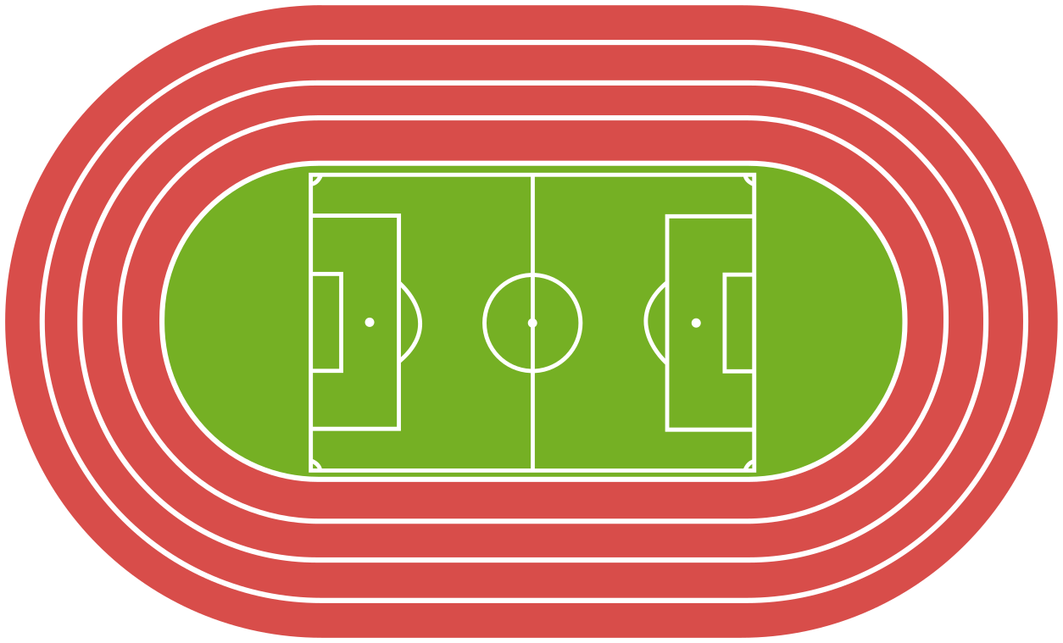

how our children benefited?
Panto:
£845
Maths resources:
£504.06
Reception bookbags:
£75
Coach hire:
£405
Dining tables:
£500
School shed:
£450
Ipads and Laptops:
£7000
Coding club:
£300
Reading diaries:
£725
Running track:
£500
Leavers hoodies:
£252

Slide 13





WITH YOUR HELP WE HAVE RAISED FOR THE SCHOOL:
£8,282.23
*Total Amount raised from October 2022-October 2023

