Slide 1
Crayke Chronicle
Issue: #9 Term: Autumn Date: 10 November 2023
FOLLOW YOUR PATHWAY AND WE GROW TOGETHER WITH CONFIDENCE
You did not choose me, I chose you that you might go and bear fruit, fruit that will last so that whatever you ask in my name the Father will give you. John 15:16
Respect Friendship Forgiveness Determination

Slide 2
In our newsletter this week…
…Find out what the children have been learning by looking at our Gallery
…News from school this week including a Learning Hub progress update, music demo workshop, village magazine competition news and staffing and attendance updates.
…Check the class pages for any information relevant to each individual class and further news about learning and achievements this week
…Find out about upcoming events next week.
Our regular items then follow:
…Awards in school
…Team Points
…PE Kits next week
…Attendance and Punctuality
…Extra curricular clubs
…CHASA news

Slide 3
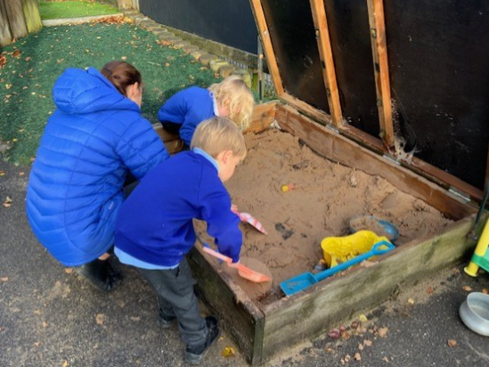
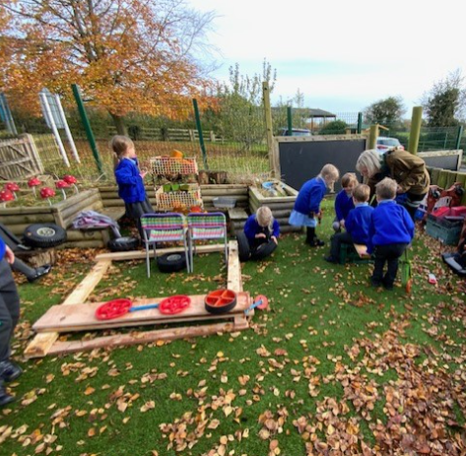
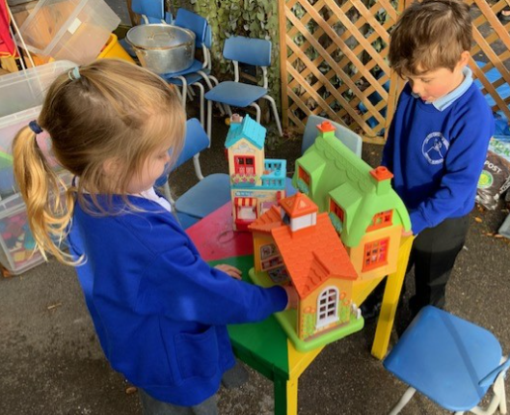
Gallery
A snapshot of learning from across the week… please use these photographs as an opportunity to talk to your children about what they have been learning!
Apple – Outdoor Provision

Slide 4
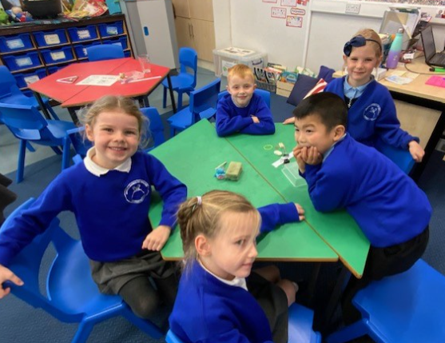
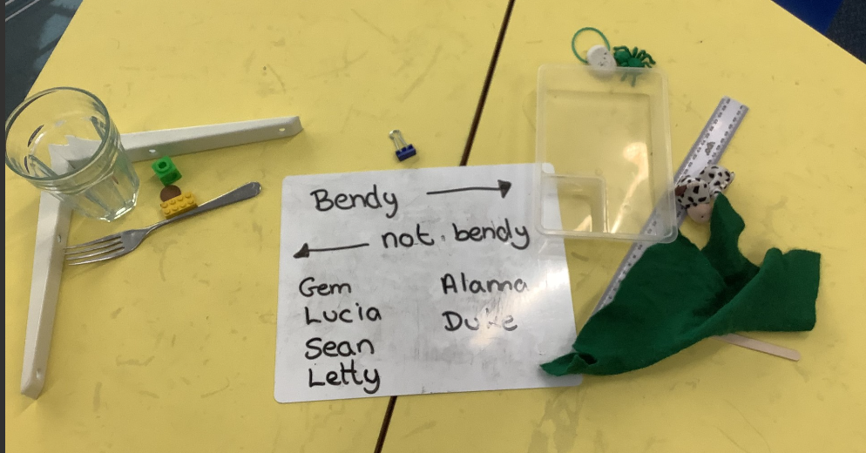
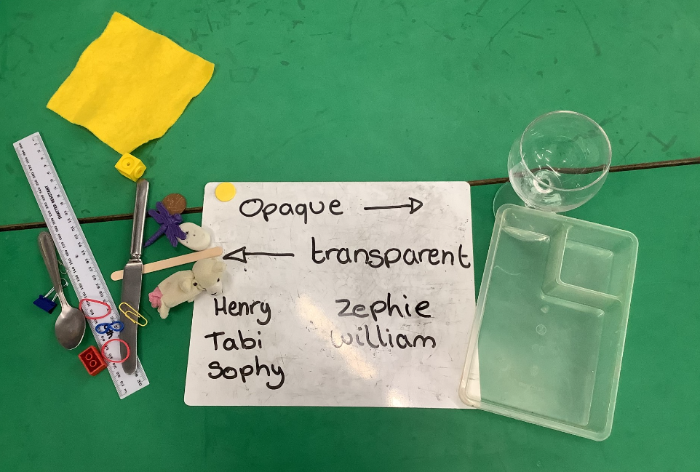
Beech - Science

Slide 5
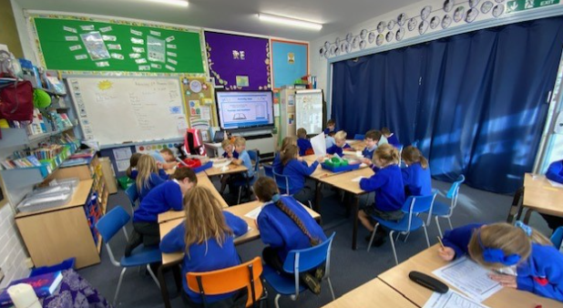
Holly – PSHE

Slide 6
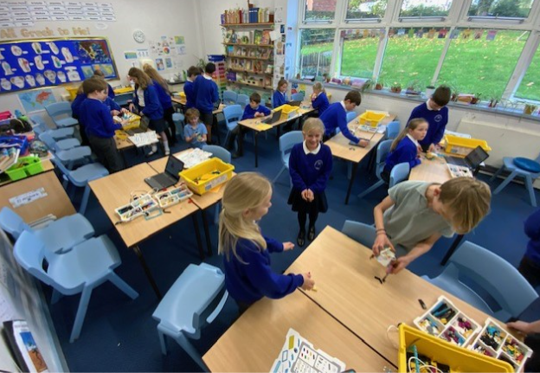
Oak – Coding/STEM workshop

Slide 7
News from school this week – Learning Hub
The transformation from cloakroom to Hub is really quite astonishing to see! We now have a space for children to learn at the far end of school which has been purposefully created with them in mind. With a fresh lick of paint and a fancy new sliding partition, we are absolutely thrilled with the outcome. It’s almost complete but it’s a good time to extend some gratitude to:
Mrs Rayner, for coming up with the original idea and sorting many of the games and books and tidying up during the half term break
Mrs Rayner’s mum for coming in during the holidays to help organise and sort resources
Mr Porter for undertaking the renovation and redecoration
Sir Bob Murray for donating funds to school to enable the works to be completed
Photos to follow soon!

Slide 8
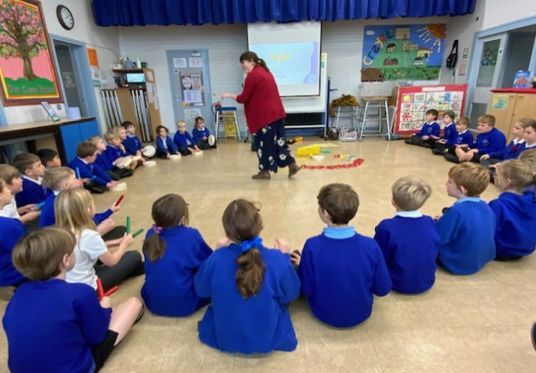
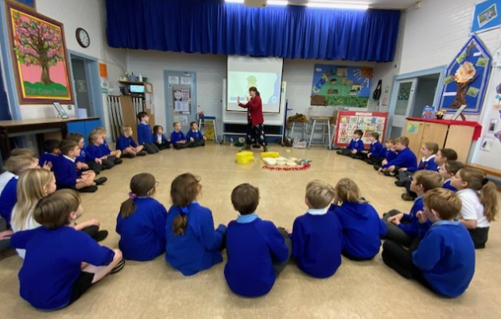
News from school this week – Music demo
It was absolutely fabulous to welcome Miss Brier and the team from the Richard Shepherd Music Foundation into school this week for a demo session, which they did with Holly Class.
The children were brilliantly engaged throughout the session and had the opportunity to play different instruments and work collaboratively. Thank you to the governors and CHASA members who joined us – we know how much you enjoyed it from the smiles on your faces and your toe tapping along to the music!

Slide 9
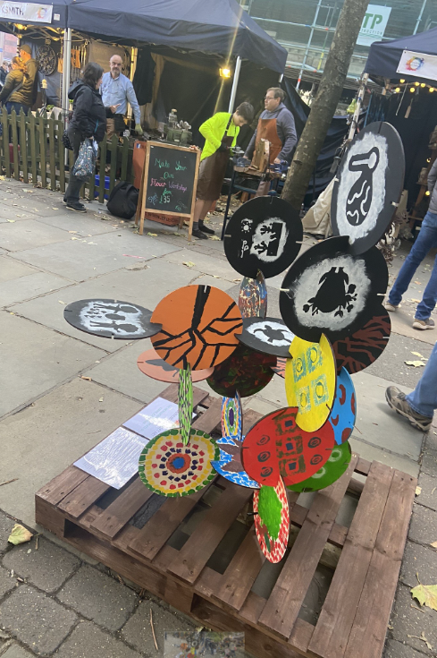
News from school this week – Craft Festival
We thought you would like this image from the Made in Yorkshire Craft Festival last month.
The entries from each class were combined to create this installation which was on display in Parliament Street and looks absolutely brilliant!
You’ll remember that this artwork reflected our focus on Black History month, specifically learning about the artists EJ Montgomery, Alma Thomas, Kara Walker and Yinka Shonibare.

Slide 10
News from school this week – Open the Book
It’s always lovely to welcome our Open the Book friends into school to lead Collective Worship, which they do fortnightly on a Thursday.
They do a wonderful job of getting the children involved in the stories and share important messages too.
This week, the focus included helping out others even if they are not close friends.

Slide 11
News from school this week – Rainbow Day!
The children looked spectacular in their rainbow outfits yesterday. Thank you for all the donations you kindly provided for the Christmas hampers – there were some brilliant and different contributions which will all combine to make wonderful raffle prizes.

Slide 12
News from school this week – Staffing Update
We are thrilled to inform you that we have successfully appointed a Learning Mentor, Mrs Gears, who will be starting with us on Monday 27 November. Mrs Gears will be working across all classes and supporting children of all ages in a variety of ways. You will also see her on the gate each morning. We know that she will be a valuable addition to our team and can’t wait for her to start!
We are also looking forward to welcoming three undergraduate students from York St John University, Miss Phelan, Miss McGuinness and Miss Lavelle, who will be joining us for blocks of time across the next academic year starting with a week in school next week. They will be predominantly working in Oak Class.

Slide 13
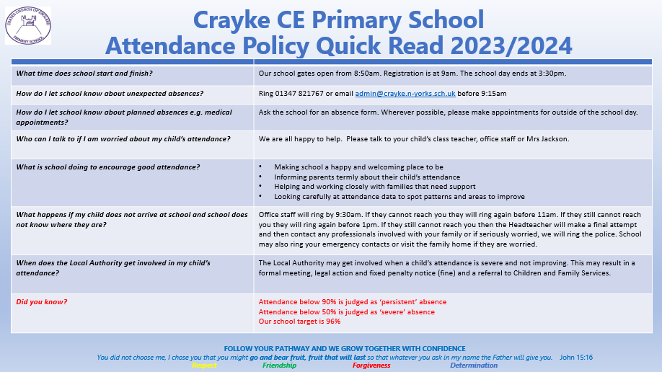
News from school this week - Attendance

Slide 14
News from school this week – competition winner!
We are always delighted to be asked to create artwork for the local magazine and we are grateful that the team are kind enough to donate a prize for the winning entry as well as sweets for the participating class. This time it was Oak’s turn and I am thrilled to announce that Brooke’s design will be on the front cover of the December/January edition. Well done Brooke!

Slide 15
News from school this week – Open Morning
We were delighted to welcome prospective families into school earlier this week for a tour of the building and grounds, as well as an opportunity to talk to pupils, staff and current parents. Our Year 6 pupils were excellent ambassadors for the school. They demonstrated superb manners and confidence when discussing what it is like to be a pupil at Crayke and made me very proud.
An enormous thank you to Victoria Cain and Jade Bunker who joined us for the morning to give prospective families a flavour of what it’s like to be a parent at Crayke.
As this event was fully booked, we have decided to run a second Open Morning on Friday 24 November. Please see slide 23 for further details and contact Mrs Bacon to make an appointment.

Slide 16
News from school this week – consent forms
Children in Years 1-6 should have brought home forms earlier this week containing a variety of information for you to sign and return to school including our Home School Agreement, Data collection form and local visit consent.
If you did not receive this, please contact Mrs Bacon.
Please return your pack of completed forms as soon as possible and no later than 17 November 2023
Please note that parents of children in Reception have already received and signed the relevant documentation before they started in September.

Slide 17
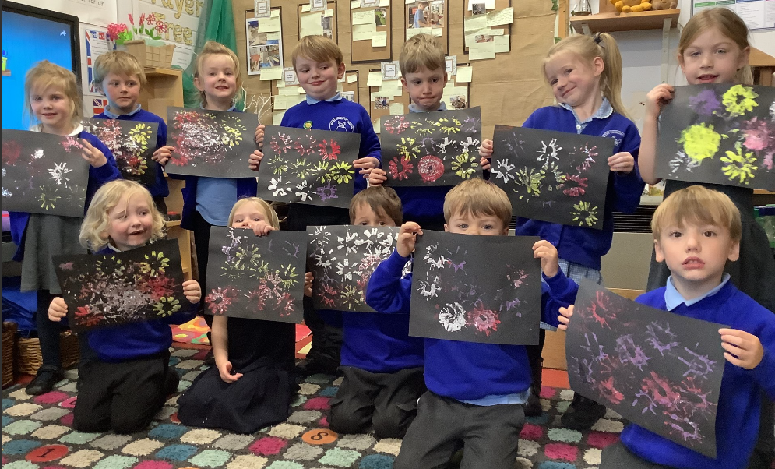
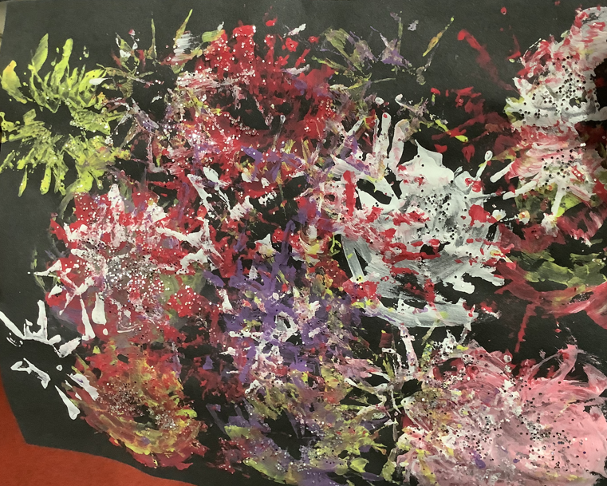
Class News- APPLE
Apple Class created some amazing firework paintings.
This week we also enjoyed creating a caravan outside using the wood, tyres and crates.

Slide 18
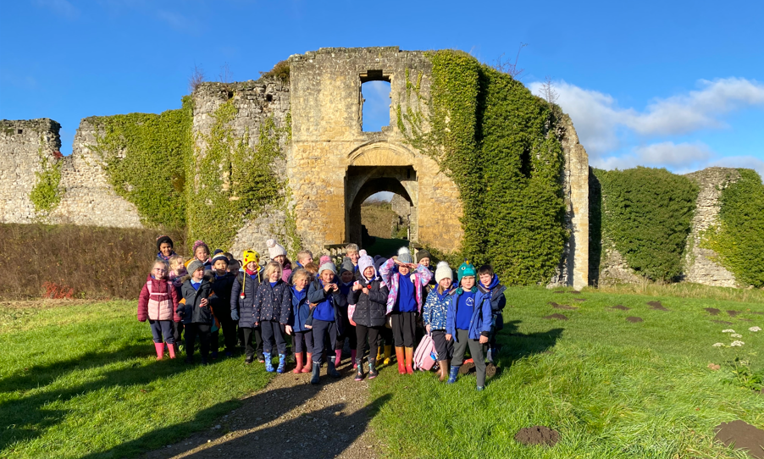
Class News - BEECH
Beech Class have arrived safely in Helmsley and are reportedly having a wonderful time on their visit to the Castle today! More photos to follow next week…

Slide 19
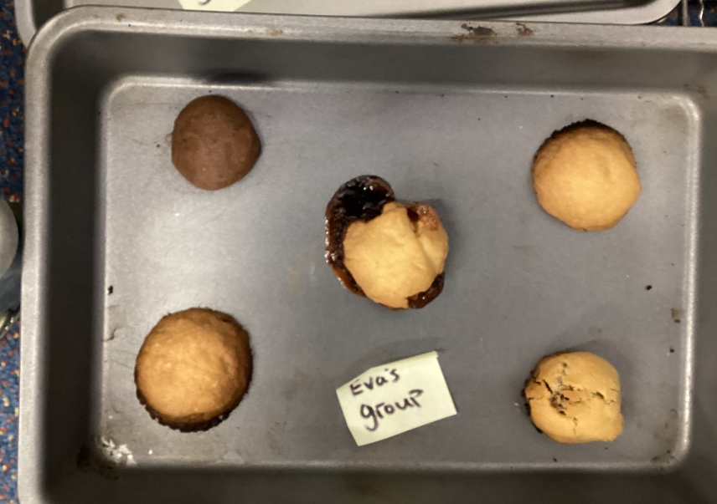
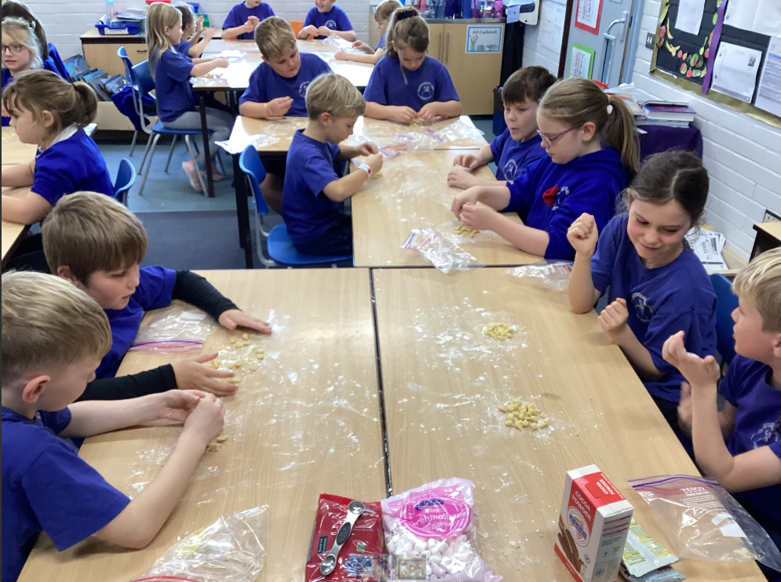
Class News – HOLLY
Design Technology
Holly class loved the opportunity this week to trial a range of ingredients for making and tasting cookies. It’s a tough job but someone has to do it!

Slide 20
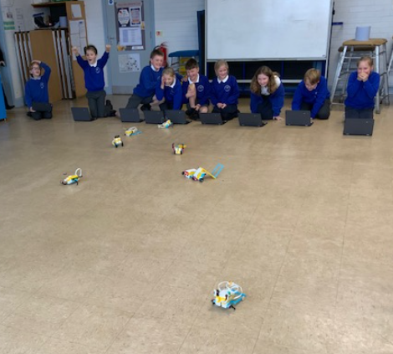
Class News - OAK
G-Tech STEM Workshop
Levels of excitement and engagement were at an all time high in Oak class on Wednesday afternoon when they were tasked with building a robot ready for a race, controlled by a coding sequence created by the children. This photo sums up their emotions perfectly!

Slide 21
Upcoming Events – next week
Anti Bullying Week – Let’s Make a Noise about Bullying
Next week, we will be focussing on anti-bullying. Children are invited to wear odd socks throughout the week if they wish to.
We are fortunate that the Di Walker Foundation has kindly agreed to fund workshop opportunities for Beech, Holly and Oak classes on Monday afternoon to make a music video to make a stand against bullying.
Children will explore what bullying means, how it presents itself and our own role in it. Discussing the importance of supporting others when they are excluded or treated unfairly and empowering children to do something positive to counter the harm and hurt that bullying causes. The film will then be edited for the school to watch back and enjoy. It’s cool to be kind!

Slide 22
Upcoming Events
Friday 17 November - Children in Need and Quidditch Day!
Next Friday is Children in Need day. Mrs Helfferich has also arranged a very special event to take place on the same day – a Quidditch workshop for all classes! Therefore, if children would like to wear non-uniform or Harry Potter themed outfits, they are very welcome to do so. Please be aware that they will be taking part in outdoor sporting activities so clothing and footwear should be suitable for this. We request a donation made via Parent Pay, which can be made by clicking the following link: https://app.parentpay.com/ParentPayShop/Foc/Default.aspx?shopid=11593

Slide 23
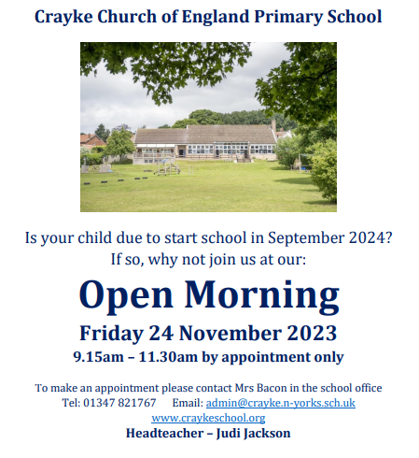
Upcoming Events – Open Morning

Slide 24
Awards in School This Week
 | Apple | Beech | Holly | Oak
Stars of the Week | Dianta Simpson | Constance Cater | Wilfred Liddell | Beatrice Ritchie
 |  | Duke Gains | Carl Keaney | Isaac Copley
Gold Awards for Sport | Ava Carvalho | Reggie Jagger | Olive Beeson | Zhdan Kovalchuk
Headteacher Awards Random Act of Kindness | Wilfred Ferreday |  | Leonard Liddell
Cloakroom Ninja tidiest cloakroom trophy | APPLE CLASS – Well done!

Slide 25
Team Points
Team | Points
Red | 711
Blue | 602
Green | 692
Yellow | 628
Well done RED team!

Slide 26
PE Kits w/c 13 November 2023
Apple: Children in Apple Class need to bring their Forest School kit in each Friday. Please send their PE kit in on Monday as children will change for PE in school. They will bring PE kits home for washing periodically.
Please ensure that on PE days, the children wear their hoodies, school jumpers or cardigans alongside white or blue t-shirts and black or navy shorts or jogging bottoms.
 | Monday | Tuesday | Wednesday | Thursday | Friday
Beech |  |  |  | X | Children in Need/Harry Potter theme - PE kit needed
Holly |  | X
Oak |  | X - swim

Slide 27
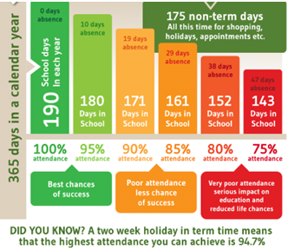
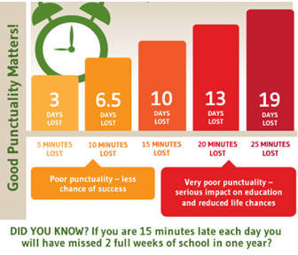
Attendance and Punctuality
This week’s attendance figures: 95.1% School Target: 96%
 | Attendance | Punctuality
Apple | 98.5%
Beech | 95.9% | 1 late
Holly | 93.8% | 2 lates (2 children)
Oak | 94.2%

Slide 28
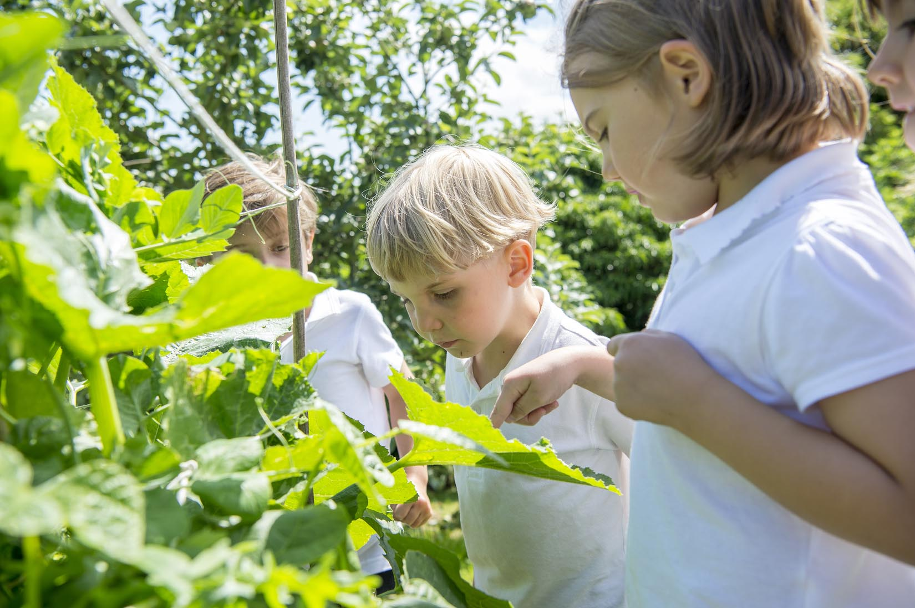
Extra Curricular Clubs - Autumn
Some clubs have limited capacity and places will be allocated on a first come first served basis. In the event of a club being fully booked, your child’s name will be added to a waiting list and you will be advised if a place becomes available. Booking is not required for before school or lunchtime clubs. For after school clubs run by school staff (denoted with *) please email Mrs Bacon on admin@crayke.n-yorks.sch.uk to book a place.
Before School:
After School:
Club | Day and Time | Group
Run a Mile | Monday, Tuesday Thursday & Friday 8:30am | All welcome – parents and carers included!
Day | Club
Monday | Craft* (£10 pay via ParentPay) 3:30 – 4:15pm Years 1 – 6 Mrs Seligman | Coding* 3:30pm – 4:15pm Years 3-6 Mr Brown
Tuesday | Multi-Sports (fee paid direct) 3:30 – 4:30pm Years 1 – 6 Mark Cromack
Wednesday | Junior Duke* (£10 pay via ParentPay) 3:30pm – 4:15pm Year 3/4 Mrs Helfferich
Thursday | Chess* (no charge) 3:30pm – 4:15pm Year 1 - 6 Mrs Seligman
NB: Clubs will not run during the last week of term so the last sessions will be during w/c 11 December 2023.
Further information will follow about the arrangements for booking clubs in the Spring Term in due course.
No Chess club on 30 November due to Christmas craft afternoon

Slide 29
The CHASA Bonfire Night stall, selling glowsticks and doughnuts, raised a phenomenal £505.52!
A massive thank you to all who helped!

Slide 30
