Slide 1
Crayke Chronicle
Issue: #10 Term: Autumn Date: 17 November 2023
FOLLOW YOUR PATHWAY AND WE GROW TOGETHER WITH CONFIDENCE
You did not choose me, I chose you that you might go and bear fruit, fruit that will last so that whatever you ask in my name the Father will give you. John 15:16
Respect Friendship Forgiveness Determination

Slide 2
In our newsletter this week…
…News from school this week including Children in Need news, a donation to Chess club and more .
…Check the class pages for any information relevant to each individual class and further news about learning and achievements this week
…Find out about upcoming events next week.
Our regular items then follow:
…Awards in school
…Team Points
…PE Kits next week
…Attendance and Punctuality
…Extra curricular clubs
…CHASA news
Please see attached documents too – CHASA poster regarding the upcoming Christmas craft activity session, online safety guide and parent guide from the anti-bullying alliance.

Slide 3
News from school this week
We were delighted to present certificates to almost 25% of our children for the Summer Reading Challenge – well done to all!
This week, children have developed their understanding of anti-bullying – see parent information pack attached.
Year 6 enjoyed the opportunity to attend Crucial Crew and learn about different aspects of safety. A group also spent a day developing their cycling proficiency during our Bikeability workshop.
Today they all look wonderful in their non-uniform and they are currently enjoying Quidditch workshops and anti-bullying workshops. There’s never a dull moment!

Slide 4
Children in Need
To support the work of this very important and worthwhile charity, we request a donation made via Parent Pay, which can be made by clicking the following link: https://app.parentpay.com/ParentPayShop/Foc/Default.aspx?shopid=11593
Please note that we are unable to accept donations in cash.
Thank you

Slide 5
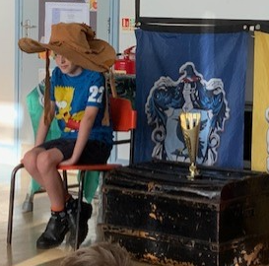
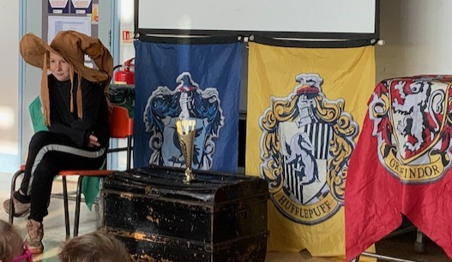
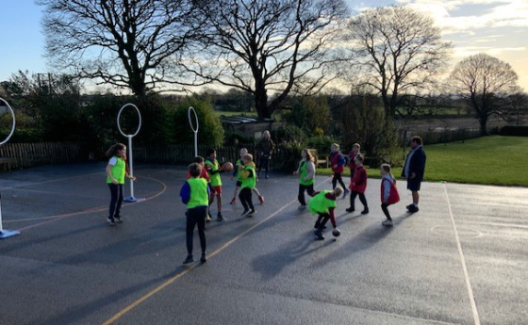
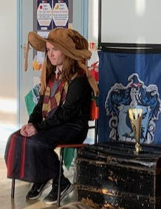
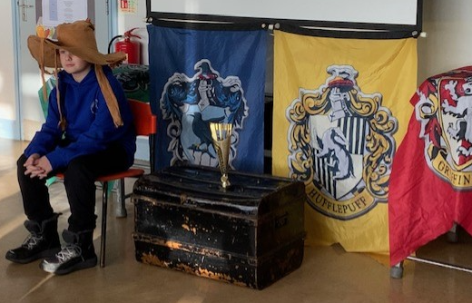
Quidditch
There was a definite sense of awe and wonder on the playground this morning when the children arrived and saw the Quidditch equipment ready for them. In fact it was like Christmas morning when Carl delightedly asked “Is this really for us?” We then had a special assembly where the team captains were chosen during a Sorting Hat activity with all the children. We look forward to finding out who the winning team is!

Slide 6
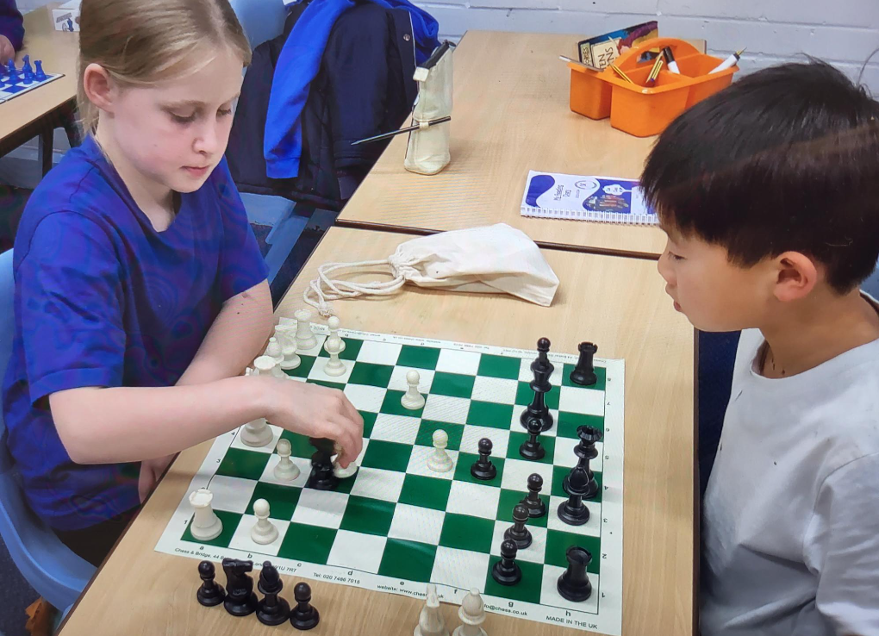
News from school this week
We are thrilled to have been given 6 new chess sets by Chess in Schools and Communities, a charity which promotes chess in schools and inner city communities. The children were so excited and they were all put to good use by the chess club with some fierce competition between the children.
Mrs Seligman

Slide 7
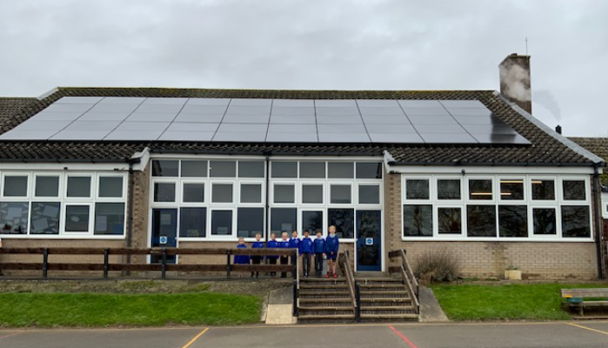
News from school this week
We are really grateful to have received another donation of £500 towards the cost of the solar panels, this time from Nestle. Thank you to Mr Unsworth for organising this behind the scenes with the Nestle team!

Slide 8
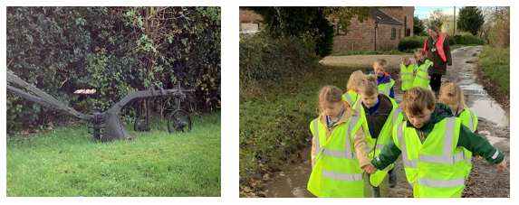
Class News- APPLE
Apple Class braved the wet and muddy conditions to take part in their ‘Fabulous Farming’ walk around the outskirts of Crayke. We looked at the crops growing in the fields and noticed that in some areas the crops weren’t growing very well, we talked about why. We were apparently a week too early to see the piglets, so we have arranged to see these once they have been born. We saw an old plough and later on saw a few ploughed fields, we talked about how much easier it would be to use a tractor rather than a horse and plough. All of the children said how much they had enjoyed the walk and they are looking forward to taking their family on the same walk to show them what we had seen. As always Apple Class, you represented the school to perfection whilst you were out and about.
Mrs Helfferich

Slide 9
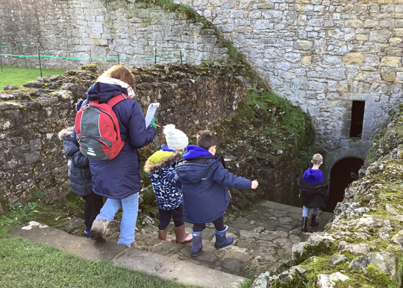
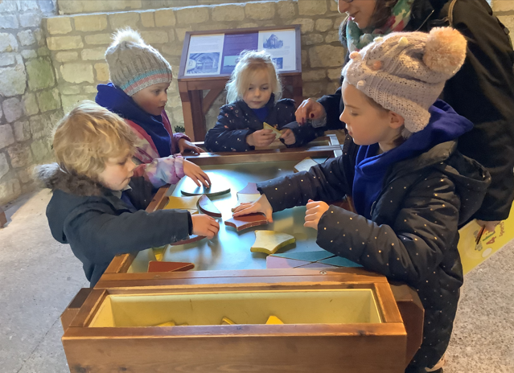
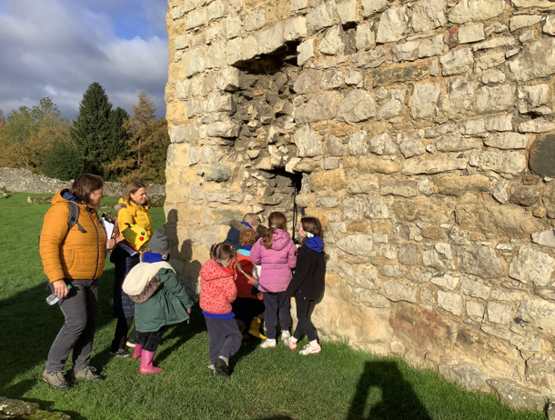
Class News - BEECH
Visit to Helmsley Castle
Thank you to our helpers – Mr Porter, Mrs Hayes, Mrs Lunn and Mrs Keaney!

Slide 10
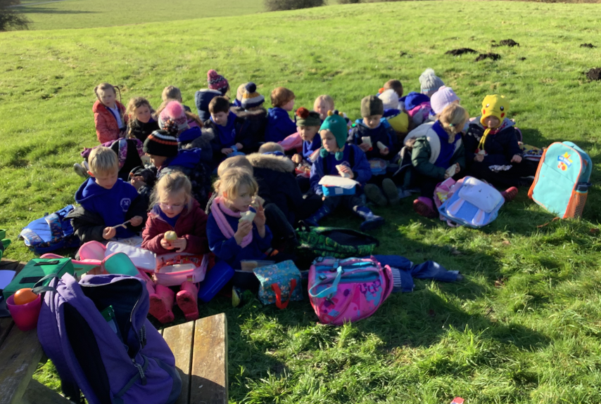
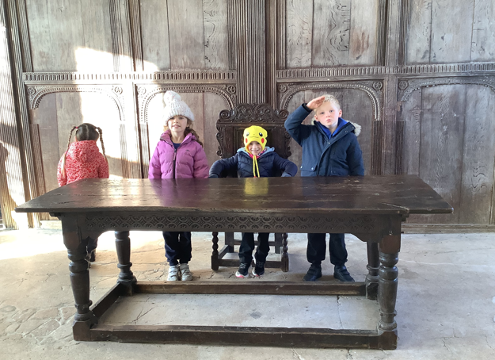
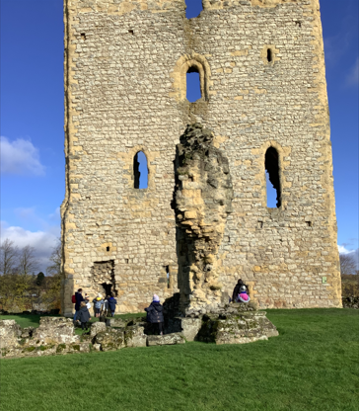

Slide 11
Upcoming Events – Open Morning

Slide 12
Upcoming Events – Spanish Day!
The staff are busy making preparations for a really exciting day on Monday 27 November. Children will spend the day in their house team groups learning about different aspects of Spain and Spanish culture including locational knowledge, artists, Spanish food and a Spanish song. They will rotate around 4 different activities as follows:
Geography – Mrs Rayner
Art – Miss Walker
DT (food) – Mrs Helfferich
Music – Mrs Seligman
We will then join together at the end of the day for a special celebration where we will sing the song together as a school and children will have the opportunity to share what they have learnt during the day.
Children are invited to wear item/s of clothing in the colour/s of the Spanish flag should they wish to on the day.

Slide 13
Awards in School This Week
 | Apple | Beech | Holly | Oak
Stars of the Week | Jackson Harker | Fenton Ward | George Ritchie | Asa Champion
 |  | Cameron Colman | Riley-Mae Simpson | Sienna Jagger
Gold Awards for Sport | Evelyn Dobreva | Gem Champion | Elijah Brown | Aiden Simpson
Headteacher Awards Random Act of Kindness | Esmond Tsang |  | Oliver Wilson
Cloakroom Ninja tidiest cloakroom trophy | Holly Class

Slide 14
Team Points
Team | Points
Red | 435
Blue | 1222
Green | 1663
Yellow | 488
Well done GREEN team!

Slide 15
PE Kits w/c 20 November 2023
Apple: Children in Apple Class need to bring their Forest School kit in each Friday. Please send their PE kit in on Monday as children will change for PE in school. They will bring PE kits home for washing periodically.
Please ensure that on PE days, the children wear their hoodies, school jumpers or cardigans alongside white or blue t-shirts and black or navy shorts or jogging bottoms.
 | Monday | Tuesday | Wednesday | Thursday | Friday
Beech |  |  |  | X | X
Holly |  | X |  |  | X
Oak |  | X - swim |  |  | X

Slide 16
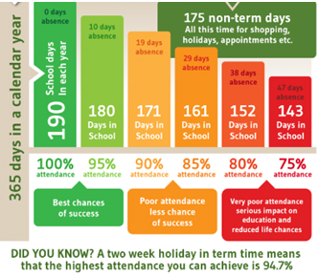
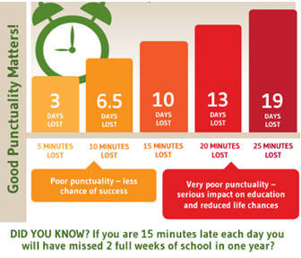
Attendance and Punctuality
This week’s attendance figures: 94.4% School Target: 96%
 | Attendance | Punctuality
Apple | 96%
Beech | 96.1% | 4 lates (3 children)
Holly | 89.5% | 4 lates (3 children)
Oak | 97.6% | 1 late
Please try to arrive at school on time – it is really important for a smooth, settled start to the day

Slide 17
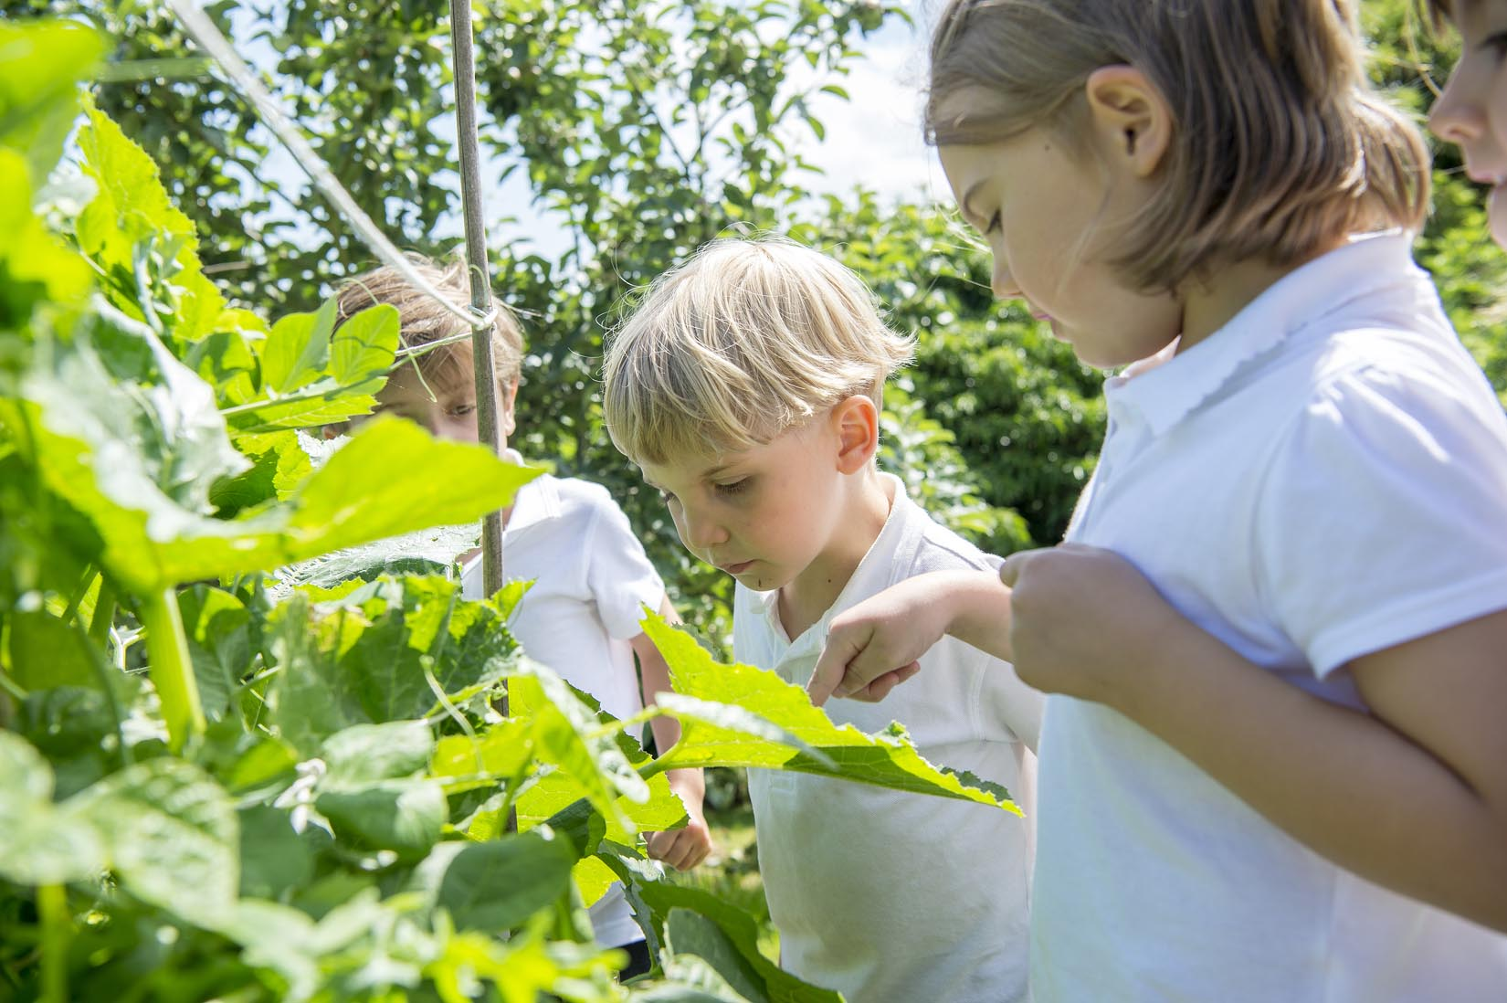
Extra Curricular Clubs - Autumn
Some clubs have limited capacity and places will be allocated on a first come first served basis. In the event of a club being fully booked, your child’s name will be added to a waiting list and you will be advised if a place becomes available. Booking is not required for before school or lunchtime clubs. For after school clubs run by school staff (denoted with *) please email Mrs Bacon on admin@crayke.n-yorks.sch.uk to book a place.
Before School:
After School:
Club | Day and Time | Group
Run a Mile | Monday, Tuesday Thursday & Friday 8:30am | All welcome – parents and carers included!
Day | Club
Monday | Craft* (£10 pay via ParentPay) 3:30 – 4:15pm Years 1 – 6 Mrs Seligman | Coding* 3:30pm – 4:15pm Years 3-6 Mr Brown
Tuesday | Multi-Sports (fee paid direct) 3:30 – 4:30pm Years 1 – 6 Mark Cromack
Wednesday | Junior Duke* (£10 pay via ParentPay) 3:30pm – 4:15pm Year 3/4 Mrs Helfferich
Thursday | Chess* (no charge) 3:30pm – 4:15pm Year 1 - 6 Mrs Seligman
NB: Clubs will not run during the last week of term so the last sessions will be during w/c 11 December 2023.
Further information will follow about the arrangements for booking clubs in the Spring Term in due course.
No Chess club on 30 November due to Christmas craft afternoon

Slide 18
Details of next meeting
DATE: Wednesday 10th January
TIME: 7.30pm
LOCATION: school staff room

Slide 19
For further details and to sign up, please click on the links below!
https://www.yourschoollottery.co.uk/cause-data/69fff70b-431f-48e4-b699-e0d3389bbf96/leaflets/8123681c-4783-4f35-bd8e-7ba7fd3db3b7/support_our_school_2019%20-%20digital.pdf?updated=638340908586300000
https://www.yourschoollottery.co.uk/cause-data/69fff70b-431f-48e4-b699-e0d3389bbf96/leaflets/d7233b89-b7f2-4e62-b690-8a7a7513f27b/ysl_ps5vr2_nov23%20-%20digital.pdf?updated=638340265128170000

Slide 20
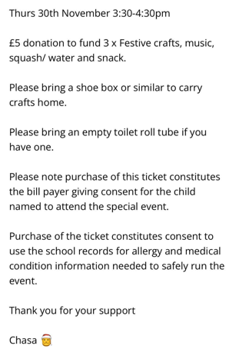
Please see attached flier with booking link to book your place!

