Slide 1
Crayke Chronicle
Issue: #11 Term: Autumn Date: 24 November 2023
FOLLOW YOUR PATHWAY AND WE GROW TOGETHER WITH CONFIDENCE
You did not choose me, I chose you that you might go and bear fruit, fruit that will last so that whatever you ask in my name the Father will give you. John 15:16
Respect Friendship Forgiveness Determination

Slide 2
In our newsletter this week…
…News from school this week including quidditch, Children in Need and Candlelighters donation.
…Check the class pages for any information relevant to individual classes and further news about learning and achievements this week
…Find out about upcoming events next week.
Our regular items then follow:
…Awards in school
…Team Points
…PE Kits next week
…Attendance and Punctuality
…Extra curricular clubs
…CHASA news

Slide 3
News from school this week
Thank you for your donations to Children in Need last week. So far we have raised £202 – thank you for your support!
We received the video edit as the outcome of last week’s Anti-bullying workshop and we’re delighted with it! The children will be shown it in due course and we’ll be sharing it via the Google classroom pages so you are also able to see their hard work and team efforts. Thanks again to the Di Walker Foundation for enabling this wonderful opportunity for our children to learn in a different way.
We also need to thank the Di Walker Foundation for enabling us to significantly expand our selection of books for children across school on important topics such as diversity, understanding difference and different families. We really are so fortunate and the children will gain so much from these books.
Mrs Rayner and I have spent two days out of school this week, alongside Mrs Hayes our Co-chair of Governors, focussing on teaching and learning. We’re really excited about what we have learnt and look forward to implementing this in the coming weeks and months.
We’ve had another successful Open Morning today, this time led predominantly by some of our Year 6 pupils. Well done to Toby, Asa, Leonard, Sienna and Oskar. A special mention to Alice who was absolutely phenomenal in her ability to talk about our school and to share her thoughts and knowledge of the routines and features of our school. Our children across school are increasingly eloquent and amazing at talking about Crayke, their experiences, their learning and what makes it a special place.

Slide 4
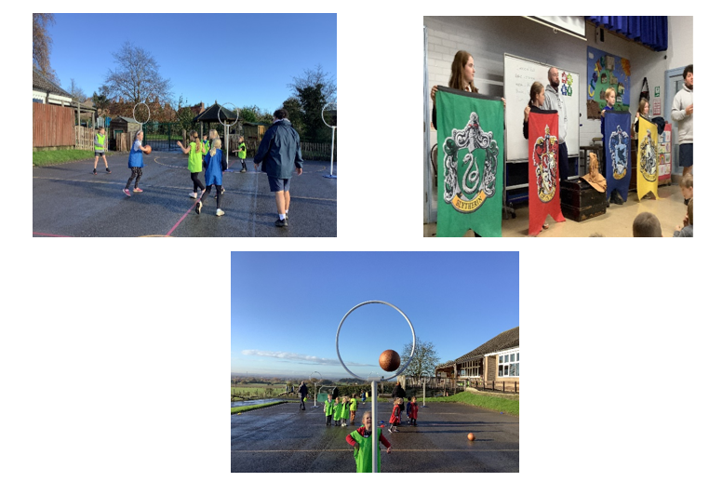
News from school this week
Quidditch – what an amazing day!
The feedback from the children has been incredible. The whole purpose of the day was offer a sport which would get children to engage and be enthusiastic. I think we can say we achieved this! The children felt that “Jack and Ben were fun and friendly instructors”.
They enjoyed “playing a sport which I had never dreamt possible due to it being in a story book”. We all “had an amazing day”, we “learnt so much but had so much fun”. Well done to everyone who took part and to our winning team: Slytherin.
Mrs Helfferich
Thanks to Mrs Helfferich for organising this brilliant opportunity for our children!

Slide 5
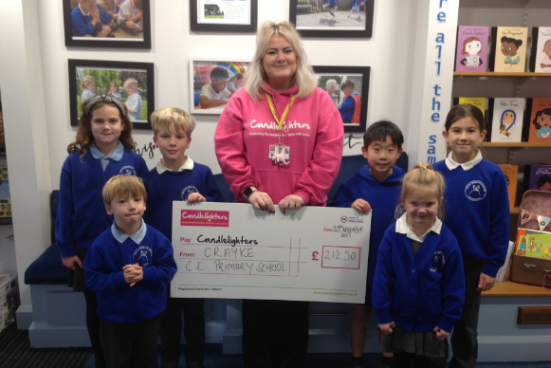
News from school this week
You’ll remember we held our lovely community coffee morning just before half term. We were delighted to present the charity Candlelighters with a donation of £212.50

Slide 6
News from school this week – active challenge

Slide 7
Class News- APPLE
We now have blending books which we will be sending home with the children who are learning to blend. These look slightly different as they have sound buttons under each grapheme and digraph lines underneath the two letters one sound. If you need any more information. Please speak to Mrs Helfferich or Miss Walker. Thank you.
Mrs Helfferich
You can also find out more by looking at the parent section of the Little Wandle website: https://www.littlewandlelettersandsounds.org.uk/resources/for-parents/#tabnametabBooksComingHome

Slide 8
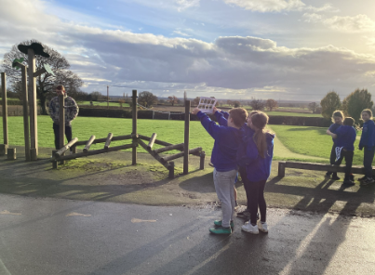
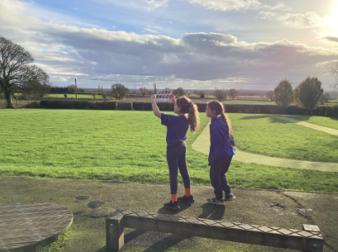
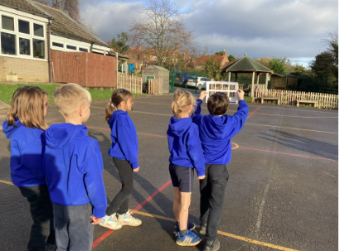
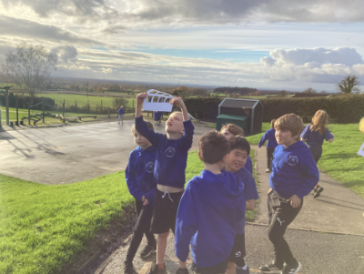
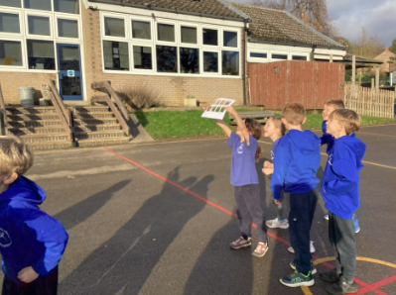
Class News – HOLLY
Holly class have been measuring clouds and learning the names of different clouds as part of our Geography theme of 'water’.
Mrs Chandler

Slide 9
Upcoming Events – Spanish Day!
A reminder that children can come dressed in the colours of the Spanish flag (or as close as possible and bright colours if no yellow or red clothing!) and if possible, bring in 1 fact about Spain. For younger children this might be something knowing the capital city but hopefully the older children will be a little more adventurous.
The children will spend the day in their house teams and rotate round each activity throughout the day as follows.
OAK CLASSROOM: Geography - with focus on Madrid and Barcelona.
HOLLY CLASSROOM: Music - learning about Spanish Music and looking at different genres of Spanish music before learning a Spanish pop song.
BEECH CLASSROOM: Art - looking at Spanish artists/architecture and learning about Picasso/making self portraits.
APPLE CLASSROOM: Food - looking at Spanish food and trying some different dishes.
This will be a brilliant opportunity for children of all ages to work collaboratively with a shared outcome and I know the staff and children are really excited about it – thanks to everyone for getting so involved in this. This will hopefully be the first of more regular house team enrichment activities that we hope to implement over time.

Slide 10
Awards in School This Week
 | Apple | Beech | Holly | Oak
Stars of the Week | Lance Ward | Isla Fenton | Aidan Brown | Kiera Rosa-Keyter
 |  | Zephie Brown | Jozef Metcalfe | Seb Parris
Gold Awards for Sport | Sylvia Hunsdale | Pippa Dawson | Elliott Braidwood | Kiera Rosa-Keyter
Headteacher Awards Random Act of Kindness | Alice Unsworth |  | George Ritchie
Cloakroom Ninja tidiest cloakroom trophy | Apple Class

Slide 11
Team Points
Team | Points
Red | 348
Blue | 501
Green | 513
Yellow | 462
Well done GREEN team!

Slide 12
PE Kits w/c 27 November 2023
Apple: Children in Apple Class need to bring their Forest School kit in each Friday. Please send their PE kit in on Monday as children will change for PE in school. They will bring PE kits home for washing periodically.
Please ensure that on PE days, the children wear their hoodies, school jumpers or cardigans alongside white or blue t-shirts and black or navy shorts or jogging bottoms.
 | Monday | Tuesday | Wednesday | Thursday | Friday
Beech |  |  |  | X | X
Holly |  | X |  |  | X
Oak |  | X - swim |  |  | X

Slide 13
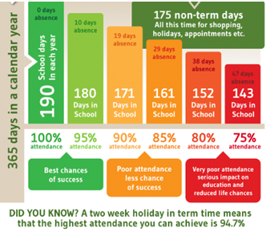
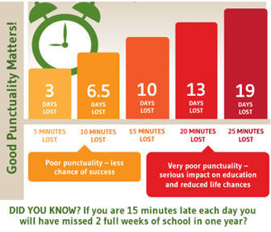
Attendance and Punctuality
This week’s attendance figures: 95.5% School Target: 96%
 | Attendance | Punctuality
Apple | 100% | 1 late
Beech | 95.5% | 4 lates (1 child)
Holly | 93.1% | 3 lates (2 children)
Oak | 96.2% | 1 late
Please try to arrive at school on time – it is really important for a smooth, settled start to the day

Slide 14
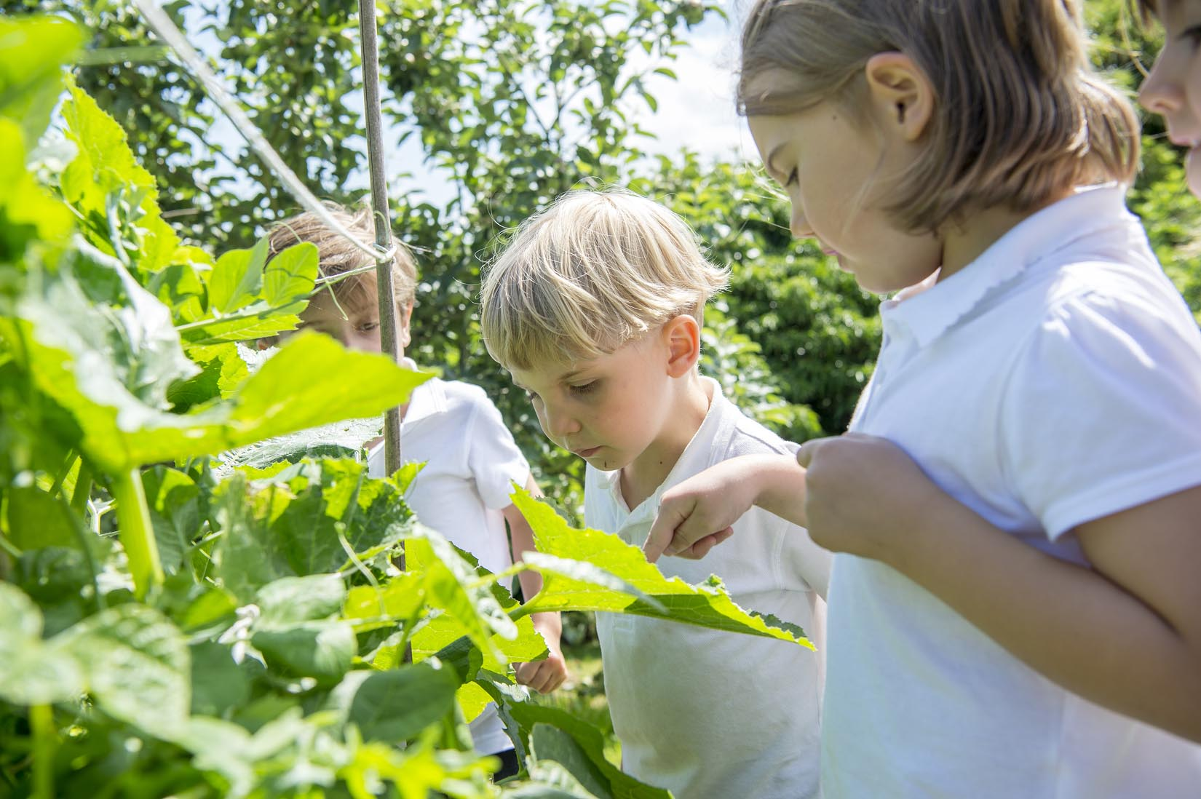
Extra Curricular Clubs - Autumn
Some clubs have limited capacity and places will be allocated on a first come first served basis. In the event of a club being fully booked, your child’s name will be added to a waiting list and you will be advised if a place becomes available. Booking is not required for before school or lunchtime clubs. For after school clubs run by school staff (denoted with *) please email Mrs Bacon on admin@crayke.n-yorks.sch.uk to book a place.
Before School:
After School:
Club | Day and Time | Group
Run a Mile | Monday, Tuesday Thursday & Friday 8:30am | All welcome – parents and carers included!
Day | Club
Monday | Craft* (£10 pay via ParentPay) 3:30 – 4:15pm Years 1 – 6 Mrs Seligman | Coding* 3:30pm – 4:15pm Years 3-6 Mr Brown
Tuesday | Multi-Sports (fee paid direct) 3:30 – 4:30pm Years 1 – 6 Mark Cromack
Wednesday | Junior Duke* (£10 pay via ParentPay) 3:30pm – 4:15pm Year 3/4 Mrs Helfferich
Thursday | Chess* (no charge) 3:30pm – 4:15pm Year 1 - 6 Mrs Seligman
NB: Clubs will not run during the last week of term so the last sessions will be during w/c 11 December 2023.
Further information will follow about the arrangements for booking clubs in the Spring Term in due course.
No Chess club on 30 November due to Christmas craft afternoon

Slide 15
Details of next meeting
DATE: Wednesday 10th January
TIME: 7.30pm
LOCATION: school staff room

Slide 16
For further details and to sign up, please click on the links below!
https://www.yourschoollottery.co.uk/cause-data/69fff70b-431f-48e4-b699-e0d3389bbf96/leaflets/8123681c-4783-4f35-bd8e-7ba7fd3db3b7/support_our_school_2019%20-%20digital.pdf?updated=638340908586300000
https://www.yourschoollottery.co.uk/cause-data/69fff70b-431f-48e4-b699-e0d3389bbf96/leaflets/d7233b89-b7f2-4e62-b690-8a7a7513f27b/ysl_ps5vr2_nov23%20-%20digital.pdf?updated=638340265128170000

Slide 17
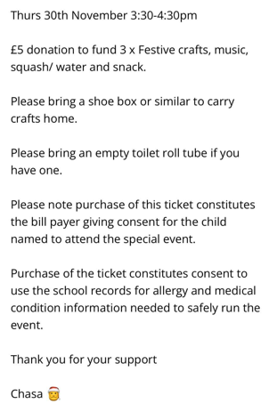
Please see attached flier with booking link to book your place!

