Slide 1
Crayke Chronicle
Issue: #12 Term: Autumn Date: 1 December 2023
FOLLOW YOUR PATHWAY AND WE GROW TOGETHER WITH CONFIDENCE
You did not choose me, I chose you that you might go and bear fruit, fruit that will last so that whatever you ask in my name the Father will give you. John 15:16
Respect Friendship Forgiveness Determination

Slide 2
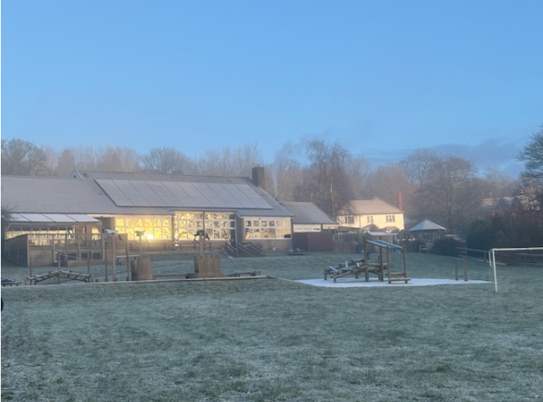
In our newsletter this week…
…News from school this week including Spanish Day report, CHASA Christmas Craft session.
…Find out about upcoming events including our Christmas plans!
Our regular items then follow:
…Awards in school
…Team Points
…PE Kits next week
…Attendance and Punctuality
…Extra curricular clubs
…CHASA news
…Church news

Slide 3
News from school this week
It’s been another busy week in school (of course!)
The week kicked off in spectacular style with our Spanish Day. We have had so much positive feedback from so many children and parents – thank you! More from Mrs Seligman on the following slide.
Nativity rehearsals are well underway – the songs sound wonderful and it’s great to see the increasing confidence of our performers. As always, you’ll be in for a treat when you come to watch!
Thanks also to CHASA for organising a really fabulous Christmas Craft Afternoon which was brilliantly organised and attended by well over half the school last night.
Have a lovely weekend!
Judi Jackson
Headteacher

Slide 4
News from school this week
Spanish Day
On Monday, the whole school participated in a curriculum enrichment 'Spanish Day' to celebrate the fact that we now learn Spanish in Key Stage 2. Children spent the day in their House Teams and rotated round the different classrooms doing an activity in each.
Mrs Helfferich cooked up a Spanish storm and served a White Bean Stew with Patatas Bravas, and the children learnt all about different Spanish foods.
In Art with Miss Walker, the children made self-portraits in the style of Pablo Picasso and looked at different architecture throughout Spain, focussing on Barcelona.
They learnt about the physical geography of Spain and looked at the cities Barcelona and Madrid with Mrs Rayner.
Finally they listened to extracts of different genres of Spanish music and learnt to sing Tierra Madre (Oye) by Chayanne.
It was a fantastic day and we all learnt something that we didn't previously know about Spain. A huge thank you to all the teachers for their help and enabling the day to happen, and the children for being such enthusiastic learners.
Percy said, " I didn't know that the Macarena was Spanish".
Nancy said, " I loved the Spanish potatoes especially. Spanish food is delicious.“
Mrs Seligman

Slide 5
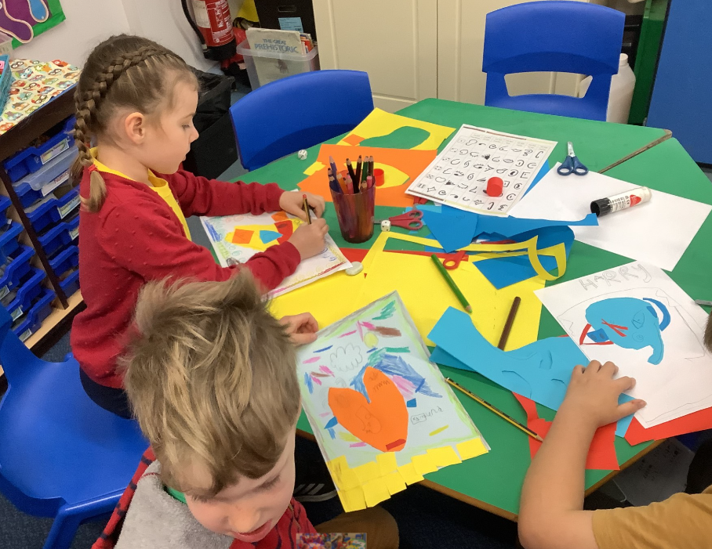
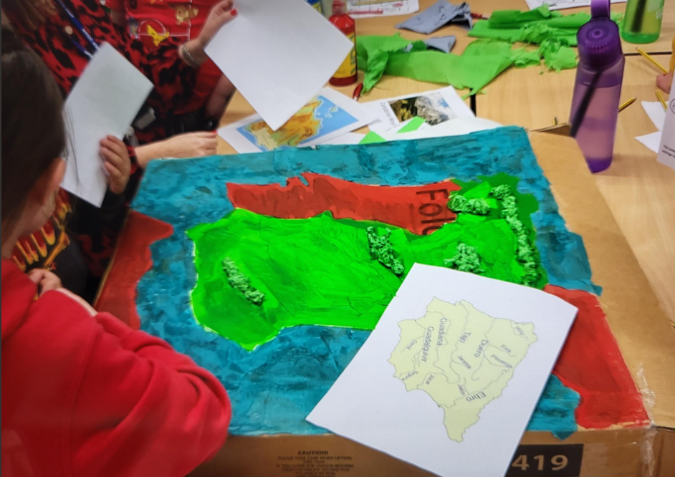
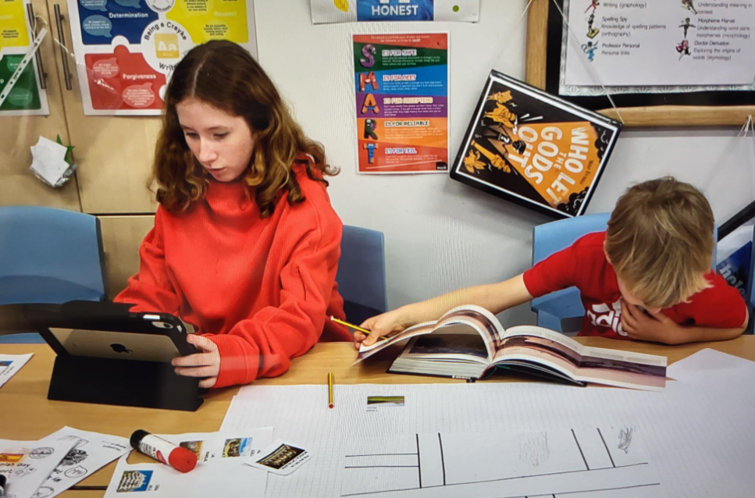
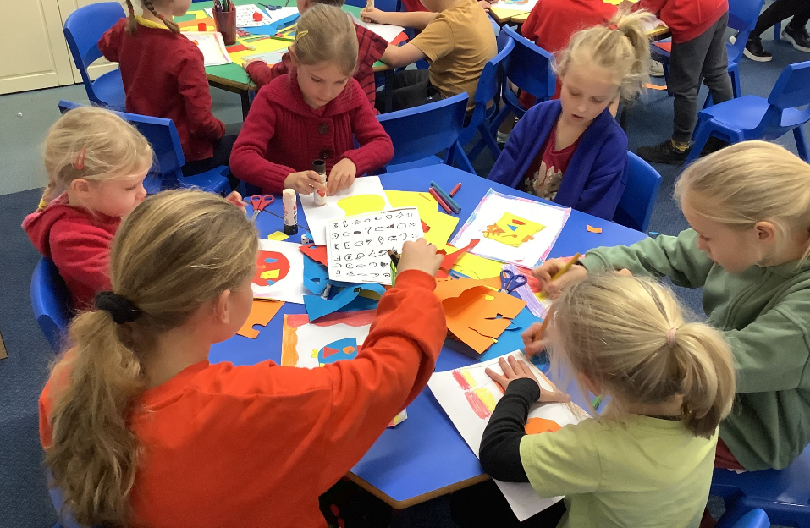
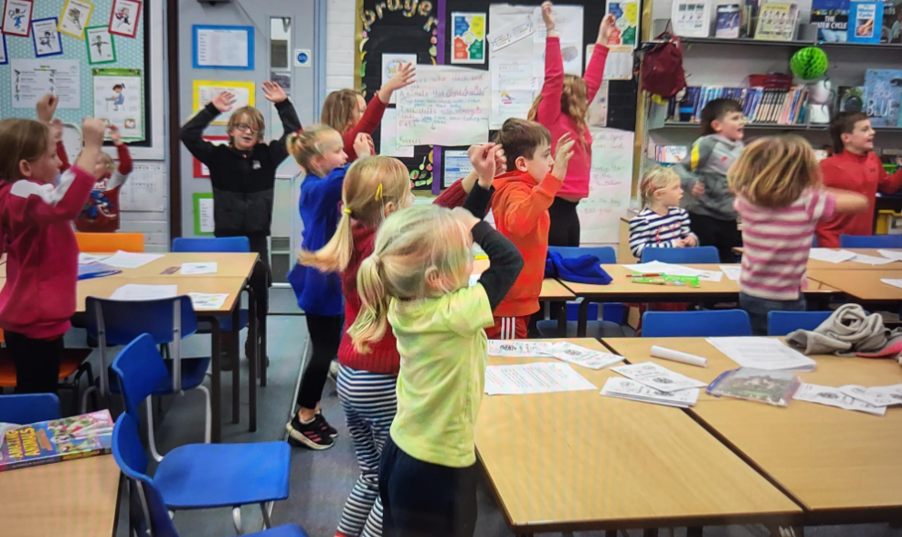
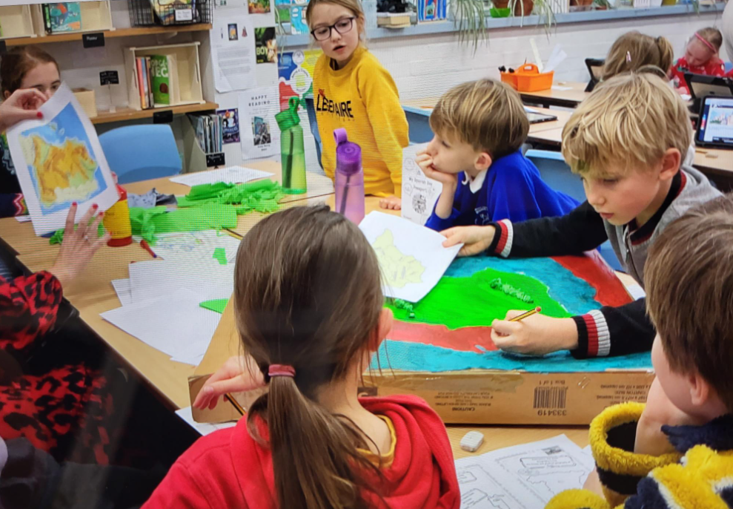
Some photos from Spanish Day

Slide 6
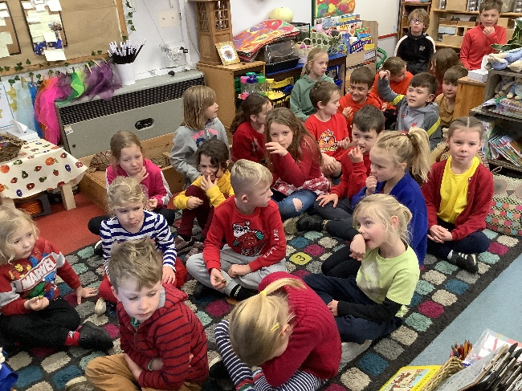
News from school this week
Spanish White Bean Stew Recipe
Ingredients
2 tablespoons Spanish olive oil
4 cloves of garlic, pressed or mashed
1 small yellow onion, diced
2 teaspoons ground cumin
1 teaspoon paprika
Salt and pepper to taste
2 bay leaves
1 cup diced tomatoes
1 15 ounce can of white beans, rinsed and drained
Instructions
Warm the olive oil in a medium-sized Dutch oven or saucepan on medium-high heat.
Add the onion and garlic and cook until soft and tender but before the garlic starts to brown.
Add the cumin and paprika to the olive oil to release the aroma and flavours.
Add the bay leaves, tomatoes, and rinsed white beans to the pot.
Add salt and pepper and stir.
Cook for 10-15 minutes or until the tomatoes and white beans are warm. Remove the bay leaves before serving.
Serve with crusty bread or as part of an evening of tapas.
Mrs Helfferich has been asked so many times for this recipe that we thought it was worth including for all!
Olive tasting was an experience for some!

Slide 7
News from school this week
IMPORTANT – PARKING AND ROAD SAFETY
There have recently been various incidents involving difficulties with this situation, particularly at collection time. In the spirit of awareness that our school values underpin our approach to all aspects of school life, can I please urge you to show respect to one another, and to local residents, when parking your car in a safe and appropriate place?
The lay-by is not to be used at the start or end of the school day for the purposes of dropping off or collecting children, unless by prior agreement with the school.
The sports hall remains the place where we strongly encourage parents to park, in order to alleviate congestion within the village. I have spoken with both the Parish Council and the local Police force to see if anything else can be done to support this tricky issue. It continues to be a work in progress with everyone doing their bit to support the safety of everyone is essential. Thank you.

Slide 8
News from school this week
Reception New Starters 2024
We have already welcomed many prospective parents for new starters in Autumn 2024 which is fabulous! Applications for school places are made via NYCC Admissions.
The application window is now open and completed applications must be submitted no later than 15 January 2024. Further details about the process are available here: https://www.northyorks.gov.uk/apply-place-primary-or-secondary-school

Slide 9
News from school this week
Staffing Update
We were delighted to welcome Mrs Gears, our Learning Mentor HLTA, who started with us on Monday. She has already spent time in all classes across school and is busy learning everyone’s names. Mrs Gears will be accompanying me and staff on the gate each morning, so she will be starting to get to know all of you in due course too.
Mrs Shirley has confirmed that she will be returning to school after Christmas, which I know the whole school community will be absolutely thrilled about. She will be returning to work alongside Mrs Chandler in Holly class from Mon-Thu but will be popping in for some sessions before then.
This does mean that we will be saying farewell to Mr Palmer at Christmas and wish him all the best for his future endeavours. We are grateful for the work he has done to support children in Holly this term, the many first aid forms he has completed (!) and, of course, his coaching of the Y5/6 football team.

Slide 10
News from school this week
Club News
Please note that ALL clubs will conclude during week commencing 11 December and there will be NO clubs during the last week of term. Clubs will resume in the New Year. This includes both before school and after school clubs, with the exception of Tiddlywinks wraparound club. This will remain open until the end of term, except for on the last day of term when there will be no after school club due to our earlier finish at 2:30pm.
In the Spring Term, priority will be given to pupils who were unable to access clubs this term. In some cases, we may need to limit the number of clubs attended by pupils in order to ensure fairness for all.
Thank you to all the staff who have run clubs this term.

Slide 11
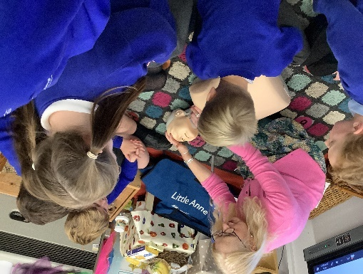
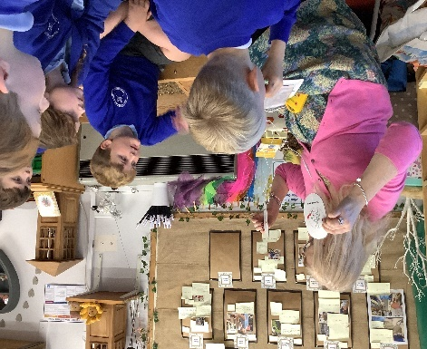
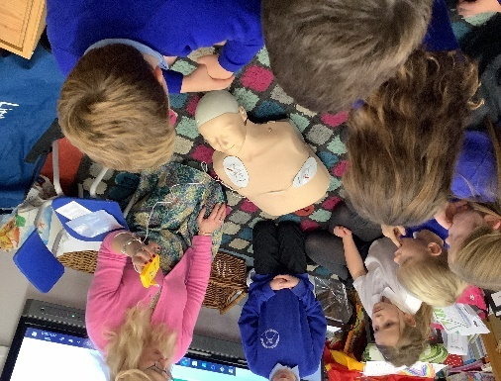
News from school this week
Junior Duke Club Update
For the last few weeks we have been learning about how to use a defib and carry out CPR.
We have been joined by Nicola Zywica for the last two sessions, she talked about her job on the maternity ward and taught the children how to use the defib.
We talked about DR ABC and the importance of knowing your home address as well as knowing how to call the emergency services.
Our Junior Duke Ambassador is Sir Bob Murray. He will be joining us to help celebrate our success of competing this award in the summer.

Slide 12
News from school this week
THANK YOU to School Council for organising this sale and running it so efficiently each playtime!
Dear Crayke Primary School students,
Thank you for raising £177.97. in support of the Royal British Legion Poppy appeal.
Your magnificent amount will go a long way to supporting ex service personnel and their families
John Sutherland J.P. MJF
Royal British Legion Poppy Appeal PAO NEB03

Slide 13
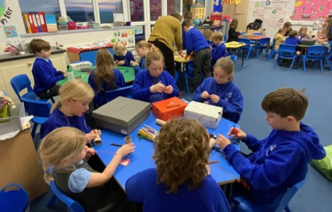
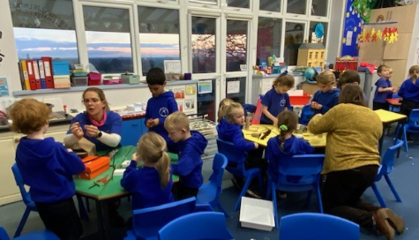
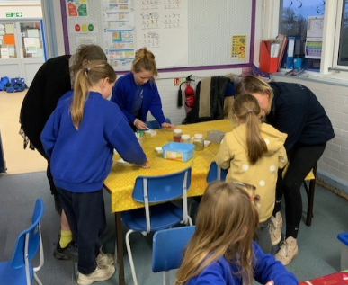
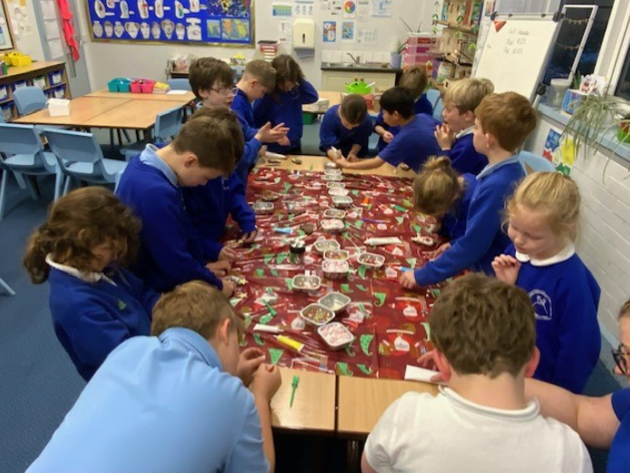
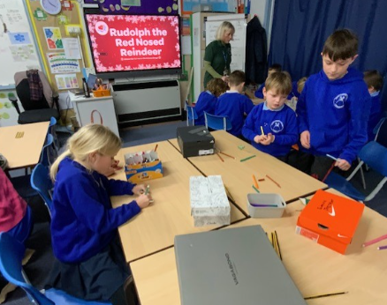
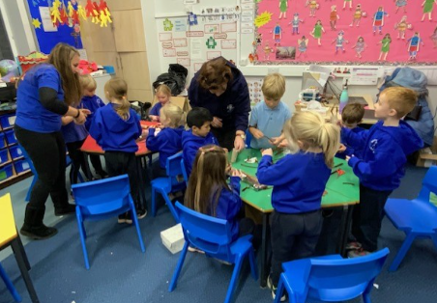
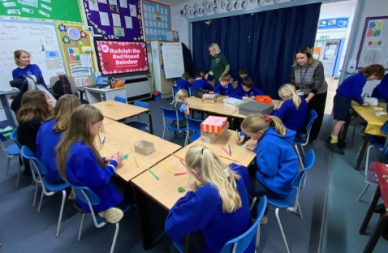
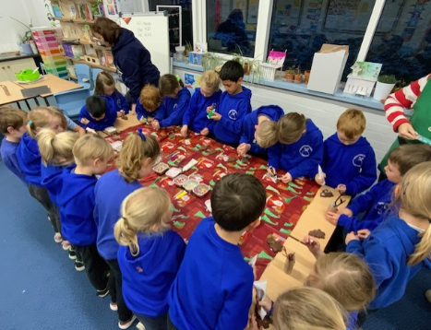
News from school this week
CHASA Christmas Craft Afternoon

Slide 14
Upcoming Events – KS1 Nativity
We are really looking forward to welcoming you into school for nativity performances of “Baubles”. The children in Apple and Beech class are working very hard and the songs are sounding beautiful!
We will be putting on two performances on Wednesday 13 December at 9:30am and 2:15pm.
Tickets are free and can be booked via our new booking system. Details of this will be shared next week.

Slide 15
Upcoming Events – Christmas@Crayke 2023
As summarised on the following page, we are planning a range of Christmas events in the run up to the end of term. Plans are made with the best of intentions at the time of going to print, however please be mindful that circumstances beyond our control can change plans and may do so at short notice.
Mrs Yates is already getting excited about the thought of Christmas Lunch with all the trimmings! We are thrilled to be able to welcome governors and the CHASA committee to join us for lunch too.
The Christmas tree has been delivered to school; we are extremely grateful to Newburgh Christmas Trees for this kind and generous donation. The children will be decorating the Christmas tree early next week, when we will all assemble in the hall to sing carols; it is a wonderful and moving event that is sure to get everyone into the Christmas spirit!

Slide 16
Upcoming Events – Christmas@Crayke 2023
Date | Time | Event | What we need from you as parents
Friday 8 December | 1:30pm – 3:00pm | Whole School Pantomime – Sports Hall | Please ensure that your child has a warm coat and water bottle.
Monday 11 December |  | Christmas cards can be brought in from today | Please ensure that Christmas cards are clearly labelled with first name, surname and class to ensure safe delivery to the correct recipient.
Tuesday 12 December | 9:30am | Nativity Dress Rehearsal | All children involved need their costumes ready before today.
Wednesday 13 December | 9:30am 2:15pm | Nativity Performance 1 Nativity Performance | Book your free tickets when the link is shared next week.
Tuesday 19 December | 12pm | Christmas Lunch | If your child normally has a packed lunch and would like Christmas Lunch please contact Mrs Bacon on admin@ In the event of dietary requirements, a form will require completion prior to the event.
Tuesday 19 December | pm | Christmas Party afternoon | Come to school wearing party outfits.
Friday 22 December |  | Christmas Jumper Day Christmas Carol Concert Reindeer Rush afternoon End of term -2:30pm | Children are welcome to wear non-uniform and Christmas jumpers. Parents and carers are welcome to meet us at church for a service at 11am. Please ensure appropriate footwear for running outside. Sponsorship information sent separately.

Slide 17
Awards in School This Week
 | Apple | Beech | Holly | Oak
Stars of the Week | Zeffy Copley | Louise Keaney | Grant Colman | Sam Stubbins
 |  | Tomas Davies | Rosie Seligman | Leonard Liddell
Gold Awards for Sport | Mabel Ankers | Isabelle Kay | Scarlett Woodhouse | Aiden Simpson
Headteacher Awards Random Act of Kindness | Edmund Sadler |  | Wilfred Liddell
Cloakroom Ninja tidiest cloakroom trophy | Holly Class

Slide 18
Team Points
Team | Points
Red | 1768
Blue | 1759
Green | 1516
Yellow | 1262
Well done RED team!

Slide 19
PE Kits w/c 4 December 2023
Apple: Children in Apple Class need to bring their Forest School kit in each Friday. Please send their PE kit in on Monday as children will change for PE in school. They will bring PE kits home for washing periodically.
Please ensure that on PE days, the children wear their hoodies, school jumpers or cardigans alongside white or blue t-shirts and black or navy shorts or jogging bottoms.
 | Monday | Tuesday | Wednesday | Thursday | Friday
Beech |  |  |  | X | X
Holly |  | X |  |  | X
Oak |  | X - swim |  |  | X

Slide 20
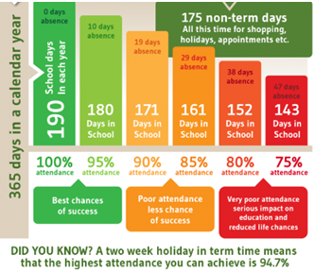
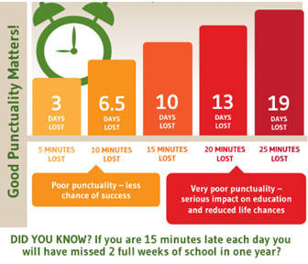
Attendance and Punctuality
This week’s attendance figures: 91.6% School Target: 96%
 | Attendance | Punctuality
Apple | 95% | 1 late
Beech | 94.8% | 5 lates (1 child)
Holly | 87.2% | 6 lates (2 children)
Oak | 91.9% | 3 lates (3 children)
Please try to arrive at school on time – it is really important for a smooth, settled start to the day

Slide 21
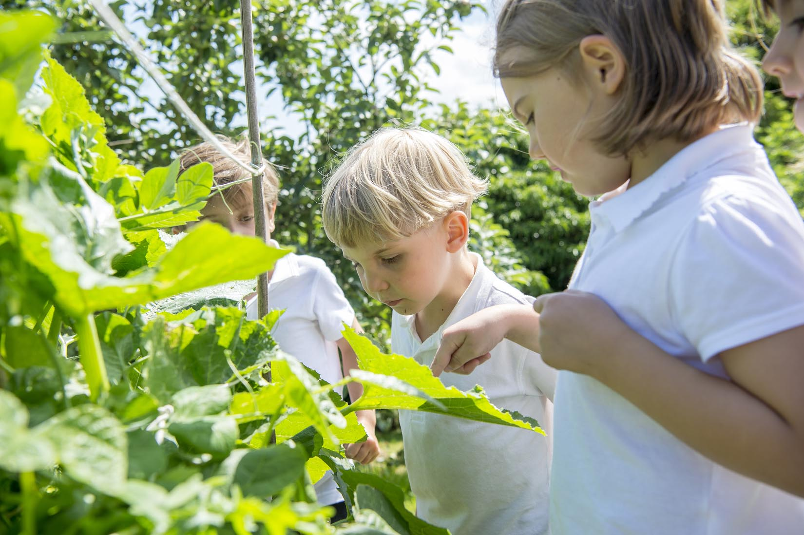
Extra Curricular Clubs - Autumn
Some clubs have limited capacity and places will be allocated on a first come first served basis. In the event of a club being fully booked, your child’s name will be added to a waiting list and you will be advised if a place becomes available. Booking is not required for before school or lunchtime clubs. For after school clubs run by school staff (denoted with *) please email Mrs Bacon on admin@crayke.n-yorks.sch.uk to book a place.
Before School:
After School:
Club | Day and Time | Group
Run a Mile | Monday, Tuesday Thursday & Friday 8:30am | All welcome – parents and carers included!
Day | Club
Monday | Craft* (£10 pay via ParentPay) 3:30 – 4:15pm Years 1 – 6 Mrs Seligman | Coding* 3:30pm – 4:15pm Years 3-6 Mr Brown
Tuesday | Multi-Sports (fee paid direct) 3:30 – 4:30pm Years 1 – 6 Mark Cromack
Wednesday | Junior Duke* (£10 pay via ParentPay) 3:30pm – 4:15pm Year 3/4 Mrs Helfferich
Thursday | Chess* (no charge) 3:30pm – 4:15pm Year 1 - 6 Mrs Seligman
NB: Clubs will not run during the last week of term so the last sessions will be during w/c 11 December 2023.
Further information will follow about the arrangements for booking clubs in the Spring Term in due course.

Slide 22
Details of next meeting
DATE: Wednesday 10th January
TIME: 7.30pm
LOCATION: school staff room

Slide 23
For further details and to sign up, please click on the links below!
First draw this weekend!
https://www.yourschoollottery.co.uk/cause-data/69fff70b-431f-48e4-b699-e0d3389bbf96/leaflets/8123681c-4783-4f35-bd8e-7ba7fd3db3b7/support_our_school_2019%20-%20digital.pdf?updated=638340908586300000
https://www.yourschoollottery.co.uk/cause-data/69fff70b-431f-48e4-b699-e0d3389bbf96/leaflets/d7233b89-b7f2-4e62-b690-8a7a7513f27b/ysl_ps5vr2_nov23%20-%20digital.pdf?updated=638340265128170000

Slide 25
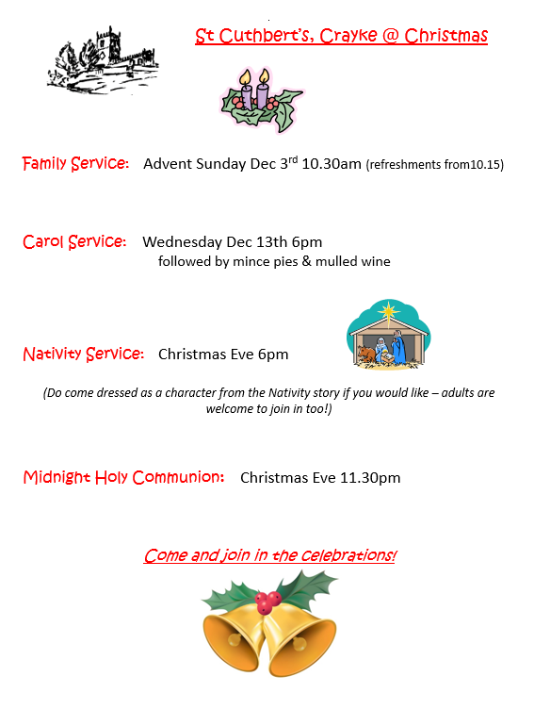
Church News

