Slide 1
Crayke Chronicle
Issue: #14 Term: Autumn Date: 15 December 2023
FOLLOW YOUR PATHWAY AND WE GROW TOGETHER WITH CONFIDENCE
You did not choose me, I chose you that you might go and bear fruit, fruit that will last so that whatever you ask in my name the Father will give you. John 15:16
Respect Friendship Forgiveness Determination

Slide 2
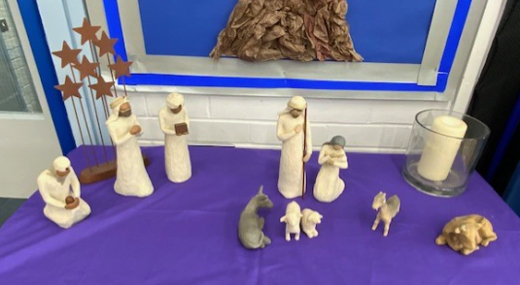
In our newsletter this week…
…News from school this week including Christmas preparations and class news.
…Find out about upcoming events before the end of term
Our regular items then follow:
…Awards in school
…Team Points
…PE Kits next week
…Attendance and Punctuality
…CHASA news
…Church news

Slide 3
News from school this week
In our penultimate newsletter of 2023, there’s lots of news this week about the exciting things we have done in school and plans for some wonderful opportunities for the new school term. The nativity performances were just fabulous and we know from your feedback how much you enjoyed it! Another huge thank you must be extended to the whole Reception and Key Stage 1 team who worked so hard to put on a show to remember.
The Rainbow Hampers were a roaring success – many thanks to CHASA for organising this raffle which raised an astonishing £352! As luck would have it, we received a quote this week for some new musical instruments for almost exactly the same amount, so we are very grateful that CHASA have agreed to fund these to support the exciting new developments in music next term (see Slide 8 for more details!)
There’s just five more “getty ups” of the Autumn Term – let’s make the last week of term brilliant by showing our school values of friendship, forgiveness, respect and determination to each other, in everything we do.
Have a lovely weekend!
Judi Jackson
Headteacher

Slide 4
News from school this week
School Council – Team Points Treat
School Council have confirmed that the House Team treat for the most team points this term will be hot chocolate and sweets. The winning team will be announced next week and the celebration will be on Wednesday afternoon. Thank you to Miss Walker for overseeing this and to School Council for their hard work this term to help make our brilliant school even better!

Slide 5
News from school this week
IMPORTANT - SAFEGUARDING UPDATE
A reminder in advance of next week’s Carol Service at the church with regards to the taking of photographs and video footage. We understand that you may wish to take images of your child/ren during such events, however we would respectfully request that any images or videos are not shared on ANY social media platforms. This is because some children, for legitimate reasons, are unable to have these shared. Thankfully, we have had no such reported issues and we are grateful not to have been put in that position. Thank you for your continued support with this important matter.

Slide 6
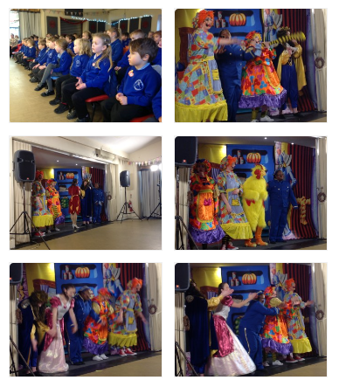
News from school this week
Pantomime
The children had a wonderful visit to the Sports Hall last Friday for the travelling pantomime performance of “Cinderella”. Thanks again to CHASA for funding this opportunity and to the Sports Hall for allowing us to use the venue. It was a great way to get into the Christmas spirit!

Slide 7
News from school this week
REMINDER: Club News
Update to club news info: On Tuesday, multi-sports club WILL be on, as a result of the session missed when school was closed due to flooding. Other clubs will resume in the New Year, w/c 15 January.
In the Spring Term, priority will be given to pupils who were unable to access clubs this term. In some cases, we may need to limit the number of clubs attended by pupils in order to ensure fairness for all.
Thank you to all the staff who have run clubs this term.

Slide 8
News from school this week
New opportunity after Christmas - music
I am delighted to inform you that, for the remainder of the academic year, children in Beech, Holly and Oak classes will be taught music by a specialist music teacher each week. In addition, the teacher will be offering a lunchtime choir (open to children of ALL ages) and an after school ensemble club (for children in Key Stage 2) which will give children a chance to learn to play a range of instruments and work towards an end of term performance. More details to follow.
A huge thank you must be extended to CHASA who have funded the majority of the costs of this really exciting opportunity for our children. Thank you!

Slide 9
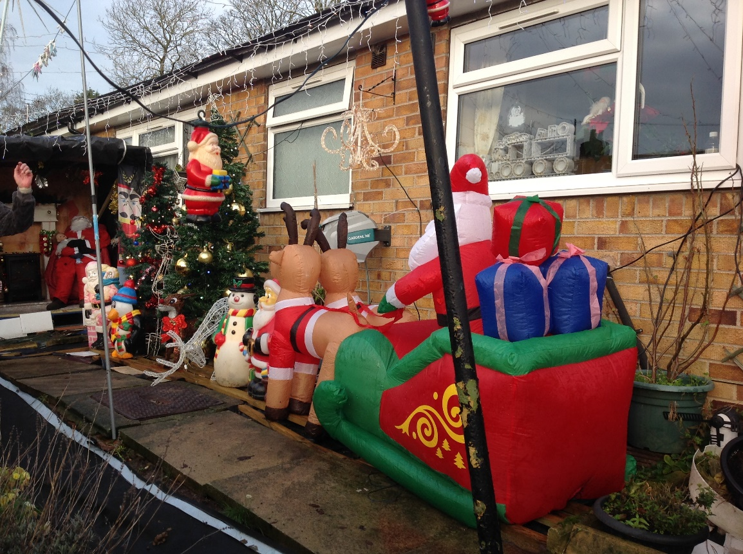
News from school this week
Crayke Village Decorations
Apple Class started their Christmas card and gift delivery to our friends in the village. Unfortunately, we didn’t get very far as we got distracted by all of the decorations across the road from school.
Two of the bungalows are raising money for Macmillan, every child will get a little present on their arrival.
Well worth an after-school visit!
Mrs Helfferich

Slide 10
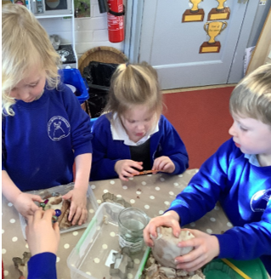
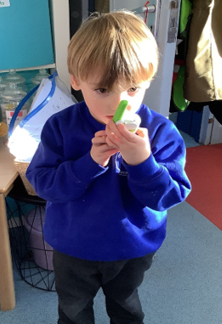
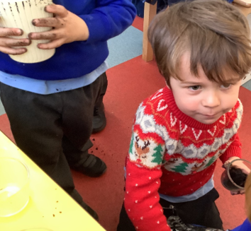
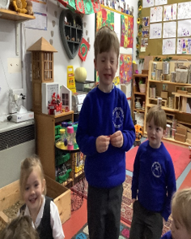
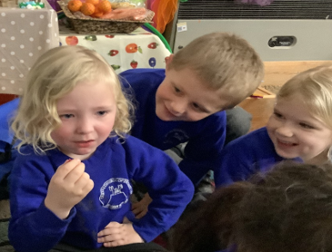
Class News- APPLE
This week we have been very busy. As well as taking part in our Nativity, we have tasted cranberries! We watched our friends faces to guess if they liked them or not. We planted tulip bulbs and made some delicious playdough meals.
The highlight of the week has to be the three walkie talkies which have been introduced. The children have enjoyed talking to each other as they work within the different areas of provision. They like to check what the others are doing.

Slide 11
Upcoming Events – Christmas@Crayke 2023
Date | Time | Event | What we need from you as parents
Tuesday 19 December | 12pm | Christmas Lunch | If your child normally has a packed lunch and would like Christmas Lunch please contact Mrs Bacon on admin@ In the event of dietary requirements, a form will require completion prior to the event.
Tuesday 19 December | pm | Christmas Party afternoon | Come to school wearing party outfits.
Friday 22 December |  | Christmas Jumper Day Christmas Carol Concert Reindeer Rush afternoon End of term -2:30pm | Children are welcome to wear non-uniform and Christmas jumpers. Parents and carers are welcome to meet us at church for a service at 11am. Please ensure appropriate footwear for running outside. Sponsorship information sent separately.

Slide 12
Upcoming Events Reindeer Rush – Friday 22 December
Raising money for St Leonards Hospice
Thank you for the donations already received.
https://www.justgiving.com/page/craykeprimaryreindeerrush?utm_source=Facebook&fbclid=IwAR3EMKvLGhB9uUvheYgYm7rVNZ1InUMi7tm9AFU1pvxAF_5T9y5rcDJPeJY
Each child in school will receive a pair of antlers and some reindeer dust. They will be following me (Father Christmas) around the playground, completing numerous laps. Unfortunately, the field and running track are just too wet.
We are hoping that York Mix and St Leonards Hospice team will be joining us, bringing with them this year’s new surprise addition.
Mrs Helfferich

Slide 13
Awards in School This Week
 | Apple | Beech | Holly | Oak
Stars of the Week | ALL the children! | Alanna Dawson | Isla Grant | Oskar Braidwood
 |  | Pippa Dawson | Arianna Saeedi | Felicity Ritchie
Gold Awards for Sport | Wilfred Ferreday | Milo Burnett-Armstrong | Aidan Brown | Cyrus Saeedi

Slide 14
Team Points
Team | Points
Red | 3355
Blue | 2971
Green | 3339
Yellow | 2997
Well done RED team!

Slide 15
PE Kits w/c 18 December 2023
Apple: Children in Apple Class need to bring their Forest School kit in each Friday. Please send their PE kit in on Monday as children will change for PE in school. They will bring PE kits home for washing periodically.
Please ensure that on PE days, the children wear their hoodies, school jumpers or cardigans alongside white or blue t-shirts and black or navy shorts or jogging bottoms.
 | Monday | Tuesday Christmas Parties | Wednesday | Thursday | Friday Reindeer Rush
Beech |  |  |  | X | X
Holly |  |  |  |  | X
Oak |  |  |  | X | X

Slide 16
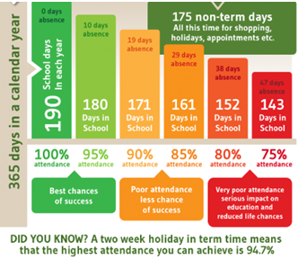
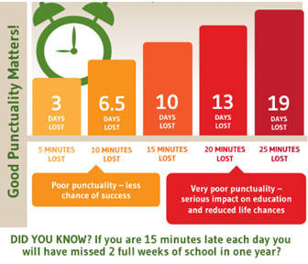
Attendance and Punctuality
This week’s attendance figures: 92.4% School Target: 96%
 | Attendance | Punctuality
Apple | 96.1% | 1 late
Beech | 96.2% | 2 lates (2 children)
Holly | 93.4% | 3 lates (2 children)
Oak | 88% | 4 lates (3 children)
Please try to arrive at school on time – it is really important for a smooth, settled start to the day

Slide 17
For further details and to sign up, please click on the links below!
https://www.yourschoollottery.co.uk/cause-data/69fff70b-431f-48e4-b699-e0d3389bbf96/leaflets/8123681c-4783-4f35-bd8e-7ba7fd3db3b7/support_our_school_2019%20-%20digital.pdf?updated=638340908586300000
https://www.yourschoollottery.co.uk/cause-data/69fff70b-431f-48e4-b699-e0d3389bbf96/leaflets/d7233b89-b7f2-4e62-b690-8a7a7513f27b/ysl_ps5vr2_nov23%20-%20digital.pdf?updated=638340265128170000

Slide 18
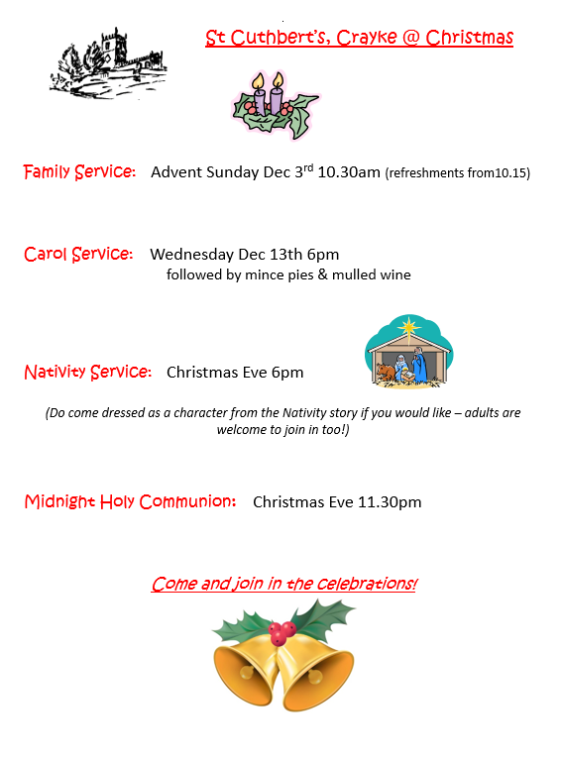
Church News

