Slide 1
Crayke Chronicle
Issue: #15 Term: Autumn Date: 22 December 2023
FOLLOW YOUR PATHWAY AND WE GROW TOGETHER WITH CONFIDENCE
You did not choose me, I chose you that you might go and bear fruit, fruit that will last so that whatever you ask in my name the Father will give you. John 15:16
Respect Friendship Forgiveness Determination

Slide 2
Message from the Headteacher
It’s been a really lovely week in school and we are all definitely in the festive spirit now! Christmas Lunch was a roaring success; we were thrilled to be able to host governors and the CHASA committee team. The Christmas parties were a lovely opportunity for children to mix in different groups and we are looking forward to ending the term in style with our Carol concert and Reindeer Rush sponsored event today, as well as a magical visit from a surprise visitor at the end of the day!
As we approach the end of term, on behalf of the staff, we would like to thank you to you all for your support, good wishes, cards and gifts. We are truly humbled by your generosity.
Thanks also must be extended to:
our exceptional team of governors who provide so much support for our school in so many different ways.
our amazing CHASA committee and members, who also do so very much for our school community and work tirelessly behind the scenes to enhance the opportunities given to our children.
the whole staff team, who go above and beyond to educate, support and challenge the children in their classes and across the school.
Please do have a go at the School Lottery if you fancy it – they also supply gift vouchers, which could make an ideal last minute Christmas present for your nearest and dearest (speaking from experience… Merry Christmas Dad!!)
Have a restful holiday and enjoy some quality time with your loved ones! We look forward to seeing you all from 8:50am on Tuesday 9 January.
Judi Jackson

Slide 3
News from school this week
School Council – Team Points Treat
Well done to GREEN team who were the winners of this term’s treat! They really enjoyed their Christmas hot chocolate and sweet treats alongside a viewing of The Snowman.
After Christmas it all starts again so good luck to all teams!
Thanks again to Miss Walker, School Council Lead, for organising this.
Sadly we were too busy enjoying the treats to get a photograph!

Slide 4
Safeguarding Update – Online Safety
Please read alongside the guide in full which is attached to this newsletter…
At this time of year, it’s highly possible that you have a new phone, games console or other digital device stashed somewhere at home, ready to be unwrapped. Many parents also prefer to place some protective measures on those gifts – to keep their child shielded from potential #OnlineSafety risks – while others would like to, but aren’t sure where to begin.
Our guide shepherds you through the process of establishing parental controls on new internet-enabled devices, from smartphones to laptops to consoles. Simply find the device in question and read on to find out what options you have and how to enable them – letting children enjoy their shiny new gadget, without so much of the worry over where it might lead them.

Slide 5
Reindeer Rush – this afternoon!
Raising money for St Leonards Hospice
By the time you read this, we will be really close to taking part in this year’s event. The children will be bringing their antlers and Reindeer food home. I am really excited about this year’s additions. Fingers crossed that the weather behaves!
Its not too late to sponsor this amazing charity… thanks so very much to those who already have donated.
Fundraising Expert is fundraising for St Leonard's Hospice, York (justgiving.com)
Mrs Helfferich

Slide 6
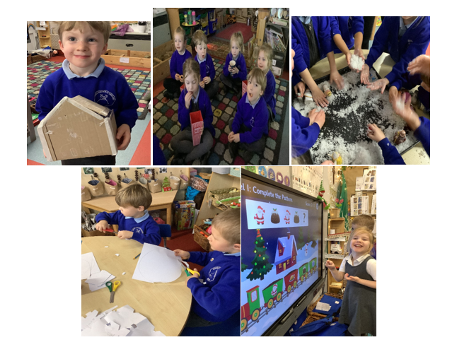
Class News- APPLE
What an action-packed time we have had! Lots of ICT from repeating Christmas patterns, decorating a Christmas tree and designing a Christmas jumper. We watched ‘The Snowman’ whilst drinking hot chocolate and eating crisps. We then played in the ‘snow’ whilst listening to ‘Do you want to build a snowman’. We made gingerbread house decorations which then progressed into making larger scale gingerbread houses. The children made snowflakes and amazing Christmas trees, lots of scissor skills. Thank you to the team for everything they have done this week.
Have a very Happy Christmas from Mrs Helfferich and the team.

Slide 7
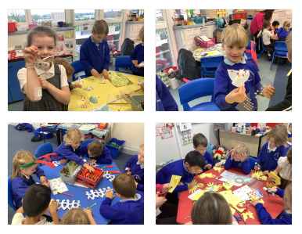
Class News - BEECH
Beech Class Christmas Crafts afternoon
We had a lovely crafty afternoon with Reverend Katie and Lucy Willshaw. We thought about the different parts of the Christmas story and each child made 4 different crafts to represent parts of the story including people of peace, an angel, baby Jesus in a manger and a candle for hope.
Mrs Dobson

Slide 8
School reopens to pupils on Tuesday 9 January. We look forward to an exciting term with each class focussing on the following themes and enquiry questions in their learning:
Information for Spring Term 2024
Class | Theme | Enquiry Question | Enrichment (Stunning Start/Marvellous Middle/Fabulous Finish)
Apple | Dinosaurs Rock! Once Upon a Time | 1) Which dinosaurs lived on earth? 2) What important lessons can we learn from Fairy Tales? | 1) Dinosaur day 2) Author visit
Beech | Oh, I do like to be beside the seaside | What is it like beside the seaside? | Virtual tour of the Grace Darling museum
Holly | Tales from Dragon Mountain | Why do people live on volcanoes and mountains? | Volcano workshop – in school
Oak | Into the Darkness… | What was it like to live in the Dark Ages? | York University visit – Astrocampus and Robotics workshop

Slide 9
Information for Spring Term 2024
Club News
Please remember, there are NO CLUBS AT ALL until w/c 15 January. This includes Running Club before school. Details of clubs will be sent out the first week back. Please note, we will not be accepting bookings for clubs until we return to school in January and the list has been distributed.
Educational Visits – Spring Term
As outlined on the previous slide, there are plans afoot for visits and/or visitors for each class next term. In addition, Oak class will be visiting Sheffield Arena on Tuesday 9 January for Young Voices – thanks to CHASA for funding the cost of the travel for this!

Slide 10
Awards in School This Week
 | Friendship | Forgiveness | Respect | Determination
Apple | Edmund Sadler | Lyuba Hobson | Mabel Ankers | Dianta Simpson
Beech | Tomas Davies | Henry Robinson | Esmond Tsang | Tabi Copley
Holly | Leo Bunker-Barnes | Riley-Mae Simpson | Keenan Lee | Evangeline Wardle
Oak | Aiden Simpson | Isabelle Sargent | Joah Brown | Brooke Smith
Headteacher | Rosie Seligman | George Ritchie | Alice Unsworth | Riley Hunsdale

Slide 11
PE Kits w/c 8 January 2024
 | Monday | Tuesday | Wednesday | Thursday | Friday
Beech | School Closed - INSET |  |  | X | X
Holly |  |  | X (NB change of day) |  | X
Oak |  |  |  | X | X
Apple: Children in Apple Class need to bring their Forest School kit in each Friday. Please send their PE kit in on Monday as children will change for PE in school. They will bring PE kits home for washing periodically.
Please ensure that on PE days, the children wear their hoodies, school jumpers or cardigans alongside white or blue t-shirts and black or navy shorts or jogging bottoms.

Slide 12
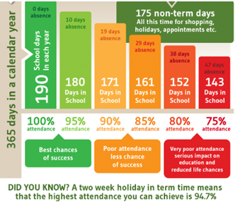
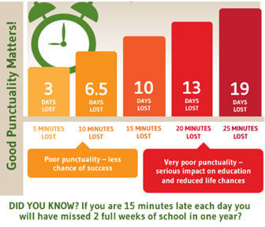
Attendance and Punctuality
This week’s attendance figures: 93% School Target: 96%
 | Attendance | Punctuality
Apple | 85.4% | 1 late
Beech | 95.9% | 3 lates / 2 children
Holly | 94.4% | 2 lates / 2 children
Oak | 91.9% | 2 lates / 2 children
Please try to arrive at school on time – it is really important for a smooth, settled start to the day

Slide 13
LOTTERY UPDATE:
We have raised £50! Come and join us to make a real difference and have the chance of winning great prizes. Buy a ticket before 23/12/23 to be entered into the Christmas Superdraw! We are on target to make £1372.80 of our £2080 target this year, with 66 tickets sold out of our 100 target. Please share far and wide and help us to get to 100!
https://www.yourschoollottery.co.uk/lottery/school/crayke-c-of-e-primary-school
https://www.yourschoollottery.co.uk/cause-data/69fff70b-431f-48e4-b699-e0d3389bbf96/leaflets/8123681c-4783-4f35-bd8e-7ba7fd3db3b7/support_our_school_2019%20-%20digital.pdf?updated=638340908586300000

Slide 14
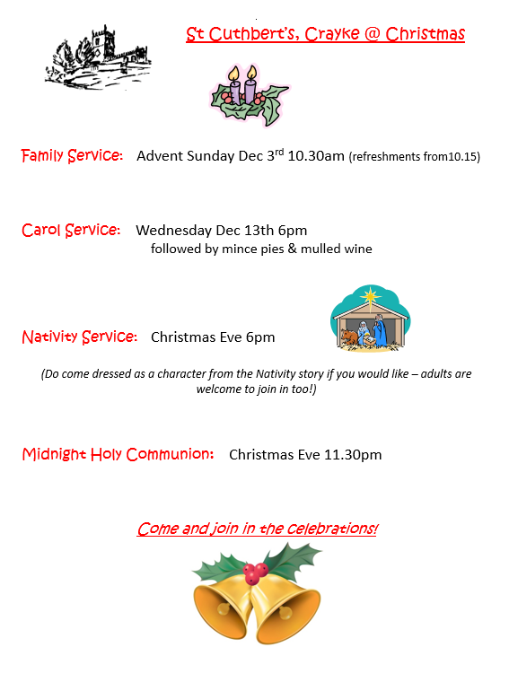
Church News

