Slide 1
Crayke Chronicle
Issue: #13 Term: Autumn Date: 8 December 2023
FOLLOW YOUR PATHWAY AND WE GROW TOGETHER WITH CONFIDENCE
You did not choose me, I chose you that you might go and bear fruit, fruit that will last so that whatever you ask in my name the Father will give you. John 15:16
Respect Friendship Forgiveness Determination

Slide 2
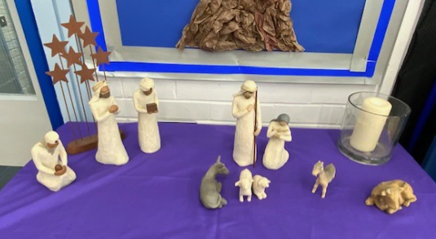
In our newsletter this week…
…News from school this week including Christmas preparations and class news.
…Find out about upcoming events before the end of term
Our regular items then follow:
…Awards in school
…Team Points
…PE Kits next week
…Attendance and Punctuality
…Extra curricular clubs
…CHASA news
…Church news

Slide 3
News from school this week
We’re all super excited for the pantomime this afternoon (oh yes we are!) – photos to follow next week. Thank you so much to CHASA for funding this opportunity and to the Sports Hall for providing the venue.
Read on to find out about what’s been happening in school this week and to see what exciting things we have in store for the rest of the term.
Have a lovely weekend!
Judi Jackson
Headteacher

Slide 4
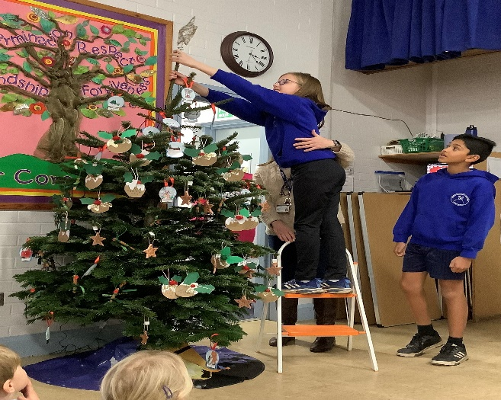
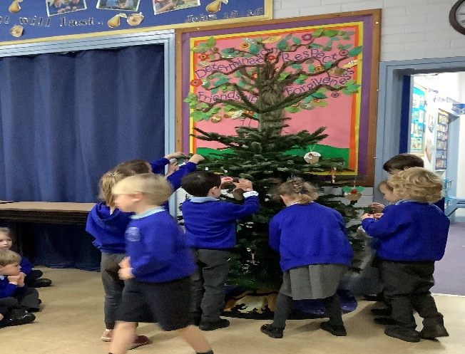
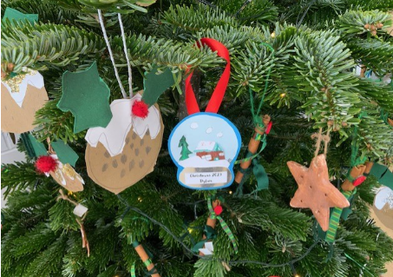
News from school this week
Christmas Tree Decoration
Staff and children gathered for the annual Christmas tree decoration event earlier this week. The decorations look spectacular and we are grateful to Newburgh Priory for the donation of the tree. Thank you to our oldest pupils, who were charged with putting the star atop the tree and switching the lights on!

Slide 5
News from school this week
Club News – Junior Duke
This week some of the children performed CPR. We talked about assessing for danger, checking for a response either by gently shaking or by speaking to them. The importance of checking their airways then look to see if they are still breathing. We talked about how important it is to call for help, get someone to bring the defib and to call the emergency services.
Next week is our last session on First Aid. We will be using a special app - I will post details about this so you can try out the app at home.
We are looking forward to next term’s challenges.
Mrs Helfferich

Slide 6
News from school this week
REMINDER: Club News
Please note that ALL clubs will conclude during next week and there will be NO clubs during the last week of term. Clubs will resume in the New Year. This includes both before school and after school clubs, with the exception of Tiddlywinks wraparound club. This will remain open until the end of term, except for on the last day of term when there will be no after school club due to our earlier finish at 2:30pm.
In the Spring Term, priority will be given to pupils who were unable to access clubs this term. In some cases, we may need to limit the number of clubs attended by pupils in order to ensure fairness for all.
Thank you to all the staff who have run clubs this term.

Slide 7
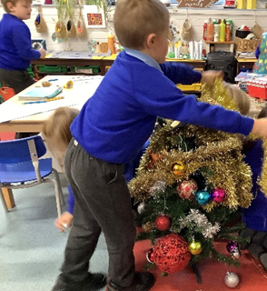
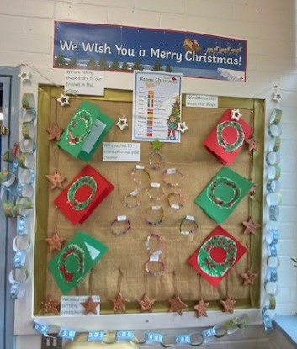
Class News- APPLE
Apple Class had lots and lots of fun decorating their class Christmas tree this week. You might just be able to spot it under all the tinsel!
It looks a little different today as the children arrived at school to find it covered in pants… those elves have been busy overnight!

Slide 8
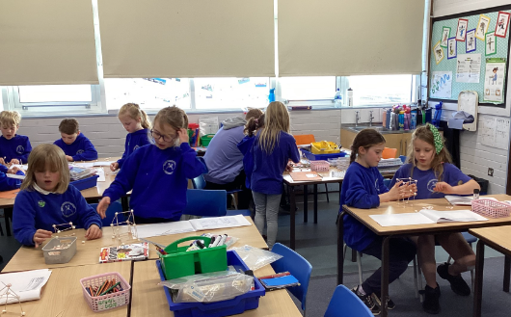
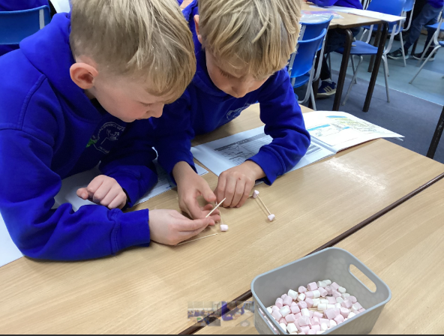
Class News – HOLLY
Design Technology
We are making free-standing frame structures exploring stability in DT (structures: pavilions)
Mrs Chandler

Slide 9
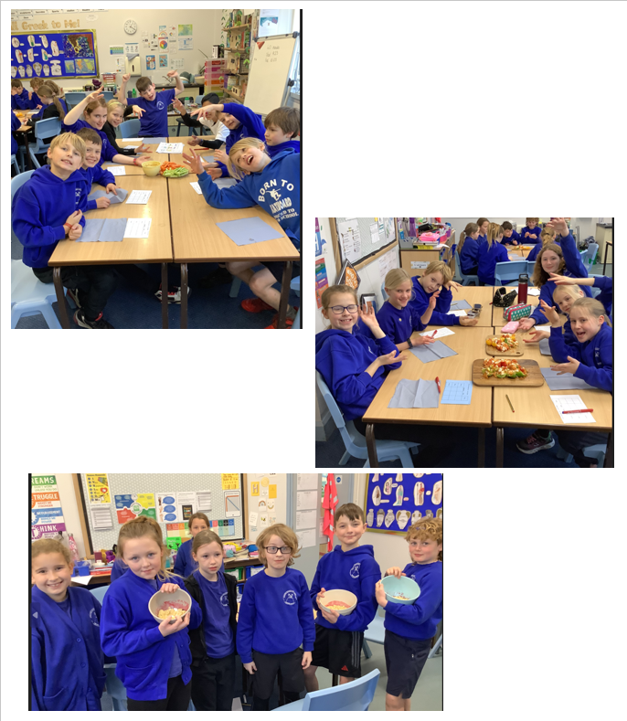
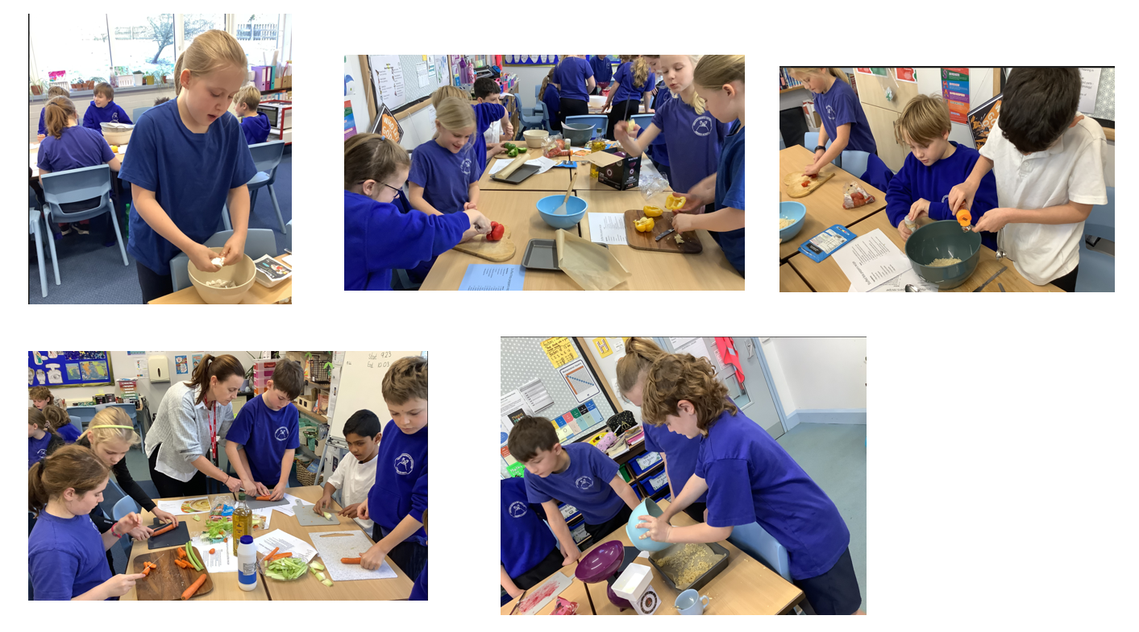
Class News - OAK
Oak Class had a wonderful day preparing a Greek themed three course meal as part of their Design Technology unit.
Miss Walker

Slide 10
Upcoming Events Reindeer Rush – Friday 22 December
After the success of last year’s event, we have decided to raise money again this year for St Leonard’s Hospice by having a Reindeer Rush running event on the final day of term. The children will be provided with antlers to run in and will be tasked with chasing Father Christmas around the grounds ! We’re also hopeful that York Mix will be coming to lead the warmup prior to the event.
If you wish to provide a donation, we would be very grateful if you could do so by clicking this link:
http://www.justgiving.com/page/craykeprimaryreindeerrush

Slide 11
Upcoming Events – Christmas@Crayke 2023
Date | Time | Event | What we need from you as parents
Monday 11 December |  | Christmas cards can be brought in from today | Please ensure that Christmas cards are clearly labelled with first name, surname and class to ensure safe delivery to the correct recipient.
Tuesday 12 December | 9:30am | Nativity Dress Rehearsal | All children involved need their costumes ready before today.
Wednesday 13 December | 9:30am 2:15pm | Nativity Performance 1 Nativity Performance | Book your tickets!
Tuesday 19 December | 12pm | Christmas Lunch | If your child normally has a packed lunch and would like Christmas Lunch please contact Mrs Bacon on admin@ by Friday 8 December at 3.30pm In the event of dietary requirements, a form will require completion prior to the event.
Tuesday 19 December | pm | Christmas Party afternoon | Come to school wearing party outfits.
Friday 22 December |  | Christmas Jumper Day Christmas Carol Concert Reindeer Rush afternoon End of term -2:30pm | Children are welcome to wear non-uniform and Christmas jumpers. Parents and carers are welcome to meet us at church for a service at 11am. Please ensure appropriate footwear for running outside. Sponsorship information sent separately.

Slide 12
Awards in School This Week
 | Apple | Beech | Holly | Oak
Stars of the Week | Ben Cheetham | Sophy Triffitt | Olive Beeson | Isabelle Sargent
 |  | Gem Champion | Grace Dawson | Sam Stubbins
Gold Awards for Sport | Lyuba Hobson | Esmond Tsang | Harry Lord | Isla Howland

Slide 13
Team Points
Team | Points
Red | 896
Blue | 753
Green | 742
Yellow | 731
Well done RED team!

Slide 14
PE Kits w/c 11 December 2023
Apple: Children in Apple Class need to bring their Forest School kit in each Friday. Please send their PE kit in on Monday as children will change for PE in school. They will bring PE kits home for washing periodically.
Please ensure that on PE days, the children wear their hoodies, school jumpers or cardigans alongside white or blue t-shirts and black or navy shorts or jogging bottoms.
 | Monday | Tuesday | Wednesday | Thursday | Friday
Beech |  |  |  | X | X
Holly |  | X |  |  | X
Oak |  |  |  | X | X

Slide 15
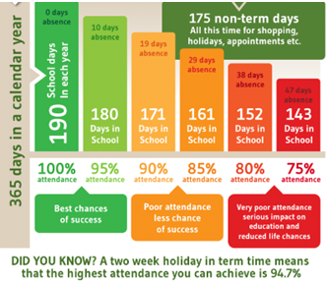
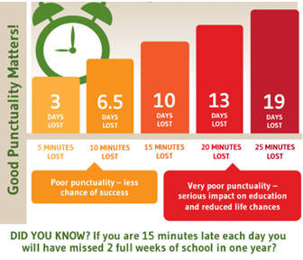
Attendance and Punctuality
This week’s attendance figures: 92% School Target: 96%
 | Attendance | Punctuality
Apple | 95.4% | 0 lates
Beech | 97.6% | 2 lates (2 children)
Holly | 90% | 3 lates (3 children)
Oak | 86.5% | 1 late
Please try to arrive at school on time – it is really important for a smooth, settled start to the day

Slide 16
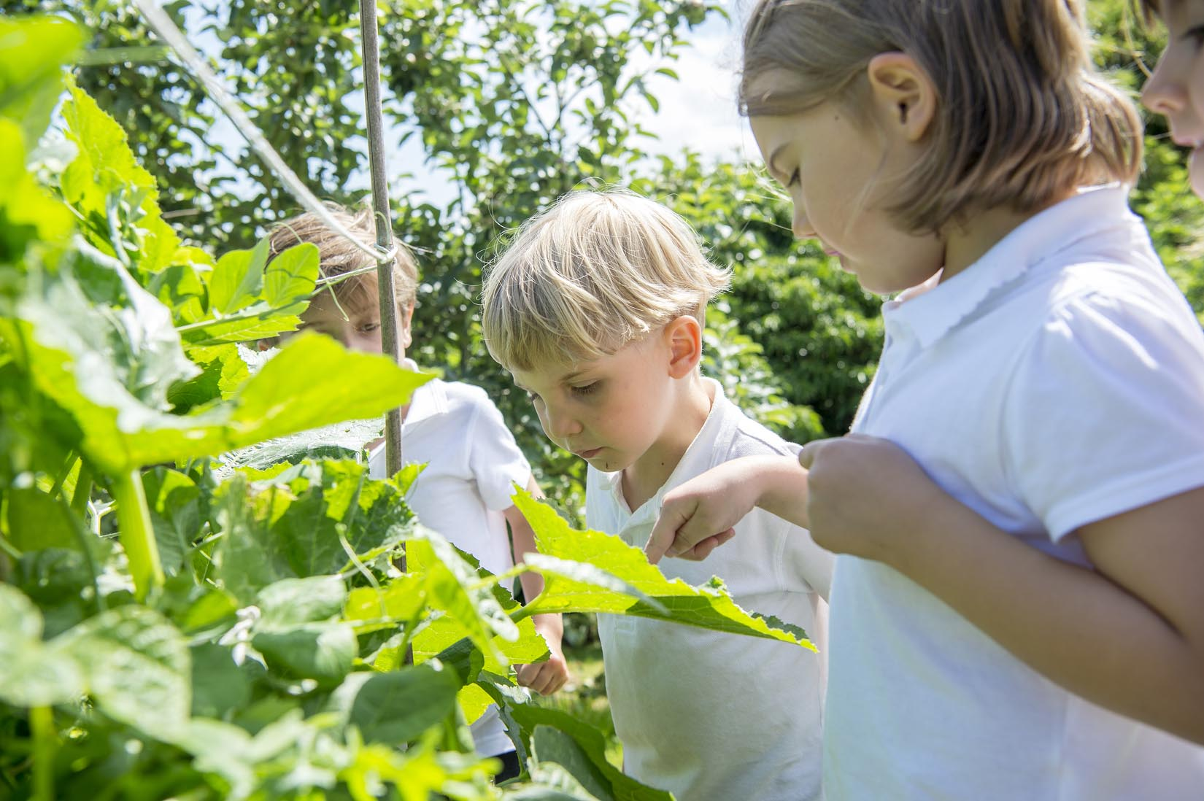
Extra Curricular Clubs - Autumn
Some clubs have limited capacity and places will be allocated on a first come first served basis. In the event of a club being fully booked, your child’s name will be added to a waiting list and you will be advised if a place becomes available. Booking is not required for before school or lunchtime clubs. For after school clubs run by school staff (denoted with *) please email Mrs Bacon on admin@crayke.n-yorks.sch.uk to book a place.
Before School:
After School:
Club | Day and Time | Group
Run a Mile | Monday, Tuesday Thursday & Friday 8:30am | All welcome – parents and carers included!
Day | Club
Monday | Craft* (£10 pay via ParentPay) 3:30 – 4:15pm Years 1 – 6 Mrs Seligman | Coding* 3:30pm – 4:15pm Years 3-6 Mr Brown
Tuesday | Multi-Sports (fee paid direct) 3:30 – 4:30pm Years 1 – 6 Mark Cromack
Wednesday | Junior Duke* (£10 pay via ParentPay) 3:30pm – 4:15pm Year 3/4 Mrs Helfferich
Thursday | Chess Club has now finished for this term
NB: Clubs will not run during the last week of term so the last sessions will be during w/c 11 December 2023.
Further information will follow about the arrangements for booking clubs in the Spring Term in due course.

Slide 17
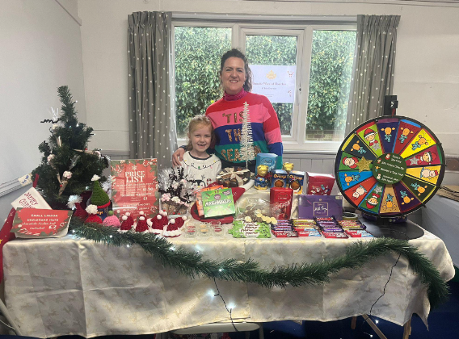
CHASA Christmas stalls have been run at Huby, Outwood Easingwold School and the Galtres Centre fairs. The combined stalls raised just over £300 for school. A big thank you to all the people who contributed to these and who helped on the stalls
We have leftover hot chocolate reindeer cones and crocheted chocolate orange Santa hats left, which we will be selling at the tuck shop today.

Slide 18
For further details and to sign up, please click on the links below!
https://www.yourschoollottery.co.uk/cause-data/69fff70b-431f-48e4-b699-e0d3389bbf96/leaflets/8123681c-4783-4f35-bd8e-7ba7fd3db3b7/support_our_school_2019%20-%20digital.pdf?updated=638340908586300000
https://www.yourschoollottery.co.uk/cause-data/69fff70b-431f-48e4-b699-e0d3389bbf96/leaflets/d7233b89-b7f2-4e62-b690-8a7a7513f27b/ysl_ps5vr2_nov23%20-%20digital.pdf?updated=638340265128170000

Slide 19
Please return your Rainbow Raffle tickets to school by Monday 11th December ready for the big draw on Wednesday.
Tickets also available online: https://crayke-home-and-school-association.sumupstore.com

Slide 20
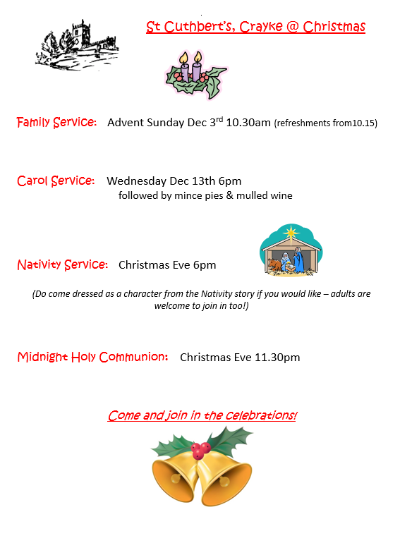
Church News

