Slide 1
Crayke Chronicle
Issue: #1 Term: Spring Date: 12 January 2024
FOLLOW YOUR PATHWAY AND WE GROW TOGETHER WITH CONFIDENCE
You did not choose me, I chose you that you might go and bear fruit, fruit that will last so that whatever you ask in my name the Father will give you. John 15:16
Respect Friendship Forgiveness Determination

Slide 2
Message from the Headteacher
Happy New Year!
I hope that everyone has had a restful holiday and adjusted to the routines of being back in school this week! Thank you once again on behalf of all the staff for your kindness and generosity with the lovely messages, cards and gifts we received at Christmas; we are very grateful.
The children have settled in well and made successful starts to their new learning themes. Further details about our curriculum offer can be found within this newsletter and on our website.
I am pleased to see the children looking so smart and well-presented; thank you for your continued support in making sure that they are wearing the correct uniform and bring the right things to school on the right days.
A special mention must be made to Oak Class children who represented the school so beautifully this week at Young Voices, and who will be serving and singing at the village Seniors Lunch this afternoon. Their behaviour and attitudes were noticed and complimented when in the wider community, which never fails to make me feel very proud indeed. Well done Oak Class! Thank you to the adults who accompanied the visit to Sheffield Arena – Mrs Rayner, Miss Walker, Mrs Willshaw and Mrs Hayes. It was an exceptionally long day for all, especially on the first day back after the holidays, but has served to give our children an experience that they will never forget.
Judi Jackson

Slide 3
A reminder that these are the areas of focus for learning for each class this term:
News from school this week – Curriculum Focus
Class | Theme | Enquiry Question | Enrichment (Stunning Start/Marvellous Middle/Fabulous Finish)
Apple | Dinosaurs Rock! Once Upon a Time | 1) Which dinosaurs lived on earth? 2) What important lessons can we learn from Fairy Tales? | 1) Dinosaur day 2) Author visit
Beech | Oh, I do like to be beside the seaside | What is it like beside the seaside? | Virtual tour of the Grace Darling museum
Holly | Tales from Dragon Mountain | Why do people live on volcanoes and mountains? | Volcano workshop – in school
Oak | Into the Darkness… | What was it like to live in the Dark Ages? | York University visit – Astrocampus and Robotics workshop

Slide 4
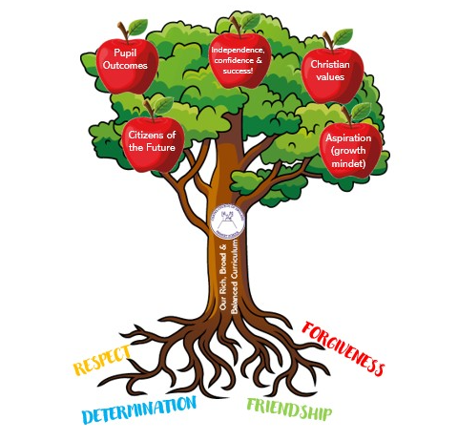
News from school this week – Curriculum Focus

Slide 5
News from school this week – Curriculum Focus
This term’s Curriculum Trees have been published on the school website for you to see what the children will be learning until Easter. The trees are available on our website, both in the Curriculum Overview section here: https://craykeschool.org/curriculum/overview-intent/
and also on the individual pages for each class:
Apple: https://craykeschool.org/classes/class-1/
Beech: https://craykeschool.org/classes/class-2/
Holly: https://craykeschool.org/classes/class-3/
Oak: https://craykeschool.org/classes/class-4/

Slide 6
News from school this week – Curriculum Focus
We are really excited that our specialist music sessions will be starting on Wednesday next week. The teacher will be Miss Leggatt and she will be teaching Beech, Holly and Oak class on an afternoon. Details of what the children will be learning can be found on their Curriculum Trees.
Miss Leggatt will also be offering a lunchtime choir club open to children from Y1-Y6.
After school, she will be running an ensemble group which will be open to children of all musical abilities in Key Stage 2. The club will run twice during the remainder of the academic year (Jan – Apr and May – July) giving two groups of up to 20 children an opportunity to participate and work towards a performance for parents in the final session. There will be a cost for this of £35 for 10 weeks.
Thank you to CHASA for funding the majority of the costs associated with this really wonderful opportunity for children in school.

Slide 7
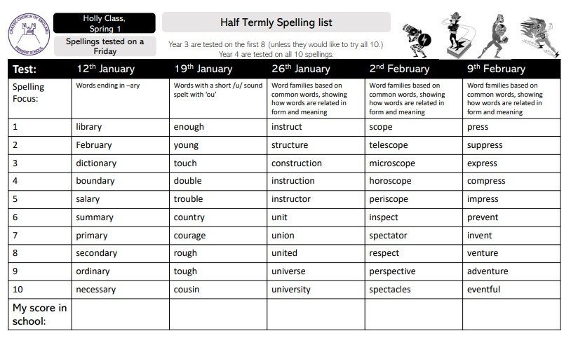
News from school this week - Spellings
Please see the Standing Items attachment for a copy of this term’s spelling lists (Y2-6)
They are also available on the webpage for your child’s class and in their Reading Diaries.

Slide 8
News from school this week – Reindeer Rush
What a great way to finish for Christmas! Thank you to everyone who sponsored our Reindeer Rush. Jasmine has sent us our certificate to let us know our final total and we await a delivery from Andy the postman . It was a windy afternoon; the field was drenched but we didn’t let that dampen our spirits. We took part in a warm up with Lenny from St Leonard’s hospice and Laura from YorkMix radio. We then went outside to walk laps of the playground. The children soon found that it was ‘snowing’, which caused great excitement.
Thank you to St Leonard’s and YorkMix; we love supporting you. See you in December 2024 for another fun filled afternoon!
Mrs Helfferich

Slide 9
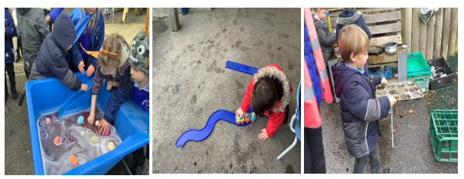
Class News- APPLE
It might have been a four-day week but it has been action packed! We have celebrated ‘National Bubble Bath Day’, by adding bath bombs to our water tray. We have spent a lot of time in our outdoor area making Santa’s sleigh; the reindeer kept venturing off to other activities so we never actually made it back to the North Pole.
We made cards to welcome Rosie the rabbit to our classroom. We are letting her settle in before the children hold her. They are so excited, they have already shown that they are going to be very responsible owners.
We admired some indoor fireworks outside, we looked at the changing colours and the hissing snakes.
We made giant junk model dinosaurs and learnt some new dinosaur songs. We look forward to learning lots more about dinosaurs over the next half term.
Mrs Helfferich

Slide 10
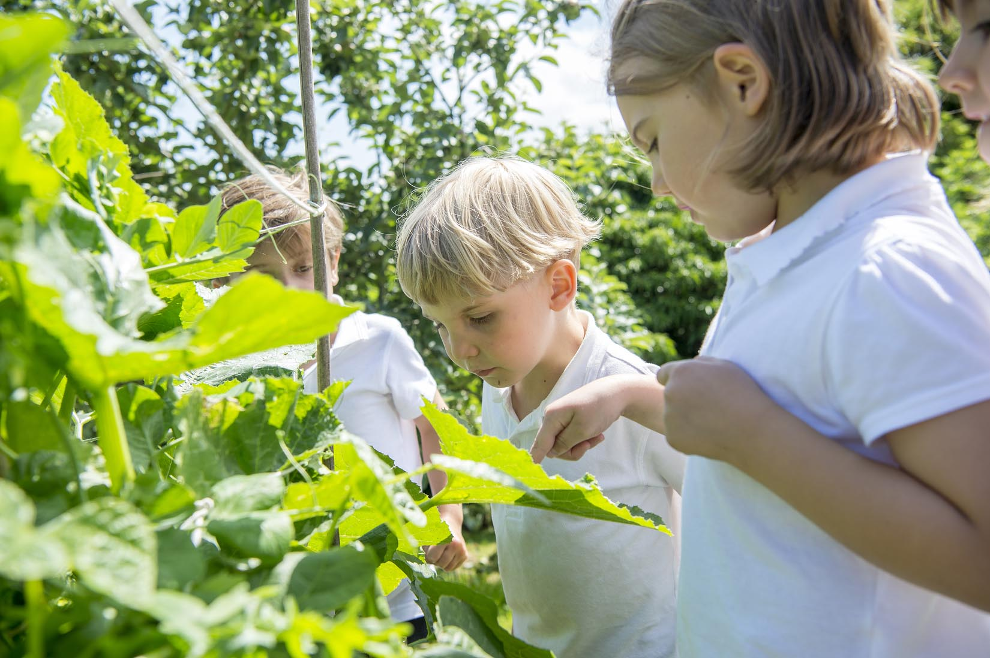
Extra Curricular Clubs - Spring
Some clubs have limited capacity and places will be allocated on a first come first served basis. In the event of a club being fully booked, your child’s name will be added to a waiting list and you will be advised if a place becomes available. Booking is not required for before school or lunchtime clubs. For after school clubs run by school staff (denoted with *) please email Mrs Bacon on admin@crayke.n-yorks.sch.uk to book a place.
Before School:
After School:
Club | Day and Time | Group
Run a Mile | Monday, Tuesday Thursday & Friday 8:30am | All welcome – parents and carers included!
Day | Club
Monday | Craft* (£10 pay via ParentPay) 3:30 – 4:15pm Years 1 – 6 Mrs Seligman
Tuesday | Multi-Sports (fee paid direct) 3:30 – 4:30pm Years 1 – 6 Mark Cromack
Wednesday | Junior Duke* PLACES FULL FOR YEAR 3:30pm – 4:15pm Year 3/4 Mrs Helfferich | Music Ensemble Club (£35 pay via ParentPay) Group 1 Jan – April / Group 2 May – July 3:30 – 4:30pm Years 3 - 6 Laarni Leggatt, SING Education
Thursday | Chess* (no charge) 3:30 – 4:15pm Years 2 – 6 Mrs Seligman | Science Club* (£8 pay via ParentPay) 3:30 – 4:15pm Years 3/4 Mrs Dobson

Slide 11
Awards in School This Week
 | Apple | Beech | Holly | Oak
Stars of the Week | Sylvia Hunsdale | Amber Brown | Elliott Braidwood | Brooke Smith
 |  | Milo Burnett-Armstrong | Olive Beeson | Sienna Jagger
Gold Awards for Sport | Lance Ward | Isla Fenton | Rosie Seligman | Joah Brown
Headteacher Awards Random Act of Kindness | Dianta Simpson |  | India Ward
Cloakroom Ninja tidiest cloakroom trophy | Oak Class

Slide 12
PE Kits w/c 15 January 2024
 | Monday | Tuesday | Wednesday | Thursday | Friday
Beech |  |  |  | X | X
Holly |  |  | X |  | X
Oak |  |  |  | X | X
Apple: Children in Apple Class need to bring their Forest School kit in each Friday. Please send their PE kit in on Monday as children will change for PE in school. They will bring PE kits home for washing periodically.
Please ensure that on PE days, the children wear their hoodies, school jumpers or cardigans alongside white or blue t-shirts and black or navy shorts or jogging bottoms.

Slide 13
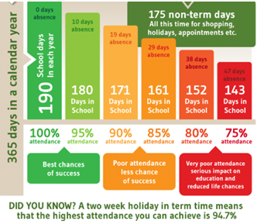
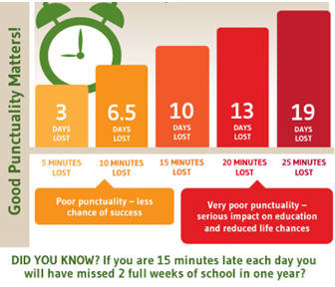
Attendance and Punctuality
This week’s attendance figures: 91.9% School Target: 96%
 | Attendance | Punctuality
Apple | 100% | 0 lates
Beech | 94.2% | 2 lates (1 child)
Holly | 87.1% | 0 lates
Oak | 91% | 0 lates
Well done Apple Class!

Slide 14
Save the Date!
We met this week to discuss our next event – a UV Disco! This will be held on Friday 9 February, after school, in the hall. Further details to follow.

