Slide 1
Crayke Chronicle
Issue: #2 Term: Spring Date: 19 January 2024
FOLLOW YOUR PATHWAY AND WE GROW TOGETHER WITH CONFIDENCE
You did not choose me, I chose you that you might go and bear fruit, fruit that will last so that whatever you ask in my name the Father will give you. John 15:16
Respect Friendship Forgiveness Determination

Slide 2
Message from the Headteacher
It’s hard to believe that we have only been back for two weeks, given how busy we have all been in school! We have had several visitors to school since Christmas and a recurring comment is that they are so impressed with the values displayed by our children and adults around school.
Friendship, forgiveness, respect and determination are evident in all classes and around school and this is being noticed!
Our new music teacher Miss Leggatt practically jumped up and down with glee on Wednesday afternoon having taught Beech, Holly and Oak classes. Her exact words were “Your children are awesome. I am blown away by their behaviour and how well they listen!”
It is always so lovely to hear such positive comments from other adults – well done everyone!
Judi Jackson

Slide 3
News from school this week
Message from the organisers of the Seniors’ Lunch…
“Thank you so much for allowing the children to come down to help and sing at the seniors party on Friday.
As always, they were a credit to the school. They freely chatted with the guests as they passed the nibbles round, very efficiently helped serve and clear away the food and delighted everyone with their beautiful singing!
Please thank the adults who came down with them, who also helped with serving food!
Thanks again, Fiona and Keren”

Slide 4
News from school this week
School Council have been busy exploring our new Big Questions. This term our questions are:
How can we celebrate our differences?
Last year, we showcased our amazing talents and skills as part of Crayke's Greatest Show. We want to put it on again this year and would love to know what you enjoyed and what we can make better.
What can we call our teampoint teams?
We want to have names for our teams that help to celebrate our learning. As a school we are focusing on exploring music in all of its different forms. We thought that musicians would be the perfect inspiration for our team names.
How can you get involved?
-If you have a favourite musician that you think we should name a team after, let us know! -We'd love for a mix of different musical styles, backgrounds and people. Think about why you think they inspire you.
-If you have any ideas on how to make Crayke's Greatest Show even better this time, let us know!
-Get thinking about what talents and skills you would like to show off and start practicing for rehearsals later in the term.
Suggestions can go into the yellow box in the hall, pass your ideas on to your School Council representative or email Miss Walker ewalker@crayke.n-yorks.sch.uk
We can't wait to hear your ideas!
Miss Walker

Slide 5
Upcoming Events
On Friday 2 February, we will be taking part in the NSPCC's Number Day again. Children are invited to 'dress up for digits' by coming to school dressed in non-uniform with a number on or something to count e.g. dots/stripes (please remember it is PE day so clothing still needs to be suitable for sport) During the day children will be participating in an NSPCC number activity. KS2 pupils are invited to complete an NSPCC Rocks activity on TTRS at home:
https://ttrockstars.com/events/events-online/nspccrocks2024/?totr
Information about how to donate to support 'Speak Out Stay Safe' and 'Childline' to follow soon.
Mrs Chandler, Maths Subject Leader

Slide 6
Class News- APPLE
We have been learning all about dinosaurs! We made dinosaur fossils using cocoa salt dough. We made some dinosaur small world environments. Due to the weather this week, we have been out exploring the snow and ice. We put dinosaurs in cold water and left them overnight. We then thought about how we could free the dinosaurs from the ice. Rosie the rabbit is settling in really well, the children are enjoying holding her.
Mrs Helfferich

Slide 7
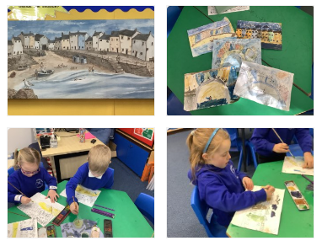
Class News - BEECH
Art
Beech Class have been inspired by the artist Janice McGloine. We have created our own paintings in watercolours using her style and in particular her 'wonky houses' which we loved!
Mrs Dobson

Slide 8
Class News – HOLLY
Holly class had a wonderful day on Thursday learning all about Volcanoes and Earthquakes in our 'Stunning Start' workshop. We played games, took part in a quiz show, used our acting skills and produced, directed and edited our own video (available soon on the Holly Class web page - just use your child's Google log-in details to watch!) demonstrating all that we had learnt. In Riley-Mae's own words "This has been really fun!" A huge thankyou to CHASA for funding such a great learning experience for us.
Mrs Chandler

Slide 9
Class News - OAK
Oak Class - Senior Citizens' Lunch
We thoroughly enjoyed attending the lunch, all the children represented Crayke School and their families wonderfully. They were polite, friendly and helpful. The lunch is always a fantastic opportunity to help our community and something we really look forward to. Well done Oak Class!
Miss Walker

Slide 10
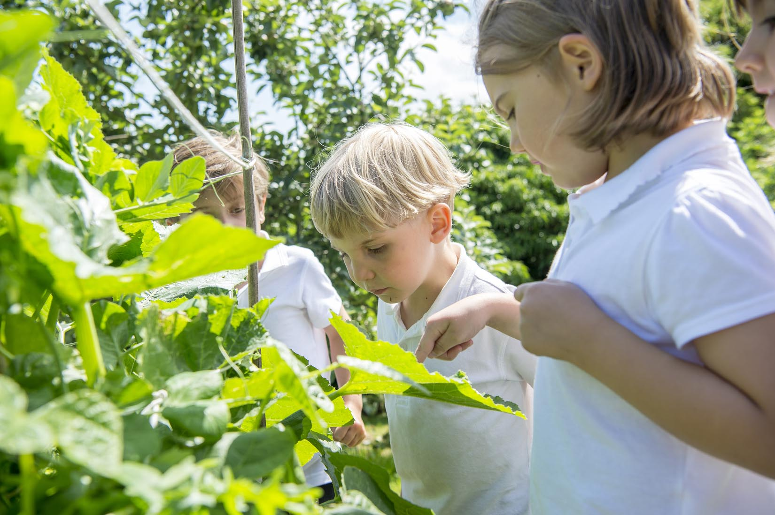
Extra Curricular Clubs - Spring
Some clubs have limited capacity and places will be allocated on a first come first served basis. In the event of a club being fully booked, your child’s name will be added to a waiting list and you will be advised if a place becomes available. Booking is not required for before school or lunchtime clubs. For after school clubs run by school staff (denoted with *) please email Mrs Bacon on admin@crayke.n-yorks.sch.uk to book a place.
Before School:
After School:
Club | Day and Time | Group
Run a Mile | Monday, Tuesday Thursday & Friday 8:30am | All welcome – parents and carers included!
Day | Club
Monday | Craft* (£10 pay via ParentPay) 3:30 – 4:15pm Years 1 – 6 Mrs Seligman
Tuesday | Multi-Sports (fee paid direct) 3:30 – 4:30pm Years 1 – 6 Mark Cromack
Wednesday | Junior Duke* PLACES FULL FOR YEAR 3:30pm – 4:15pm Year 3/4 Mrs Helfferich | Music Ensemble Club (£35 pay via ParentPay) Group 1 Jan – April / Group 2 May – July 3:30 – 4:30pm Years 2 - 6 Miss Leggatt, SING Education
Thursday | Chess* (no charge) 3:30 – 4:15pm Years 2 – 6 Mrs Seligman | Science Club* (£8 pay via ParentPay) 3:30 – 4:15pm Years 3/4/5/6 Mrs Dobson

Slide 11
Awards in School This Week
 | Apple | Beech | Holly | Oak
Stars of the Week | Jackson Harker | Charlotte Stilburn | Joshua Jefferson | Dylan Swiers
 |  | Pippa Dawson | India Ward | Zhdan Kovalchuk
Gold Awards for Sport | Zeffy Copley | Henry Robinson | Keenan Lee | Isaac Copley
Headteacher Awards Random Act of Kindness | Amber Brown |  | Keenan Lee
Cloakroom Ninja tidiest cloakroom trophy | Holly Class

Slide 12
PE Kits w/c 22 January 2024
 | Monday | Tuesday | Wednesday | Thursday | Friday
Beech |  |  |  | X | X
Holly |  |  | X - swim |  | X
Oak |  | X – new day |  |  | X
Apple: Children in Apple Class need to bring their Forest School kit in each Friday. Please send their PE kit in on Monday as children will change for PE in school. They will bring PE kits home for washing periodically.
Please ensure that on PE days, the children wear their hoodies, school jumpers or cardigans alongside white or blue t-shirts and black or navy shorts or jogging bottoms.

Slide 13
Team Points
Team | Points
Red | 1304
Blue | 976
Green | 967
Yellow | 1033
Well done RED team!

Slide 14
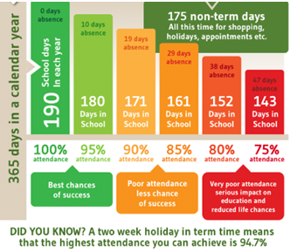
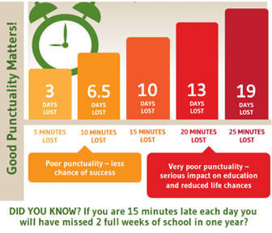
Attendance and Punctuality
This week’s attendance figures: 93.4% School Target: 96%
 | Attendance | Punctuality
Apple | 96.9% | 0 lates
Beech | 92% | 4 lates (4 children)
Holly | 91.9% | 1 late
Oak | 95.2% | 1 late

