Slide 1
Crayke Chronicle
Issue: #3 Term: Spring Date: 26 January 2024
FOLLOW YOUR PATHWAY AND WE GROW TOGETHER WITH CONFIDENCE
You did not choose me, I chose you that you might go and bear fruit, fruit that will last so that whatever you ask in my name the Father will give you. John 15:16
Respect Friendship Forgiveness Determination

Slide 2
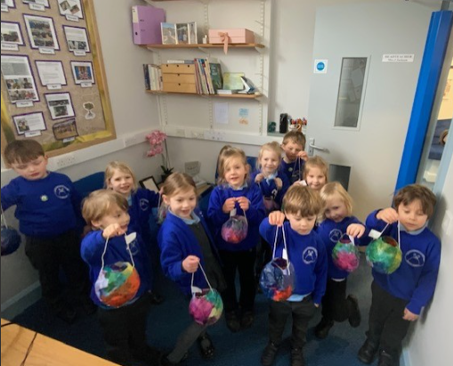
Message from the Headteacher
It was lovely to have a visit from Apple Class who proudly brought their lanterns to show me!
We would love Apple Class parents to complete this “New Starter Survey” to give us some feedback about how your child has settled in at Crayke so far:
https://forms.office.com/e/igRuxRtLqz
Thanks in advance!
Have a lovely weekend,
Judi Jackson
Headteacher

Slide 3
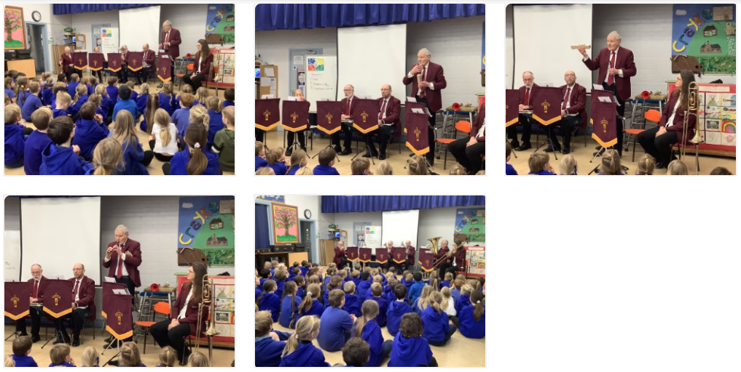
News from school this week
Easingwold Town Band demonstration
We were treated to a demonstration from some of the band members last Friday – the group were very impressed with the children’s musical knowledge, particularly in identifying the pieces being played. Our thanks to Bill and the team!
Thank you for visiting!

Slide 4
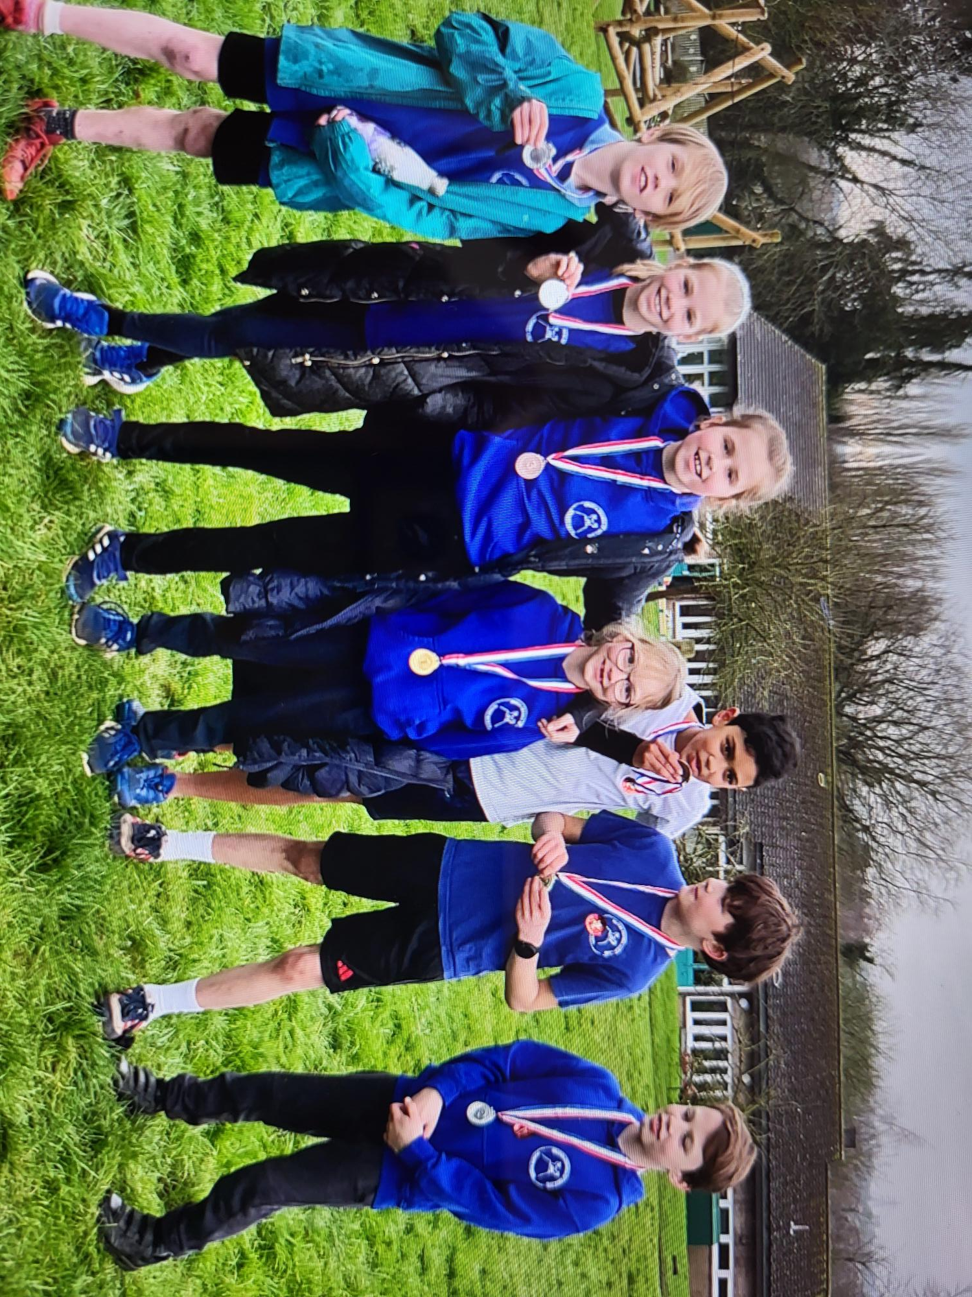
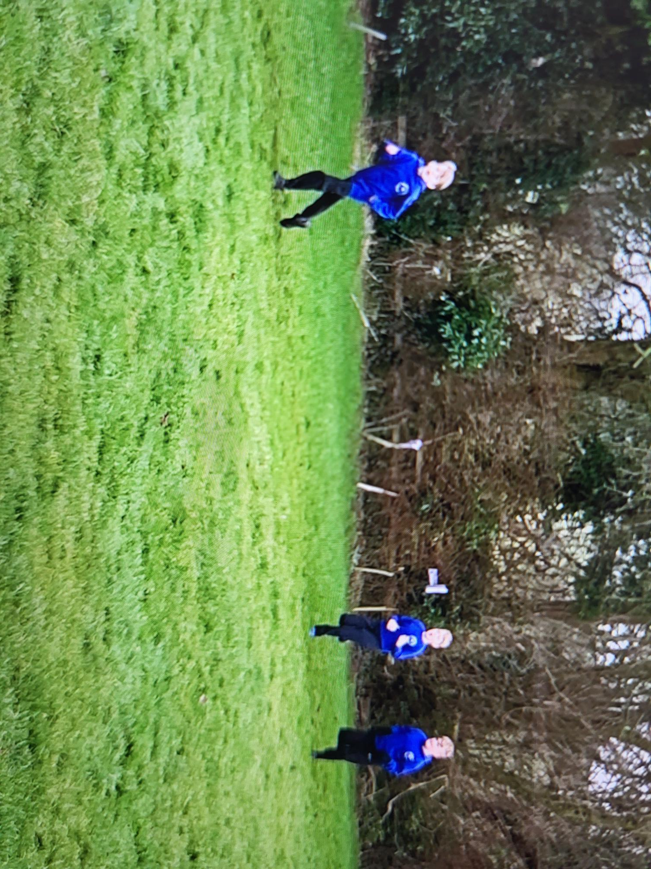
News from school this week
Cross Country Report
KS2 Cross Country was a fantastic opportunity. The children showed great sportsmanship in cheering and supporting everyone as well as perseverance in running the many laps of the field. It was very muddy but no-one let that put them off!
Special mention to Mabel, who really embodied our value of friendship when she went back for someone from another school who had fallen and helped them up. We were so proud of you Mabel!

Slide 5
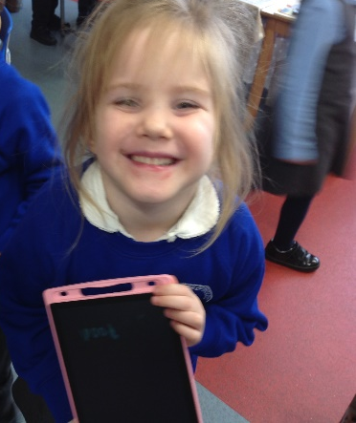
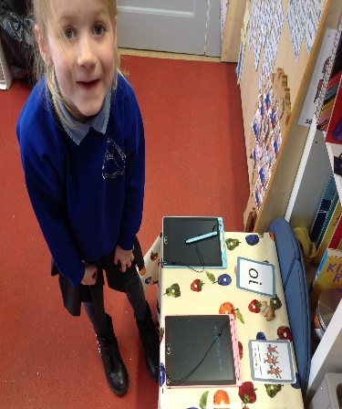
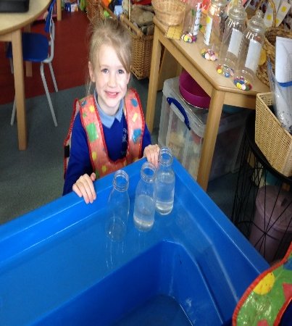
Class News- APPLE
This week we have been really busy with our phonics and maths. The children have been keen to write on the magic boards. We learnt about capacity this week, we filled bottles ‘full’, ‘half full’ and left one ‘empty’. Rosie is settling in really well and enjoying getting to know the children.
Mrs Helfferich

Slide 6
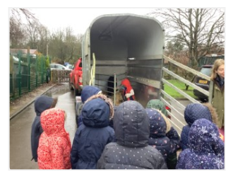
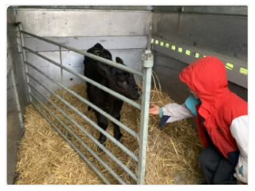
Class News - BEECH
On Tuesday, Beech Class had a wonderful surprise - a visit from Milo's one week old calf! It linked perfectly with our science work on animals and their basic needs to survive. We had great fun watching the calf being fed and asking lots of questions.
We were asked to think of a name for the cow, everyone was asked to think of suggestions at home and Milo picked his 3 favourites and then we voted for our favourite - Storm!
A huge thank you to Mr & Mrs Burnett-Armstrong for providing the children with such a fantastic experience!
Mrs Dobson

Slide 7
Upcoming Events
On Friday 2 February, we will be taking part in NSPCC's Number Day again. Children are invited to 'dress up for digits' by coming to school dressed in non-uniform with a number on or something to count e.g. dots/stripes (please remember it is PE day so clothing still needs to be suitable for sport) During the day children will be participating in an NSPCC number activity. KS2 pupils are invited to complete an NSPCC Rocks activity on TTRS at home:
https://ttrockstars.com/events/events-online/nspccrocks2024/?totr
Information about how to donate to support 'Speak Out Stay Safe' and 'Childline' to follow soon.
Mrs Chandler, Maths Subject Leader

Slide 8
Upcoming Events
Parent Meetings
It’s that time of year again where we invite parents into school to learn about upcoming statutory assessments. This year we are trialling holding these meetings at 3pm, in order to aim to maximise parental attendance before the school pick up. Details are as follows:
Please note, the dates of when these assessments will be taking place (May/June 2024) are on the diary dates. It is vitally important that your children are present in school during these assessment periods. Thank you.
Date and time | Time | Focus of meeting | Who’s invited | Meeting led by
Tuesday 6 February 2024 | 3pm | SATs | Year 6 parents | Mrs Rayner
Thursday 8 February 2024 | 3pm | Handwriting | Reception parents | Mrs Helfferich
Wednesday 6 March 2024 | 3pm | Phonics | Year 1 parents | Mrs Dobson
TBC | 3pm | Multiplication Tables Check (MTC) | Year 4 parents | Mrs Chandler

Slide 9
Upcoming Events
World Book Day
On Thursday 7th March, it's World Book Day! The children will be taking part in a range of activities within school, all around the theme of 'Books: The soundtrack to our lives.’
As we are promoting a love of music particularly this year at Crayke, we are inviting the children to bring in a favourite book (of any genre,) and choose at least one song that would be a suitable soundtrack to accompany the book (for example, a book about space or a story set in space might have 'Starman' by David Bowie, or 'Rocket Man' by Elton John as a good accompaniment.) Children will then be able to share and discuss their soundtracks, favourite books and perhaps even have a go at creating their own soundtrack to a particular part of a story!
Children won't need to dress up and can come in full school uniform as normal.

Slide 10
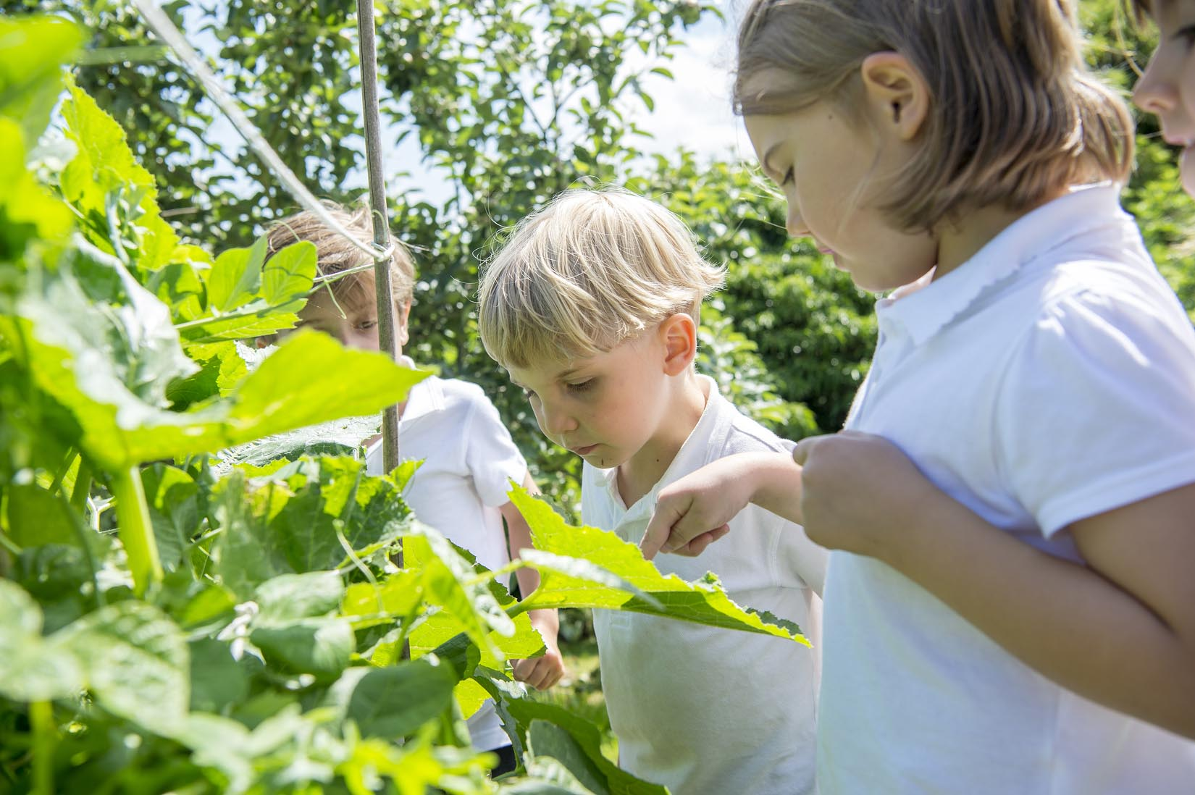
Extra Curricular Clubs - Spring
Some clubs have limited capacity and places will be allocated on a first come first served basis. In the event of a club being fully booked, your child’s name will be added to a waiting list and you will be advised if a place becomes available. Booking is not required for before school or lunchtime clubs. For after school clubs run by school staff (denoted with *) please email Mrs Bacon on admin@crayke.n-yorks.sch.uk to book a place.
Before School:
After School:
SATs club starts
Monday 5 February!
Club | Day and Time | Group
Run a Mile | Monday, Tuesday Thursday & Friday 8:30am | All welcome – parents and carers included!
Day | Club
Monday | Craft* (£10 pay via ParentPay) 3:30 – 4:15pm Years 1 – 6 Mrs Seligman | SATs* (no charge) 3:30 – 4:15pm Year 6 Mrs Rayner
Tuesday | Multi-Sports (fee paid direct) 3:30 – 4:30pm Years 1 – 6 Mark Cromack
Wednesday | Junior Duke* PLACES FULL FOR YEAR 3:30pm – 4:15pm Year 3/4 Mrs Helfferich | Music Ensemble Club (£35 pay via ParentPay) Group 1 Jan – April / Group 2 May – July 3:30 – 4:30pm Years 3 - 6 Miss Leggatt, SING Education
Thursday | Chess* (no charge) 3:30 – 4:15pm Years 2 – 6 Mrs Seligman | Science Club* (£8 pay via ParentPay) 3:30 – 4:15pm Years 3/4 Mrs Dobson

Slide 11
Awards in School This Week
 | Apple | Beech | Holly | Oak
Stars of the Week | Mabel Ankers | Jacob Watson | Arthur Barrett | Percy Ollive
 |  | Martha Seligman | Harry Lord | Brooke Smith
Gold Awards for Sport | Edmund Sadler | Tomas Davies | Carl Keaney | Leonard Liddell

Slide 12
PE Kits w/c 29 January 2024
 | Monday | Tuesday | Wednesday | Thursday | Friday
Beech |  |  |  | X | X
Holly |  |  | X - swim |  | X
Oak |  | X |  |  | X
Apple: Children in Apple Class need to bring their Forest School kit in each Friday. Please send their PE kit in on Monday as children will change for PE in school. They will bring PE kits home for washing periodically.
Please ensure that on PE days, the children wear their hoodies, school jumpers or cardigans alongside white or blue t-shirts and black or navy shorts or jogging bottoms.

Slide 13
Team Points
Team | Points
Red | 78
Blue | 67
Green | 63
Yellow | 60
Well done Red team!

Slide 14
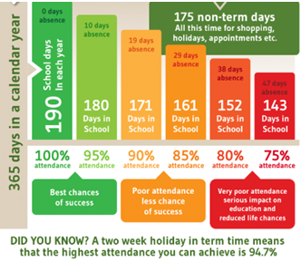
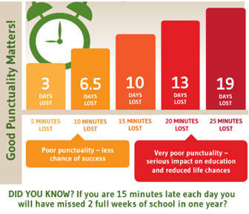
Attendance and Punctuality
This week’s attendance figures: 93.4% School Target: 96%
 | Attendance | Punctuality
Apple | 96.9% | 1 Late
Beech | 93.3% | 2 Lates / 2 Children
Holly | 95.3% | 1 Late
Oak | 89.2% | 1 Late

Slide 15
CHASA want to make sure all children are able to attend the disco, if they want to, so alongside the standard tickets CHASA has introduced a ‘Goodwill Ticket’ (free) for those who need it and a ‘Pay It Forward’ ticket (£5) for those who would like to fund a ticket for another child.

Slide 16
Please see flyers for details of the forthcoming CHASA school disco and luxury raffle! Additional supervisors would be grateful welcomed, please see details below if you're able to help. Tickets are available online only, please follow the link to purchase: https://crayke-home-and-school-association.sumupstore.com/product/uvalentines-disco-6-7-15pm Additional info: * Friday 9th February - same disco repeated in 2 sessions for capacity and safety reasons. * £5 donation to fund UV glow disco face paint, props, squash/ water, donut. * Please feel free to wear your own UV clothing/ tattoos/etc. * Please note purchase of this ticket constitutes the bill payer giving consent for the child named to attend the special event. * Purchase of the ticket constitutes consent for children’s faces to be painted and to use the school records for allergy and medical condition information needed to safely run the event. * Please contact CHASA: chasa@crayke.n-yorks.sch.uk if you do not consent to your child’s face being painted. * Apple class parents are welcome to attend if you inform us chasa@crayke.n-yorks.sch.uk * Anyone wishing to volunteer please contact VGRIFFIN@crayke.n-yorks.sch.uk
Thank you for your support! CHASA 🕺

