Slide 1
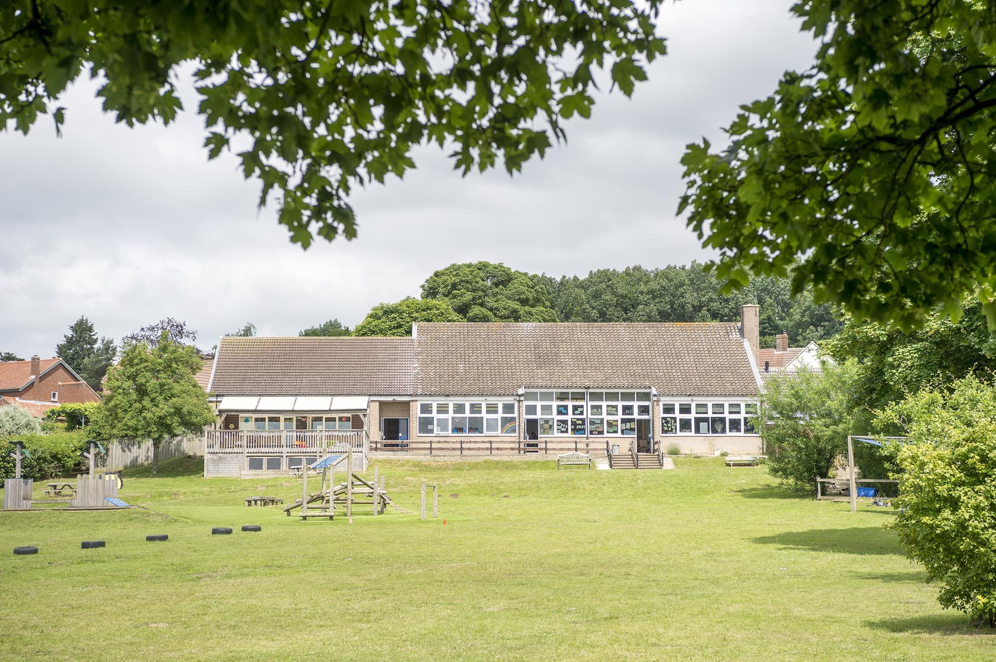
Crayke CE Primary School
Spring Term 2024
Crayke Chronicle - Standing Items

Slide 2
Our Safeguarding Team
At Crayke, we have three members of staff and a governor who make up our Safeguarding Leadership Team. Mrs Jackson is the Designated Safeguarding Lead, which means that she is the lead person responsible for child protection and safeguarding issues. Mrs Rayner and Mrs Chandler are our Deputy Designated Safeguarding Leads (Deputy DSLs); a deputy DSL supports the DSL in their role of safeguarding and child protection. Mrs Andrea Hayes is our Safeguarding Link Governor. The role of the Safeguarding Governor is to support the DSL as well as to regularly review, ask questions and make suggestions about our safeguarding policies and procedures and to report back to the governing body. All staff at Crayke know that safeguarding is EVERYONE’S responsibility. Find out more on our dedicated website Safeguarding page: https://craykeschool.org/safeguarding/
You can also report any safeguarding concerns to our DSL email: dsl@crayke.n-yorks.sch.uk
Please also be aware that as a school we subscribe to Operation Encompass, whereby we are notified of any incidences of domestic violence where a pupil at our school has been present.

Slide 3
Attendance and Punctuality
Attendance
We strive for high levels of attendance at school. Please try, wherever possible, to book holidays out of term time. The impact of even one day’s absence on your child’s learning is huge. Also, please try to book medical appointments out of school hours if possible as this also minimises the time missed. If your child is very unwell and unable to attend school, please inform the office by phoning 01347 821767 no later than 9:15am. Thank you for your support with this important matter.
Punctuality
It is very important that the children arrive to school on time so that: 1. They take part in all of the learning opportunities for the day with complete focus and without interruption from late arrivals. 2. Teachers can teach the best possible lessons without complete focus and without interruption from late arrivals.

Slide 4
School Website
Our school website contains a wealth of information on all matters relating to school life.
Please visit the curriculum section here: https://craykeschool.org/curriculum/ to find out more about what your child is learning in school.
Please also visit the ‘Parents’ section for more information about school routines and expectations and the ‘Children’ section for other useful information.

Slide 5
Online Safety
We recognise the importance of online safety and also understand that it is a fast paced, ever changing online world where parents can struggle to keep up with the technical knowledge and understanding demonstrated by their children. The National Online Safety organisation produce guides, which we share with parents and carers regularly. These leaflets are also made available on the Online Safety section of our website. Should you wish to access any of the other online safety parent guides available on a whole range of topics including what parents need to know about Amazon Fire Tablets, Google Chromebooks, and ways to champion equality online, please have a look at this weblink: https://nationalonlinesafety.com/guides
Should you wish to access more information about how to support your child/ren with online safety at home, this course is available which explains in detail the risks they might be exposed to and what you can do to support them. https://info.nationalonlinesafety.com/myleene-uk

Slide 6
Cost of Living Crisis – Pupil Premium
We are very aware that costs continue to rise and look set to do so for some time. If you are encountering financial difficulties, we may be able to signpost support. Please get in touch.
If your circumstances have changed and you think your child may be eligible for free school meals, it has never been easier to apply. There is no stigma attached to this, it is not highlighted to the children in any way, and the school gets valuable funding too. If you would like a confidential conversation about whether you may be eligible for free school meals, please do not hesitate to speak to me. To apply directly please use this weblink: https://www.northyorks.gov.uk/free-school-meals

Slide 7
SPRING TERM 24 | Week 1 Served w/c 8th Jan, 29th Jan, 26th Feb & 18th Mar | Week 2 Served w/c 15th Jan, 5th Feb & 4th Mar | Week 3 Served w/c 22nd Jan, 19th Feb & 11th Mar
Monday | Lasagne Broccoli & Carrots Homemade Garlic Bread Cornflake Crispie Fresh Fruit or Fruit Yoghurt | Pizza Mixed Salad & Grated Carrot Potato Wedges Fruit Jelly & Ice-cream Fresh Fruit or Fruit Yoghurt | Crunchy Topped Mac & Cheese Green Beans & Sweetcorn Homebaked Garlic Bread Jam Doughnut Muffin Fresh Fruit or Fruit Yoghurt
Tuesday | Chicken Nuggets Diced Potatoes Peas & Sweetcorn Homemade 50/50 Bread Marble Berry Sponge & Custard Fresh Fruit or Fruit Yoghurt | Meatballs in a Creamy Sauce 50/50 Rice Carrots & Broccoli Crusty Bread Chocolate Sponge & Chocolate Sauce Fresh Fruit or Fruit Yoghurt | Sausage & Mashed Potato Gravy Carrots & Broccoli Homemade 50/50 Bread Oatie Apple Crumble & Custard Fresh Fruit or Fruit Yoghurt
Wednesday | Roast Pork & Stuffing Mashed Potato Medley of Vegetables Gravy Crusty Bread Cheese & Crackers Fresh Fruit or Fruit Yoghurt | Roast Chicken, Yorkshire Pudding & Gravy Roast Potatoes Medley of Vegetables Sliced Wholemeal Bread Orange Shortcake Fresh Fruit or Fruit Yoghurt | Minced Beef & Dumplings Roast Potatoes Carrots & Peas Sliced Wholemeal Bread Chocolate Orange Mousse Pot with Melting Moment Fresh Fruit or Fruit Yoghurt
Thursday | Beef Chilli Wrap Vegetable Rice Carrots & Green Beans Fruity Flapjack Fresh Fruit or Fruit Yoghurt | Spaghetti Bolognese Sweetcorn & Green Beans Homebaked Garlic Flatbread Oak & Fruit Cookie Fresh Fruit or Fruit Yoghurt | Chicken Korma & 50/50 Rice Cauliflower & Green Beans Naan Bread Cheese & Biscuit Fresh Fruit or Fruit Yoghurt
Friday | Battered Fish & Chips with Ketchup Peas & Sweetcorn Sunflower Seed Bread Lemon Drizzle Muffin Fresh Fruit or Fruit Yoghurt | Fish Star, Chips and Ketchup Vegetable Sticks Homemade 50/50 Bread Chocolate Berry Mousse Cake Fresh Fruit or Fruit Yoghurt | Fish Fingers, Chips & Ketchup Sweetcorn & Peas Crusty Bread Berry Iced Bun Fresh Fruit or Fruit Yoghurt

Slide 8
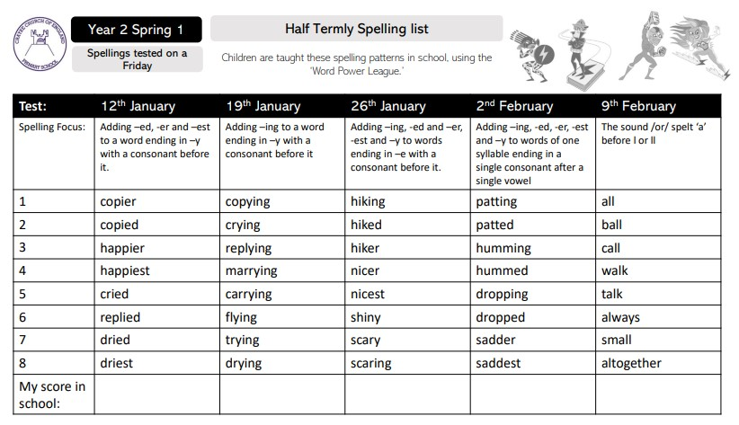
Spring Term Spelling Lists – Year 2 Spring 1

Slide 9
Spring Term Spelling Lists – Year 2 Spring 2

Slide 10
Spring Term Spelling Lists – Holly Spring 1

Slide 11
Spring Term Spelling Lists – Holly Spring 2

Slide 12
Spring Term Spelling Lists – Oak Spring 1

Slide 13
Spring Term Spelling Lists – Oak Spring 2

Slide 14
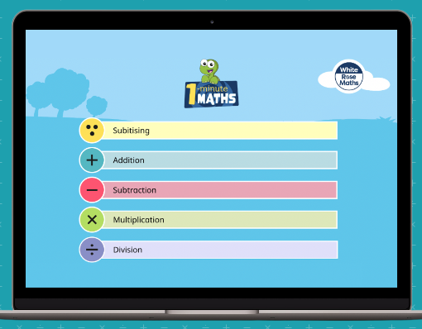
1 minute maths

