Slide 1



SPRING TERM NEWSLETTER

Slide 2



A MESSAGE FROM CHASA
As we enter the spring, we thought we might update you on the past few months and what we have achieved. With help from parents, teachers, the children and wider community, we have had some wonderful events that have been really successful and here we are to show you what the money YOU have raised will be spent on. We are ever so grateful for your continued support and hope you are just as excited as us about what we have planned over the next few months!
THANK YOU!

Slide 3



This year’s focus is on supporting the development of
MUSIC
for all children in school.
We would like to support the school in the development of musical expertise within school by enhancing the music curriculum offer and seeking professional musicians to run workshops and demonstrations for the children.
We would like to extend the range of musical resources available for children to use.
We have funded the cost of the coach travel for Oak Class to visit Sheffield Arena for Young Voices!
We are looking to extend the range of instruments available for children to play in school.

Slide 4

Over the years we have raised funds to buy many things including books, IT equipment and dining tables for the hall. We also fund book bags for our Reception new starters and hoodies for our Y6 leavers.
With each passing year, as Y6 children move on to secondary school, we lose members and therefore, in order to continue organising fun events for the children and their families, we need new members to join us. Please look out for our meeting dates that we will publicise in the school newsletter.
If you are unable to attend meetings but have fundraising suggestions or can help us at our main events (such as the discos and Summer Fairs) please do let us know. We cannot arrange these events without your help.
WE ARE LOOKING FOR NEW MEMBERS!
CHASA is a group of busy parents and friends of the school who arrange fundraising events (such as fairs,
quiz nights, raffles, ice cream Fridays, and discos) throughout the year to generate extra funds to buy resources to benefit the children at Crayke CE Primary School.

Slide 5

CURRENT FUNDRAISING
TUCK SHOP
PRE-LOVED UNIFORM
Every Friday, the children love the tuck shop after school, and it has been a very popular addition to our fundraising. We are so pleased to say that since the beginning of November, the tuck shop has raised £476.37.
We have a stock of pre-loved uniform. We love the concept of recycling to do our bit to save the planet; it saves you money and raises money for the school.
If you require any items, please contact us. If you have any good quality uniform items that your child has outgrown, we encourage you to donate to our stock (via the school office). The last uniform sale at Parents evening raised £80! Look out for the upcoming sale at the Parents evening in March.

Slide 6




HELP US RAISE FUNDS FOR FREE!
Sign up to https://www.easyfundraising.org.uk/causes/craykeceschoolcrayke/ and make Crayke CE School your chosen charity and they will donate a small percentage of your purchase cost to us (at no cost to you).
Just use the app or website every time you shop online.
Hundreds of retailers have signed up including Amazon, Argos, Next, Ebay, John Lewis, M&S, Just Eat, TUI, Trainline and many, many more...
They also give a lump sum to us if accessed to compare and change insurance or utility providers.

Slide 7
Minimal effort fundraising..
Your school lottery was launched in December. So far, 57 tickets each week have been purchased by wonderful parents and grandparents (and teachers and governors and the wider community). So far this year we have raised £193.60 and are on target to make £1224.00 this year (January-December). tickets cost £1 per week and you will be in the chance of winning the £25,000 jackpot! Please support us by signing up here: https://www.yourschoollottery.co.uk/lottery/school/crayke-c-of-e-primary-school

Slide 8



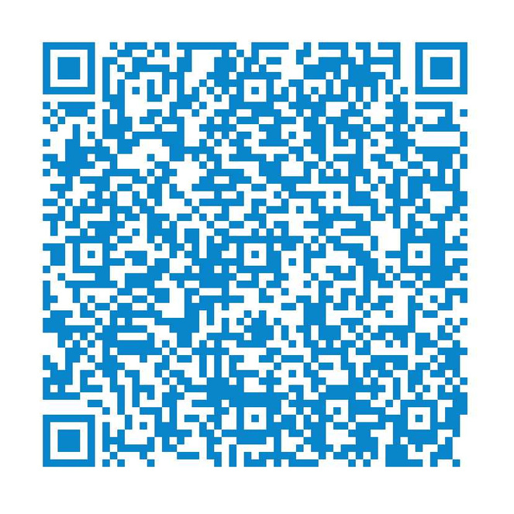
Minimal effort fundraising..

Slide 9


CHASA Meeting - All Welcome - Monday 4th March 2024 - 1.30pm
Pre-loved Uniform Sale -
Tuesday 12th and Wednesday 13th of March 2024
DATES FOR THE DIARY
Easter After School Craft Session - Thursday 21st March 2024
Summer Fair - Sunday 23rd June 2024 SAVE THE DATE!

Slide 10
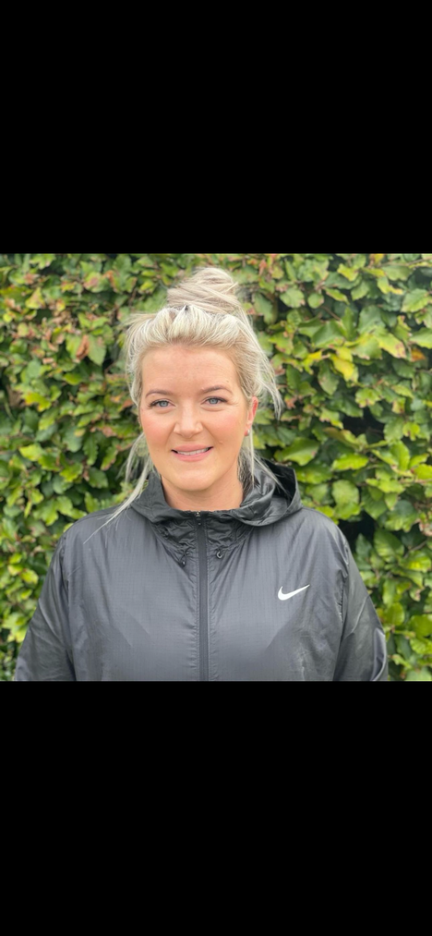
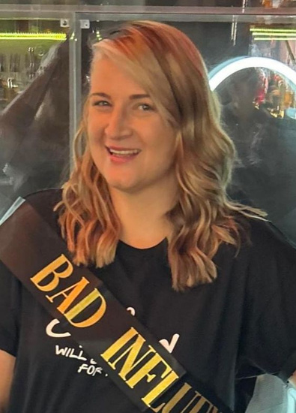



CHASA COMMITTEE
CONTACT DETAILS
Victoria Cain
Jade Bunker
Tracey Swiers
Rebecca Stubbins
CHAIR
VICE CHAIR
TREASURER
SECRETARY
chasa@crayke.n- yorks.sch.uk
chasavicechair@cray ke.n-yorks.sch.uk
chasatreasurer@cra yke.n-yorks.sch.uk
chasasecretary@cra yke.n-yorks.sch.uk

Slide 11



Fundraising Nov 23-
FEB 24
Xmas
cards
£187
Xmas
stalls
£292
Nestlé
grants
£500
School
Lottery
£193.60
Rainbow
raffle
£352
Luxury
raffle
£405
Cartridge
recycling
£65
Easy-
Fundraising
£61.13
Tuck Shop
£476.37
UV
DISCO
£505
Stikins
£34.72
Xmas
craft night
£295
Online
Xmas
Gifts
£55
Bonfire
night
£506
For a more detailed insight, please contact chasatreasurer@crayke.n-yorks.sch.uk

Slide 12



WHAT DID THE SCHOOL SPEND IT ON?
Chocolate oranges
OAK
Young
voices
trip
Beech
school
trip
Holly
volcano
workshop
Felt
tips
SPECIALISTMUSIC LESSONS FOR EVERY CLASS
MUSICAL INSTRUMENTS
CHRISTMAS ELF VISIT
CHRISTMAS PANTOMIME
LUNCHTIME
SCHOOL
CHOIR
SOLAR
PANEL CONTRIBUTION
*APPLE CLASS TRIP COMING IN SUMMER

Slide 13

With your help, since the start of November, we have raised:
£3,927.82

