Slide 1
Crayke Chronicle
Issue: #4 Term: Spring Date: 2 February 2024
FOLLOW YOUR PATHWAY AND WE GROW TOGETHER WITH CONFIDENCE
You did not choose me, I chose you that you might go and bear fruit, fruit that will last so that whatever you ask in my name the Father will give you. John 15:16
Respect Friendship Forgiveness Determination

Slide 2
Message from the Headteacher
As part of our “Year of Music”, we would be grateful if parents/carers could take a few moments to complete this survey: https://forms.office.com/e/grdHMpVbG3
It will provide us with useful details about the musical tuition your child may already be receiving and also give us some information about whether you would like signposting to other musical opportunities within the local area. Please complete the survey for each child you have in school, whether they currently learn an instrument or not, before the end of next week. Thanks in advance!
It is hard to believe that next week is the final week of this half term; we break up for February half term at 3:30pm on Friday 9 February and return to school on Monday 19 February.
Have a lovely weekend,
Judi Jackson
Headteacher

Slide 3
News from school this week
Cross Country Report
Well done to our medal winners from last week’s cluster event at Husthwaite Primary School!
 | GOLD | SILVER | BRONZE
Year 4 | Rosie | Lucas
Year 5 |  | Nancy Joah
Year 6 |  | Toby | Alice Asa

Slide 4
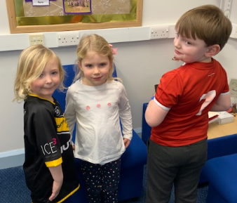
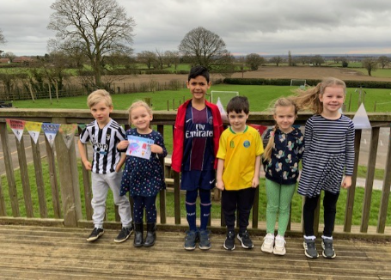
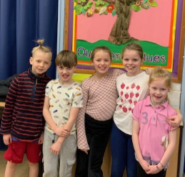
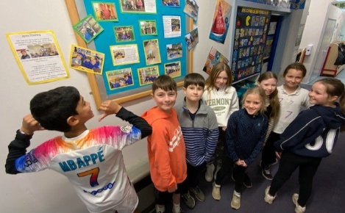
News from school this week
Number Day
The children look spectacular in their outfits and we’ve all been busy counting all morning!
If anyone wishes to donate to NSPCC, the general link for donations is:
https://www.nspcc.org.uk/support-us/ways-to-give/donate/

Slide 5
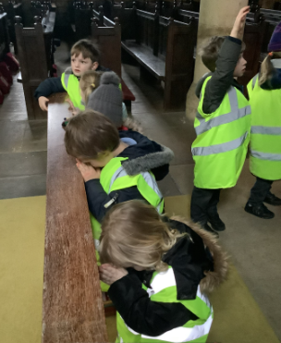
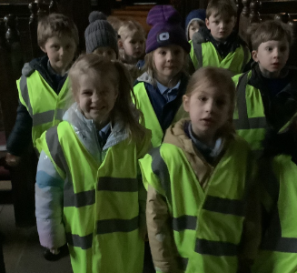
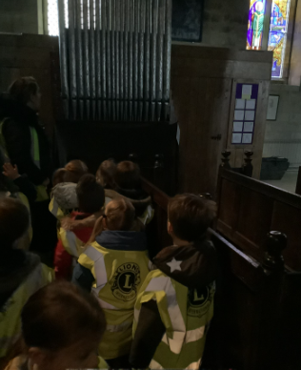
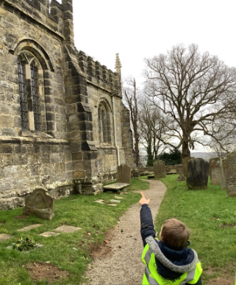
Class News- APPLE
As part of our Religious Education this half term, Apple Class have been exploring places that are special. We learnt about Christians and their special place of a Church. We had the opportunity to visit St Cuthbert's in Crayke. We looked for features of the church including: bell tower, pews, pulpit, stained glass windows, altar and font. The children loved exploring the Church especially admiring the beautiful windows and spotting crosses around the church building.
We're learning about lots of different religions within Apple Class and would love to welcome visitors into school to speak about their faith, particularly those of other faiths to Christianity. If you know anyone within the community who would like to do so, please get in touch with Miss Walker at ewalker@crayke.n-yorks.sch.uk
Miss Walker

Slide 6
Class News- APPLE
A reminder that we would love Apple Class parents to complete this “New Starter Survey” to give us some feedback about how your child has settled in at Crayke so far:
https://forms.office.com/e/igRuxRtLqz
It really will only take a few minutes and will give us information about what has worked well and what we can do even better – thank you.

Slide 7
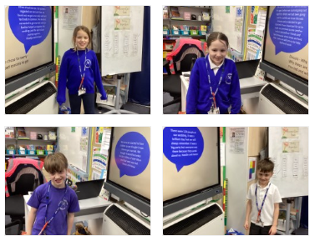
Class News – HOLLY
We have had 4 new teachers in Holly class this week helping me to teach our RE lesson! They all did a great job helping to lead our learning but agreed it was a harder job than it looks standing at the front!
Mrs Chandler

Slide 8
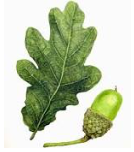
Class News - OAK
Archbishop Young Leaders Award
This week, Oak Class learnt about the Archbishop Young Leaders Award that they will be beginning after half term. The Young Leaders Award aims to equip young people to ‘be the change they want to see’ in their local communities, and through a number of interactive lessons and practical challenges our pupils will be involved in serving their community and making a difference. Children have been introduced to a 'challenge grid' where they can select a minimum of five challenges to do between now and April, to count towards their award. These can be found on the Oak Class Google Site (using the children's school Google login.)
For more information about the award, please visit www.abyyt.com.
Thank you in anticipation for your support with this exciting project,
Mrs Rayner

Slide 9
Upcoming Events
Parent Meetings
It’s that time of year again where we invite parents into school to learn about upcoming statutory assessments. This year we are trialling holding these meetings at 3pm, in order to aim to maximise parental attendance before the school pick up. Details are as follows:
Please note, the dates of when these assessments will be taking place (May/June 2024) are on the diary dates. It is vitally important that your children are present in school during these assessment periods. Thank you.
Date and time | Time | Focus of meeting | Who’s invited | Meeting led by
Tuesday 6 February 2024 | 3pm | SATs | Year 6 parents | Mrs Rayner
Wednesday 6 March 2024 | 3pm | Phonics | Year 1 parents | Mrs Dobson
Monday 19 February 2024 | 3pm | Handwriting (Change of date) | Reception parents | Mrs Helfferich
Thursday 7 March | 3pm | Multiplication Tables Check (MTC) | Year 4 parents | Mrs Chandler

Slide 10
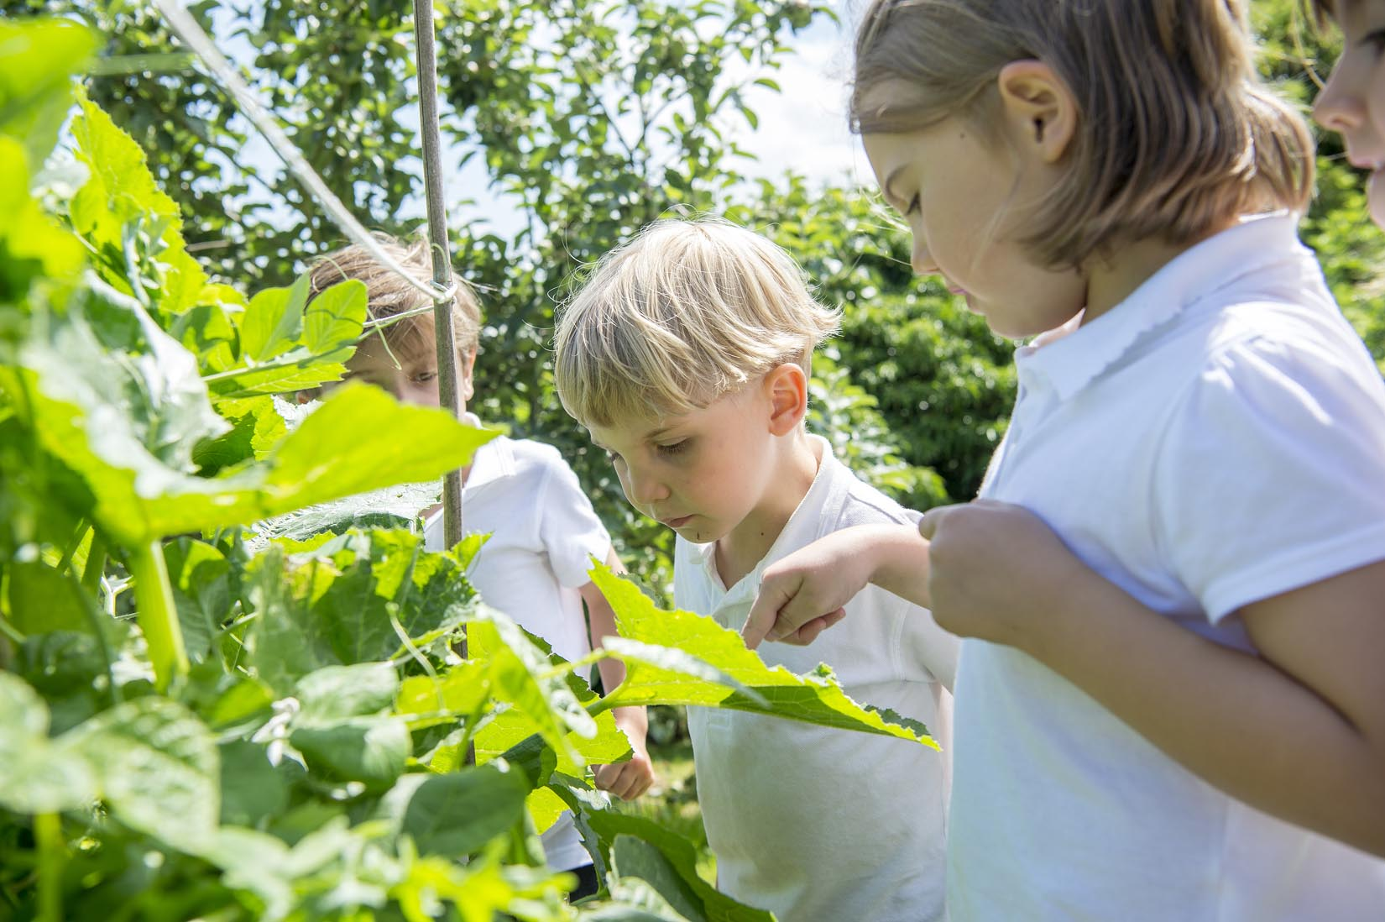
Extra Curricular Clubs - Spring
Some clubs have limited capacity and places will be allocated on a first come first served basis. In the event of a club being fully booked, your child’s name will be added to a waiting list and you will be advised if a place becomes available. Booking is not required for before school or lunchtime clubs. For after school clubs run by school staff (denoted with *) please email Mrs Bacon on admin@crayke.n-yorks.sch.uk to book a place.
Before School:
After School:
Club | Day and Time | Group
Run a Mile | Monday, Tuesday Thursday & Friday 8:30am | All welcome – parents and carers included!
Day | Club
Monday | Craft* (£10 pay via ParentPay) 3:30 – 4:15pm Years 1 – 6 Mrs Seligman | SATs* (no charge) 3:30 – 4:15pm Year 6 Mrs Rayner
Tuesday | Multi-Sports (fee paid direct) 3:30 – 4:30pm Years 1 – 6 Mark Cromack
Wednesday | Junior Duke* PLACES FULL FOR YEAR 3:30pm – 4:15pm Year 3/4 Mrs Helfferich | Music Ensemble Club (£35 pay via ParentPay) Group 1 Jan – April / Group 2 May – July 3:30 – 4:30pm Years 3 - 6 Miss Leggatt, SING Education
Thursday | Chess* (no charge) 3:30 – 4:15pm Years 2 – 6 Mrs Seligman | Science Club* (£8 pay via ParentPay) 3:30 – 4:15pm Years 3/4 Mrs Dobson | Times Tables Club* (no charge) 3:30-4:15pm Year 4 Mrs Chandler NB Selected dates – see next slide

Slide 11
Club News
Year 4 Times Table Club
Pupils in Year 4 are welcome to attend this club which will help prepare them for the upcoming MTC check by playing games. This will be run on the following dates, from 3:30 – 4:15pm
Thursday 29th February
Thursday 14th March
Thursday 11th April
Thursday 25th April
Thursday 9th May
Thursday 23rd May
Thursday 6th June
Mrs Chandler

Slide 12
Club News
Year 6 SATs Club: Change of Start Date
Please note that, due to unforeseen circumstances, the Year 6 SATs club will now begin straight after half term on Monday 19th February with each session running until 4:15pm.
This will be a chance for Year 6 pupils to revise with their peers and help them to feel prepared and confident going into their SATs tests in May. Please confirm your child's attendance by emailing lrayner@crayke.n-yorks.sch.uk so that I can plan accordingly.
Mrs Rayner

Slide 13
Awards in School This Week
 | Apple | Beech | Holly | Oak
Stars of the Week | Evelyn Dobreva | Alanna Dawson | Oliver Wilson | Nancy Barrett
 |  | Arabella Hinzpeter | Dexter Bird | Toby Seligman
Gold Awards for Sport | Dianta Simpson | Martha Seligman | Mabel Dawson | Ted Clark
Headteacher Awards Random Act of Kindness | Jackson Harker | Riley-Mae Simpson
Cloakroom Ninja tidiest cloakroom trophy | Apple Class

Slide 14
PE Kits w/c 5 February 2024
 | Monday | Tuesday | Wednesday | Thursday | Friday
Beech |  |  |  | X | X
Holly |  |  | X - swim |  | X
Oak |  | X |  |  | X
Apple: Children in Apple Class need to bring their Forest School kit in each Friday. Please send their PE kit in on Monday as children will change for PE in school. They will bring PE kits home for washing periodically.
Please ensure that on PE days, the children wear their hoodies, school jumpers or cardigans alongside white or blue t-shirts and black or navy shorts or jogging bottoms.

Slide 15
Team Points
Team | Points
Red | 880
Blue | 760
Green | 960
Yellow | 1053
Well done YELLOW team!

Slide 16
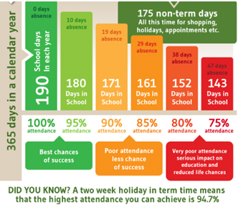
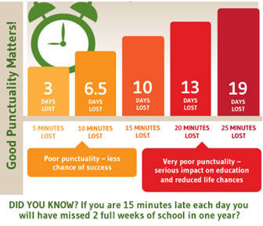
Attendance and Punctuality
This week’s attendance figures: 94.2% School Target: 96%
 | Attendance | Punctuality
Apple | 96.9% | 0 lates
Beech | 96.3% | 0 lates
Holly | 88.8% | 1 late
Oak | 97.2% | 2 lates (2 pupils)

Slide 17
CHASA want to make sure all children are able to attend the disco, if they want to, so alongside the standard tickets CHASA has introduced a ‘Goodwill Ticket’ (free) for those who need it and a ‘Pay It Forward’ ticket (£5) for those who would like to fund a ticket for another child.

Slide 18
Please see flyers for details of the forthcoming CHASA school disco and luxury raffle! Additional supervisors would be grateful welcomed, please see details below if you're able to help. Tickets are available online only, please follow the link to purchase: https://crayke-home-and-school-association.sumupstore.com/product/uvalentines-disco-6-7-15pm Additional info: * Friday 9th February - same disco repeated in 2 sessions for capacity and safety reasons. * £5 donation to fund UV glow disco face paint, props, squash/ water, donut. * Please feel free to wear your own UV clothing/ tattoos/etc. * Please note purchase of this ticket constitutes the bill payer giving consent for the child named to attend the special event. * Purchase of the ticket constitutes consent for children’s faces to be painted and to use the school records for allergy and medical condition information needed to safely run the event. * Please contact CHASA: chasa@crayke.n-yorks.sch.uk if you do not consent to your child’s face being painted. * Apple class parents are welcome to attend if you inform us chasa@crayke.n-yorks.sch.uk * Anyone wishing to volunteer please contact VGRIFFIN@crayke.n-yorks.sch.uk
Thank you for your support! CHASA 🕺

Slide 20
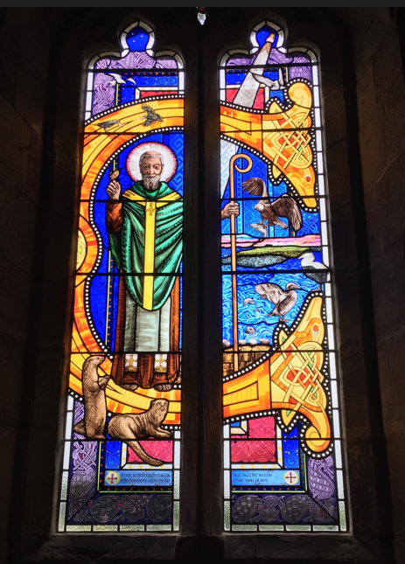
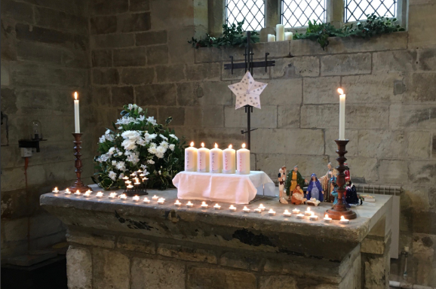
Church News – from the Family Service Team
Happy New Year! It's February already!!
You and your families are all invited to join the first Family Service of 2024 on Sunday 4th February at 10.30am.
The friendly and familiar to all the children as well as Crayke School Governor; Lucy Willshaw will be part of the team leading the service and activities. All starting at 10.15am with cake, biscuits and hot/cold drinks.
Future dates at St Cuthbert's:
March 5th Family Service as usual at 10.30am
March 31st EASTER DAY - there will be a Family Holy Communion at 10am (note the time!)
As ever, other services in the Benefice can be found on our website at https://bylandchurches.wordpress.com/services-in-church/

