Slide 1
Crayke Chronicle
Issue: #6 Term: Spring Date: 23 February 2024
FOLLOW YOUR PATHWAY AND WE GROW TOGETHER WITH CONFIDENCE
You did not choose me, I chose you that you might go and bear fruit, fruit that will last so that whatever you ask in my name the Father will give you. John 15:16
Respect Friendship Forgiveness Determination

Slide 2
Message from the Headteacher
Welcome back to Spring 2! It has definitely been a “mixed weather” week but there are some signs of Spring which have been lovely to see!
This week we have welcomed Ms Christiana Bradley to join our team as a kitchen assistant. We are delighted that she has settled in so quickly. This has enabled us to make further improvements to the running of lunchtime service.
We have some lovely and exciting news to share with you too… Miss Walker and her partner are expecting a baby! She is due in August, so will aim to be with us for the remainder of the academic year, before starting her maternity leave. We are all thrilled and know that she will be a wonderful mum.
Judi Jackson
Headteacher

Slide 3
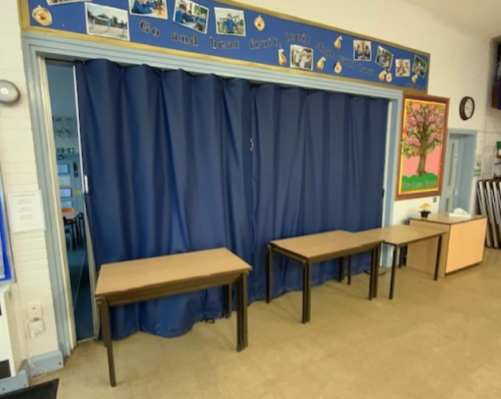
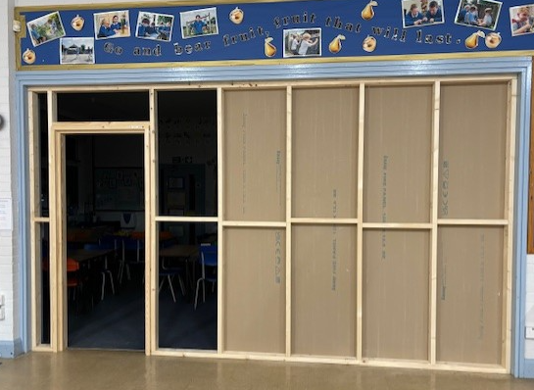
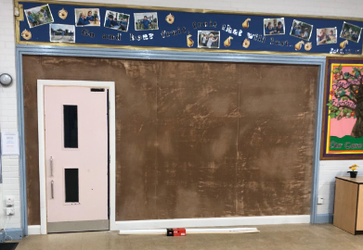
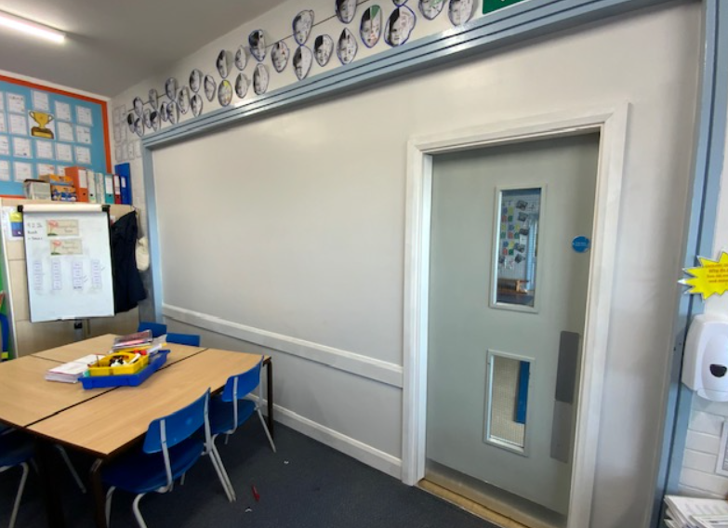
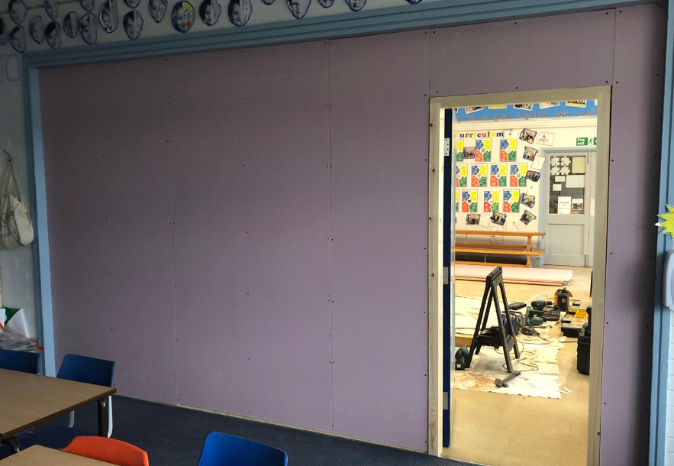
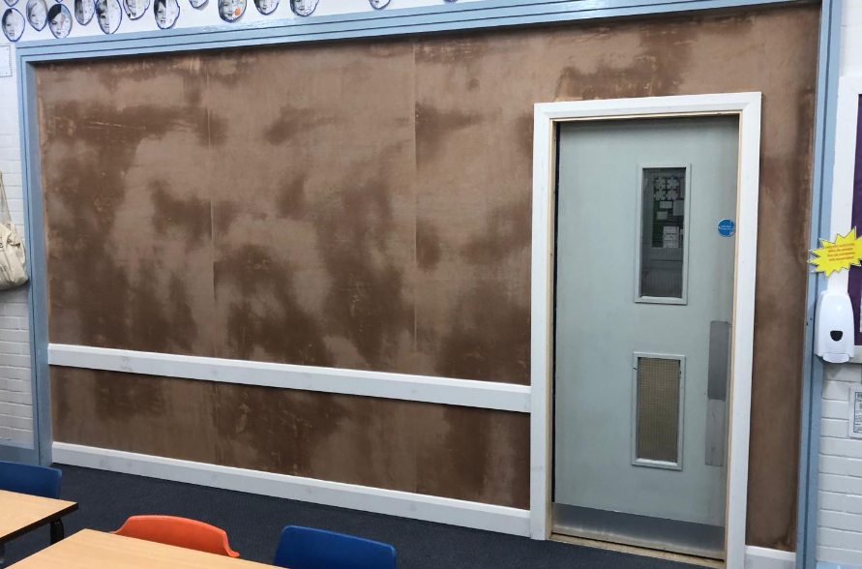
News from school this week
School Improvement – The Great Wall of Crayke!
I have never known, or experienced, so much excitement about a wall! We are absolutely ecstatic that the blue partition curtain was replaced during half term and we now have a solid wall alongside a door which we have re-purposed from another local school. It’s due another coat of paint or two from our resident expert decorator Mr Porter but here’s the journey so far…!
BEFORE…
Current view in Holly Class!

Slide 4
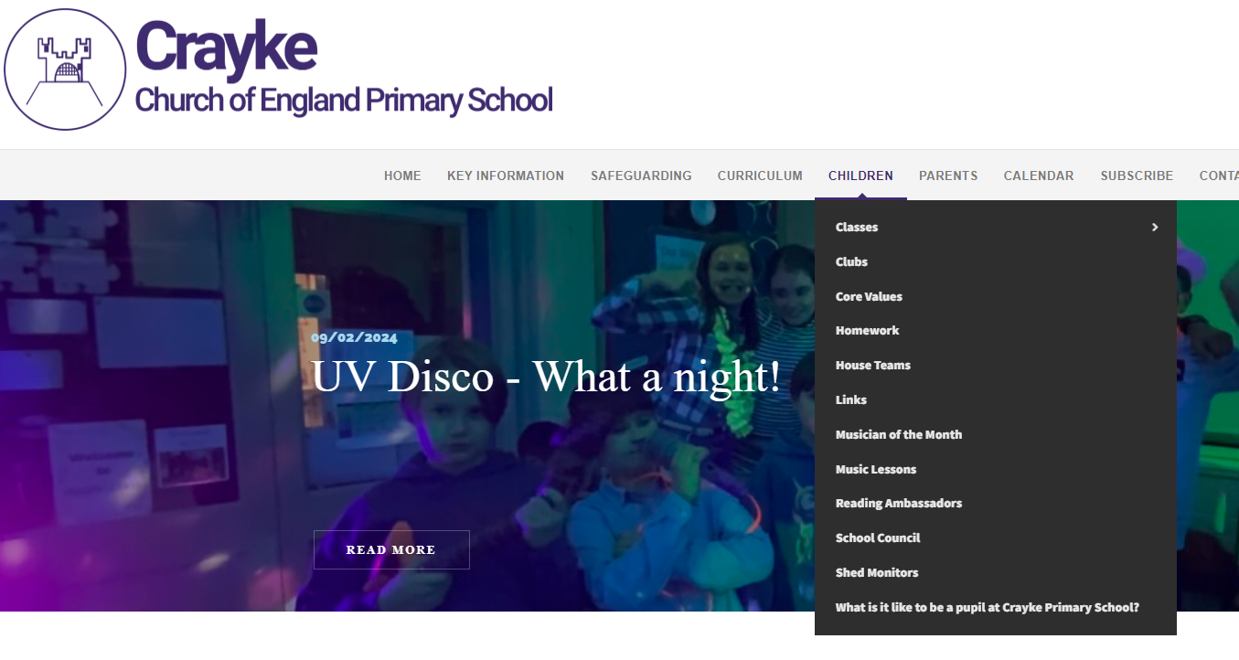
News from school this week
Website developments
We are continually updating the school website and our most recent efforts have been within the “Children” section. Please do spend some time browsing this to find out more about your child/ren’s lives in school. Some pages are still “work in progress” so please do bear with us.
We have been asked to password protect the Musician of the Month page of our website. The password will be sent out via text later today. We respectfully ask that, as the resources are paid for, they (and the password) are not to be shared beyond our school community. Thank you.

Slide 5
News from school this week
Pupil Voice Update – Percy and Joah’s Packed Lunch Recipes
Just before half term I happened to be chatting to Percy and Joah as they tucked into their lunch. I was, quite, simply, stunned by their revelation that they made their own packed lunches and that they were really quite ambitious in what they were including. From this conversation, a seed was sown and it has resulted in a brand new feature in our newsletter… Percy and Joah’s Packed Lunch Recipes! We know how difficult it can be to ensure your child has different food to eat in their packed lunches (or at other meals) so please have a read of the next slide and maybe try to make it yourselves!
I am thrilled with their dedication to this task; I know how much effort they have put into it and am so grateful to them and their families for supporting it. Well done Percy and Joah and thank you!

Slide 6
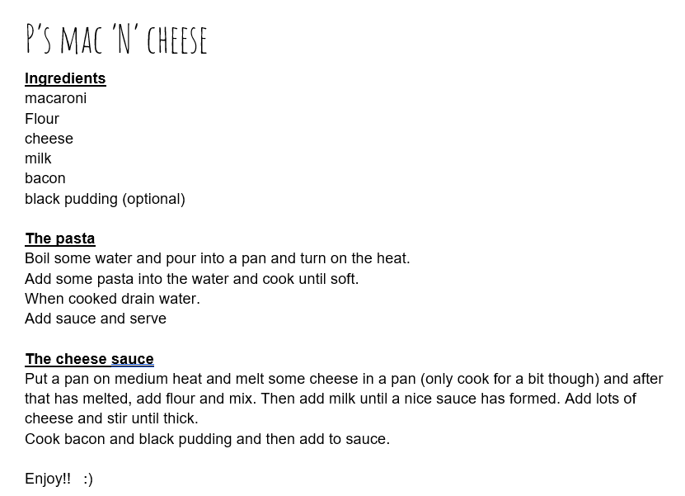
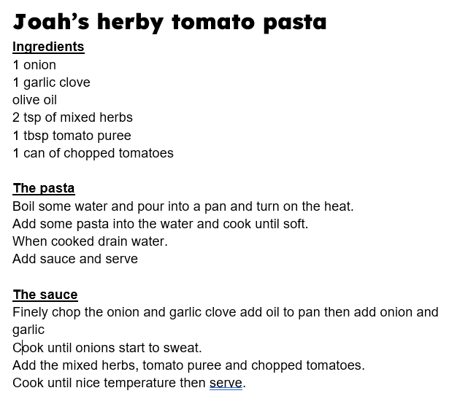

Slide 7
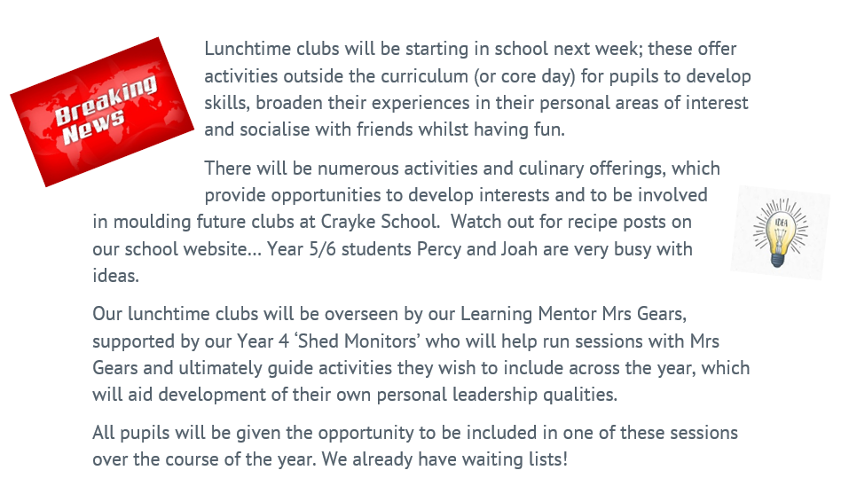
News from school this week
Launch of Lunchtime Clubs!

Slide 8
News from school this week
Safeguarding Pupil Voice Update – School Council focus on Pupil Safety in School
TASK: Where do we feel safe in school?
What did we do?
Before half term, the school council and Miss Walker walked around the school and thought about where we feel safe and where we don't.
What did we find out?
In the tour, we found that places that are crowded and areas with no adults were where some of us feel less safe.
How could we improve this?
Classroom - make sure children go outside after lunch and not back to the class
School entrance area – doorbell on the gate further up before the door
Toilets - school fair – adults use staff toilets; consider partitions in urinals; reminders about toilet rules.
Cloakroom - make sure belongings are put away properly; think about bag sizes and contents; Oak Class to use hall door for entry and exit to playground
Field – only be on the football pitch if playing football; have a rota for football and non football days; be aware.
Report compiled by Y5/6 School Councillors – Felicity, Zhdan, Sienna, Joah and Toby

Slide 9
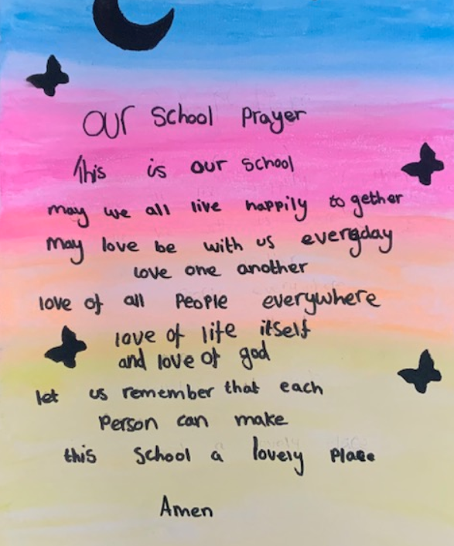
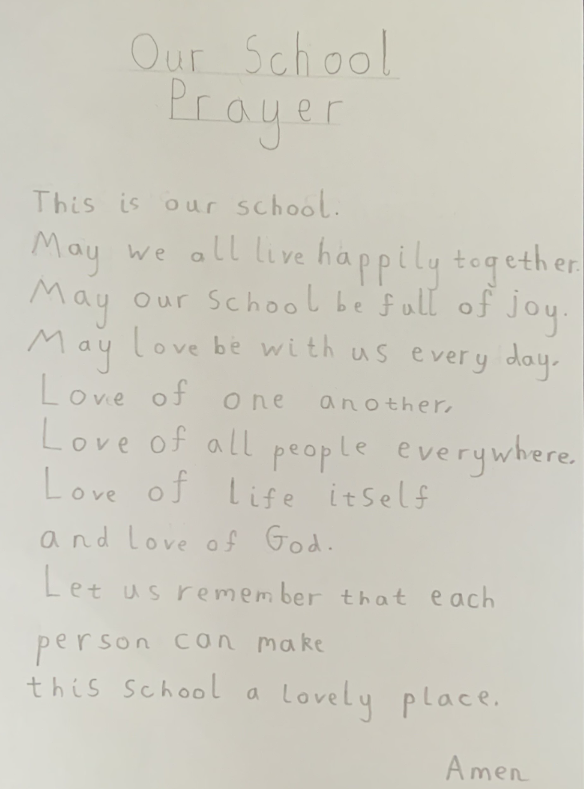
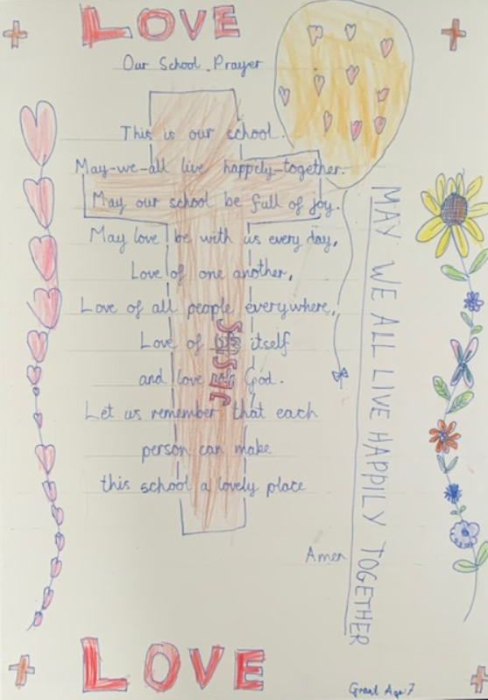
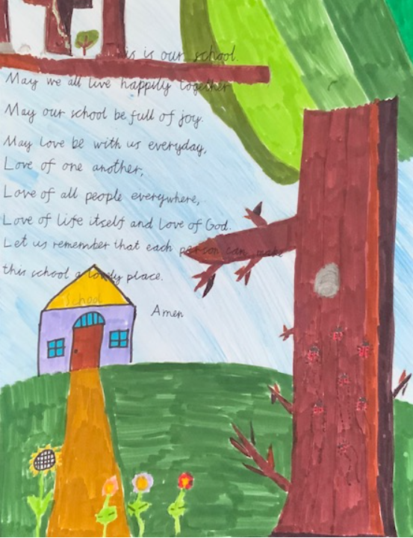
News from school this week
Handwriting Competition
We have received a few entries from each class for our competition and judging will take place next week, with the prize being awarded in Celebration Worship next Friday.
Thank you to those children who have taken time and effort to participate – you have clearly worked really hard on this and I am very proud of all of you! Here’s a selection of entries received…

Slide 10
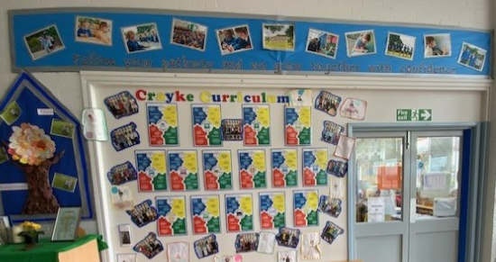
News from school this week
Curriculum Update
We are really proud of our Crayke Curriculum, which has our school values at its centre. At the beginning of each lesson, the relevant “jigsaw” is shared with the children in Beech, Holly and Oak class and a particular element of each value is selected to focus on within the session. These are all available on our school website in the curriculum section https://craykeschool.org/curriculum/
In addition, we thought it would be good to share one with you each week over the next few weeks, so you can help reinforce this at home and also open up discussions about what your child/ren have been learning. Please see next slide!

Slide 11
This week’s Jigsaw… Being a Crayke Reader

Slide 12
News from school this week
Mrs Seligman… Marathon Runner!
Some of you may already be aware that Mrs Seligman, who teaches in Holly and Oak Classes and leads Craft and Chess clubs after school, is training hard for the upcoming London Marathon! I’m not quite sure how on earth she is finding the time to train, but she’s really committed to doing it, in order to raise money for a very worthy cause – Tommy’s. In case anyone wishes to donate, here’s the link to do it: https://2024tcslondonmarathon.enthuse.com/pf/millie-seligman
We will look forward to sharing that medal in an upcoming achievement worship – go Mrs Seligman!

Slide 13
Upcoming Events
Our Spring Term Parent Consultation Evenings will be taking place after school on Tuesday 12 and Wednesday 13 March 2024.
Further information about booking appointments will be shared in due course.
Tiddlywinks OOSC will NOT be open for children on those evenings and families will need to make alternative arrangements for childcare.

Slide 14
Class News- APPLE
Helping Hands for Nepal
This week, Maxine and Sue visited Apple Class, they have been rebuilding a school in Nepal.
The first school was completely destroyed by an earthquake and the second school was damaged by a landslide. This reminded us of our fairy tale topic and our book of the week ‘The Three Little Pigs’. Maxine and Sue have now helped to fund an amazing new school which is earthquake proof and really sturdy.
At the start of the talk, we felt really sorry for the Nepalese children; their classrooms were bare, they had no tables or chairs, not a toy in sight and no carpets on the floor. We looked around at our lovely classroom, we reflected on how lucky we were to be at Crayke School. By the end of the talk we could see how happy the children; they didn’t mind their hour-long journey walking to school or having just a bowl of rice for lunch, it was the people within the school that were important.
Apple Class are going to hold fundraisers to buy some tables and benches for our Nepalese friends. We are also going to get them some bubble wands, they apparently love them.
We have been learning all about the Nepalese flag, the country and their way of life

Slide 15
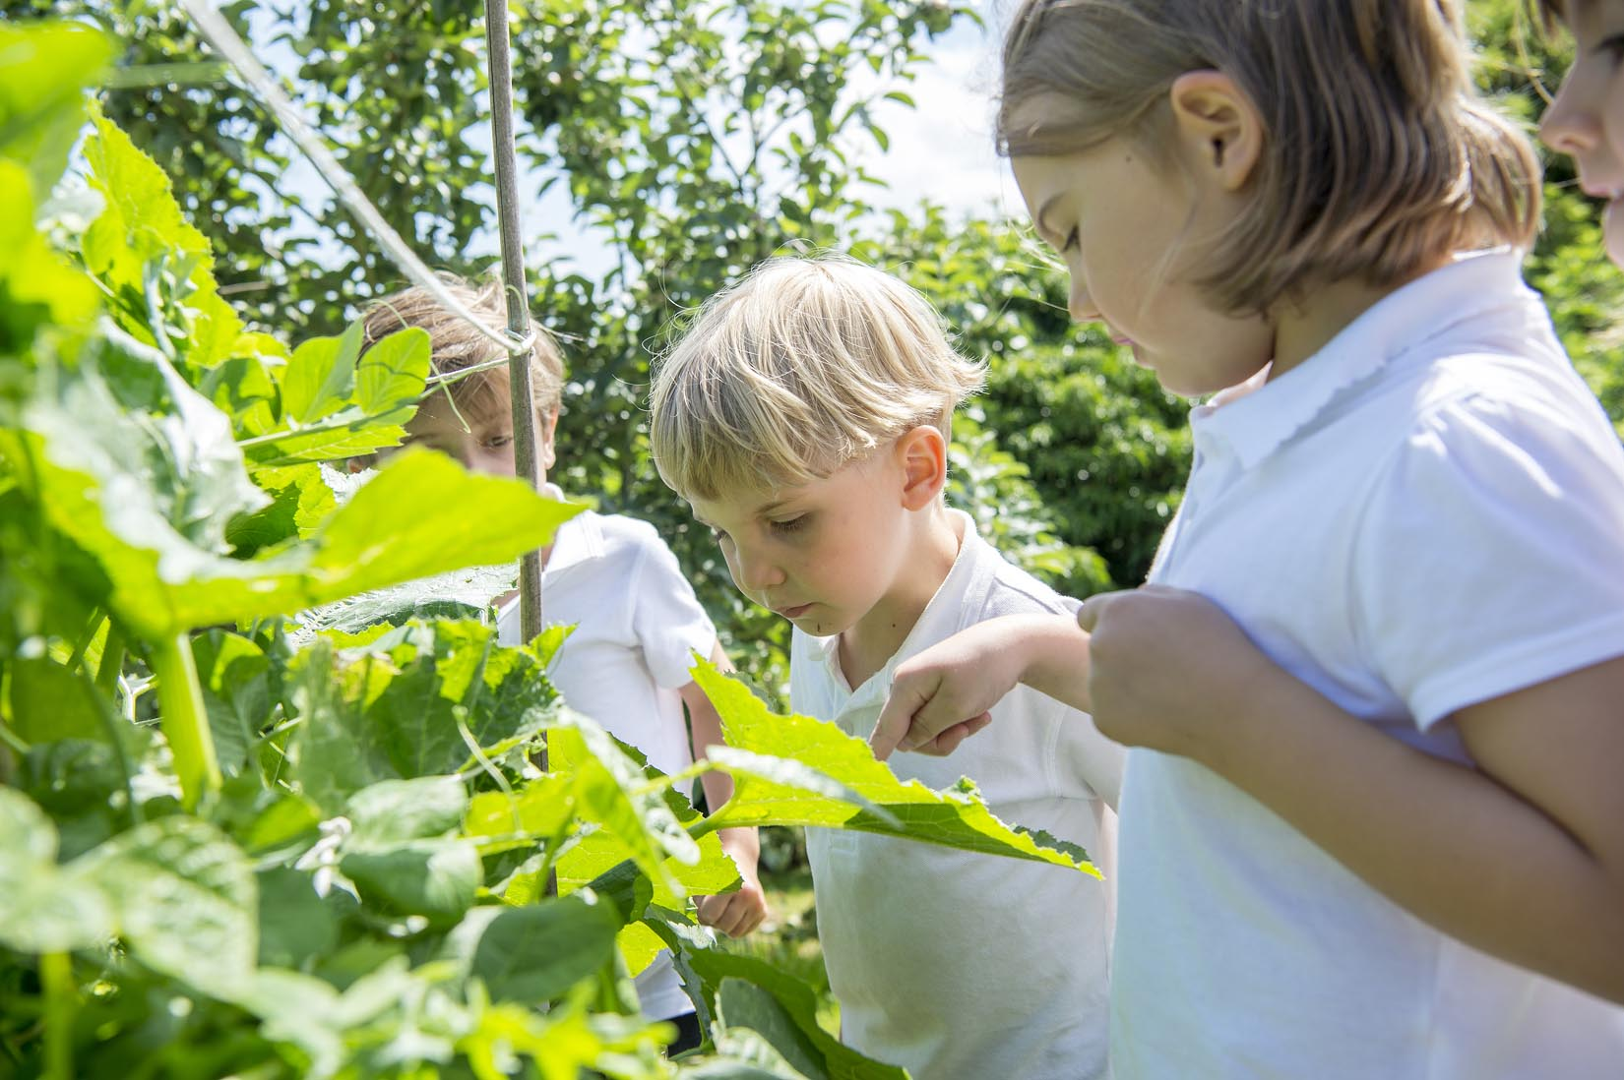
Extra Curricular Clubs - Spring
Some clubs have limited capacity and places will be allocated on a first come first served basis. In the event of a club being fully booked, your child’s name will be added to a waiting list and you will be advised if a place becomes available. Booking is not required for before school or lunchtime clubs. For after school clubs run by school staff (denoted with *) please email Mrs Bacon on admin@crayke.n-yorks.sch.uk to book a place.
Before School:
After School:
Club | Day and Time | Group
Run a Mile | Monday, Tuesday Thursday & Friday 8:30am | All welcome – parents and carers included!
Day | Club
Monday | Craft* (£10 pay via ParentPay) 3:30 – 4:15pm Years 1 – 6 Mrs Seligman | SATs* (no charge) 3:30 – 4:15pm Year 6 Mrs Rayner
Tuesday | Multi-Sports (fee paid direct) 3:30 – 4:30pm Years 1 – 6 Mark Cromack
Wednesday | Junior Duke* PLACES FULL FOR YEAR 3:30pm – 4:15pm Year 3/4 Mrs Helfferich | Music Ensemble Club (£35 pay via ParentPay) Group 1 Jan – April / Group 2 May – July 3:30 – 4:30pm Years 3 - 6 Miss Leggatt, SING Education
Thursday | Chess* (no charge) 3:30 – 4:15pm Years 2 – 6 Mrs Seligman | Science Club* (£8 pay via ParentPay) 3:30 – 4:15pm Years 3/4 Mrs Dobson | Times Tables Club* (no charge) 3:30-4:15pm Year 4 Mrs Chandler

Slide 16
Club News
There will be no Craft Club on Monday 4 March as Mrs Seligman will not be in school that day.
There will be no Junior Duke on Wednesday 13 March or Science club on Thursday 14 March due to it being Parent Consultation Evening week.

Slide 17
Awards in School This Week
 | Apple | Beech | Holly | Oak
Stars of the Week | Ottilie Hinzpeter | Tomas Davies | India Ward | Cyrus Saeedi
 |  | Henry Robinson | Grace Dawson | Sophie Sargent
Gold Awards for Sport | Ben Cheetham | Honor Howland | Lucas Stubbins | Alice Unsworth
Headteacher Awards Random Act of Kindness | Isla Howland | Isabelle Sargent | Kiera Rosa-Keyter
Cloakroom Ninja tidiest cloakroom trophy | Beech Class

Slide 18
PE Kits w/c 26 February 2024
 | Monday | Tuesday | Wednesday | Thursday | Friday
Beech |  |  |  | X | X
Holly |  |  | X - swim |  | X
Oak |  | X |  |  | X
Apple: Children in Apple Class need to bring their Forest School kit in each Friday. Please send their PE kit in on Monday as children will change for PE in school. They will bring PE kits home for washing periodically.
Please ensure that on PE days, the children wear their hoodies, school jumpers or cardigans alongside white or blue t-shirts and black or navy shorts or jogging bottoms.

Slide 19
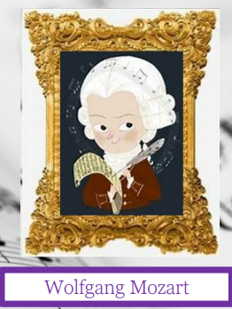
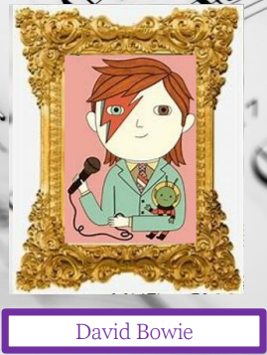
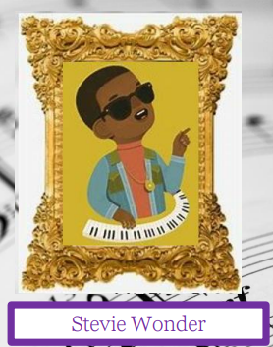
Team Points
Team | Points
Mozart | 585
Bowie | 439
Fitzgerald | 977
Wonder | 499
Well done Fitzgerald team!

Slide 20
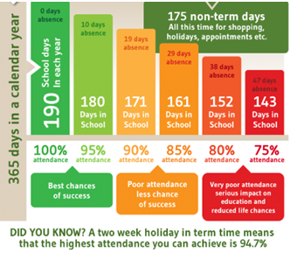
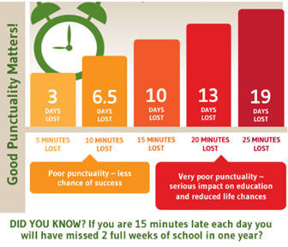
Attendance and Punctuality
This week’s attendance figures: 96.1% School Target: 96%
 | Attendance | Punctuality
Apple | 93.9% | 0 lates
Beech | 96.7% | 2 lates (2 children)
Holly | 94.7% | 3 lates (1 child)
Oak | 98.4% | 0 lates

Slide 21
A massive thank you to everyone who supported both the disco and luxury raffle (and a special thank you to Mrs Dobson for boosting raffle sales in school!):
School Disco total raised: £505
Luxury Raffle total raised: £405
The raffle winners were: E Wilkinson, M Seligman, C Porter, R Ritchie, L Garthwaite, V Cain, K Howland
The money raised will go directly towards supporting music provision in school.
Upcoming dates:
Change of date for next CHASA meeting to: Monday 4th March 1.30pm at St Monica’s Meeting Room, Easingwold (also on Zoom)
Pre-loved uniform sales during Parent Consultation Evenings – Tuesday 12 and Wednesday 13th March
CHASA Easter Craft Session: Thursday 21st March after school - ticket details out soon
Summer Fair (save the date!): Sunday 23rd June

Slide 22
Pre loved uniform – donations please!
Ahead of the planned pre-loved uniform sale during Parent Consultation Evenings (12/13 March 2024), we would be really grateful for donations of any items of school uniform. They can be dropped off in the school office or in the basket outside the main school door.
Thanks in advance.

Slide 23
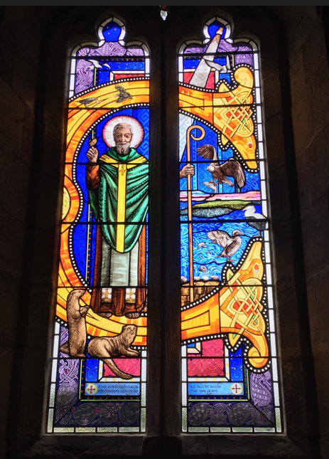
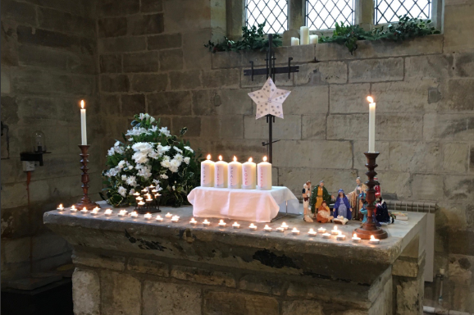
Church News – from the Family Service Team
Future dates at St Cuthbert's:
March 5th Family Service as usual at 10.30am
March 31st EASTER DAY - there will be a Family Holy Communion at 10am (note the time!)
As ever, other services in the Benefice can be found on our website at https://bylandchurches.wordpress.com/services-in-church/

