Slide 1
Crayke Chronicle
Issue: #5 Term: Spring Date: 9 February 2024
FOLLOW YOUR PATHWAY AND WE GROW TOGETHER WITH CONFIDENCE
You did not choose me, I chose you that you might go and bear fruit, fruit that will last so that whatever you ask in my name the Father will give you. John 15:16
Respect Friendship Forgiveness Determination

Slide 2
Message from the Headteacher
Well, here we are in the middle of the academic year!
It has been lovely to have pupils from Apple and Oak class visit this week with their writing books, showing me the progress they have made since the start of the year and sharing examples of work they are proud of. We are cultivating some excellent writers with some amazing vocabulary!
Have a lovely half term and we look forward to seeing you on Monday 19 February from 8:30am for Run a Mile club, or from 8:50am when the gates open.
Judi Jackson
Headteacher

Slide 3
News from school this week
Safeguarding Update – What to do if you are worried about a child
As we approach half term, I would like to draw your attention to an updated poster which has been displayed outside school, a copy of which is also available on the Safeguarding section of our website: https://craykeschool.org/safeguarding/ .
A reminder that if you have any concerns about a child or children, please contact me on dsl@crayke.n-yorks.sch.uk As my emails are monitored less frequently during holidays, you may wish to telephone North Yorkshire Safeguarding 0300 131 2 131 if you are worried – this can also be done anonymously.
Thank you.

Slide 4
News from school this week
Safeguarding Update – Parking and Dropping Off
It’s been a while but it’s always worth a quick reminder about being respectful to local residents when considering where to park your cars at drop off and pick up times. Please use the Sports Hall wherever possible.
Due to safety and safeguarding reasons, it is not possible to use the layby for dropping your children off at school, unless by prior arrangement and agreement with the Headteacher. Please share this with your spouses if you are the chief newsletter reader and they also do the school run, to ensure that everyone has the same message.
Thank you.

Slide 5
News from school this week
Safeguarding Update – Filtering and Monitoring
Parents can be reassured that at Crayke Primary School we employ the highest quality filtering and monitoring systems to mitigate the risks of our children's online safety. The school uses Smoothwall as its filtering and monitoring system.
The system monitors keyboard entry and reports key words and watch words as they are typed on any child's keyboard of the devices they use in school. This provides real time and highly effective monitoring of all users on the school system. We hope that this provides parents and carers with confidence that their children's experience of the online world is safe and backed up by a broad curriculum of online safety guidance.
Should you wish to discuss this further, or have any questions, please do not hesitate to contact either myself (Designated Safeguarding Lead) or Mrs Rayner (Computing Subject Leader and Deputy Designated Safeguarding Lead) or visit the Online Safety section of our website: https://craykeschool.org/online-safety/
Internet safety is a huge part of our school curriculum and we challenge children to think about the key themes of content, contact, conduct and contract which form the four main areas for online safety. We believe that this gives them the best preparation for digital citizenship of the future.
Please remember to apply appropriate settings to children's devices when they are using the internet at home or on mobile devices. Please refer to advice and guidance to ensure children's devices are appropriately managed.

Slide 6
News from school this week
New House Team Names… Revealed!
A HUGE thank you to Miss Walker and the School Council for undertaking a wonderful job in revamping our house team names. I am delighted to announce that they are as follows:
Former Team Name | New Team Name | Musician | Reason
Blue | Bowie | David Bowie | All about embracing differences and being unafraid to be himself
Green | Fitzgerald | Ella Fitzgerald | Promotes the message of 'It's not where you come from, but where you're going that counts.'
Red | Mozart | Wolfgang Amadeus Mozart | World renowned classical composer & example of huge success when young, touring the world.
Yellow | Wonder | Stevie Wonder | Overcoming a physical disability to follow his dreams; he is also a UN Messenger of Peace
Children will have the opportunity to learn more about these musicians during our music themed World Book Day next month, using our “Little People, Big Dreams” resources.

Slide 7
News from school this week
Half term handwriting competition!
As part of our ongoing focus this year on writing, I am pleased to announce an opportunity for children to “show off” their best handwriting and presentation skills in a competition this half term.
Children are invited to write our school prayer on a piece of white A4 paper and submit it to me by the end of the school day on Friday 23 February. The winning entry will be displayed in the hall and a prize will be awarded. Children need to take care with their letter formation, spelling and overall presentation.
A copy of the school prayer can be found on the following slide for reference.

Slide 8
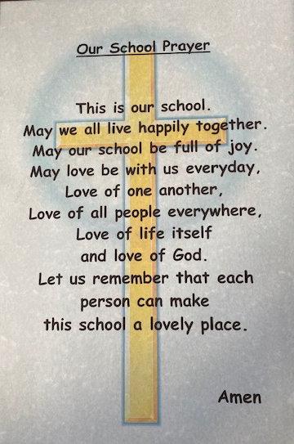
Our School Prayer

Slide 9
News from school this week
MUSIC SURVEY
FINAL REMINDER: As part of our “Year of Music”, we would be grateful if parents/carers could take a few moments to complete this survey: https://forms.office.com/e/grdHMpVbG3 (if you have not yet already done so)
Your response to this will provide us with useful details about the musical tuition your child may already be receiving and also give us some information about whether you would like signposting to other musical opportunities within the local area. Please complete the survey for each child you have in school, whether they currently learn an instrument or not, before the end of today. Thanks in advance!
From the responses received already, it indicates that there is definite interest from some parents to pursue musical tuition. Please visit this weblink: https://northyorkshiremusichub.co.uk/ to register this with the North Yorkshire Music Hub if you wish to pursue instrumental lessons for your child/ren in school.

Slide 10
Upcoming Events
Following the success of the Spanish Enrichment Day in November, I am thrilled to share with you that Mrs Dobson, our Science Subject Lead, is already busy organising the next whole school enrichment day.
This will be a STEM Day, on the theme of “Time” and will be held on Tuesday 19 March. Children will work in their mixed age house teams again, as we know how much children enjoyed this opportunity last time.
Further details to follow after half term!

Slide 11
Upcoming Events
ArtBytes Competition
Year 5 have been working hard on their illuminated manuscripts and are looking forward to entering them into the ArtBytes competition next half term. We're hopeful to build on Isaac's success from last year when he received national runner up!
Children and parents don't need to do anything. I will upload a photo of the completed artwork with the person's first name only. This will be posted onto our school page on the ArtBytes website.
More details and links will follow including how to vote after half term. Good luck everyone!
Miss Walker, Art Subject Leader

Slide 12
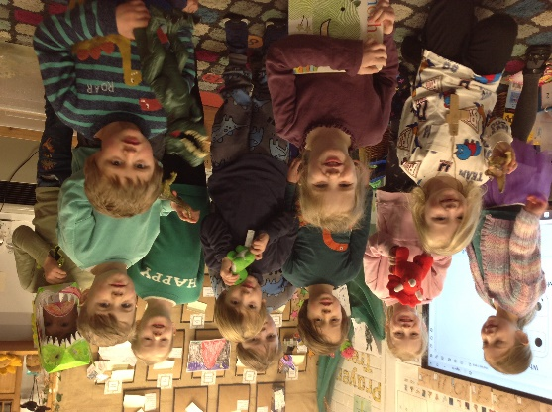
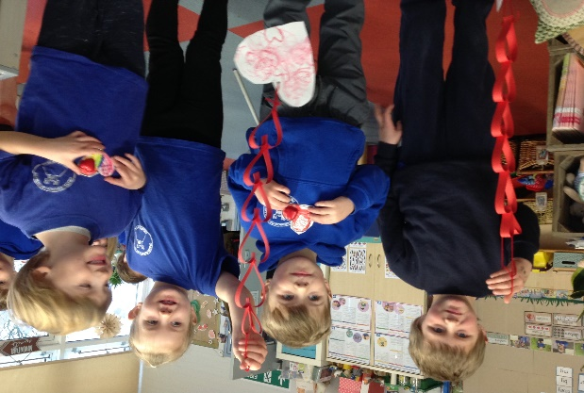
Class News- APPLE
We finished our ‘Dinosaurs Rock!’ by coming to school dressed in dinosaur colours or wearing clothing with dinosaurs on. We read lots of dinosaur stories which the children brought in from home and played with our favourite dinosaurs. We made thank you presents for our friends in the community, to thank them for being our friends.

Slide 13
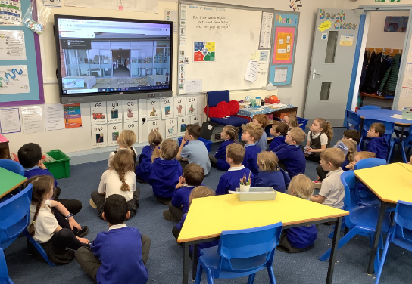
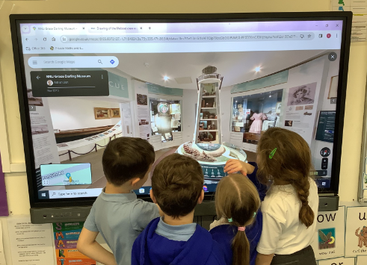
Class News - BEECH
Beech class have been learning about Grace Darling and her great sea rescue. On Wednesday afternoon we took a virtual tour of the museum dedicated to her which is located in Bamburgh. We used this source to find out more about her life and work. We looked at ten key objects the museum displays including her boat, her dress and her locket. We all agreed she is a fantastic heroine and the children would love to visit the museum if anybody is on holiday in Northumberland.
Mrs Dobson

Slide 14
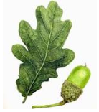
Class News - OAK
A copy of the slides from the Year 6 SATs meeting can be found on the Oak Class Google page (using the children's login,) for anyone who couldn't make the meeting earlier this week.
A reminder for parents and carers of Year 6 children to please email lrayner@crayke.n-yorks.sch.uk to confirm your child's place for our Monday SATs club, starting straight after half term from 3.30-4.15pm.
Mrs Rayner

Slide 15
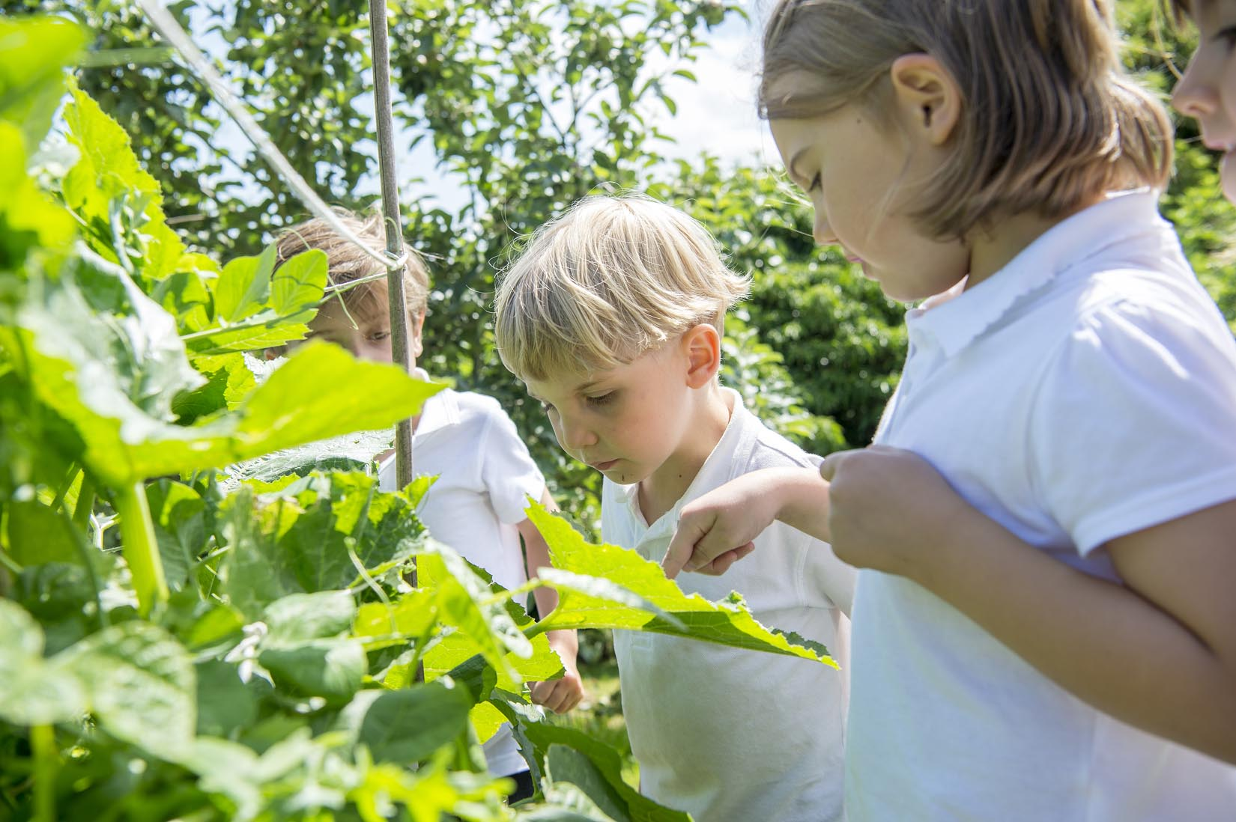
Extra Curricular Clubs - Spring
Some clubs have limited capacity and places will be allocated on a first come first served basis. In the event of a club being fully booked, your child’s name will be added to a waiting list and you will be advised if a place becomes available. Booking is not required for before school or lunchtime clubs. For after school clubs run by school staff (denoted with *) please email Mrs Bacon on admin@crayke.n-yorks.sch.uk to book a place.
Before School:
After School:
Club | Day and Time | Group
Run a Mile | Monday, Tuesday Thursday & Friday 8:30am | All welcome – parents and carers included!
Day | Club
Monday | Craft* (£10 pay via ParentPay) 3:30 – 4:15pm Years 1 – 6 Mrs Seligman | SATs* (no charge) 3:30 – 4:15pm Year 6 Mrs Rayner
Tuesday | Multi-Sports (fee paid direct) 3:30 – 4:30pm Years 1 – 6 Mark Cromack
Wednesday | Junior Duke* PLACES FULL FOR YEAR 3:30pm – 4:15pm Year 3/4 Mrs Helfferich | Music Ensemble Club (£35 pay via ParentPay) Group 1 Jan – April / Group 2 May – July 3:30 – 4:30pm Years 3 - 6 Miss Leggatt, SING Education
Thursday | Chess* (no charge) 3:30 – 4:15pm Years 2 – 6 Mrs Seligman | Science Club* (£8 pay via ParentPay) 3:30 – 4:15pm Years 3/4 Mrs Dobson | Times Tables Club* (no charge) 3:30-4:15pm Year 4 Mrs Chandler

Slide 16
Club News
There will be no Junior Duke on Wednesday 21 February as Mrs Helfferich is out of school on First Aid training.

Slide 17
Awards in School This Week
 | Apple | Beech | Holly | Oak
Stars of the Week | Ava Carvalho | Zephie Brown | Barnaby Ritchie | Arwen Dawson
 |  | Honor Howland | Riley Hunsdale | Brooke Smith
Gold Awards for Sport | Lyuba Hobson | Constance Cater | Frankie Grainger | Oskar Braidwood
Headteacher Awards Random Act of Kindness | Ava Carvalho | Florence Hindley
Cloakroom Ninja tidiest cloakroom trophy | Oak Class

Slide 18
PE Kits w/c 19 February 2024
 | Monday | Tuesday | Wednesday | Thursday | Friday
Beech |  |  |  | X | X
Holly |  |  | X - swim |  | X
Oak |  | X |  |  | X
Apple: Children in Apple Class need to bring their Forest School kit in each Friday. Please send their PE kit in on Monday as children will change for PE in school. They will bring PE kits home for washing periodically.
Please ensure that on PE days, the children wear their hoodies, school jumpers or cardigans alongside white or blue t-shirts and black or navy shorts or jogging bottoms.

Slide 19
Team Points
Team | Points
Mozart | 801
Bowie | 551
Fitzgerald | 1045
Wonder | 1089
Well done Wonder team!

Slide 20
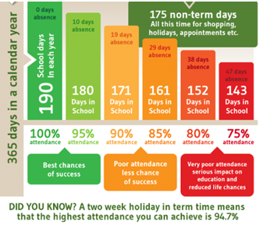
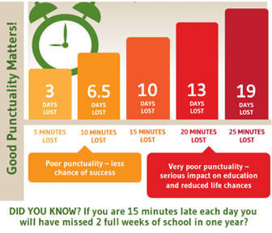
Attendance and Punctuality
This week’s attendance figures: 95.8% School Target: 96%
 | Attendance | Punctuality
Apple | 93.85% | 1 Late
Beech | 97.7% | 7 lates / 4 children
Holly | 94.06% | 3 lates / 3 children
Oak | 96.8% | 2 lates / 2 children

Slide 21
LAST CHANCE TO BUY TICKETS – 2PM DEADLINE TODAY!!

Slide 22
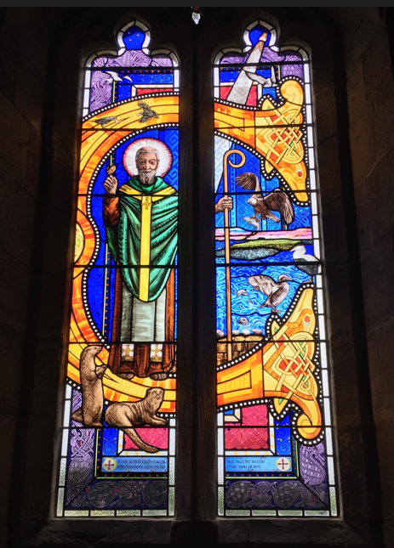
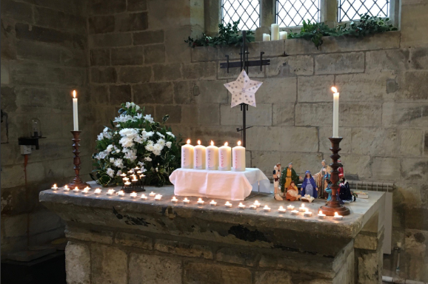
Church News – from the Family Service Team
Future dates at St Cuthbert's:
March 5th Family Service as usual at 10.30am
March 31st EASTER DAY - there will be a Family Holy Communion at 10am (note the time!)
As ever, other services in the Benefice can be found on our website at https://bylandchurches.wordpress.com/services-in-church/

