Slide 1
Crayke Church of England Primary School DATES FOR YOUR DIARY 2023/2024 Last updated: 23 February 2024
FOLLOW YOUR PATHWAY AND WE GROW TOGETHER WITH CONFIDENCE You did not choose me, I chose you that you might go and bear fruit, fruit that will last so that whatever you ask in my name the Father will give you. John 15:16 Respect Friendship Forgiveness Determination

Slide 2
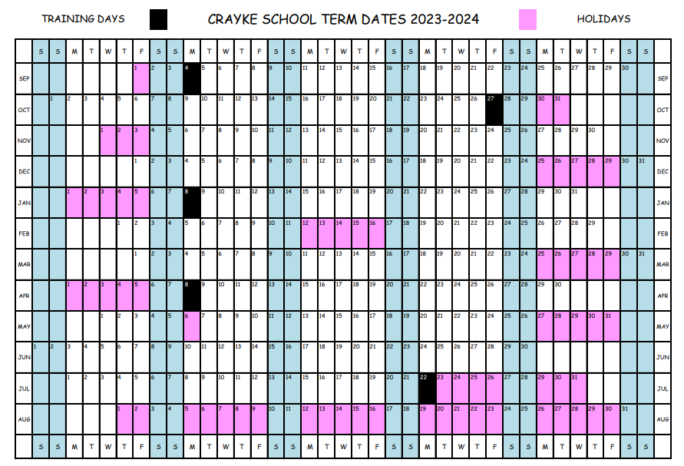

Slide 3
February 2024
Day | Date | Event | Who | Where
Wednesday | 28 February | Swimming | Holly | Thirsk Leisure Centre

Slide 4
March 2024 (page 1 of 2)
Day | Date | Event | Who | Where
Monday | 4 March 1:30pm | CHASA Meeting (NB change of date) | CHASA Committee | St Monica’s Easingwold
Tuesday | 5 March | Visit to York University Astro Campus | Oak | York
Wednesday | 6 March | Swimming | Holly | Thirsk Leisure Centre
Wednesday | 6 March 3pm | Phonics Meeting | Year 1 | School
Thursday | 7 March | World Book Day | All children | School
Thursday | 7 March 3pm | MTC meeting for parents | Year 4 parents | School
Friday | 8 March | Interim reports to parents | All children | Via pupil post
Tuesday | 12 March | Parent Consultation Evening 1/2 | Parents and carers | Classrooms
Wednesday | 13 March | Parent Consultation Evening 2/2 | Parents and carers | Classrooms

Slide 5
March 2024 (page 2 of 2)
Day | Date | Event | Who | Where
Thursday | 14 March | Skip2BFit - HIIT | All children | Hall/outside
Friday | 15 March | Red Nose Day | All children | School
Monday | 18 March | Non-uniform day – tombola donations | All children | School
Monday | 18 March | Full Governing Body Meeting | All governors | Hall
Tuesday | 19 March | STEM Enrichment Day | All children | School
Wednesday | 20 March | Crayke’s Greatest Show | Selected representatives | Hall
Thursday | 21 March | CHASA After School Easter Crafts | All children | Hall
Friday | 22 March 11am | Easter Service | All welcome | St Cuthbert’s Church
Friday | 22 March | Easter Egg Hunt | All children | Outside
Friday | 22 March 2:30pm | School closes for Easter holidays | All children | School

Slide 6
April 2024
Day | Date | Event | Who | Where
Sunday | 7 April | Open Gardens | Community event | Crayke

Slide 7
May 2024
Day | Date | Event | Who | Where
w/c Monday | 13 May | KS2 SATs | Year 6 children | Classroom
Tuesday | 21 May | Tempest Photography – classes | All children | School

Slide 8
June 2024
Day | Date | Event | Who | Where
w/c Monday | 10 June | Phonics Check | Year 1 | Beech
w/c Monday | 10 June | Multiplication Tables Check | Year 4 | Holly
Wednesday | 12 June 5:30pm | Reception new starter parent meeting | September 2024 new starters | Hall
Monday | 17 June | Full Governing Body Meeting | All governors | Hall
Friday | 21 June | Make Music Event York St John | Oak | York
Sunday | 23 June | CHASA Summer Fair | All welcome | School
Wednesday | 26 June - am | Reception new starter visit 1/3 | New starters | Apple

Slide 9
July 2024
Day | Date | Event | Who | Where
Wednesday | 3 July - pm | Reception new starter visit 2/3 | New starters | Apple
Friday | 5 July | Sports Day | All children | Outside
Monday | 8 July | KS2 Performance – dress rehearsal | Holly and Oak | Hall
Tuesday | 9 July 2pm | KS2 Performance 1/2 | Holly and Oak | Hall
Wednesday | 10 July am + lunch | Reception new starter visit 3/3 | New starters | Apple
Wednesday | 10 July 6pm | KS2 Performance 2/2 | Holly and Oak | Hall
Friday | 12 July | Sports Day (Reserve) | All children | Outside
Friday | 19 July 11am | Leavers’ Service | All welcome | St Cuthbert’s Church

