Slide 1
Crayke Chronicle
Issue: #7 Term: Spring Date: 1 March 2024
FOLLOW YOUR PATHWAY AND WE GROW TOGETHER WITH CONFIDENCE
You did not choose me, I chose you that you might go and bear fruit, fruit that will last so that whatever you ask in my name the Father will give you. John 15:16
Respect Friendship Forgiveness Determination

Slide 2
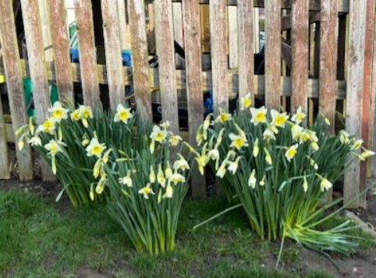
Message from the Headteacher
It’s been another incredibly busy week in school and it’s March already! It has been Assessment Week in school this week; I am so impressed with how the children have applied themselves and worked with dedication and resilience. Staff are busy preparing interim reports for you, ahead of Parent Consultation Evenings.
This week, we welcomed over 20 teachers from across the local area after school for a writing moderation event. Teachers were able to share examples of pupil’s work, suitably replenished by Mrs Bacon’s excellent cups of tea and biscuits!
Many of the staff commented on our lovely learning environment, which was so nice to hear as we have worked so hard to make it that way!
Have a lovely weekend,
Judi Jackson
Headteacher

Slide 3
News from school this week – Staffing Update
Another staffing update for you this week… it is with a heavy heart that I share the news that Mrs Shirley has made the reluctant decision to leave Crayke at Easter. This has not been an easy choice for her by any means but this will enable her to spend more time with her growing family.
After nearly 20 years of service, Mrs Shirley has touched the lives of so many children and families and will be so very much missed by us all. She has made such a valuable contribution to the life of our school in so many roles including working across different classes as a teaching assistant, chief first aider, wellbeing champion, accompanying countless educational visits and residentials, being a shoulder to cry on and the voice of wisdom and reason.
Mrs Shirley is the longest serving member of staff at Crayke and it won’t be the same place without her but we wish her well and have issued stern instructions to keep in touch!

Slide 4
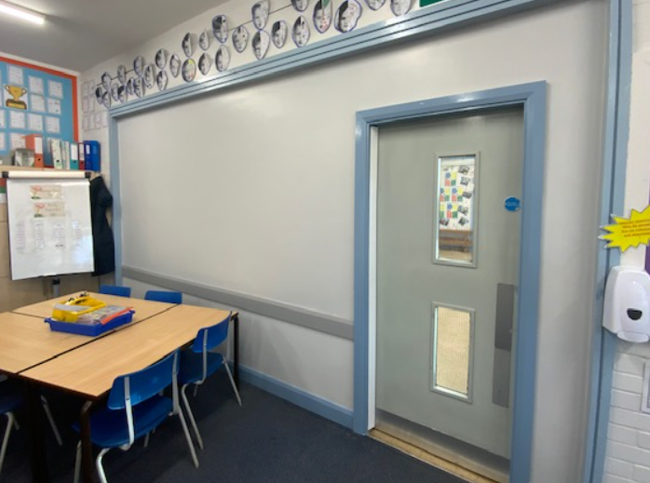
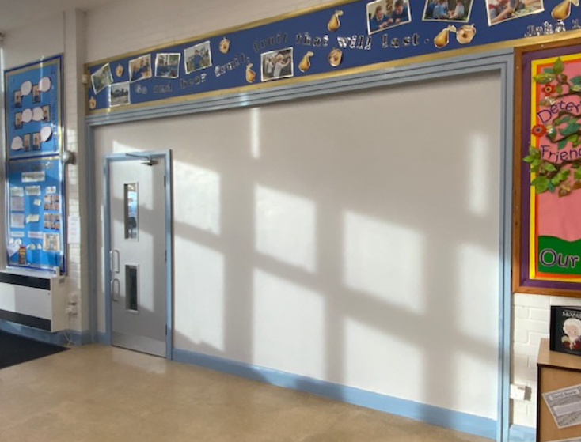
News from school this week – Wall Update!
We love it so much!

Slide 5
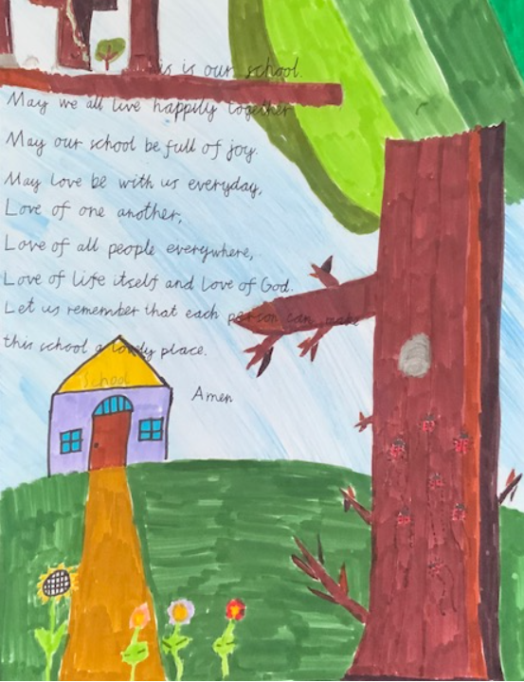
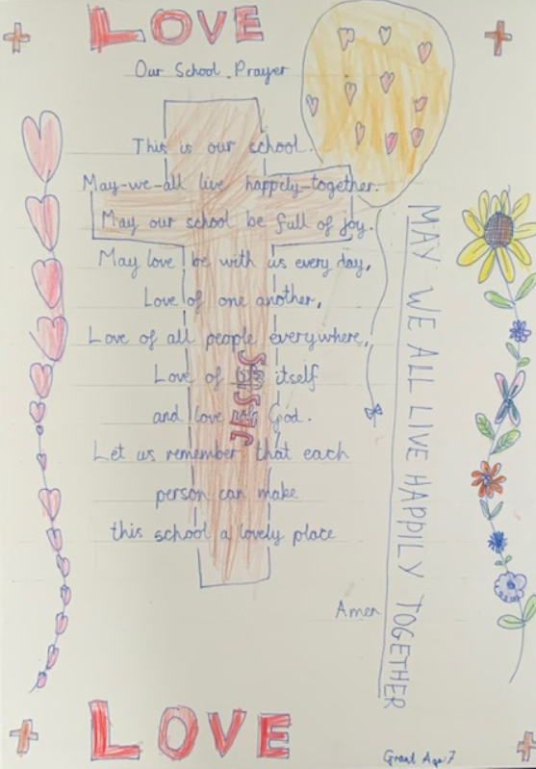
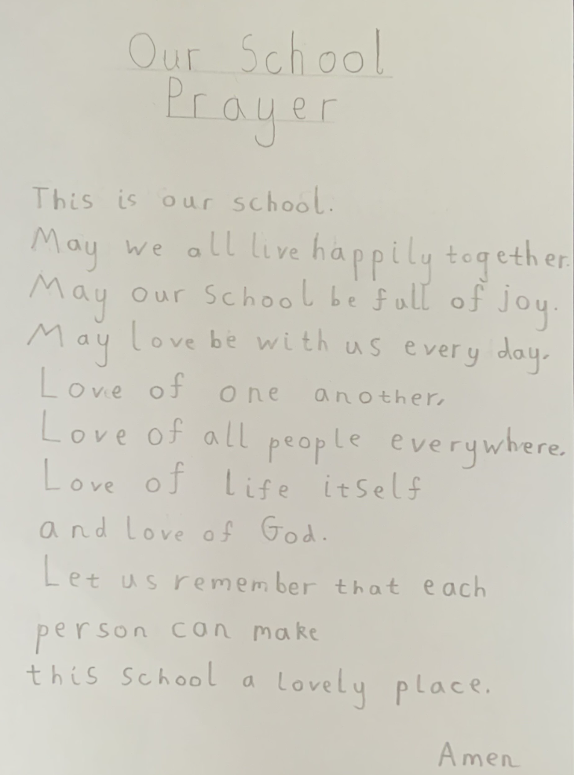
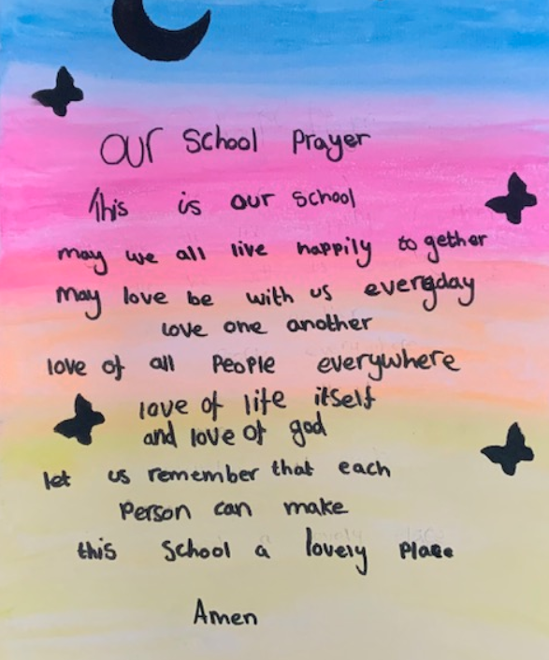
News from school this week
Handwriting Competition
Mrs Bacon and Mrs Gears were given the VERY difficult job this week of judging our handwriting competition and they have chosen the following…
Overall winner!
Zhdan Year 5
2nd place
Grant Year 3
3rd place
Gem Year 2
Special recognition
Sienna Year 6

Slide 6
News from school this week – Healthy Choices
Packed Lunches and Playtime Snacks – Reminders
It is worth a reminder to ask parents and carers to ensure that packed lunches contain a balanced selection of healthy items.
We have also seen an increase in unhealthy playtime snacks including crisps, mini-rolls and chocolate biscuits. Please ensure your child is sent with a healthy playtime snack such as fruit or a cereal bar.
We are a nut aware school and we do have pupils with serious nut allergies. Please do not send your child to school with items containing nuts for playtimes or as part of their packed lunches.
Remember – children in Apple and Beech class are given a healthy snack daily, provided by government funding, so they do not require a snack from home.

Slide 7
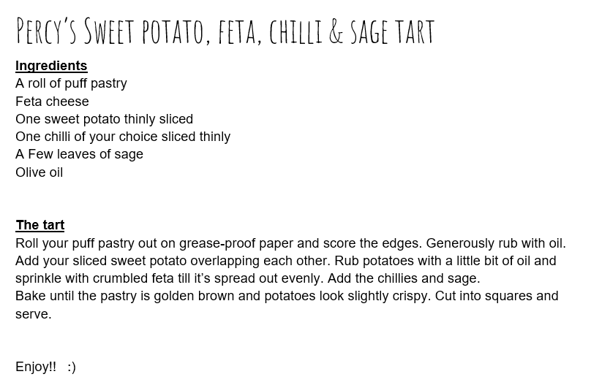

Slide 8
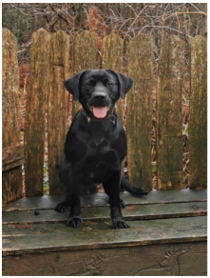
News from school this week – PAT Dog
Introducing Finn our new PAT Dog, who will be visiting school from next week, as outlined in Mrs Gears’ letter to parents and carers yesterday.
Important: Please let Mrs Bacon know if you do not wish your child to interact with Finn by emailing admin@crayke.n-yorks.sch.uk
Thank you

Slide 9
This week’s Jigsaw… Being a Crayke Sportsperson

Slide 10
Class News- APPLE
This week the children have been very creative, they have been using the cardboard saws to make sledges, robot heads, laptops, faces and cubes. They have been listening to other children’s ideas, discussing what needs doing and who is in charge of doing the various jobs. They have worked so well together and with great maturity considering that they are only 4/5yrs old.
We have learnt all about polar bears and the importance of looking after our environment to make sure that we protect our planet and all its inhabitants.
We listened to Ella Fitzgerald and learnt all about her upbringing and how she became ‘The Queen of Jazz’. The children were intrigued by her childhood and how successful she became.
Mrs Helfferich

Slide 11
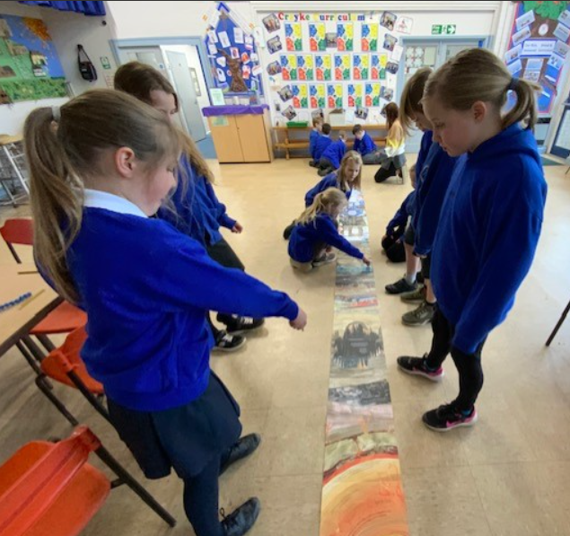
Class News - OAK
A group of pupils were looking at the book “The Skies Above my Eyes” as part of their learning about the solar system. It reminded some of them about their work on rocks and soil when in Lower Key Stage 2 and a book they had used then – “The Street Beneath My Feet” so we got that one out too! Between the two books they took up the whole hall!

Slide 12
Upcoming Events – Parent Consultations
Our Spring Term Parent Consultation Evenings will be taking place after school on Tuesday 12 and Wednesday 13 March 2024.
The booking system will be the same as last year and emails/texts will be sent out this afternoon.
Remember we are aiming for 100% of families to attend appointments. We will make contact with you if you fail to book a slot.
Tiddlywinks OOSC will NOT be open for children on those evenings and families will need to make alternative arrangements for childcare.

Slide 13
Upcoming Events – Red Nose Day
On Friday 15 March it is Red Nose Day! Children are welcome to wear non-uniform including an item of red clothing if they wish.
Should you wish to donate to this valuable charity, you can do so via this link: https://app.parentpay.com/ParentPayShop/Foc/Default.aspx?shopid=13880
Please note, we are unable to accept cash
donations in school.

Slide 14
Upcoming Events – Crayke’s Greatest Show

Slide 15
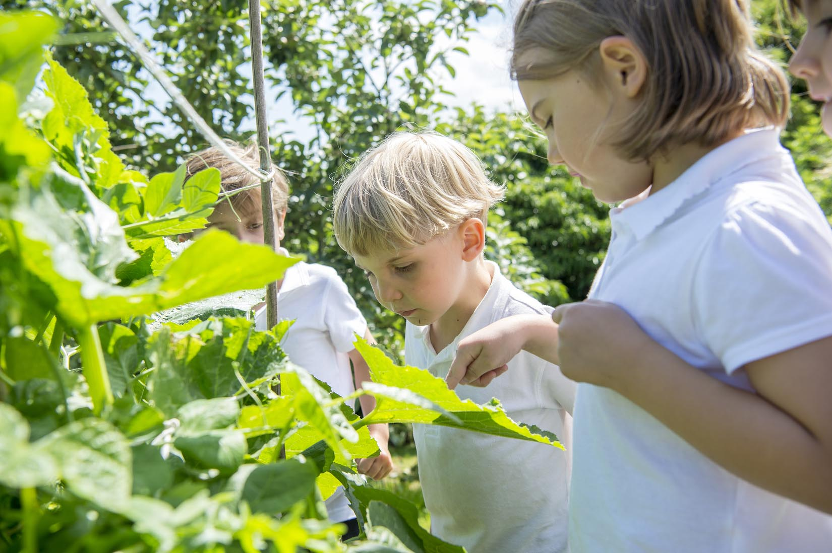
Extra Curricular Clubs - Spring
Some clubs have limited capacity and places will be allocated on a first come first served basis. In the event of a club being fully booked, your child’s name will be added to a waiting list and you will be advised if a place becomes available. Booking is not required for before school or lunchtime clubs. For after school clubs run by school staff (denoted with *) please email Mrs Bacon on admin@crayke.n-yorks.sch.uk to book a place.
Before School:
After School:
Club | Day and Time | Group
Run a Mile | Monday, Tuesday Thursday & Friday 8:30am | All welcome – parents and carers included!
Day | Club
Monday | Craft* (£10 pay via ParentPay) 3:30 – 4:15pm Years 1 – 6 Mrs Seligman | SATs* (no charge) 3:30 – 4:15pm Year 6 Mrs Rayner
Tuesday | Multi-Sports (fee paid direct) 3:30 – 4:30pm Years 1 – 6 Mark Cromack
Wednesday | Junior Duke* PLACES FULL FOR YEAR 3:30pm – 4:15pm Year 3/4 Mrs Helfferich | Music Ensemble Club (£35 pay via ParentPay) Group 1 Jan – April / Group 2 May – July 3:30 – 4:30pm Years 3 - 6 Miss Leggatt, SING Education
Thursday | Chess* (no charge) 3:30 – 4:15pm Years 2 – 6 Mrs Seligman | Science Club* (£8 pay via ParentPay) 3:30 – 4:15pm Years 3/4 Mrs Dobson | Times Tables Club* (no charge) 3:30-4:15pm Year 4 Mrs Chandler

Slide 16
Club News - Reminders
There will be no Craft Club on Monday 4 March as Mrs Seligman will not be in school that day.
There will be no Junior Duke on Wednesday 13 March or Science club on Thursday 14 March due to it being Parent Consultation Evening week.

Slide 17
Awards in School This Week
 | Apple | Beech | Holly | Oak
Stars of the Week | Dianta Simpson | Pippa Dawson | Rosie Seligman | Oskar Braidwood
 |  | Reggie Jagger | Aidan Brown | Nancy Barrett
Gold Awards for Sport | Mabel Ankers | Duke Gains | Oliver Wilson | Isla Howland
Headteacher Awards Random Act of Kindness | Joshua Griffin-Miles | Joshua Jefferson
Cloakroom Ninja tidiest cloakroom trophy | Apple Class

Slide 18
PE Kits w/c 4 March 2024
 | Monday | Tuesday | Wednesday | Thursday | Friday
Beech |  |  |  | X | X
Holly |  |  | X - swim |  | X
Oak |  | X |  |  | X
Apple: Children in Apple Class need to bring their Forest School kit in each Friday. Please send their PE kit in on Monday as children will change for PE in school. They will bring PE kits home for washing periodically.
Please ensure that on PE days, the children wear their hoodies, school jumpers or cardigans alongside white or blue t-shirts and black or navy shorts or jogging bottoms.

Slide 19
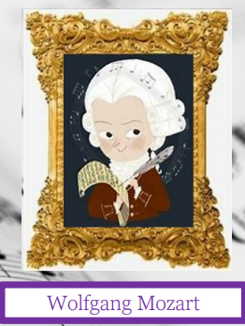
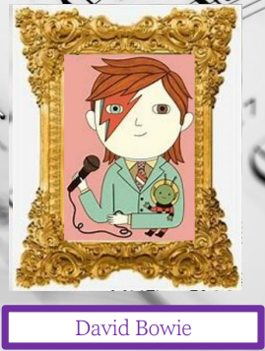
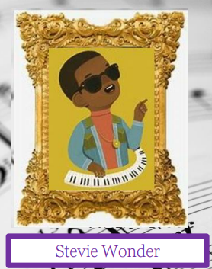
Team Points
Team | Points
Mozart | 511
Bowie | 507
Fitzgerald | 714
Wonder | 713
Well done Fitzgerald team!

Slide 20
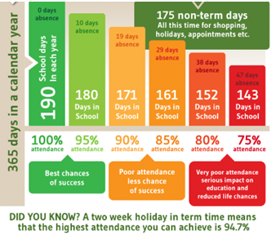
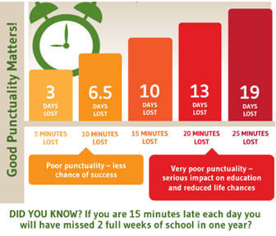
Attendance and Punctuality
This week’s attendance figures: 92.8% School Target: 96%
 | Attendance | Punctuality
Apple | 89.2% | 0 lates
Beech | 87.7% | 1 late
Holly | 97.2% | 1 late
Oak | 95.2% | 0 lates

Slide 21
Reminders of Upcoming dates:
Change of date for next CHASA meeting to: Monday 4th March 1.30pm at St Monica’s Meeting Room, Easingwold (also on Zoom)
Pre-loved uniform sales during Parent Consultation Evenings – Tuesday 12th and Wednesday 13th March
CHASA Easter Craft Session: Thursday 21st March after school - ticket details out soon
Summer Fair (save the date!): Sunday 23rd June

Slide 22
Pre loved uniform – donations please!
Ahead of the planned pre-loved uniform sale during Parent Consultation Evenings (12/13 March 2024), we would be really grateful for donations of any items of school uniform. They can be dropped off in the school office or in the basket outside the main school door.
Thanks in advance.

Slide 23
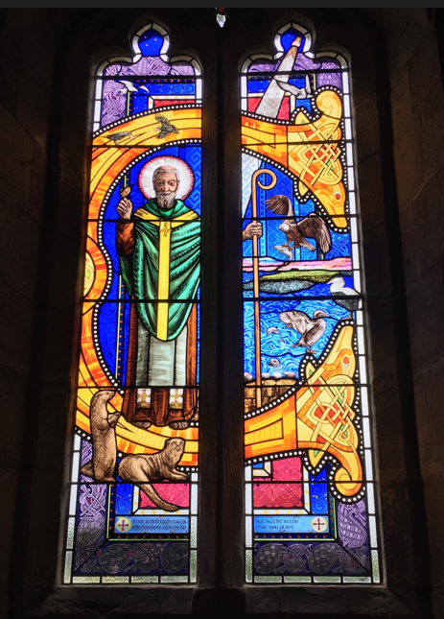
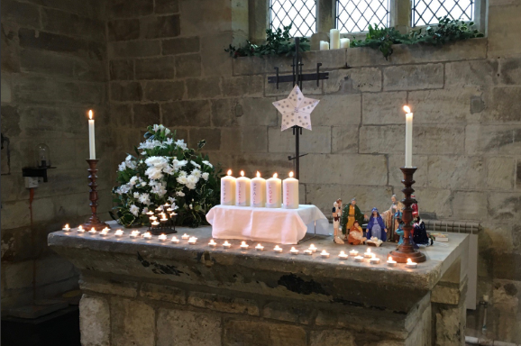
Church News – from the Family Service Team
Future dates at St Cuthbert's:
March 5th Family Service as usual at 10.30am
March 31st EASTER DAY - there will be a Family Holy Communion at 10am (note the time!)
As ever, other services in the Benefice can be found on our website at https://bylandchurches.wordpress.com/services-in-church/

