Slide 1
Design Technology at Crayke Primary

Slide 2
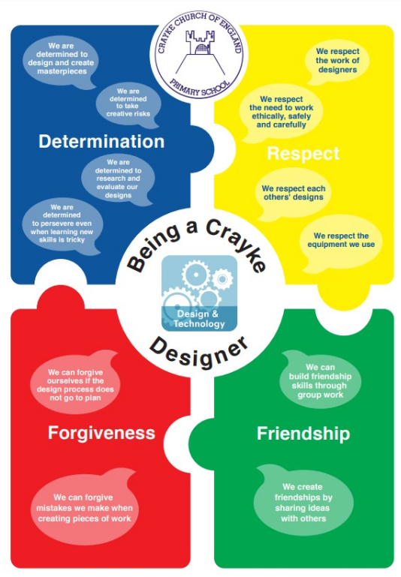
What does it mean to be a Crayke Designer?
“Design is not just what it looks like and feels like. It is how it work.” Steve Jobs
Subject Leaders | Emily Walker and Caroline Helfferich
Link Governor | Edgar Seligman
CPD | Kapow
We use Kapow (a National Curriculum fully aligned specialist scheme) which splits Design Technology into four strands: Design, Make, Evaluate and Technical Knowledge.
This is further divided into six areas to fully develop children’s design skills and knowledge: Cooking and Nutrition, Textiles, Structures, Mechanisms/ Mechanical Systems. In KS2 this is extended to include Electrical Systems and Digital World.
Teachers adapt Kapow units to fit our thematic approach and ensure that there is appropriate coverage of the requirements of the National Curriculum, within the bounds of our two-year rolling programme due to our mixed-age classes.
The sequencing and progression of different design skills and knowledge is also mapped throughout our curriculum to ensure links over time and across subjects. We provide children with different opportunities and contexts in which to build their knowledge and understanding.
Where appropriate, we block learning in order to immerse children fully. Where relevant and possible, we offer enrichment activities to motivate, excite and inspire pupils in the form of ‘Stunning Starts’, ‘Marvellous Middles’ and ‘Fabulous Finishes’ – these may take the form of educational visits, visitors, theme days, achievement assemblies, exhibitions etc..
We follow our lesson structure making connections and spotting values through our DT lessons. Creatively produced DT books give children a sense of pride in the presentation of their work.
Impact will be measured by assessing against the Kapow statements through ‘Insight pupil tracking’ as:
Below
Just below
On track

Slide 3
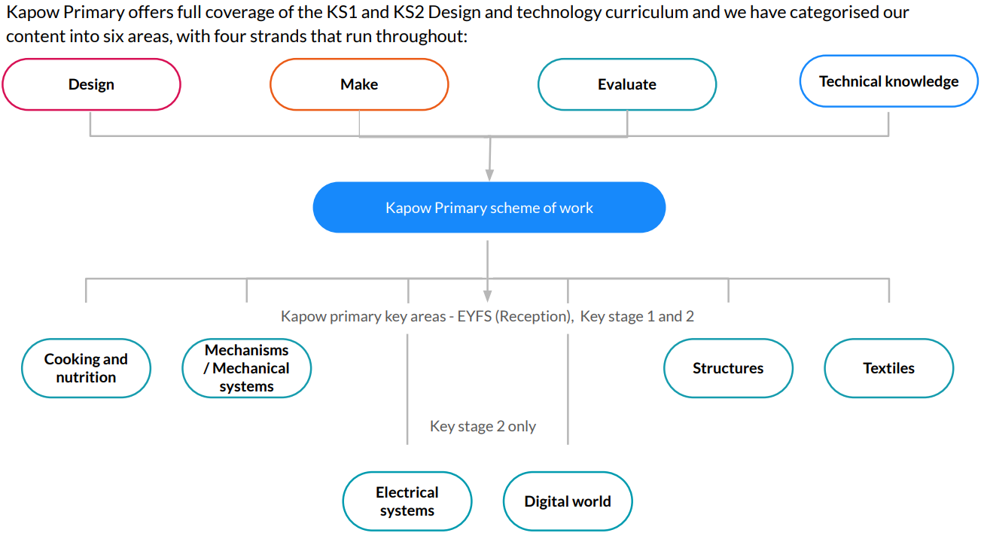
Overview of Design Technology

Slide 5
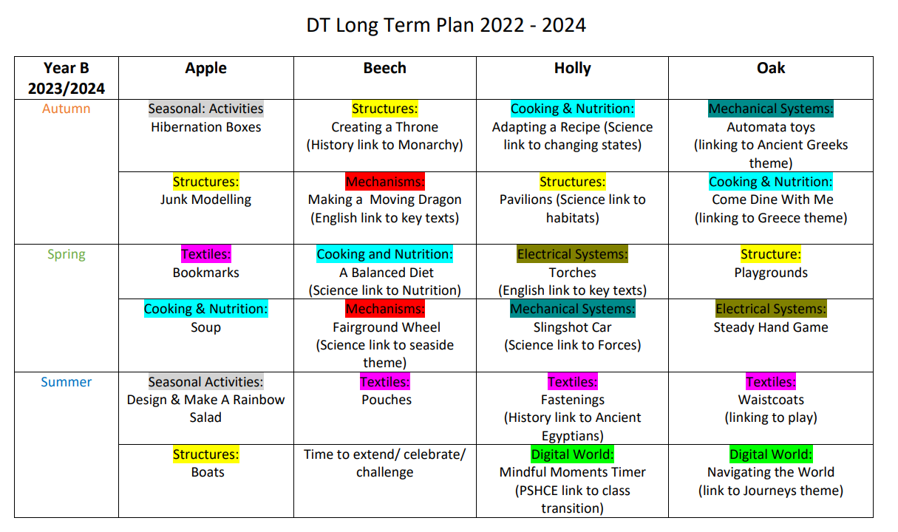

Slide 6
Progression in Design Technology at Crayke Primary
Our Curriculum – how does it progress from Early Years to Key Stage 3?
The Early Years curriculum map has been devised to feed into the Key Stage 1 curriculum.
Key Stage 1 units have been planned to provide opportunities for building on EYFS skills and preparation for KS2.
Our Key Stage 2 units have been arranged with opportunities to allow children to build on the knowledge and skills they have acquired thus far and to apply it to new contexts.
Units of work come from Kapow specialist DT scheme and have been built to link to termly themes where appropriate, alongside the National Curriculum objectives.
As they move into Key Stage 3, pupils should be taught to develop their creativity, ideas and increase proficiency in their execution. They should develop a critical understanding of design, master practical skills, design, make, evaluate and improve as well as take inspiration from design throughout history.

Slide 7
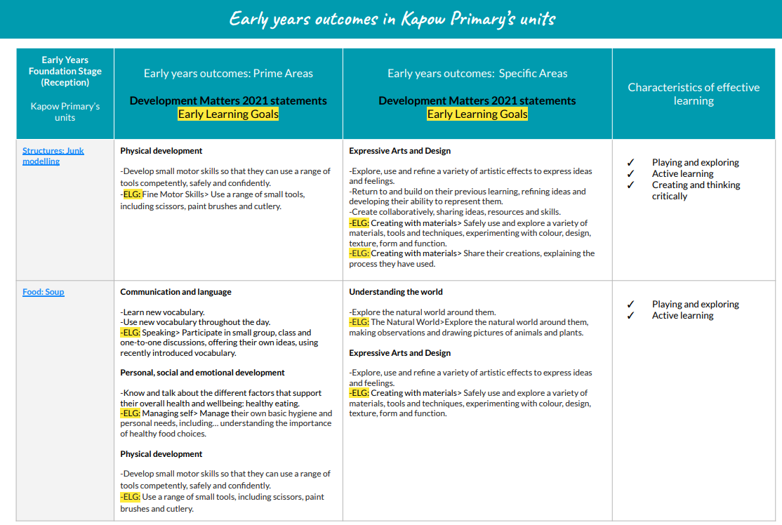
Links to Early Years Outcomes

Slide 8
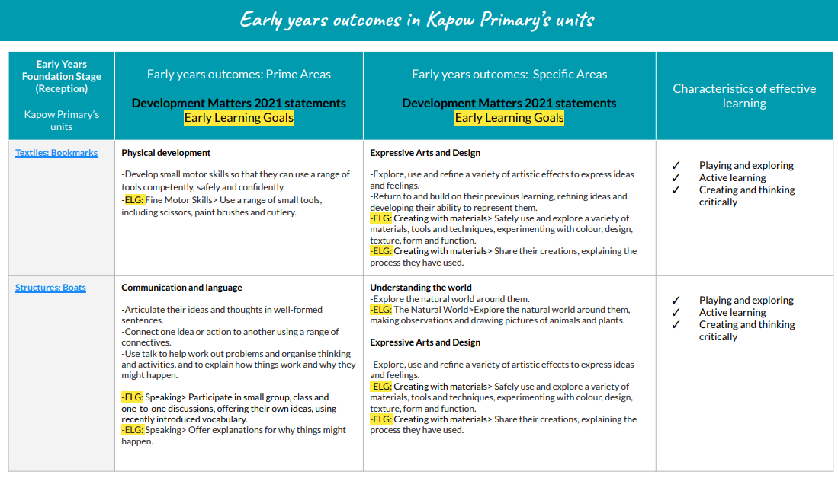
Links to Early Years Outcomes

Slide 9
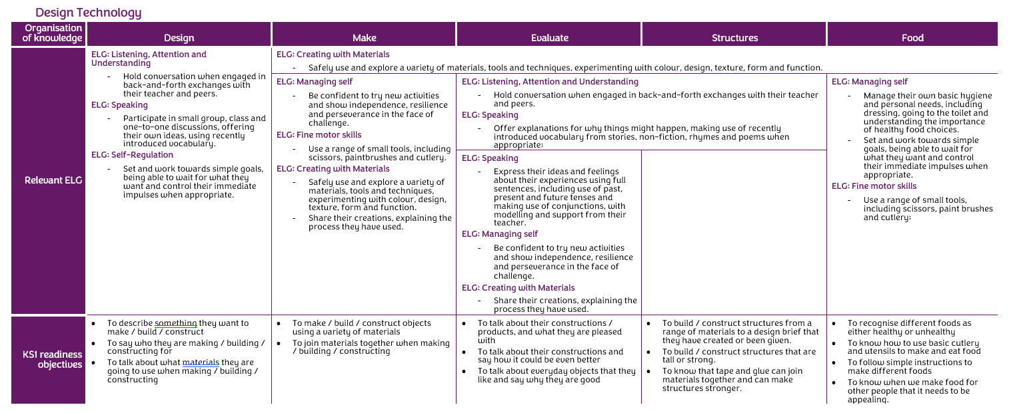
Bridging EYFS and Key Stage 1 – Design Technology

Slide 10
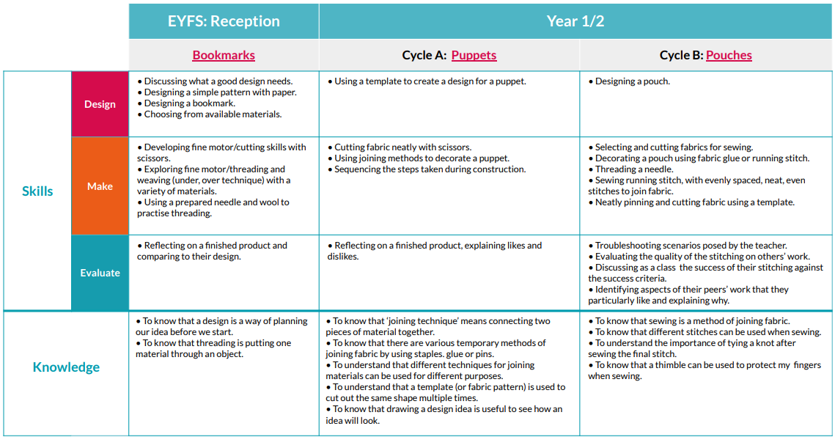
EYFS to Key Stage 1 Progression: Textiles

Slide 11
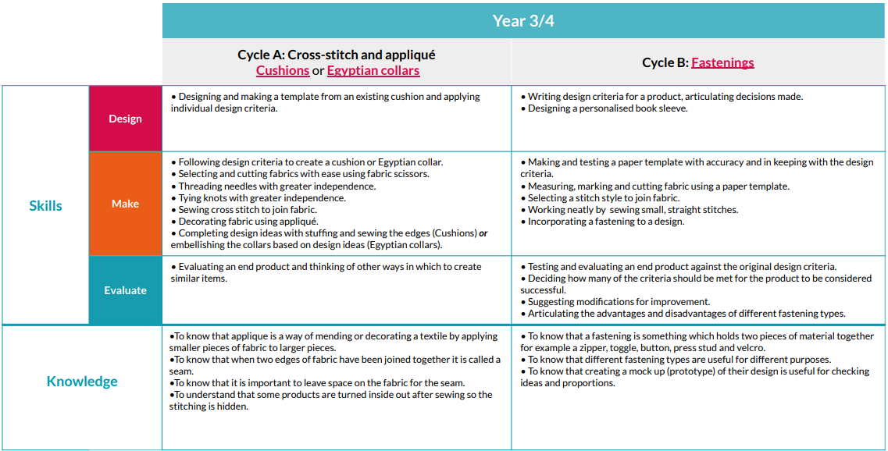
Key Stage 2 Progression: Textiles

Slide 12
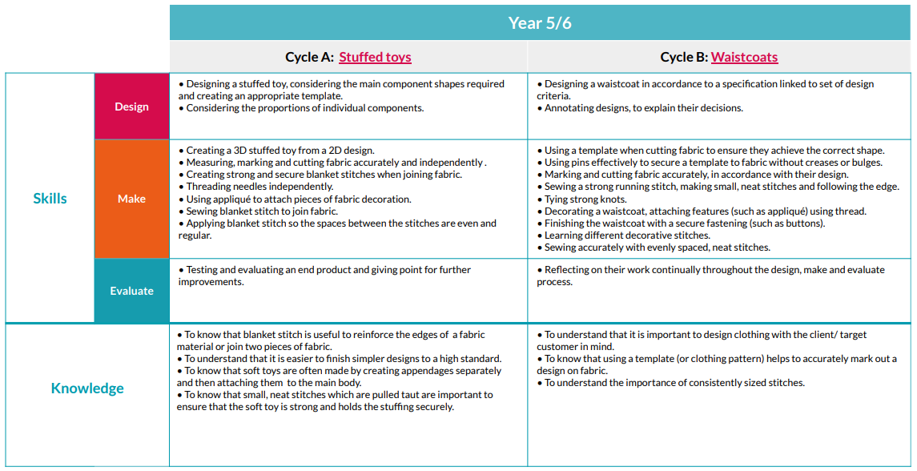
Key Stage 2 Progression: Textiles

Slide 13
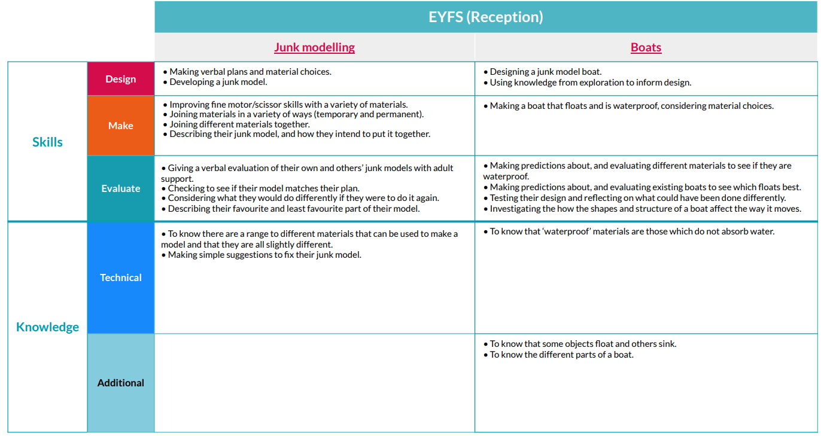
EYFS Progression: Structures

Slide 14
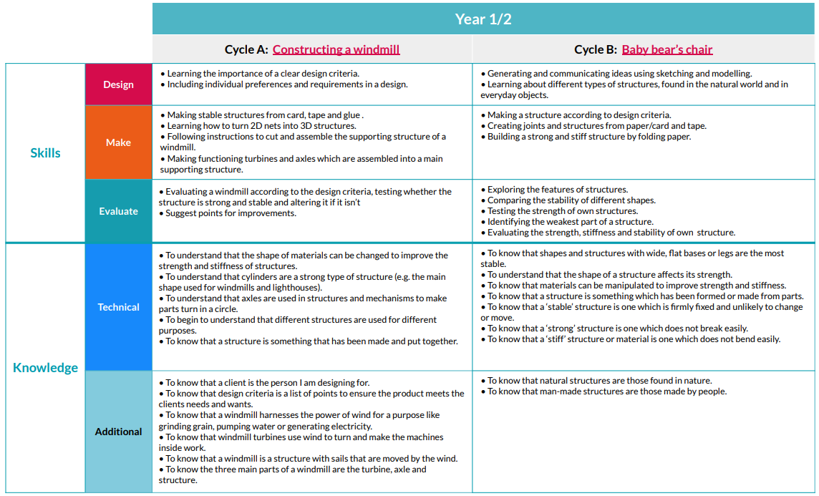
Key Stage 1 Progression: Structures
* Adapted: Create a Throne

Slide 15
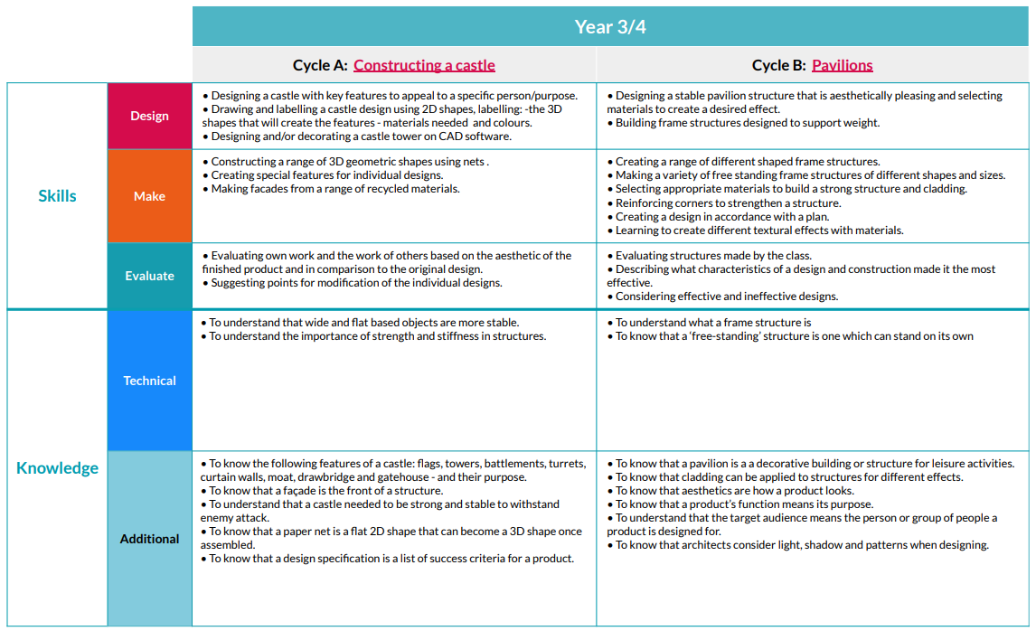
Key Stage 2 Progression: Structures

Slide 16
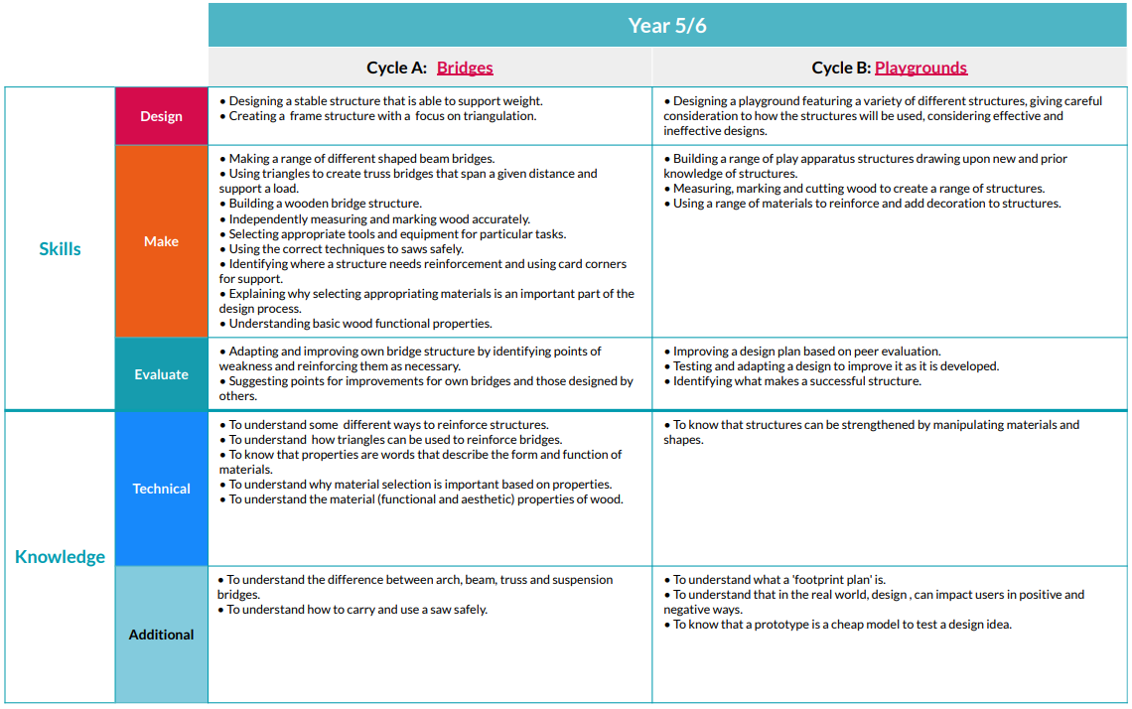
Key Stage 2 Progression: Structures

Slide 17
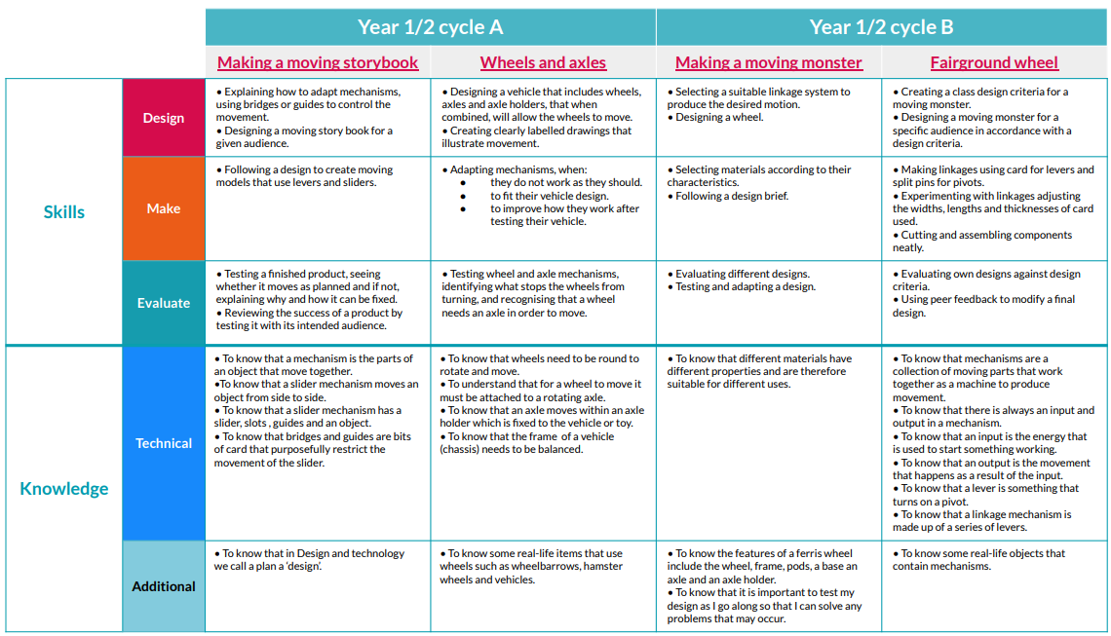
Key Stage 1 Progression: Mechanisms/ Mechanical Systems
*Adapted: Make a moving dragon

Slide 18
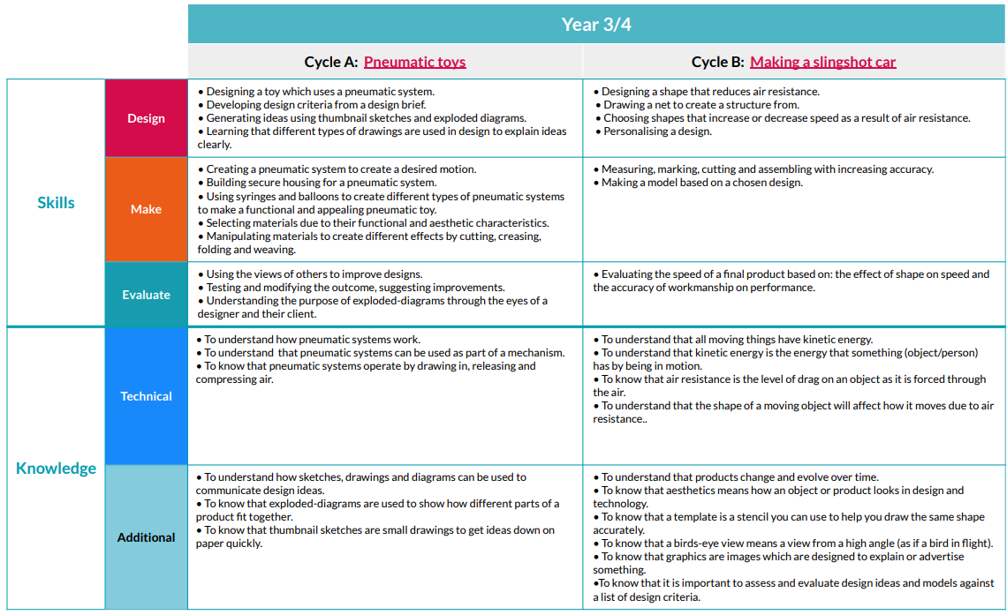
Key Stage 2 Progression: Mechanisms/ Mechanical Systems

Slide 19
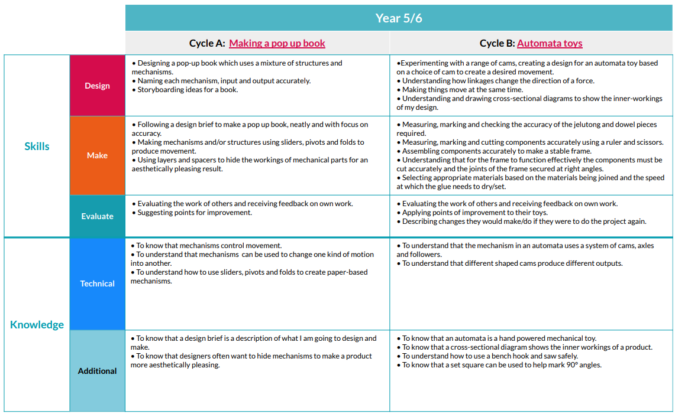
Key Stage 2 Progression: Mechanisms/ Mechanical Systems

Slide 20
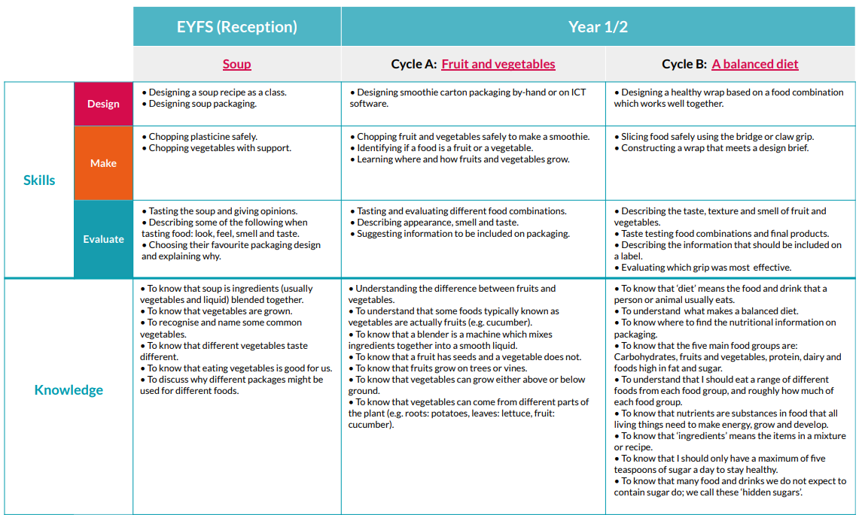
Key Stage 1 Progression: Cooking and Nutrition

Slide 21
Key Stage 2 Progression: Cooking and Nutrition

Slide 22
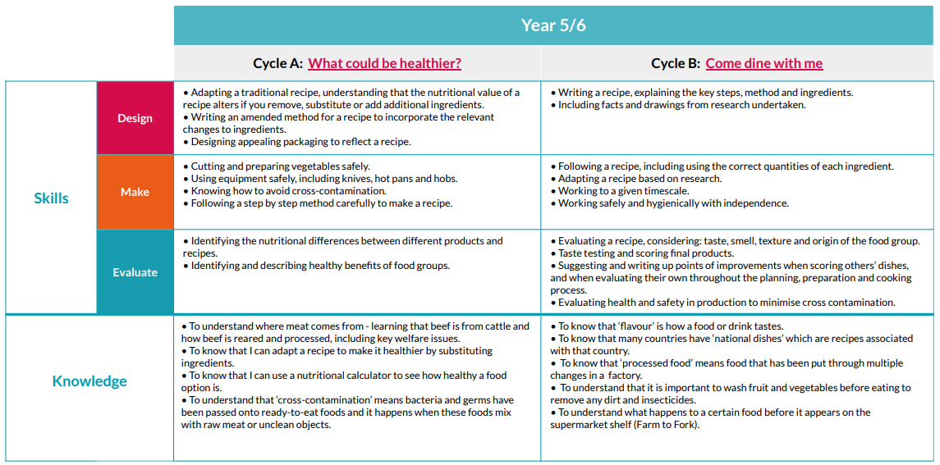
Key Stage 2 Progression: Cooking and Nutrition

Slide 23
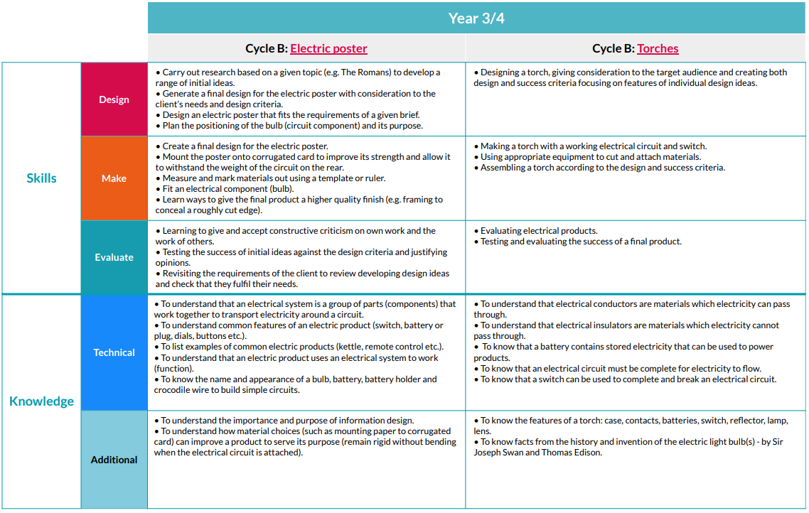
Key Stage 2 Progression: Electrical Systems (KS2 only)

Slide 24
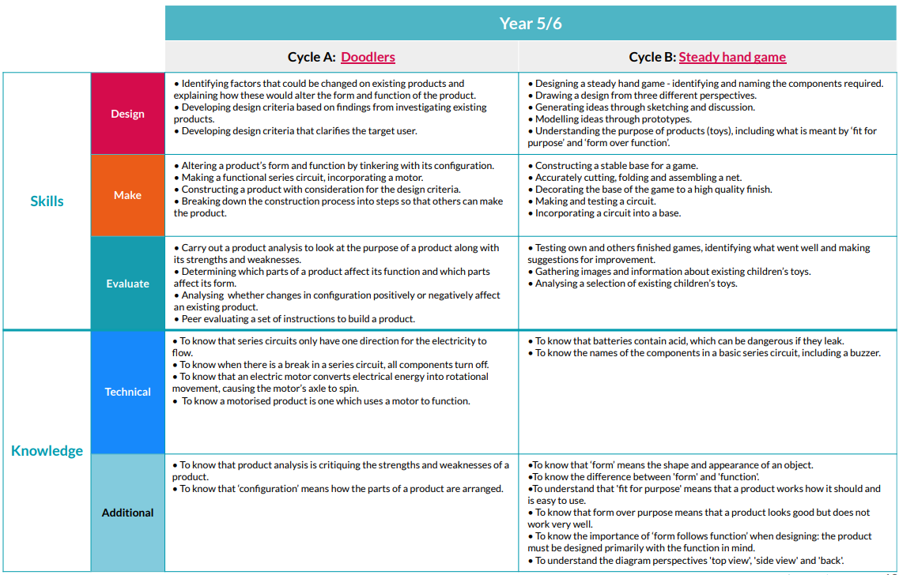
Key Stage 2 Progression: Electrical Systems (KS2 only)

Slide 25
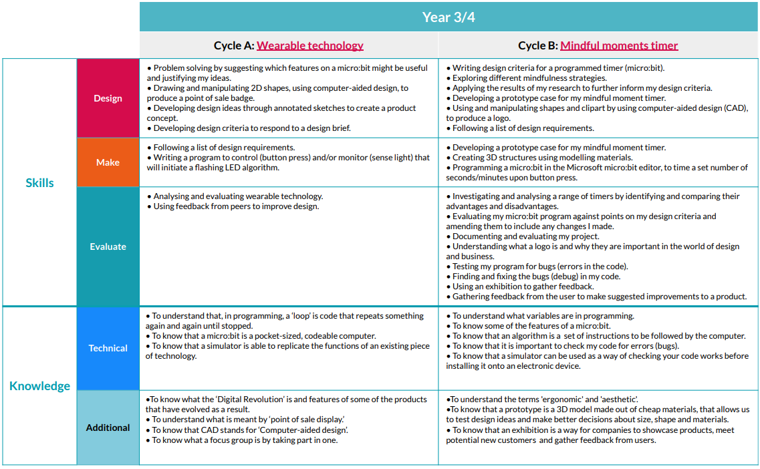
Key Stage 2 Progression: Digital World (KS2 only)
*Adapted: Electronic Charm

Slide 26
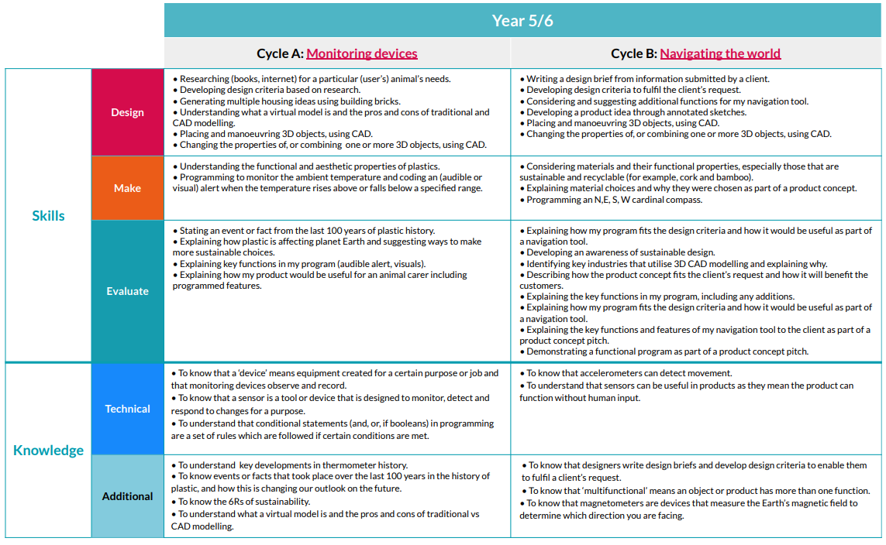
Key Stage 2 Progression: Digital World (KS2 only)

Slide 27
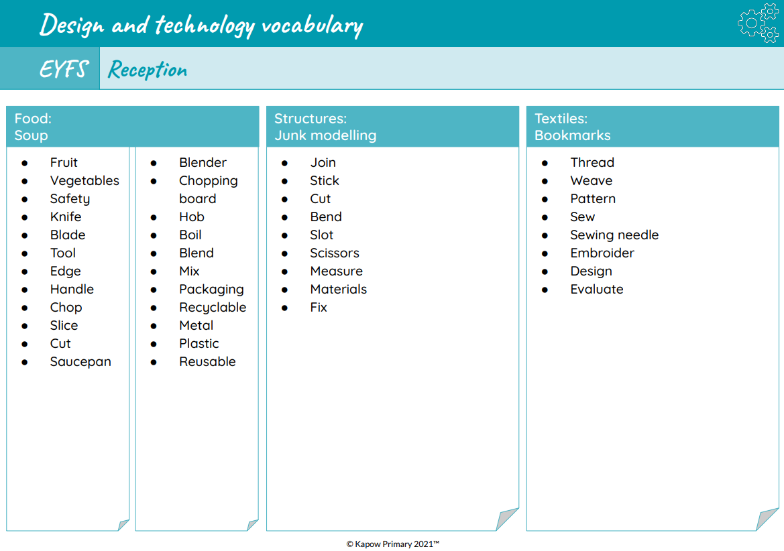
Vocabulary Progression in Design Technology

Slide 28
Vocabulary Progression in Design Technology
Additional vocabulary will also be taught and explored through child-led learning and continuous provision opportunities including within Forest School.

Slide 29
Vocabulary Progression in Design Technology

Slide 30
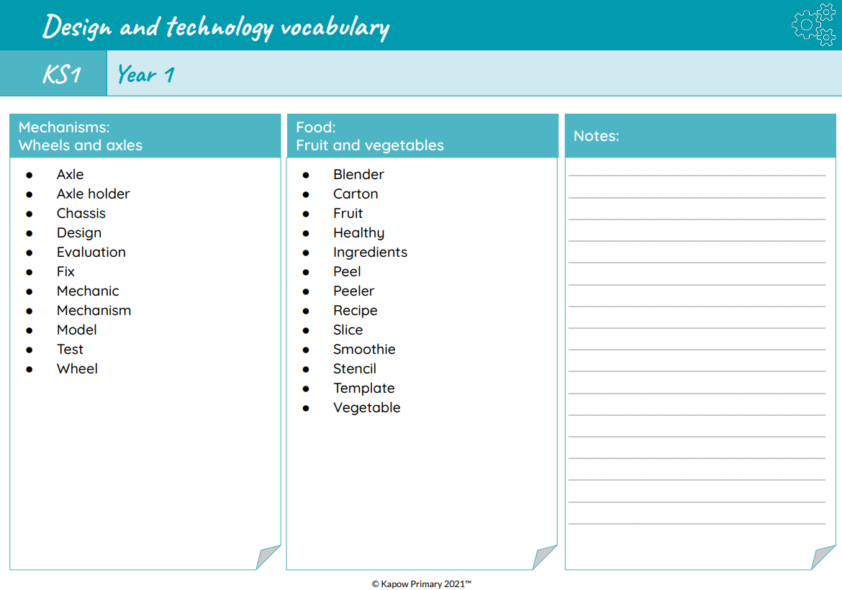
Vocabulary Progression in Design Technology
Additional specific vocabulary that links to adaptations to fit our themes can be found on Knowledge Organisers and Medium Term Plans for each unit.

Slide 31
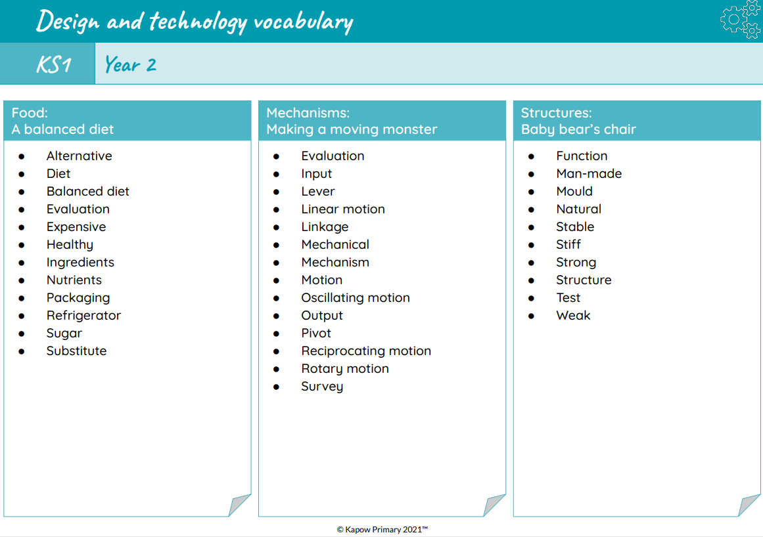
Vocabulary Progression in Design Technology

Slide 32
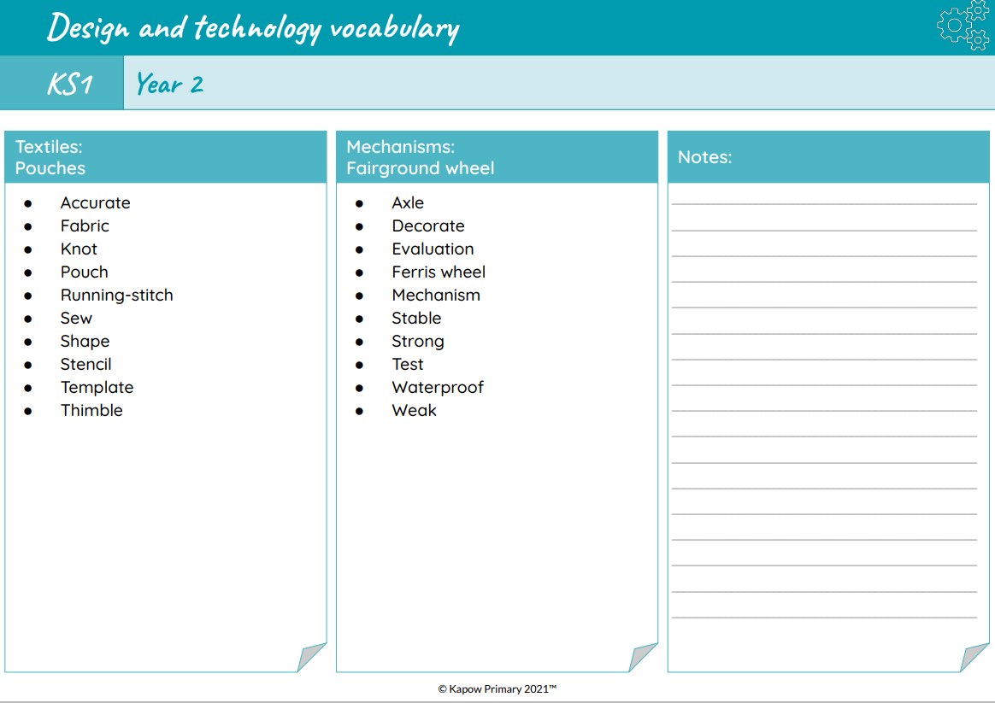
Vocabulary Progression in Design Technology
Additional specific vocabulary that links to adaptations to fit our themes can be found on Knowledge Organisers and Medium Term Plans for each unit.

Slide 33
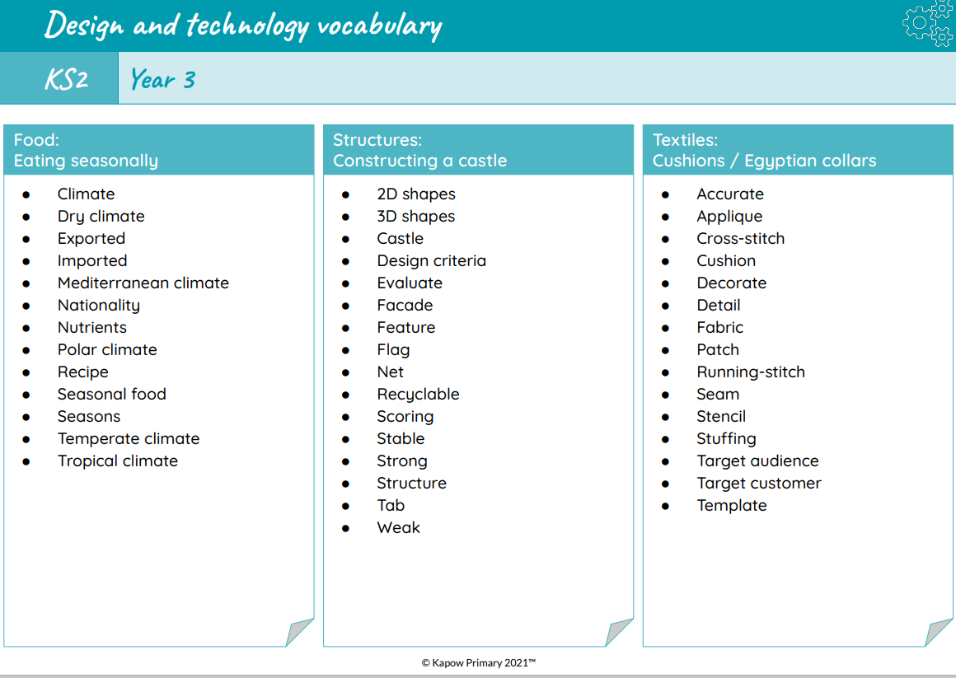
Vocabulary Progression in Design Technology

Slide 34
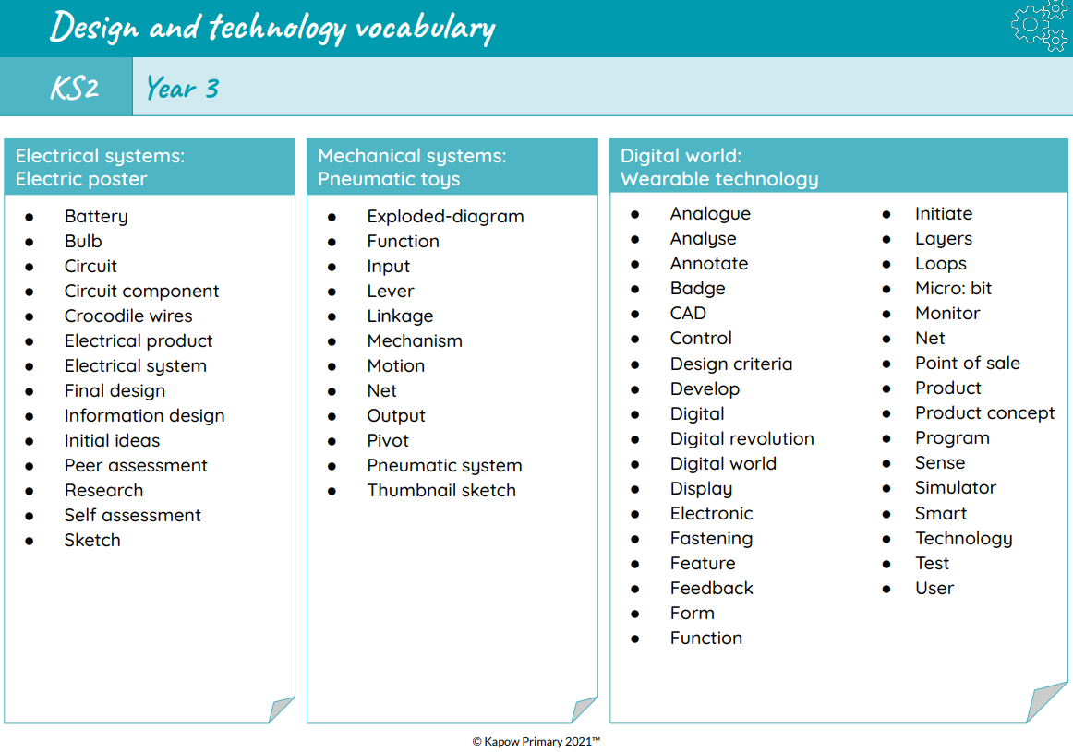
Vocabulary Progression in Design Technology

Slide 35
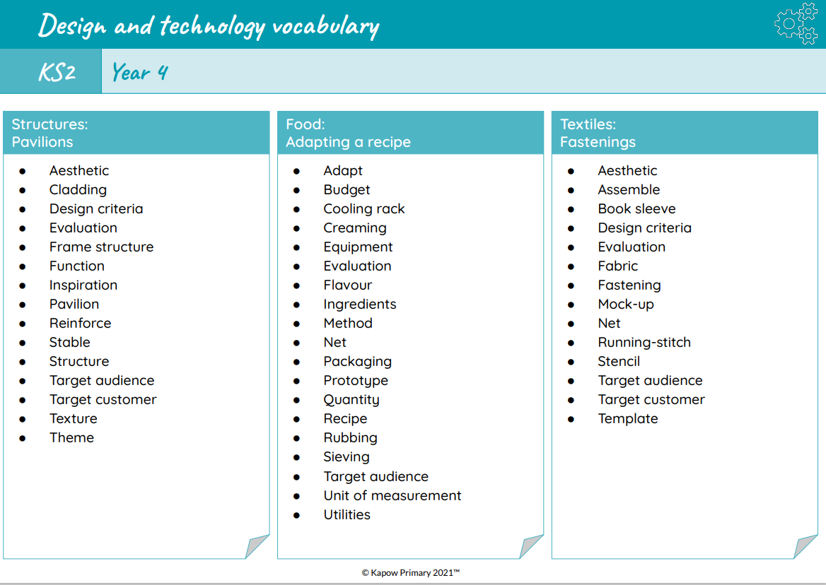
Vocabulary Progression in Design Technology

Slide 36
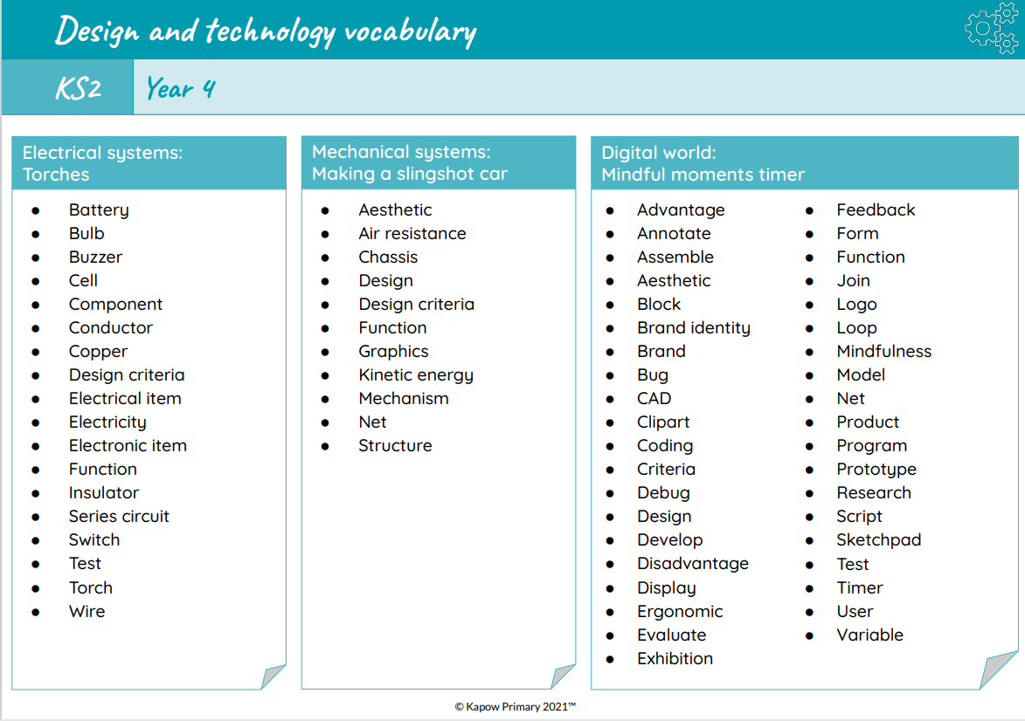
Vocabulary Progression in Design Technology

Slide 37
Vocabulary Progression in Design Technology

Slide 38
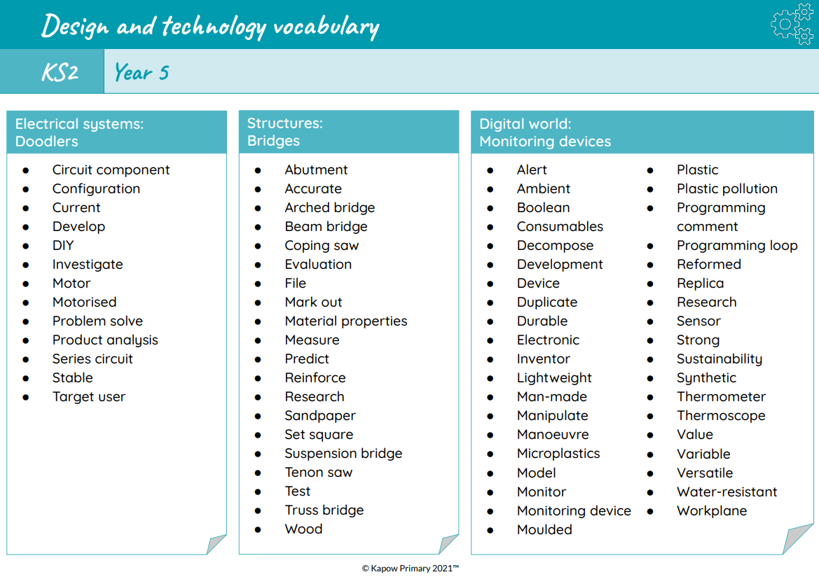
Vocabulary Progression in Design Technology

Slide 39
Vocabulary Progression in Design Technology

Slide 40
Vocabulary Progression in Design Technology

Slide 41
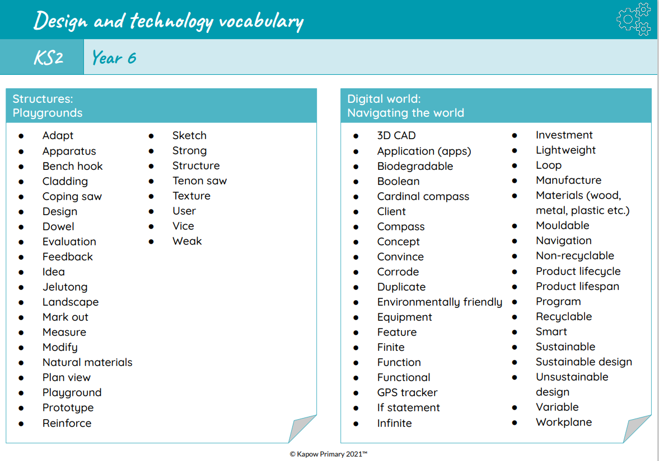
Vocabulary Progression in Design Technology

Slide 42
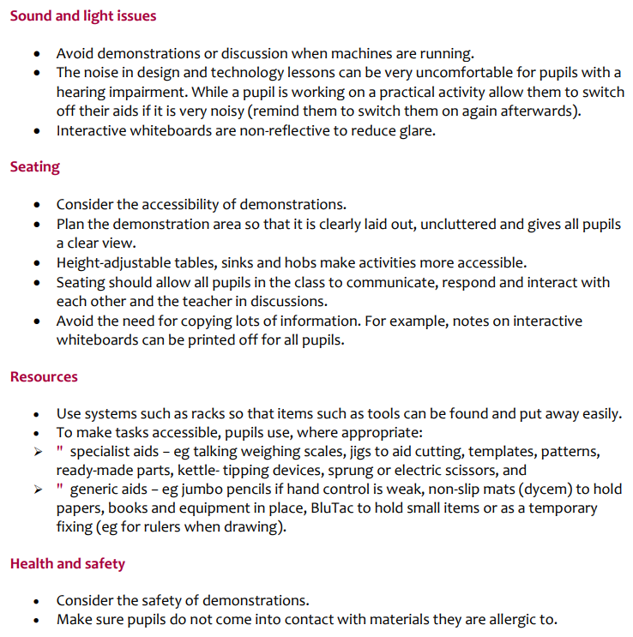
Including Pupils with SEND in Design Technology
Adjustments for SEND pupils will be made on an individual basis by staff who know them best. These adjustments may include referring to EHCPs where applicable. Staff may also take into account the following considerations for SEND pupils and make adjustments as needed to ensure all pupils are included with Design Technology lessons.

Slide 43
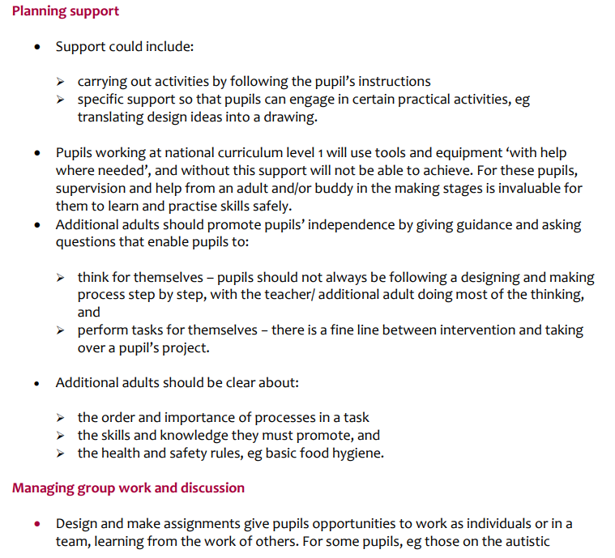
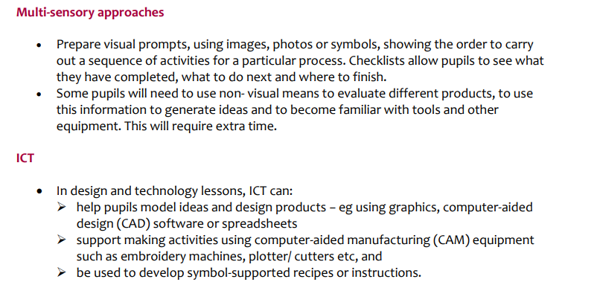

Slide 44
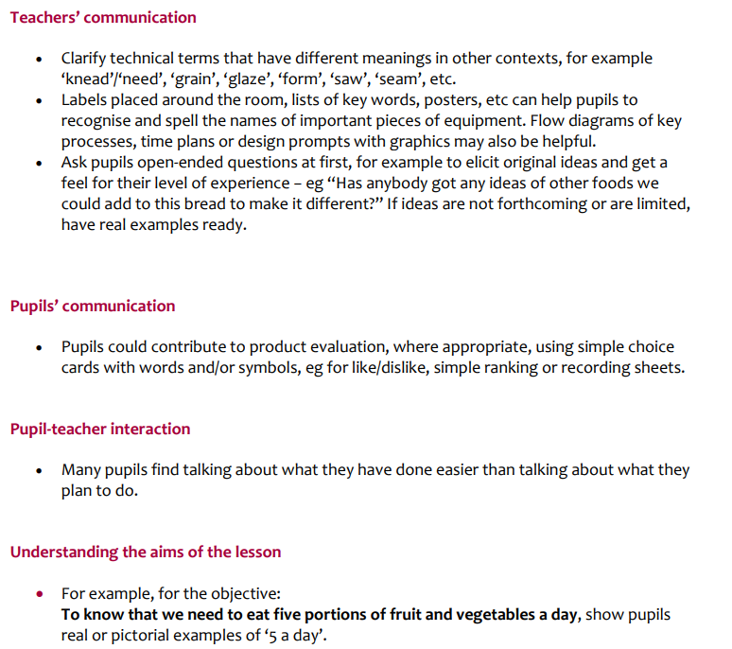
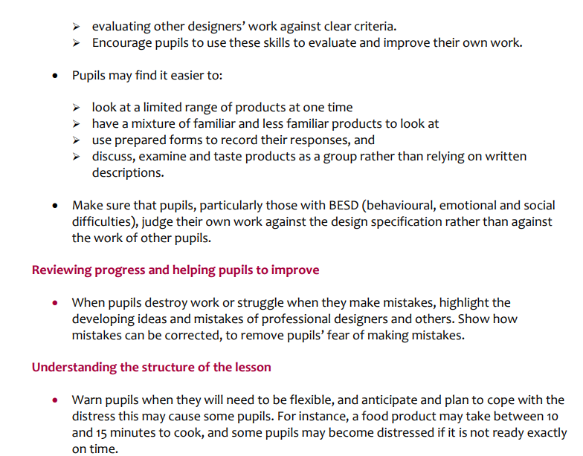

Slide 45
