Slide 1

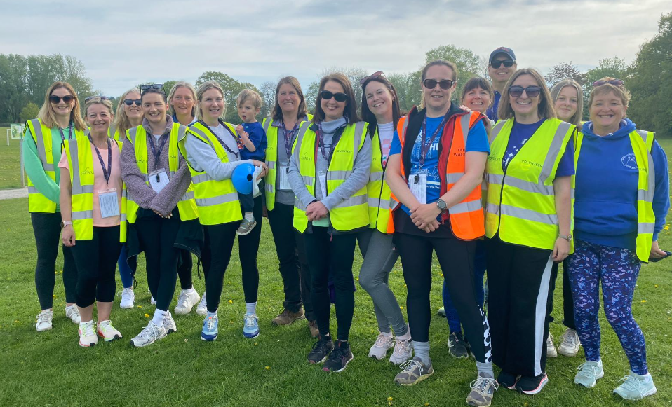
The Wellbeing and Workload Pledge
Summer 2025
“You did not choose me, I chose you that you might go and bear fruit, fruit that will last, so that whatever you ask in my name the Father will give you.”
John 15:16

Slide 2
Vision
Crayke CE Primary School is a Church of England School where all within our school community are encouraged to “Follow your pathway and grow together with confidence.” This is rooted in our core school values of friendship, forgiveness, respect and determination and is underpinned by our Biblical reference “You did not choose me, I chose you that you might go and bear fruit, fruit that will last so that whatever you ask in my name the Father will give you.” John 15:16
This is summarised in our Christian Vision as follows: As a happy and caring school family, which respects everyone as an individual, our vision is to grow compassionate, confident and resilient learners who fulfil their unique potential and become the best version of themselves to thrive in an ever-changing world.
At our school, we are committed to providing an environment where all staff can flourish in mind, body, and spirit.
This pledge outlines our dedication to supporting staff wellbeing and managing workload effectively, ensuring a thriving community for all who learn and work here.
“You did not choose me, I chose you that you might go and bear fruit, fruit that will last, so that whatever you ask in my name the Father will give you.”
John 15:16

Slide 3
Our Pledge
The mental health and wellbeing of our staff are of utmost importance to us. We are immensely grateful for the dedication, passion, and hard work that all staff contribute to the success and thriving of our school community. This pledge sets out our commitment to protecting and promoting the wellbeing of all staff, ensuring a supportive environment where everyone can flourish.
We believe that everyone in our school community should have the opportunity to enjoy the highest possible wellbeing and mental health. As part of our vision, which promotes growth in mind, body, and spirit, we aim to create an environment where staff are not only valued but also supported in balancing their professional responsibilities with their personal wellbeing.
We understand that doing what is right, acting with integrity, and treating one another with compassion are central to a healthy work environment. This pledge sets out the actions we will take as a school to safeguard staff wellbeing and workload, fostering a culture of respect, support, and collective care.
“You did not choose me, I chose you that you might go and bear fruit, fruit that will last, so that whatever you ask in my name the Father will give you.”
John 15:16

Slide 4
A culture of community and belonging
At our school, we believe that a strong, positive culture is the foundation for success. Rooted in our Biblical reference to ‘go and bear fruit, fruit that will last’ (John 15:16), we are committed to creating an environment where every member of our school community—staff, pupils, and parents—feels valued, supported, and able to thrive. We know that when people feel a true sense of belonging, they can flourish in mind, body, and spirit.
Unlike many settings where culture is not always prioritised, we recognise that a supportive and ambitious school climate is essential for wellbeing, workload management, and professional fulfilment. Research from the Education Endowment Foundation (EEF) highlights the importance of school culture in staff retention, pupil outcomes, and overall school effectiveness. The Department for Education’s (DfE) Staff Wellbeing Charter also emphasises the role of positive relationships in creating a thriving workforce.
“You did not choose me, I chose you that you might go and bear fruit, fruit that will last, so that whatever you ask in my name the Father will give you.”
John 15:16

Slide 5
A culture of community and belonging
To build a culture of community and belonging, we commit to:
• Fostering meaningful relationships between staff, pupils, and parents, ensuring that everyone feels heard, understood, and valued.
• Encouraging collaboration at all levels, ensuring staff feel supported through professional dialogue, shared decision-making, and peer mentoring.
• Maintaining open communication, so staff have a voice in shaping school priorities and are confident in raising concerns without fear of judgement.
• Creating an inclusive and safe environment, where everyone can express themselves authentically and contribute to a shared vision.
• Recognising and celebrating achievements, ensuring that staff feel appreciated for their dedication and hard work.
• Providing time and space for staff wellbeing, acknowledging that balance is key to long-term success and sustainability.
Our commitment to a culture of belonging is not an abstract idea—it is embedded in everything we do. By prioritising relationships, collaboration, and shared values, we ensure that our school remains a place where every individual can flourish, feel valued, and be the best versions of themselves.
“You did not choose me, I chose you that you might go and bear fruit, fruit that will last, so that whatever you ask in my name the Father will give you.”
John 15:16

Slide 6
Prioritising Staff Mental Health and Wellbeing
We are committed to fostering a culture where mental health and wellbeing are given the same importance as physical health. Aligned with our vision of ‘follow your pathway and we grow together in confidence’, we strive to tackle the stigma surrounding mental health and wellbeing, promoting openness and understanding throughout our school community.
We believe that everyone should have access to the support they need to thrive, both professionally and personally. This includes fulfilling our legal duties to manage work-related stress, offering sensitive pastoral care, and ensuring that all staff receive the appropriate support when needed. Together, we create an environment where mental health and wellbeing are prioritised, and every member of our school community can flourish.
“You did not choose me, I chose you that you might go and bear fruit, fruit that will last, so that whatever you ask in my name the Father will give you.”
John 15:16

Slide 7
Additional Support
We offer the following support services to ensure our staff have access to the help they need:
Pastoral Support: We are committed to providing sensitive and understanding pastoral care for staff, offering a safe space for open discussions about mental health and wellbeing. This can include one-to-one support, referrals to additional services, and regular check-ins.
Regular Wellbeing Check-ins: In addition to informal support, we encourage regular wellbeing check-ins with line managers to discuss workload, wellbeing, and any concerns that might impact mental health.
Support Networks: We foster an open and understanding culture where staff can connect and support one another. This includes the opportunity to “walk and talk”, take a book from our staff library, participate in our staff group chat, share celebrations
Access to Wellbeing Resources: From stress-relief techniques to practical mental health guides and a well-being calendar which is updated monthly and published around school, we provide a range of resources that staff can access at any time to support their mental health.
Staff “get togethers”: Whether it’s a shared lunch on an INSET Day, or an evening out together, we recognise the importance of spending time together as a staff team and getting to know each other as people, not just colleagues.
Governance: Governors will take into account staff wellbeing when making any decisions such as the impact of any new or updated policies.
These provisions, combined with access to Wisdom (Health Assured) and North Yorkshire Employee Benefits (https://www.northyorks.gov.uk/jobs-and-careers/total-rewards), are part of our holistic approach to ensuring that all staff feel supported and valued in maintaining their mental health and wellbeing.
“You did not choose me, I chose you that you might go and bear fruit, fruit that will last, so that whatever you ask in my name the Father will give you.”
John 15:16

Slide 8
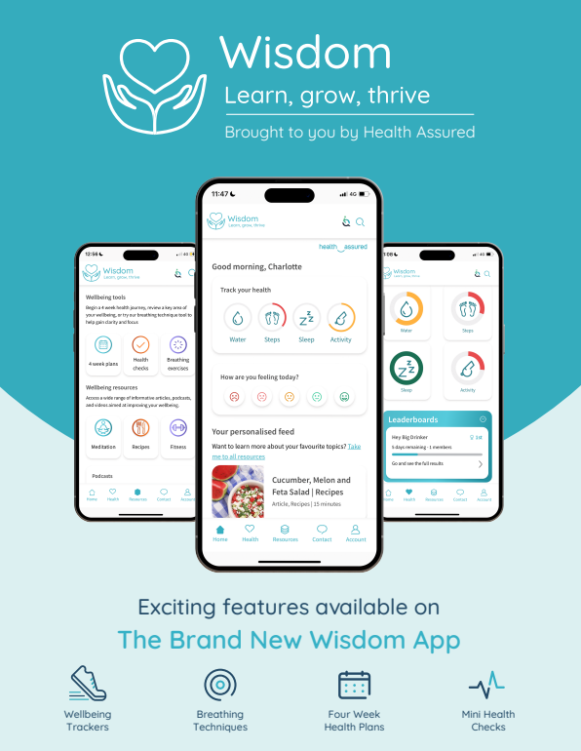

Slide 9
Crayke CE Primary School Perks
We strive to go above and beyond for our staff, offering additional considerations that support well-being, work-life balance, and professional fulfilment.
These include:
• Personal Passions and Well-being: We recognise the importance of personal growth and work-life balance. Where possible, we offer flexible working arrangements, including leave of absence, sabbaticals, and support in responding to personal circumstances.
• Family First: We understand that family comes first. We aim to be as supportive as possible with appointments and absences beyond the staff absence policy. We also encourage staff to attend important family events—memories matter!
• A Relaxing Cuppa: Tea and coffee facilities are available to ensure staff can take a well-deserved break, often alongside a sweet treat.
• Investment in Professional Development: We are committed to staff development, offering both internal and external training opportunities. Our performance management systems ensure a clear focus on growth and career progression.
• Leadership Development Opportunities: We actively support staff in developing their leadership potential. Through the National Professional Qualifications (NPQs), we provide structured leadership training, equipping staff with the skills and knowledge to progress in their careers.
Self-care: A range of hand soaps and creams are provided in the staff toilets for a mini pamper opportunity in a busy working day.
“You did not choose me, I chose you that you might go and bear fruit, fruit that will last, so that whatever you ask in my name the Father will give you.”
John 15:16

Slide 10
Prioritising Workload
We work proactively to drive down unnecessary workload and ensure that staff can balance the demands of their roles with personal well-being. Workload can encompass a wide range of tasks and responsibilities within a teacher’s working life, and we recognise the impact that excessive workload can have on both mental health and overall job satisfaction. The school understands its duty of care towards all staff and is committed to fostering a supportive environment.
We are dedicated to reviewing and refining our policies and practices to reduce administrative burdens, improve efficiency, and streamline processes. By encouraging clear expectations, reducing unnecessary tasks, and making time for professional development, we aim to support staff in focusing on what matters most: the success and well-being of our pupils. We also recognise the importance of staff autonomy and agency, giving our staff the space to innovate and work in ways that inspire both them and their learners.
In line with our vision of ‘follow your pathway and we grow together with confidence’, we believe that when staff are not overwhelmed by excessive workload, they are better equipped to thrive in their professional roles and contribute fully to the school community. Through these efforts, we aim to create a working environment where the health and well-being of staff are nurtured, and everyone has the opportunity to flourish.
“You did not choose me, I chose you that you might go and bear fruit, fruit that will last, so that whatever you ask in my name the Father will give you.”
John 15:16

Slide 11
Reduced Directed Time
We have taken steps to reduce the directed time for teachers across the academic year, ensuring a better work-life balance.
Some of the initiatives include:
• Dedicated Subject Leader Release Time: Allocated time for subject leaders to focus on leadership and development without impacting teaching time.
• Time for Administrative Tasks: Numerous staff meeting sessions are dedicated to tasks like report writing and other paperwork to avoid overburdening teachers during their personal time.
• Rare Late Nights: Late nights are kept to a minimum, with school events and activities planned to avoid unnecessary time commitments outside of regular hours.
• Efficient Communication: Unnecessary meetings are avoided. Messages are relayed efficiently through staff briefings or email, ensuring that staff time is respected and maximised for teaching and development.
“You did not choose me, I chose you that you might go and bear fruit, fruit that will last, so that whatever you ask in my name the Father will give you.”
John 15:16

Slide 12
Ofsted, June 2024
“Leaders consider the workload and well-being of staff carefully. Staff are overwhelmingly happy at the school and feel well supported.”
“You did not choose me, I chose you that you might go and bear fruit, fruit that will last, so that whatever you ask in my name the Father will give you.”
John 15:16

