Slide 1

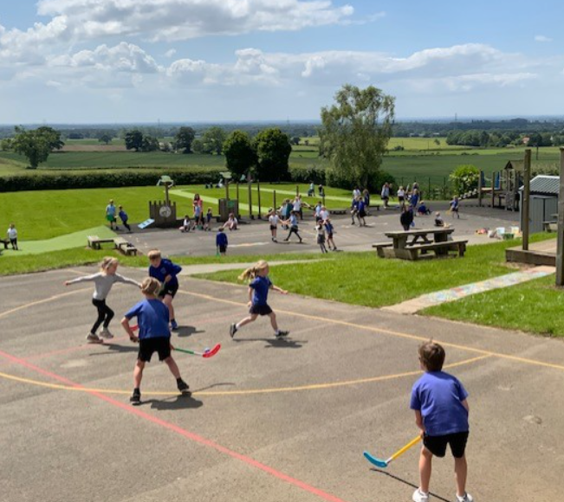
Crayke CE Primary School
Summer Term 2 2026
Crayke Chronicle - Standing Items

Slide 2
Our Safeguarding Team
At Crayke, we have two members of staff and a governor who make up our Safeguarding Leadership Team. Mrs Jackson is the Designated Safeguarding Lead, which means that she is the lead person responsible for child protection and safeguarding issues. Mrs Helfferich is our Deputy Designated Safeguarding Lead (Deputy DSL); a deputy DSL supports the DSL in their role of safeguarding and child protection. Mrs Andrea Hayes is our Safeguarding Link Governor. The role of the Safeguarding Governor is to support the DSL as well as to regularly review, ask questions and make suggestions about our safeguarding policies and procedures and to report back to the governing body. All staff at Crayke know that safeguarding is EVERYONE’S responsibility. Find out more on our dedicated website Safeguarding page: https://craykeschool.org/safeguarding/
You can also report any safeguarding concerns to our DSL email: dsl@crayke.n-yorks.sch.uk
Please also be aware that as a school we subscribe to Operation Encompass, whereby we are notified of any incidences of domestic violence where a pupil at our school has been present.

Slide 3
Attendance and Punctuality
Attendance
We strive for high levels of attendance at school. Please try, wherever possible, to book holidays out of term time. The impact of even one day’s absence on your child’s learning is huge. Also, please try to book medical appointments out of school hours if possible as this also minimises the time missed. If your child is very unwell and unable to attend school, please inform the office by phoning 01347 821767 no later than 9:15am. Thank you for your support with this important matter.
Punctuality
It is very important that the children arrive to school on time so that:
1. They take part in all of the learning opportunities for the day with complete focus and without interruption from late arrivals.
2. Teachers can teach the best possible lessons without complete focus and without interruption from late arrivals.

Slide 4
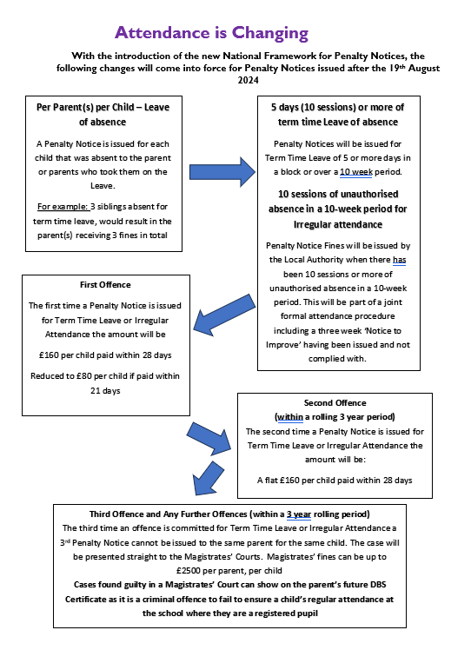
Attendance and Punctuality
New rules around attendance are now in force. Further details are outlined here.

Slide 5
School Website
Our school website contains a wealth of information on all matters relating to school life.
Please visit the curriculum section here: https://craykeschool.org/curriculum/ to find out more about what your child is learning in school.
Please also visit the ‘Parents’ section for more information about school routines and expectations and the ‘Children’ section for other useful information.

Slide 6
Online Safety
We recognise the importance of online safety and also understand that it is a fast paced, ever changing online world where parents can struggle to keep up with the technical knowledge and understanding demonstrated by their children. The National Online Safety organisation produce guides, which we share with parents and carers regularly. These leaflets are also made available on the Online Safety section of our website. Should you wish to access any of the other online safety parent guides available on a whole range of topics including what parents need to know about Amazon Fire Tablets, Google Chromebooks, and ways to champion equality online, please have a look at this weblink: https://nationalonlinesafety.com/guides
Should you wish to access more information about how to support your child/ren with online safety at home, this course is available which explains in detail the risks they might be exposed to and what you can do to support them. https://info.nationalonlinesafety.com/myleene-uk

Slide 7
Cost of Living Crisis – Pupil Premium
We are very aware that costs continue to rise and look set to do so for some time. If you are encountering financial difficulties, we may be able to signpost support. Please get in touch.
If your circumstances have changed and you think your child may be eligible for free school meals, it has never been easier to apply. There is no stigma attached to this, it is not highlighted to the children in any way, and the school gets valuable funding too. If you would like a confidential conversation about whether you may be eligible for free school meals, please do not hesitate to speak to me. To apply directly please use this weblink: https://www.northyorks.gov.uk/free-school-meals

Slide 8
Curriculum Information for Summer Term 2026
We look forward to an exciting term with each class focussing on the following themes and enquiry questions in their learning:
SUMMER 2026 | Theme | Enquiry Question | Enrichment (Stunning Start/Marvellous Middle/Fabulous Finish) | Further curriculum information available on our website here:
Apple | Ready, Steady, Grow | How do things grow? | Monk Park Farm visit | https://craykeschool.org/wp-content/uploads/2025/09/Curriculum-Map-Apple-Class-for-the-year.pdf
Beech | Step into Summer | How has Crayke changed over time? | Local visit walk | https://craykeschool.org/wp-content/uploads/2026/04/Beech-Class-Curriculum-Tree-Year-B-Summer-Term-2026.pdf
Holly | Pharaohs, Farms and Feasts | What can we learn from what the Ancient Egyptians left? | Virtual museum visit | https://craykeschool.org/wp-content/uploads/2026/04/Holly-Class-Curriculum-Tree-Year-B-Summer-2026.pdf
Oak | Journeys | How can we think about different areas of our life and our world as journeys? | Immersive experience | https://craykeschool.org/wp-content/uploads/2026/04/Oak-Class-Curriculum-Tree-Summer-Year-B-2026.pdf

Slide 9

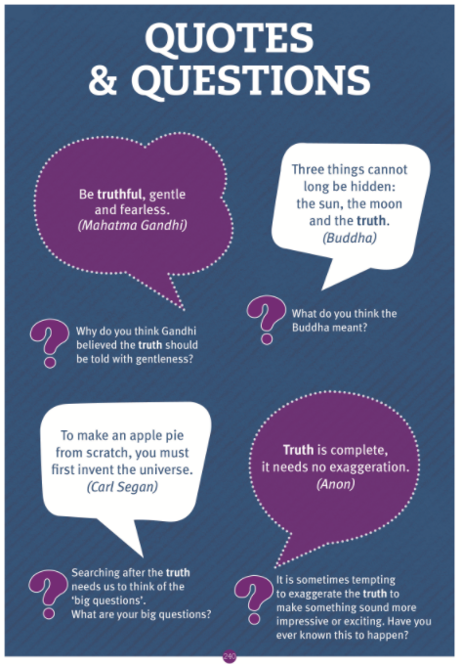
Home School Values – Summer 2
CLICK HERE:
https://craykeschool.org/2026/home-school-values-summer-2026/

Slide 10
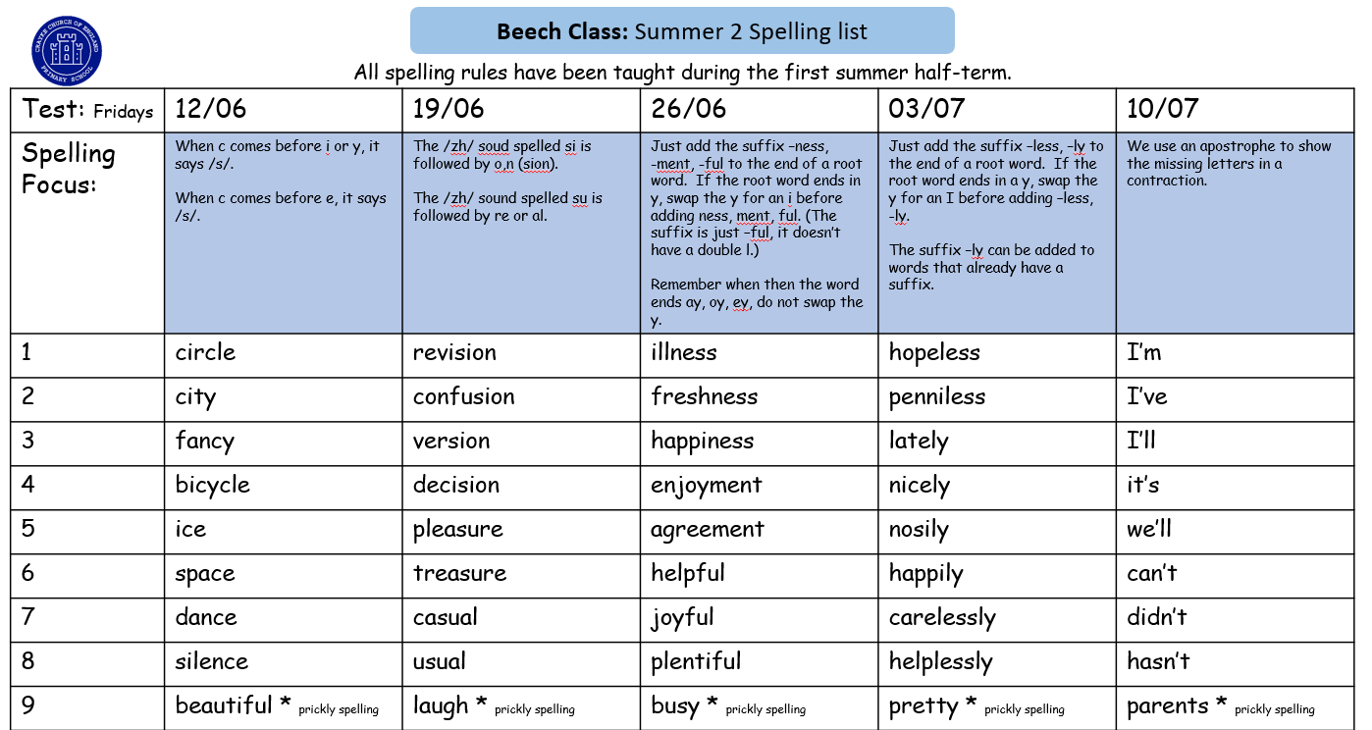
Spellings – Beech Class Summer 2
CLICK HERE:
https://craykeschool.org/classes/class-2/

Slide 11
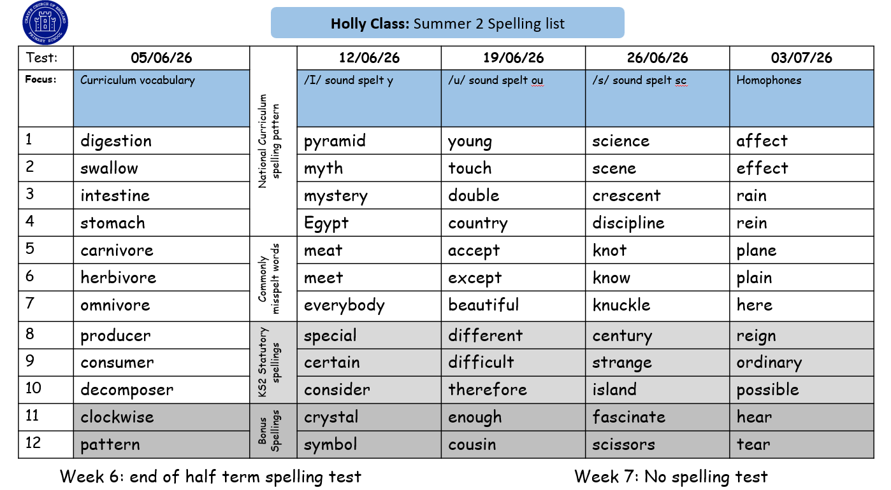
Spellings – Holly Class Summer 2
CLICK HERE:
https://craykeschool.org/classes/class-3/

Slide 12
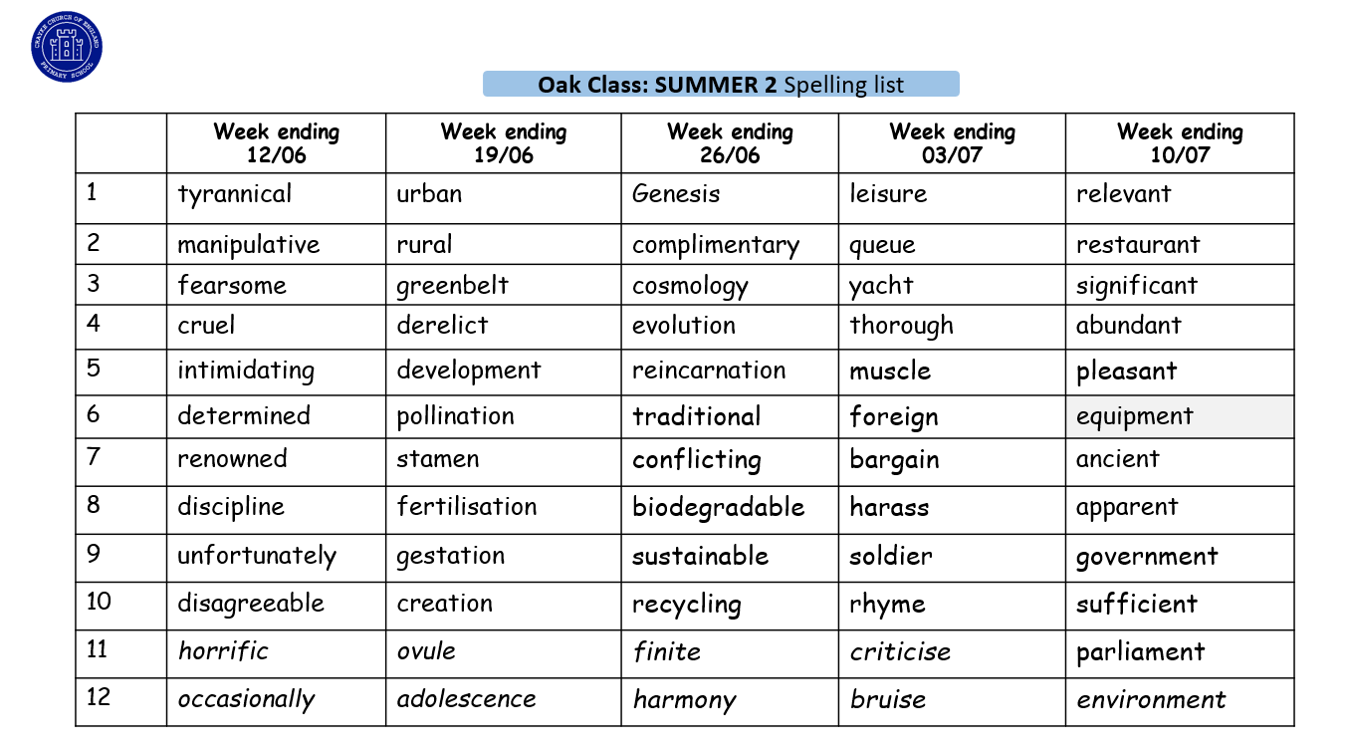
Spellings – Oak Class Summer 2
CLICK HERE:
https://craykeschool.org/classes/class-4/

Slide 13
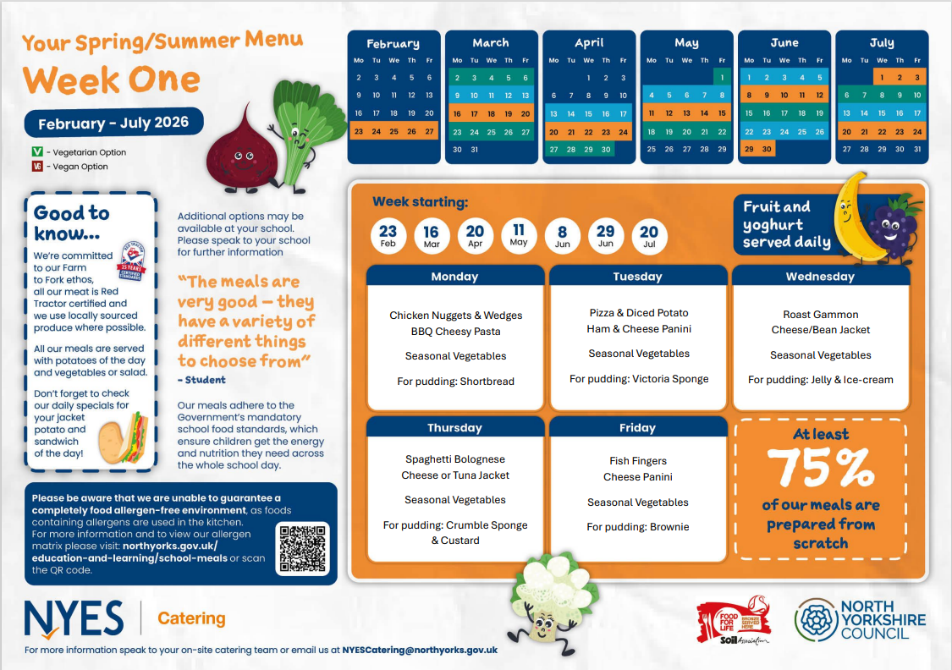
Lunch Menu – Week 1

Slide 14
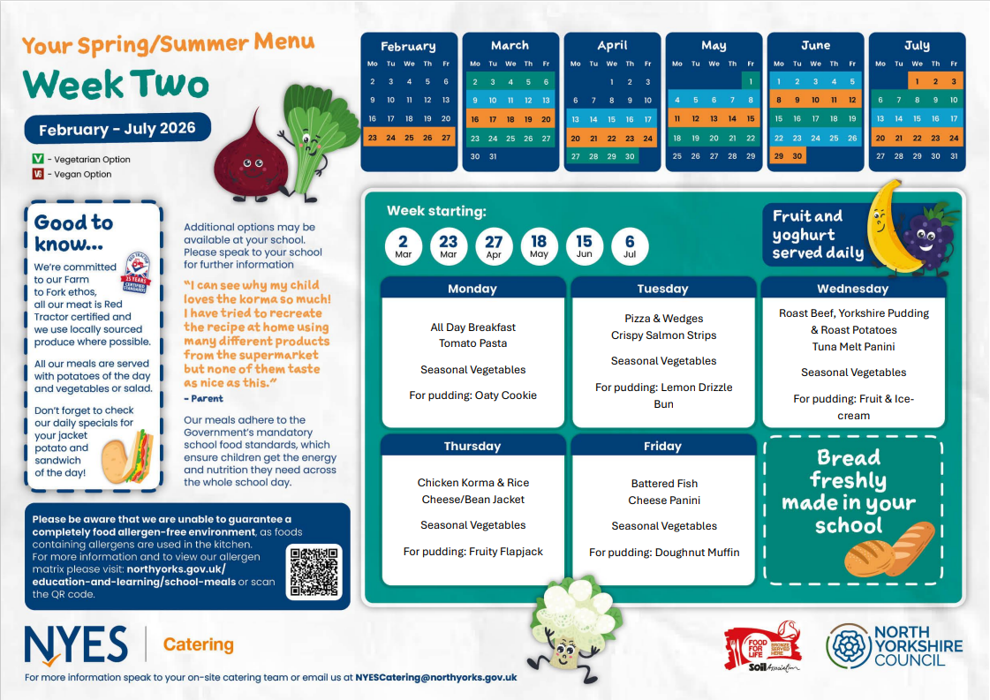
Lunch Menu – Week 2

Slide 15
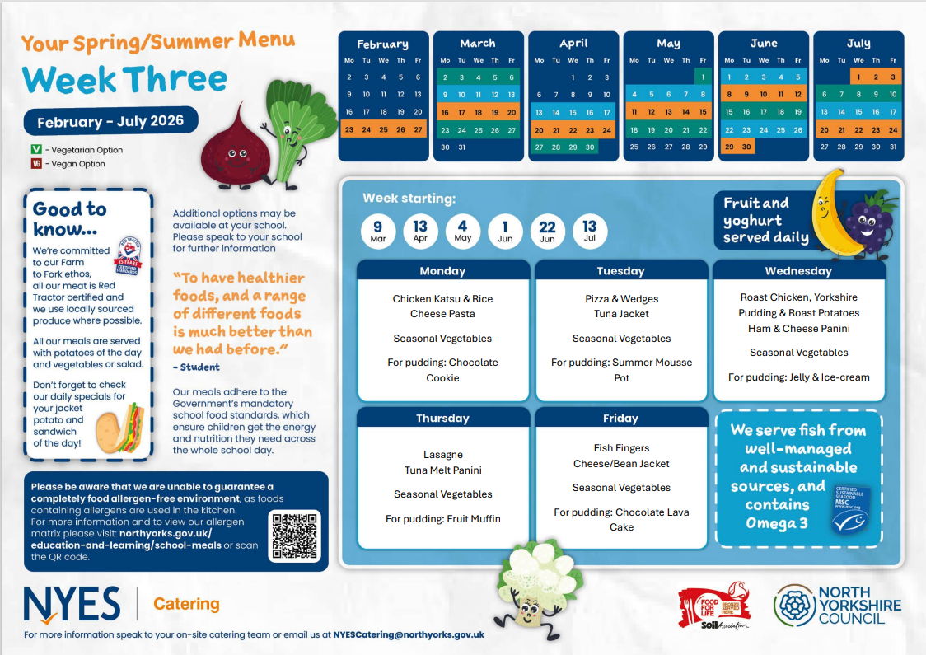
Lunch Menu – Week 3

Slide 16
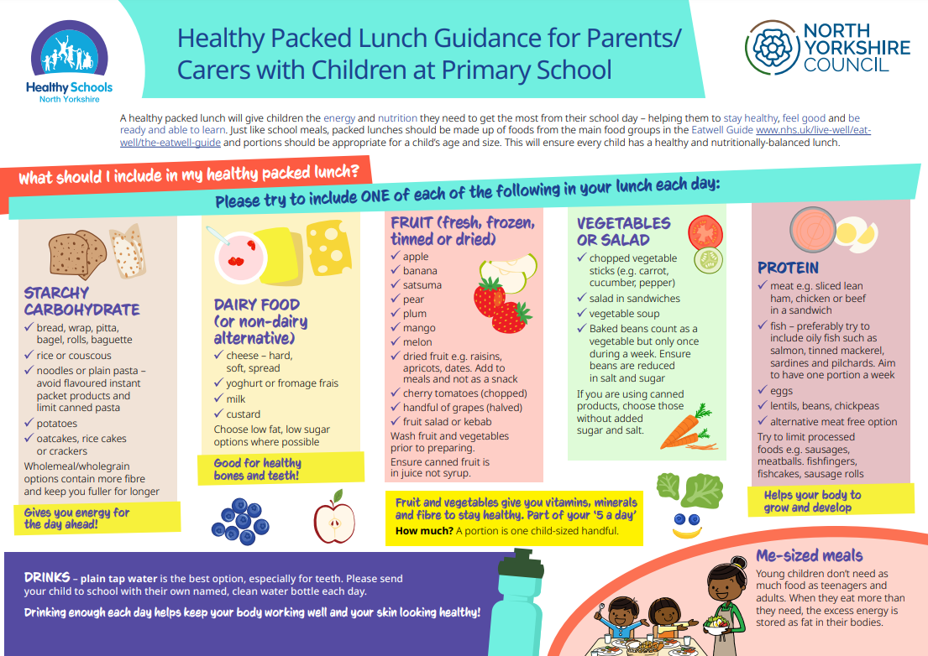

Slide 17
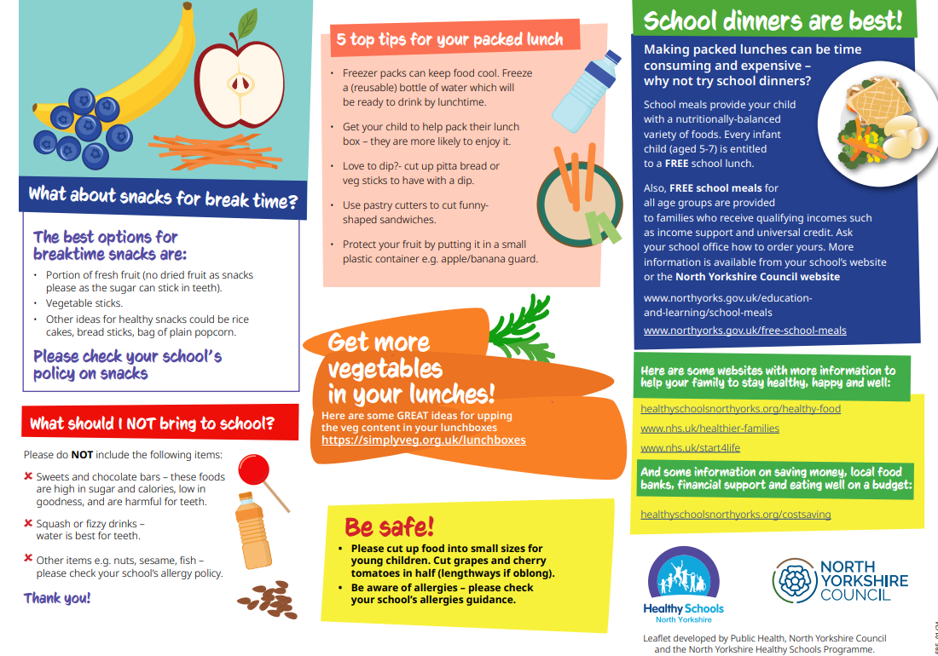

Slide 18
Safeguarding Update – Allergies
We would like to remind all families of the importance of not sending nuts, nut-based products, sesame seeds, or foods containing sesame in your child’s snacks or packed lunches. This precaution is vital to protect children with severe allergies, as exposure to these allergens can cause serious and potentially life-threatening reactions. We appreciate your cooperation in helping us maintain a safe and inclusive environment for all children.
Thank you for your ongoing support in helping us create a safe, healthy and welcoming environment where every child can thrive.

