Slide 1
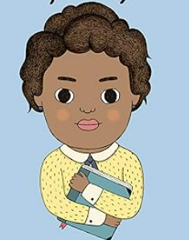
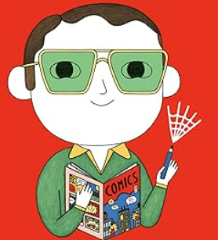
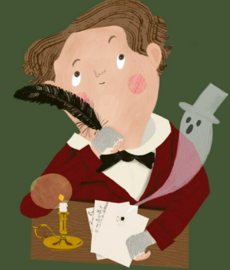
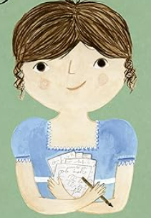
Crayke Primary School
House Teams 26/27
What can you discover about our authors?
Why choose these individuals?
This year we are focussing on authors and writers who have shaped our literary heritage.
As writers, they weave our values into their works creating a meaningful impact on the reader.
Our authors come from a range of backgrounds, cultures, spiritual paths and time periods. In each of them we can recognise our values and use this to take their inspirational messages into our own lives.
Maya Angelou
Stan Lee
Charles Dickens
Jane Austen

Slide 2


Charles Dickens
How did Charles Dickens show respect?
When Charles was young, he made up his own adventures. But after his father went to prison for debt, Charles ended up working in a factory with other children. He worked his way out, making a name for himself as a reporter and gifted storyteller. He wrote about all sorts of people including the very poor of Victorian England. He showed respect to the poor when very many other Victorians showed disdain.
Charles became one of the most beloved novelists of all time, aware of the power of a tale and of giving poor children a voice.
Team Captain:
India
Try reading:
Oliver Twist
A boy is born into poverty and must try and make a life for himself. He endures the hardship of the workhouse and life on the streets all as he tries to survive. He is taken under the wing of Fagin, who encourages Oliver to turn to a life of crime.

Slide 3

Stan Lee
How did Stan Lee show friendship?
As a young boy Stan loved to tell stories. As he grew, he developed his love of comics and created Marvel. His heroes, whilst super, still had flaws like regular human beings. This was really important to Stan, as he knew good friends come in all different forms.
After he died, the Stan Lee Foundation continued work to help support story-telling. It’s vision is to ‘ensure the power of story-telling remains accessible to all’.
Team Captain:
Grant
Try reading:
The Amazing Spider-Man
A comic all about a young boy named Peter Parker who is bitten by a spider and develops amazing super-hero powers. He tries to save the world from disaster whilst still trying to navigate being a normal teenager!

Slide 4

Jane Austen
How did Jane Austen show determination?
Jane loved stories as they offered her escapism from a restrictive society. In a time when women weren’t expected to go to school, let alone write books, Jane became a trailblazer and inspiration for so many women writers after her. She wrote about society in a way no-one else had. Her books centred on female characters who bravely made their own choices. She showed determination by defying attitudes of the time and showing that women are intelligent people, not just wives or daughters.
Team Captain:
Arthur
Try reading:
Emma
Emma Woodhouse is pretty, clever, and thinks she knows what's best for everyone... especially when it comes to finding them the perfect husband! Her meddling unfortunately ends in problems for all her friends which she must try and put right.

Slide 5
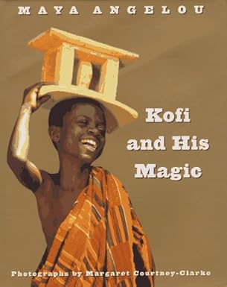
Maya Angelou
How did Maya Angelou show forgiveness?
As a black citizen, Maya Angelou experienced a lot of prejudice, as she was growing up in a time when America was racially segregated. Maya was a strong black voice when many black people weren’t allowed to speak up. She grew up in poverty and had a difficult childhood. Despite so many challenges, Maya always talked about the importance of forgiveness. She said: “It’s one of the greatest gifts you can give yourself, to forgive. Forgive everybody.”
Team Captain:
Eva
Try reading:
Kofi And His Magic
Kofi, a child from the West African town of Bonwire, takes you on a journey from Bonwire to northern Africa, to his school, to a festival, and to the ocean, sharing a snapshot of his daily life in Africa.

