Slide 1

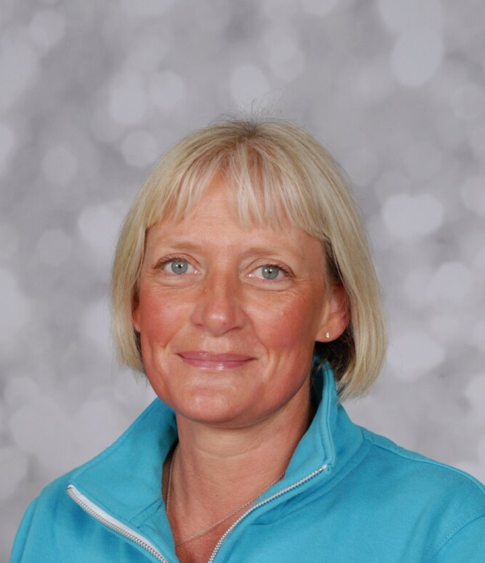
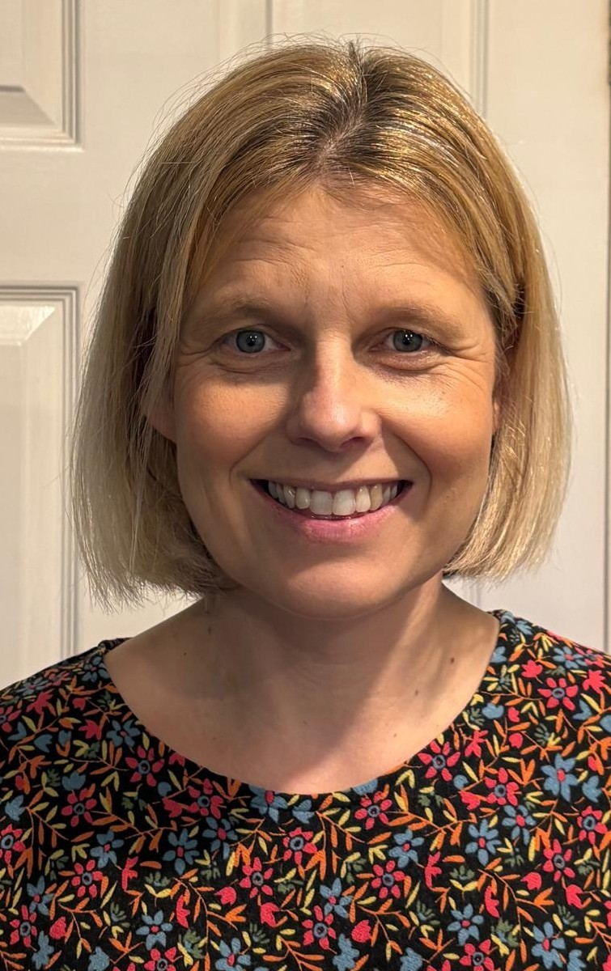
You are joining Apple Class in September 2026.
You will meet Mrs Helfferich and Mrs Hetherington, they will help you settle into school and help you learn lots of new things.
Welcome to Crayke School

Slide 2
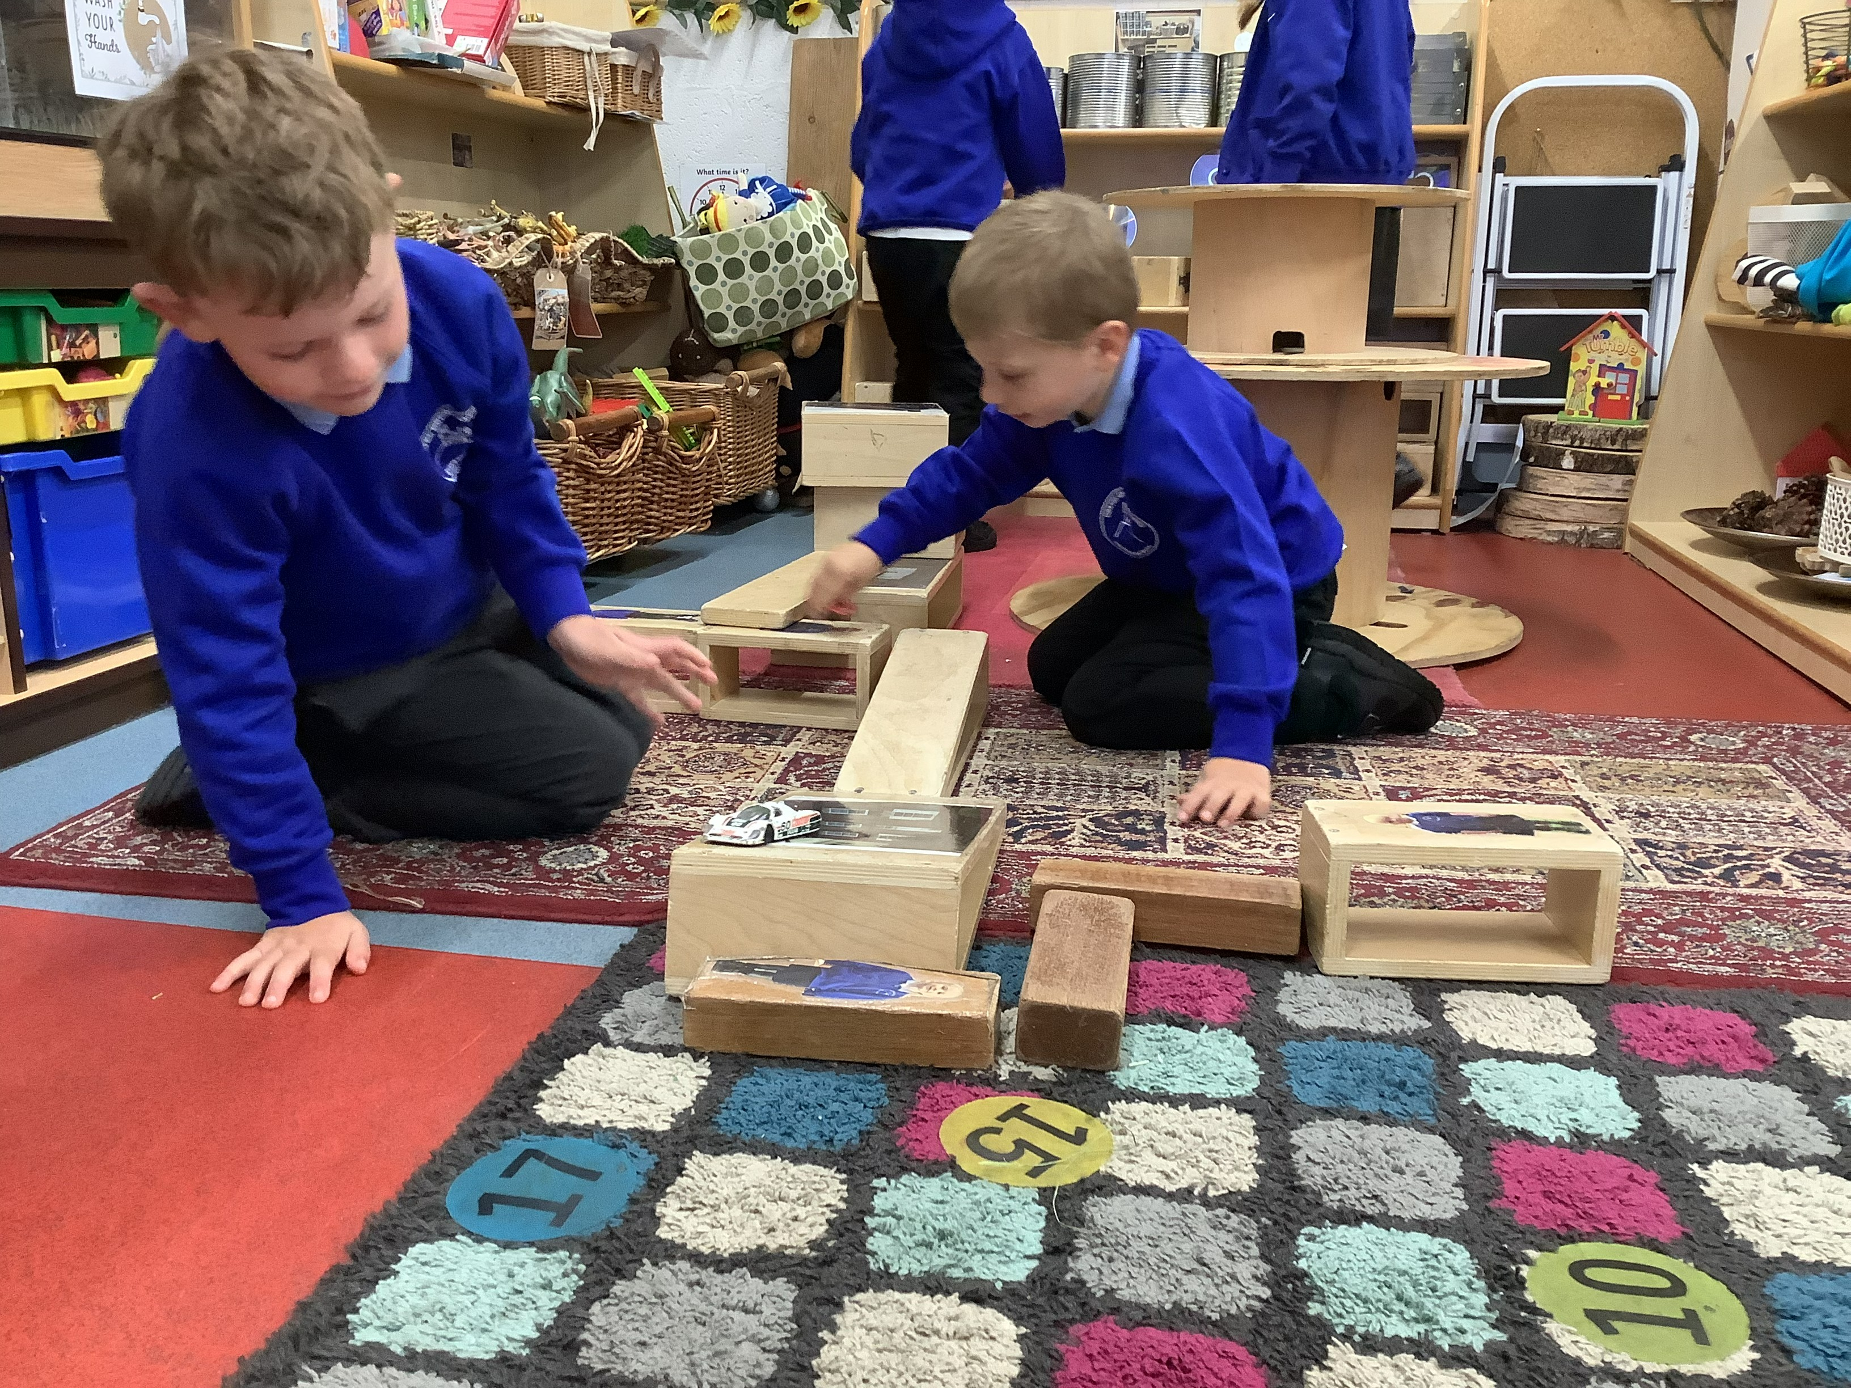
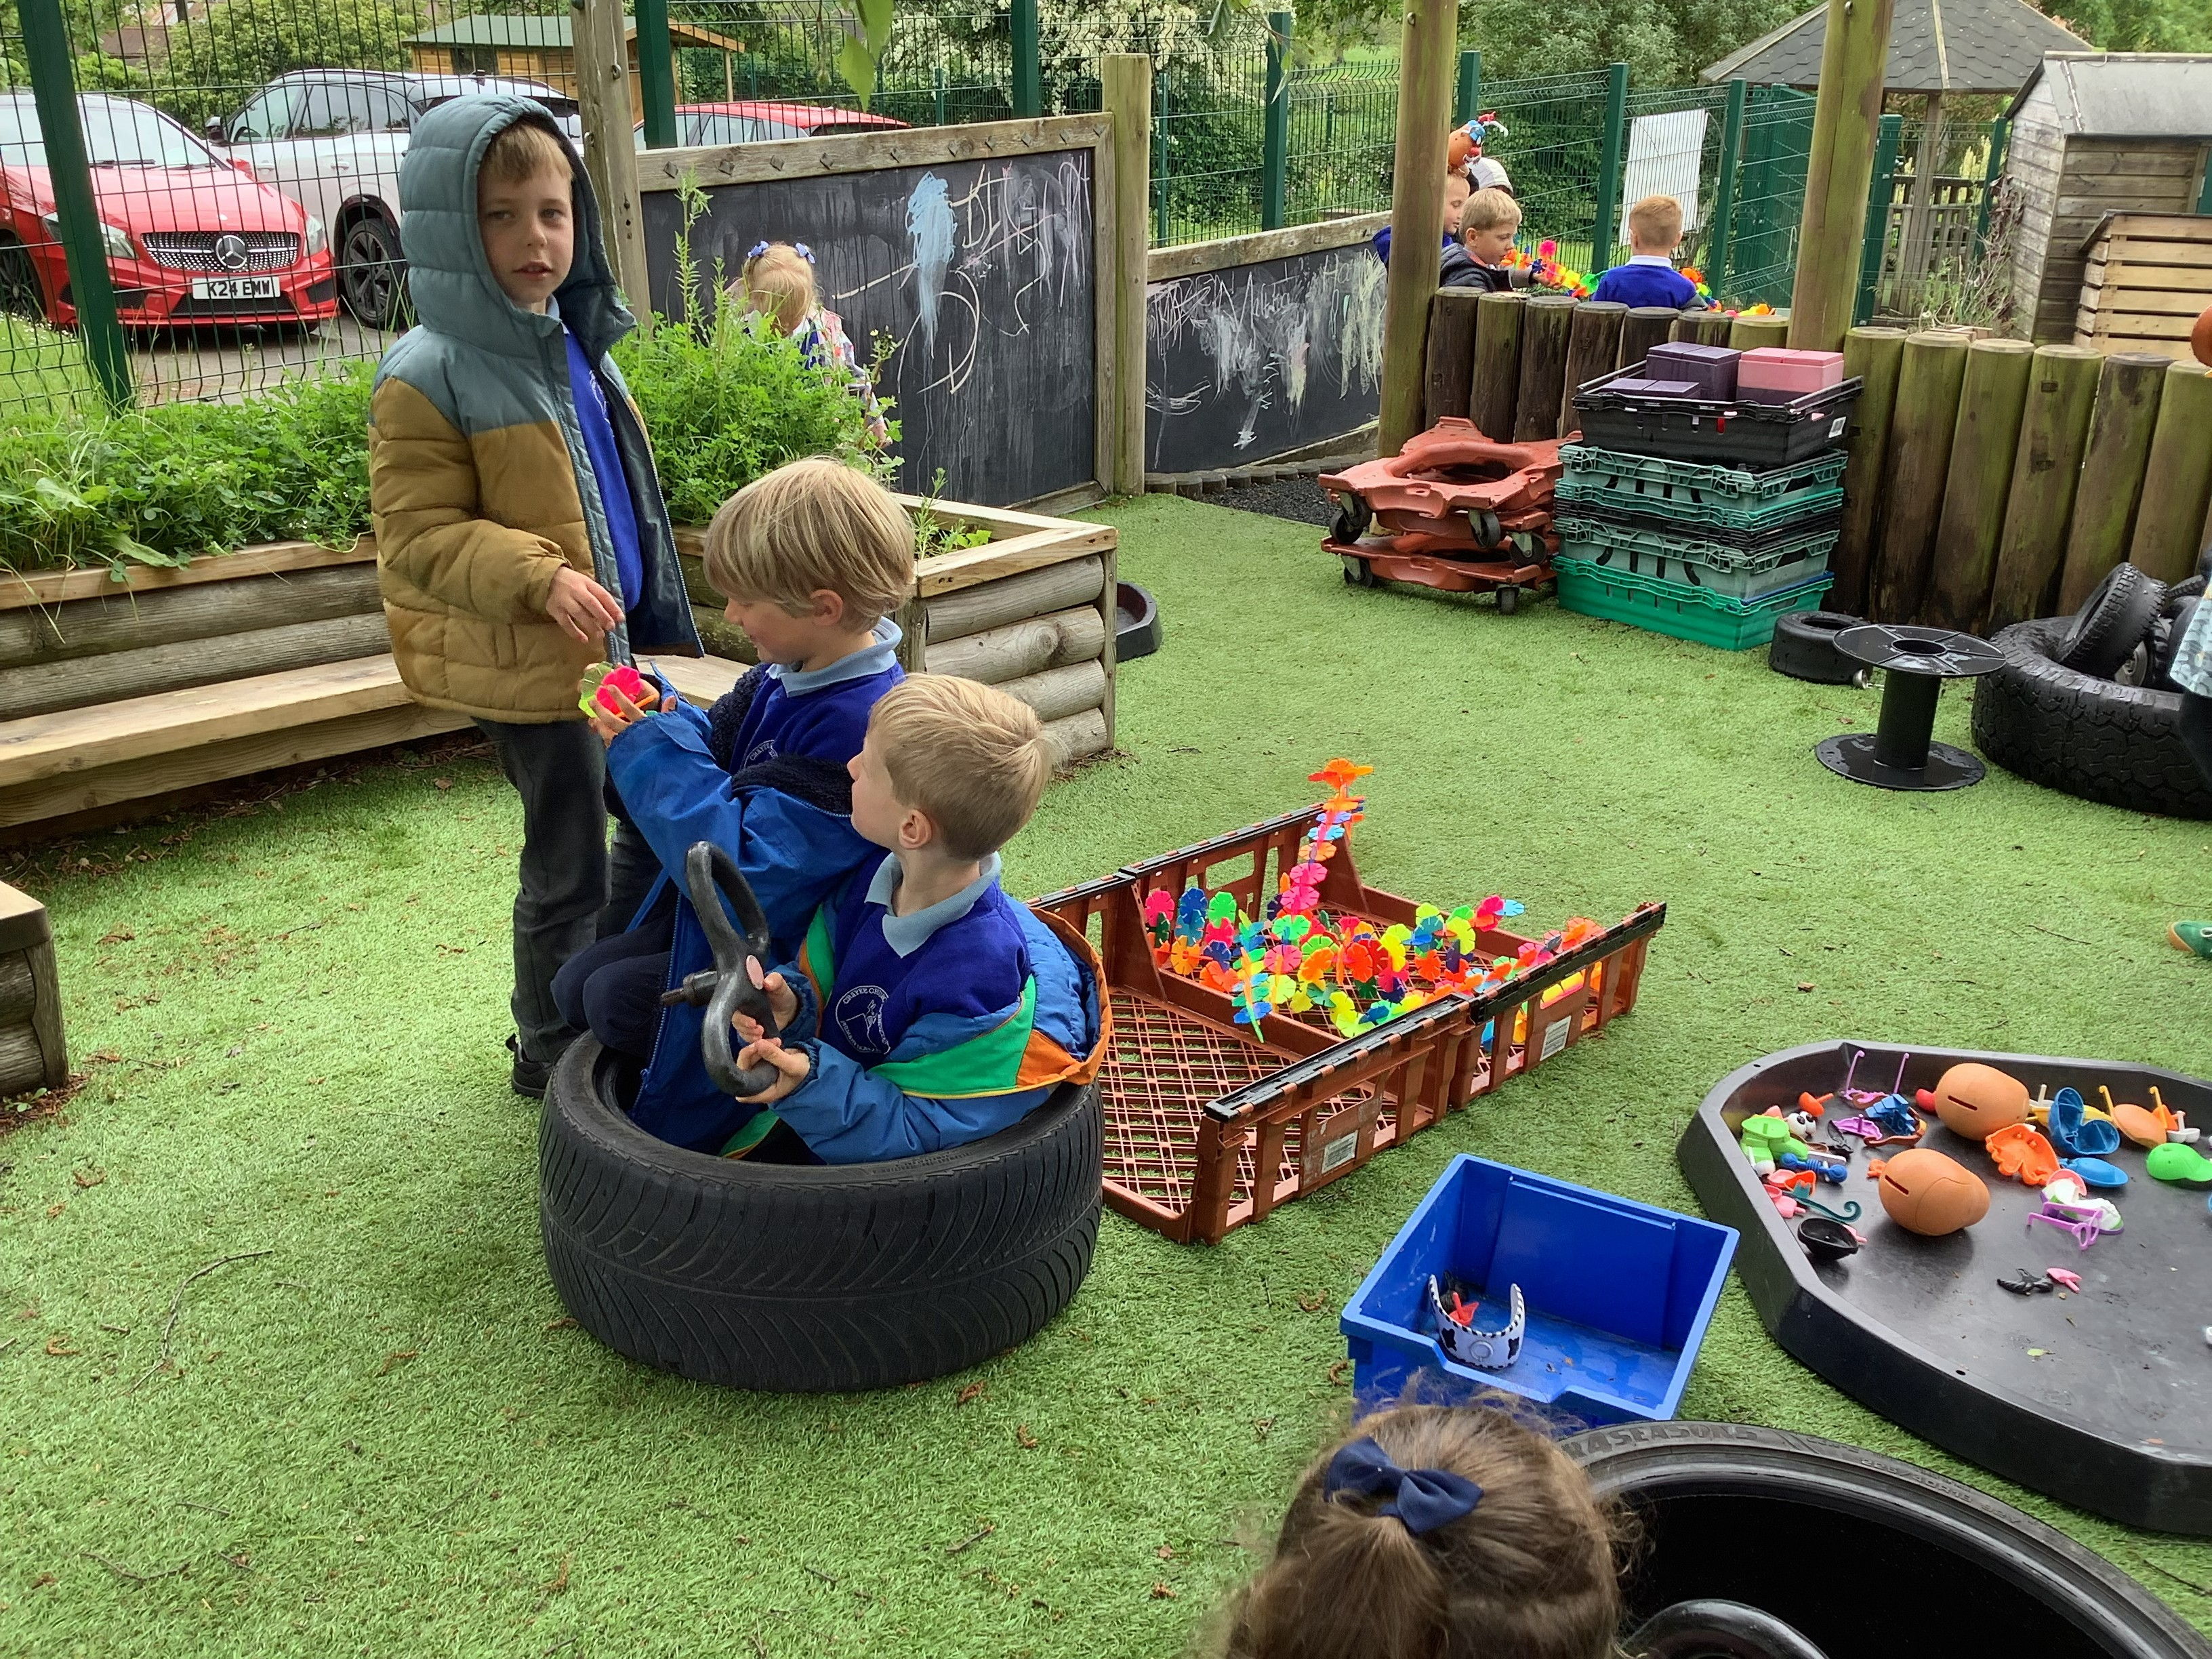
We have two areas in Apple Class, one is inside and the other is outside.
We have lots of exciting activities for you to explore.

Slide 3
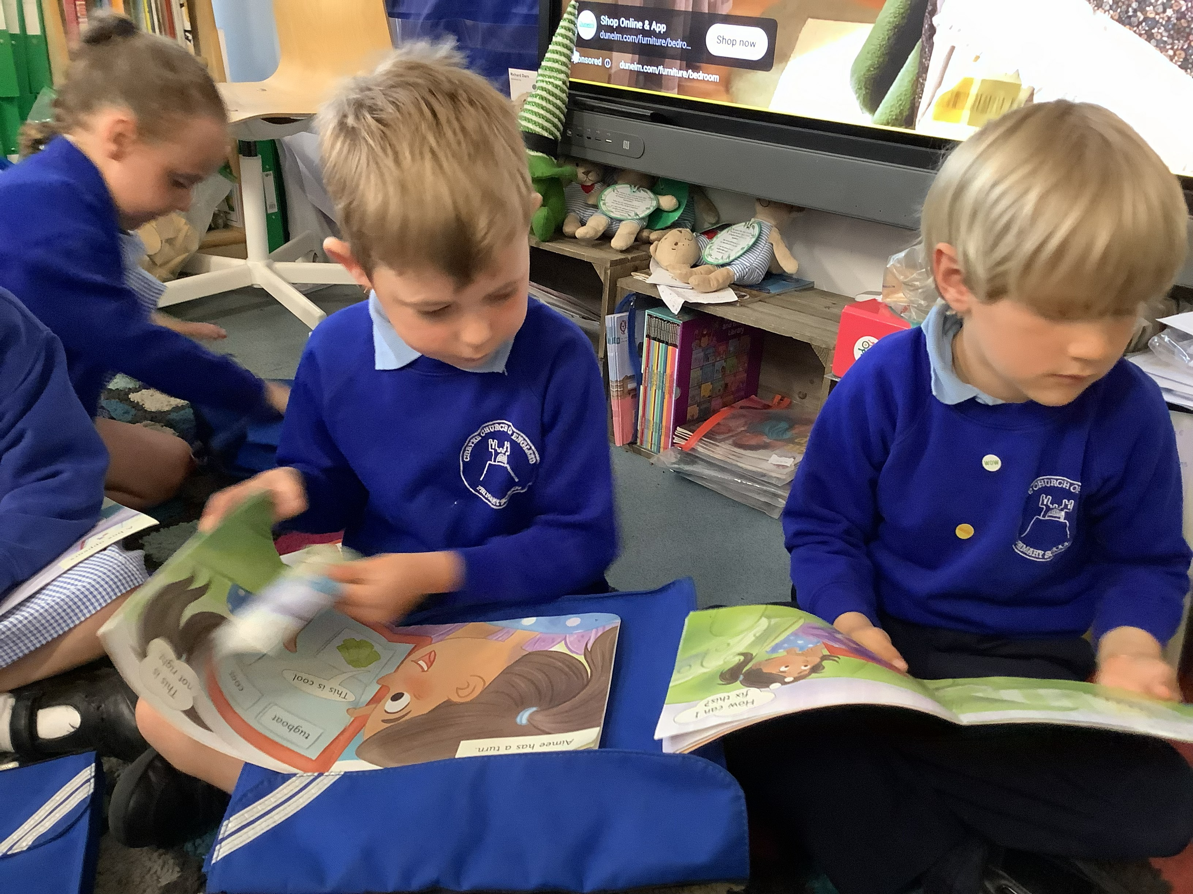
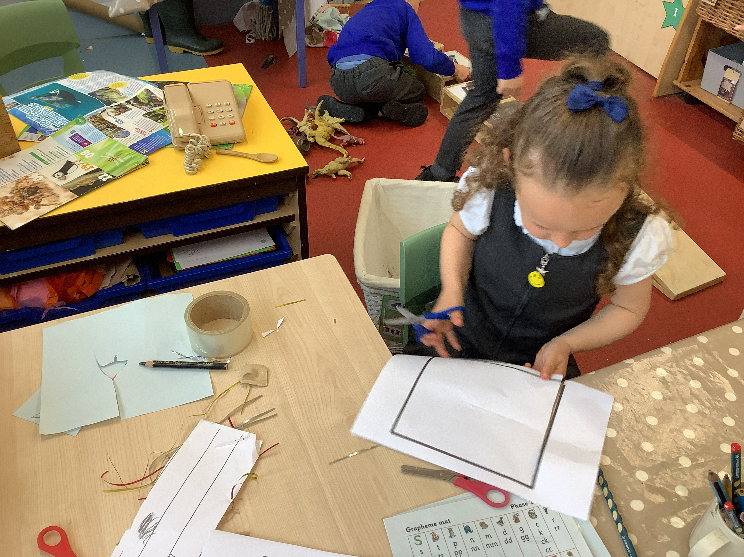
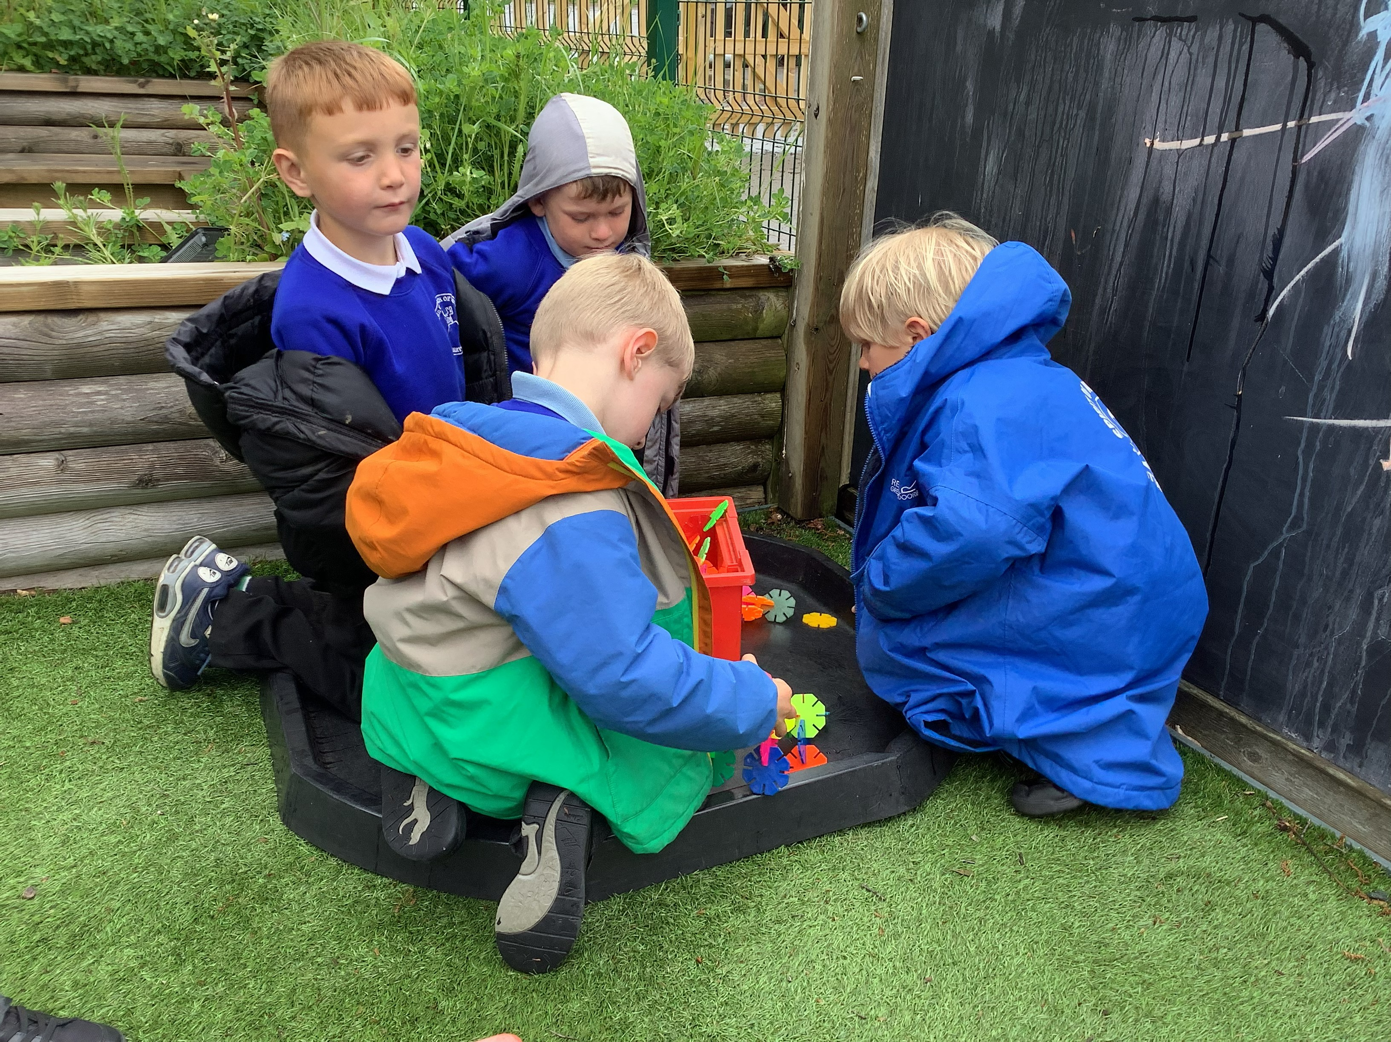
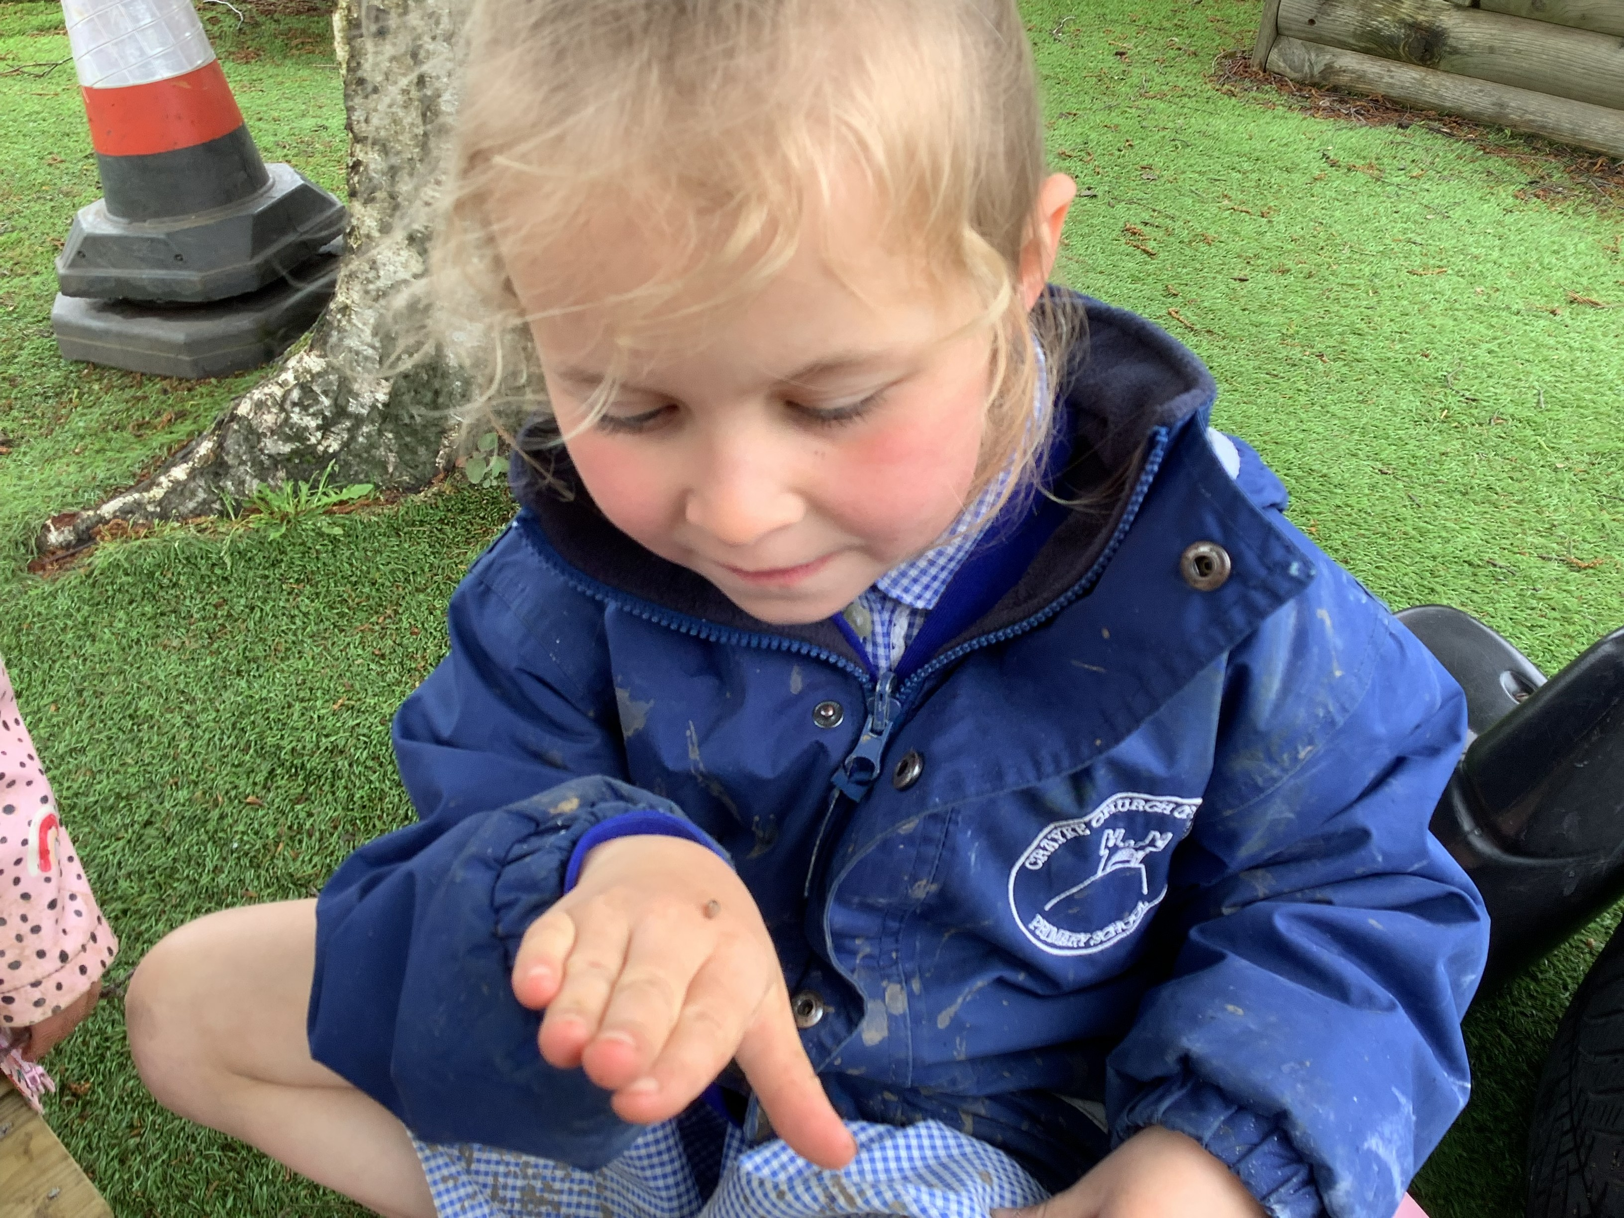
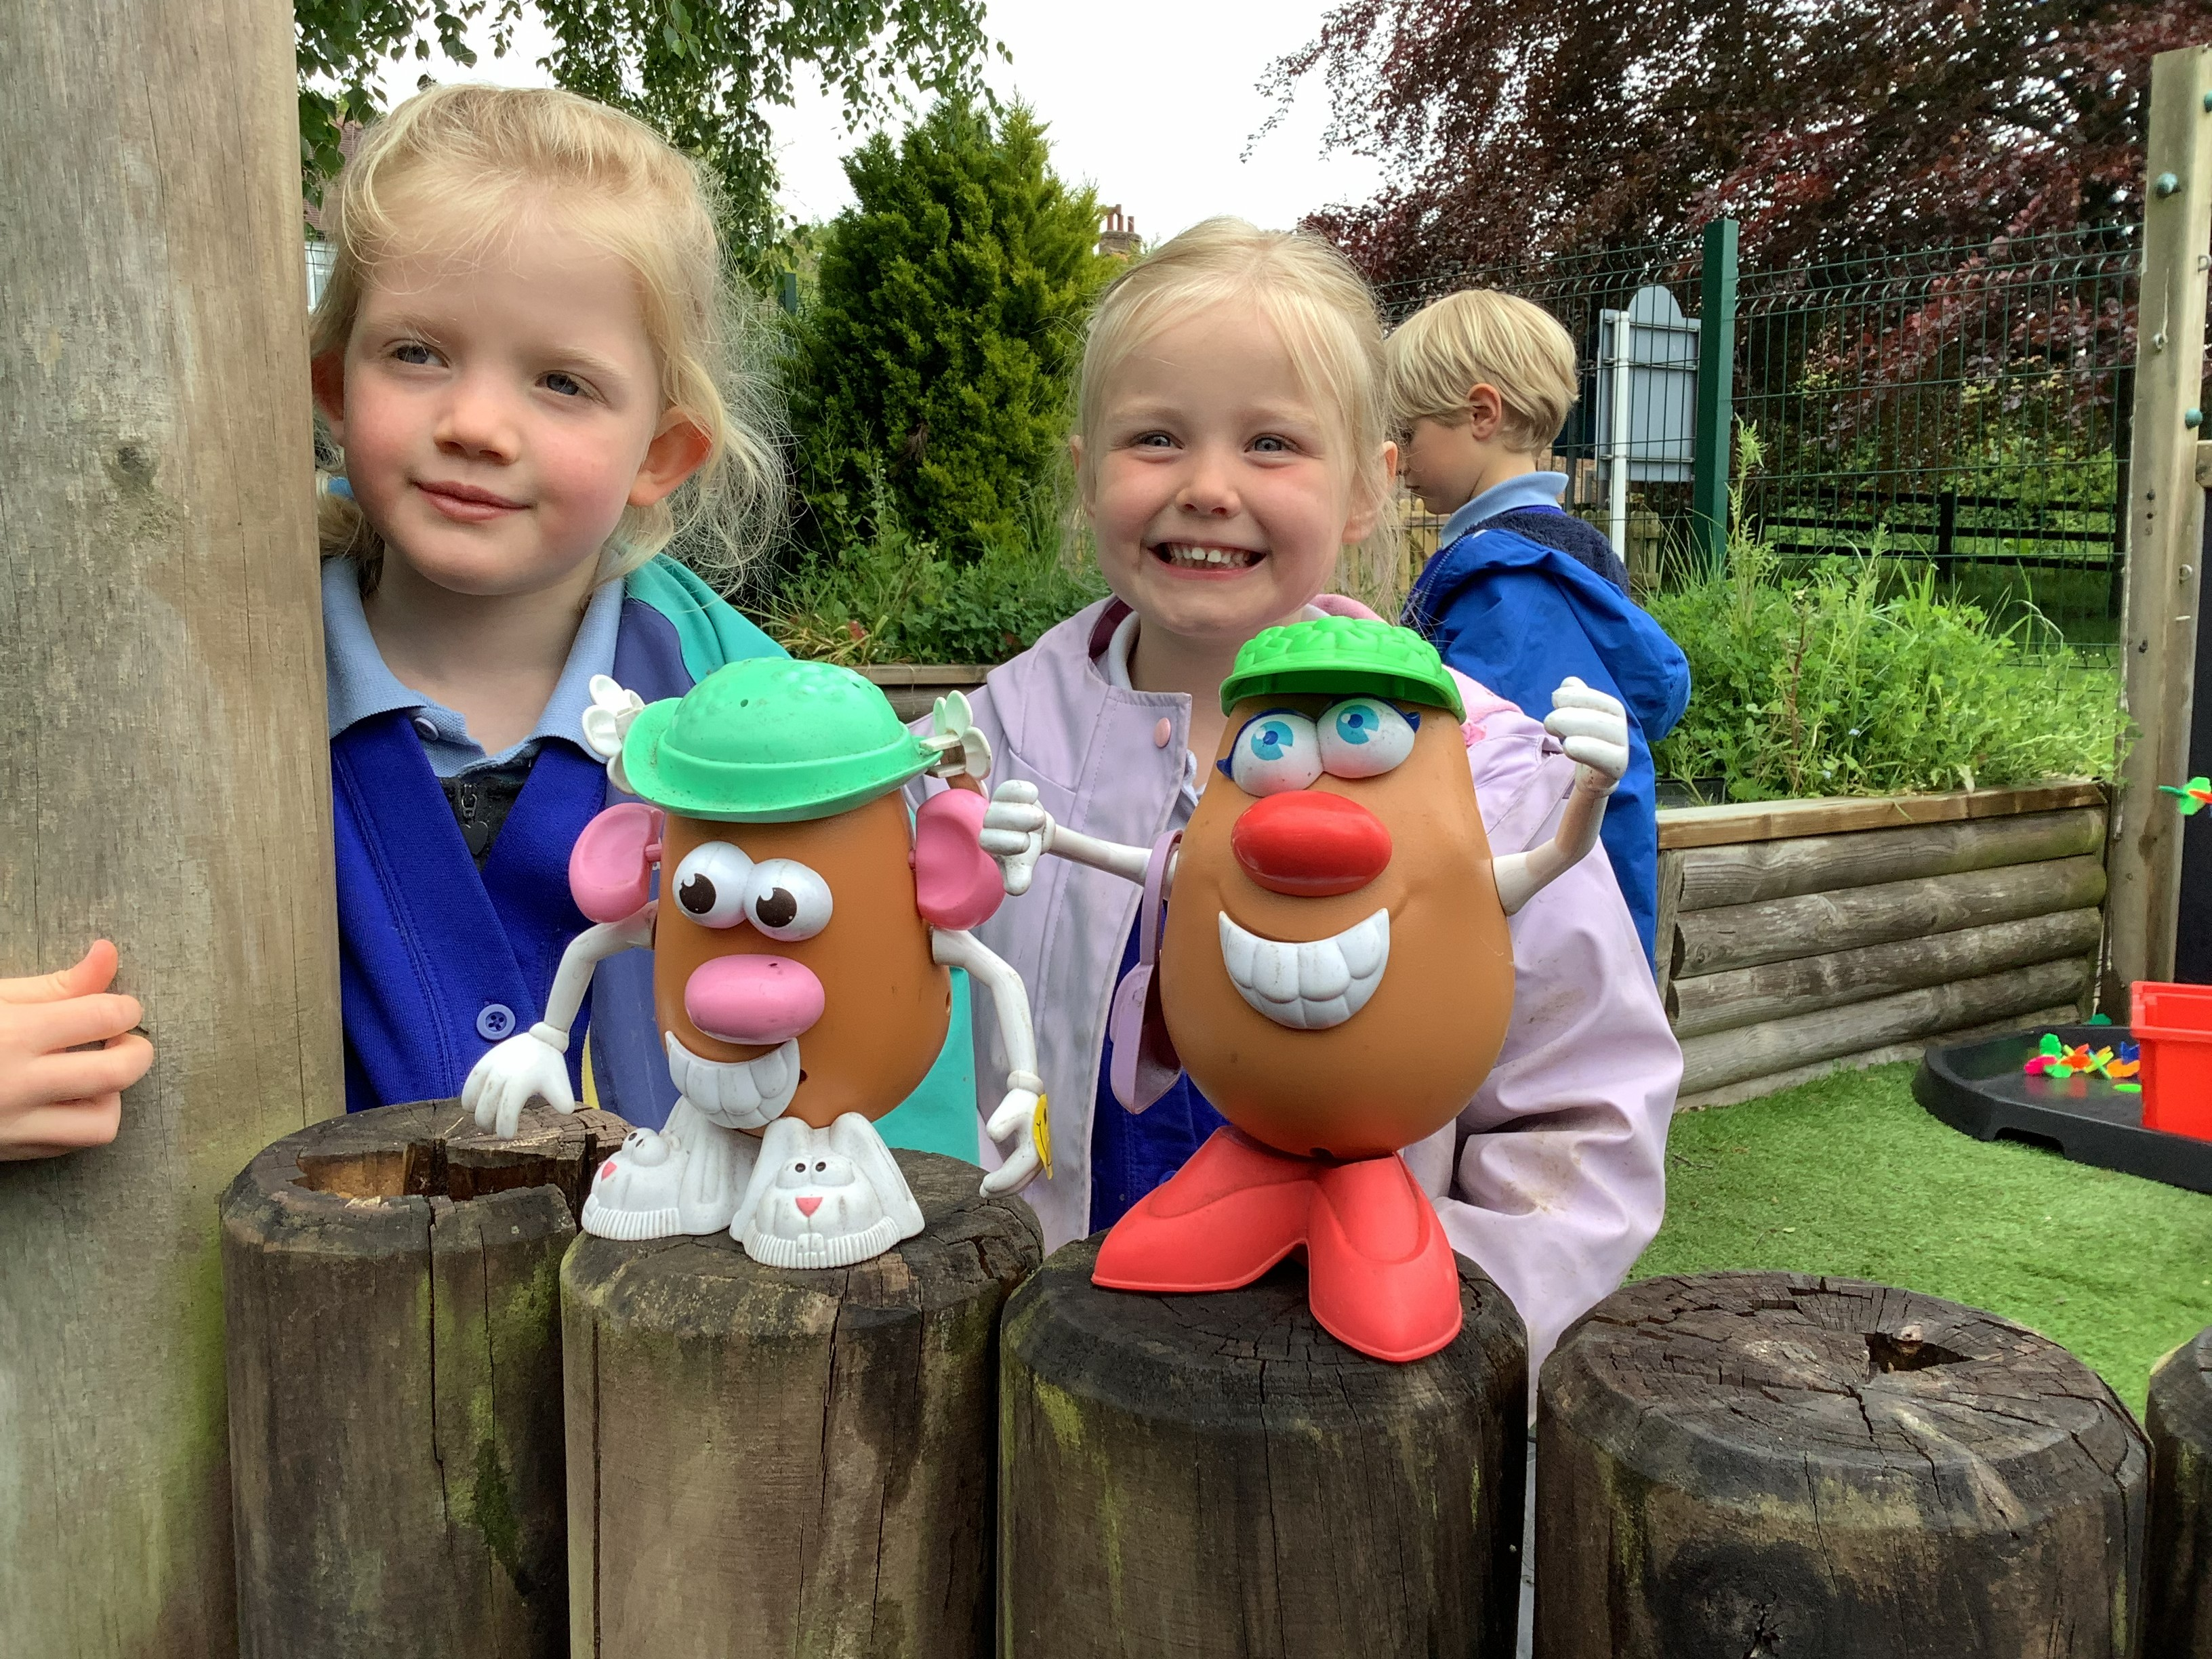
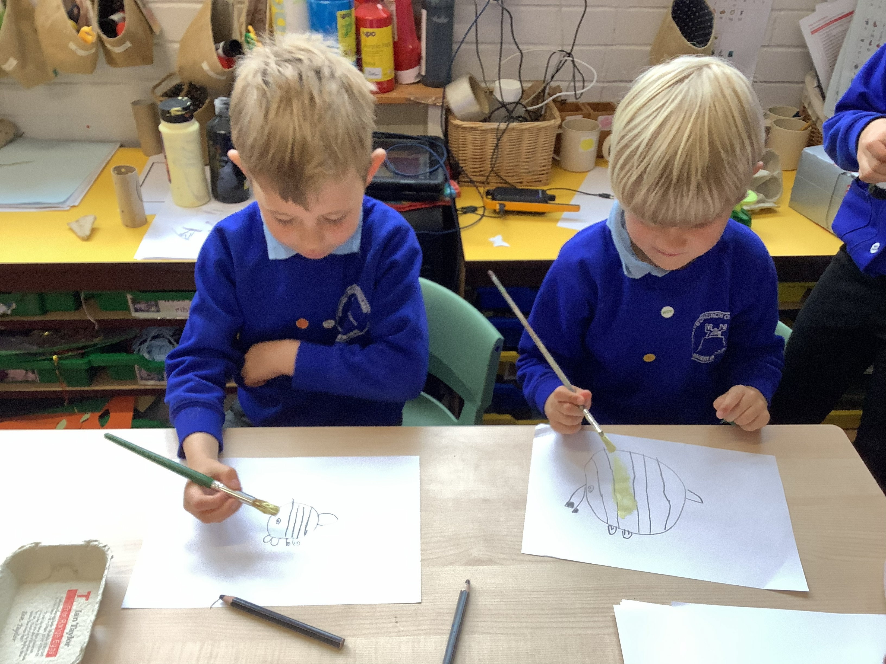
Which activities do you think you would like to try?

Slide 4
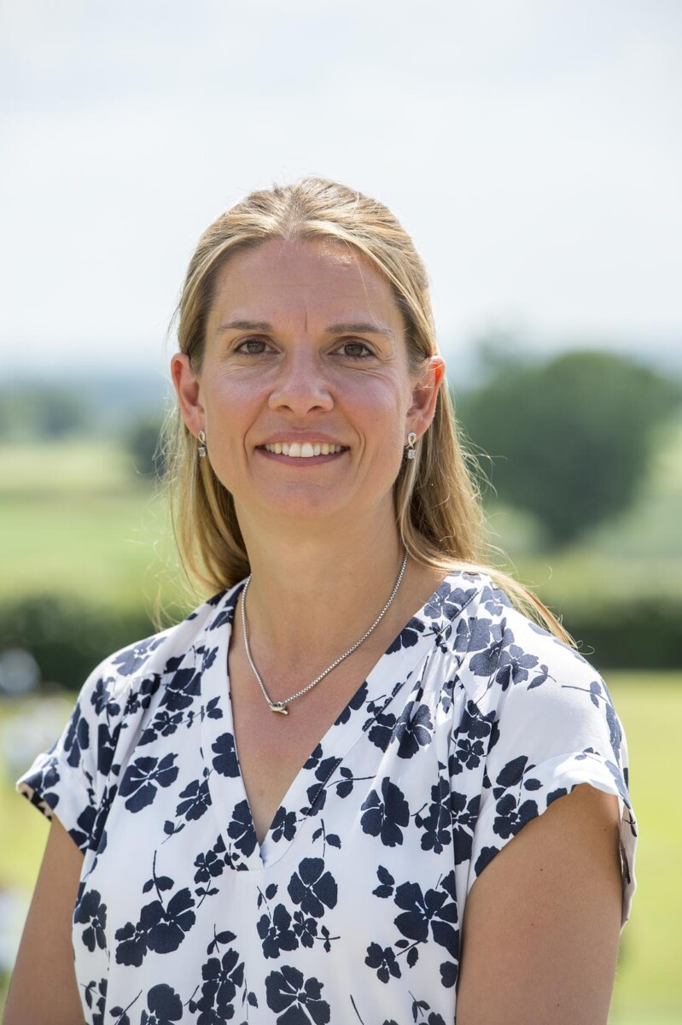
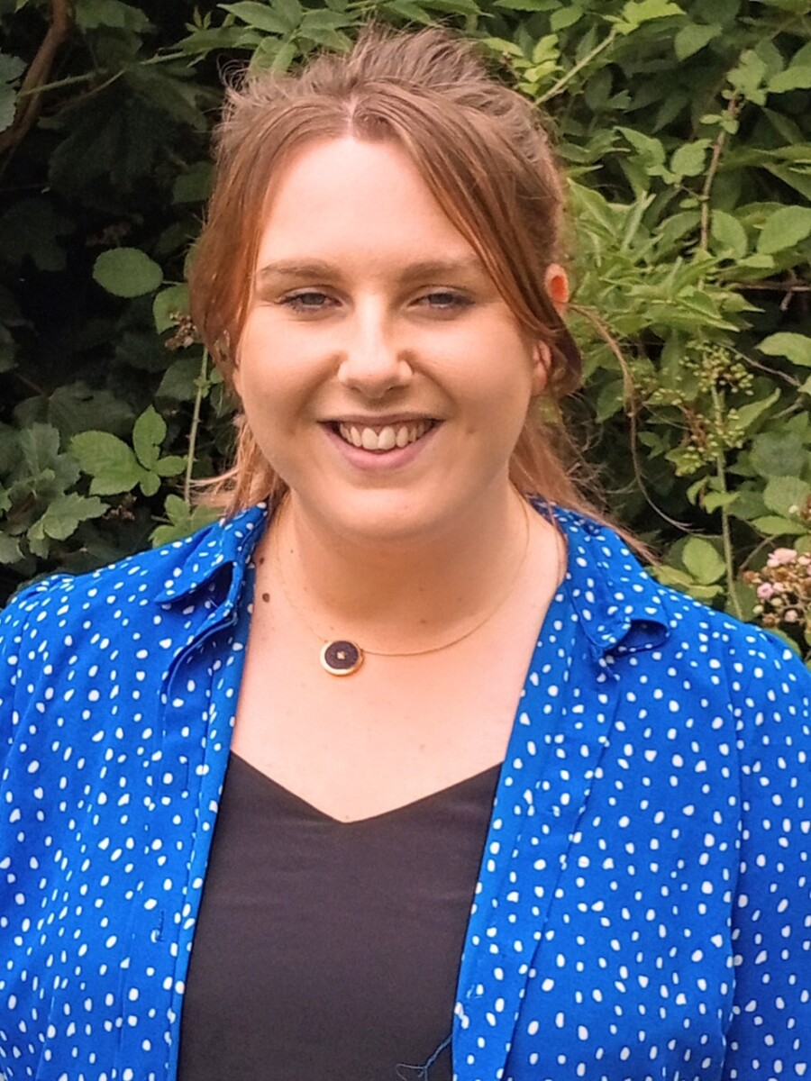
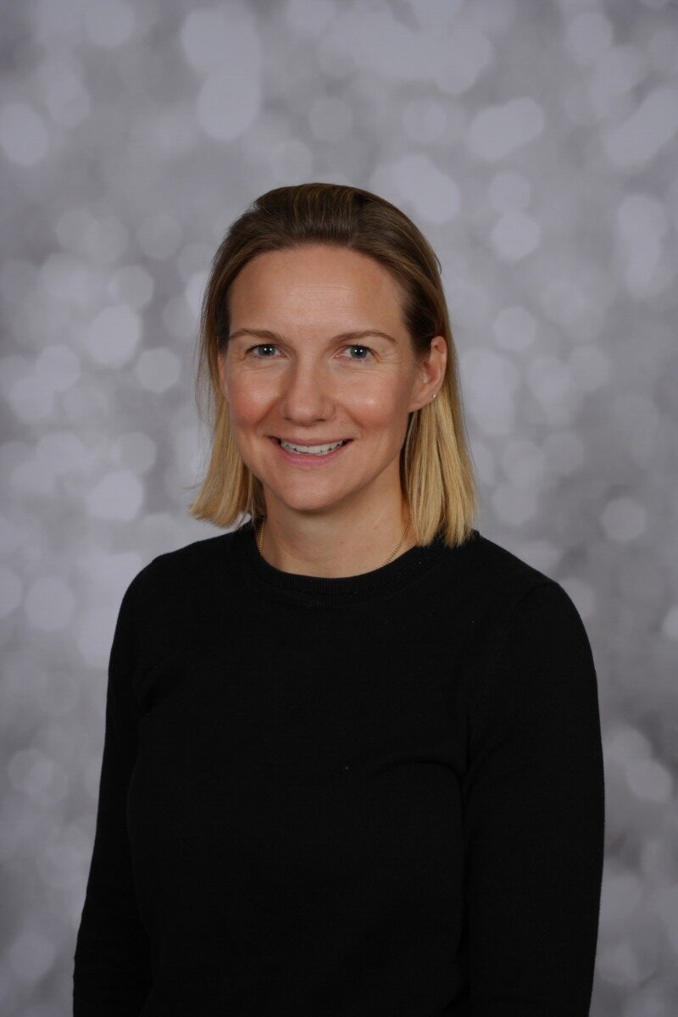
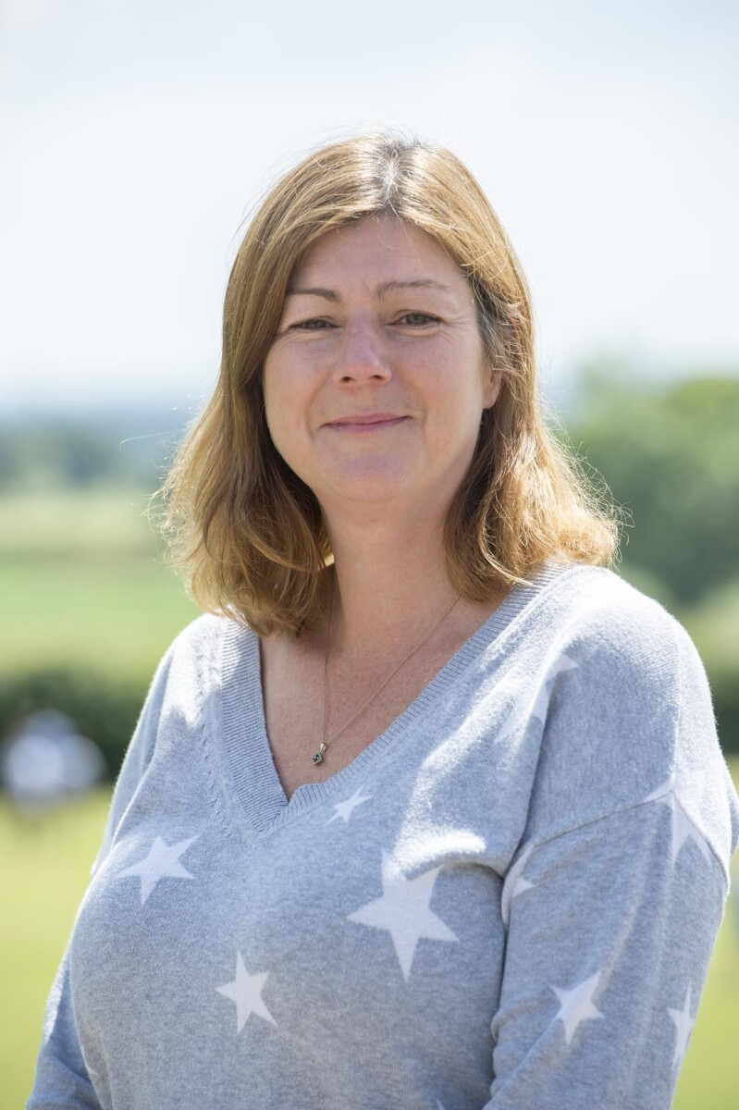
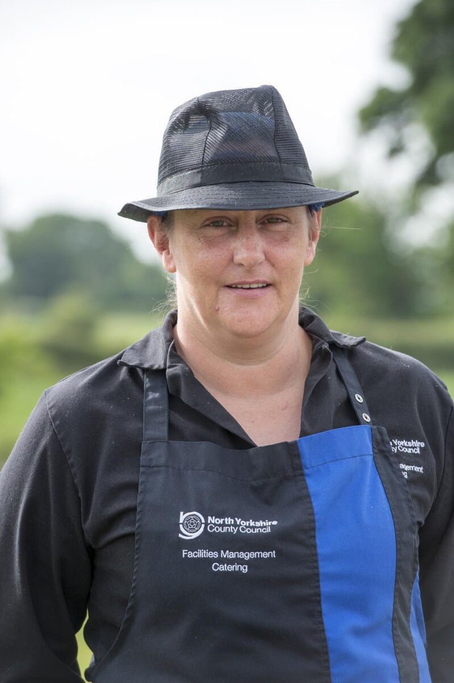
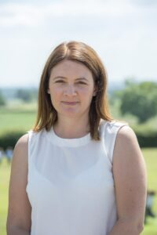
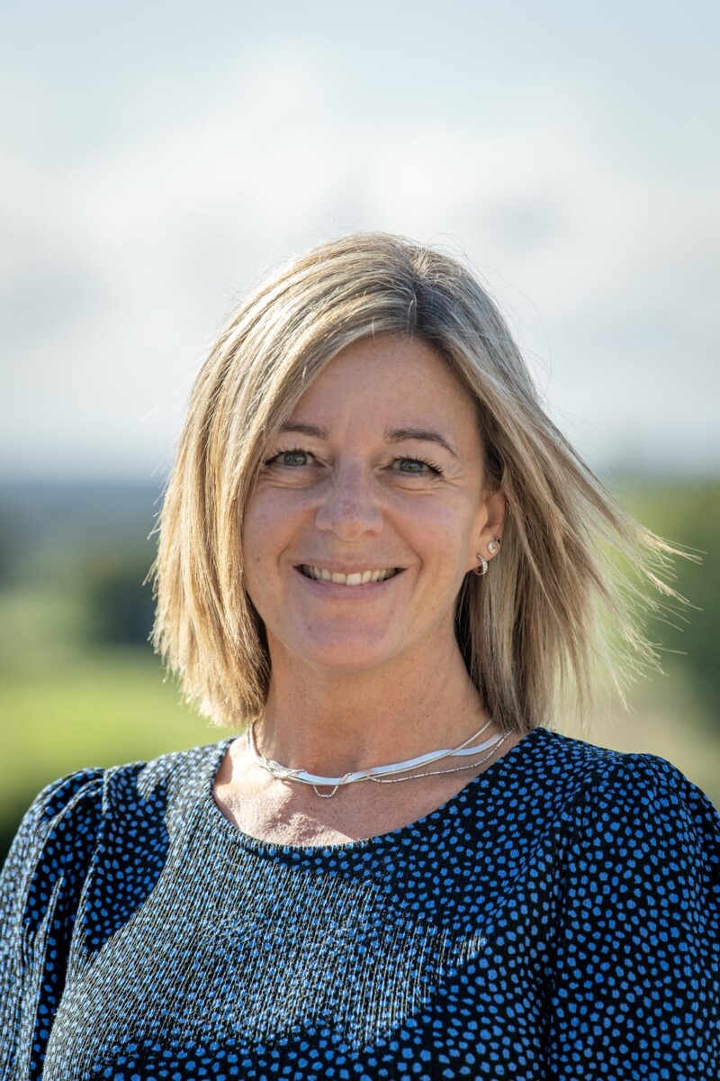
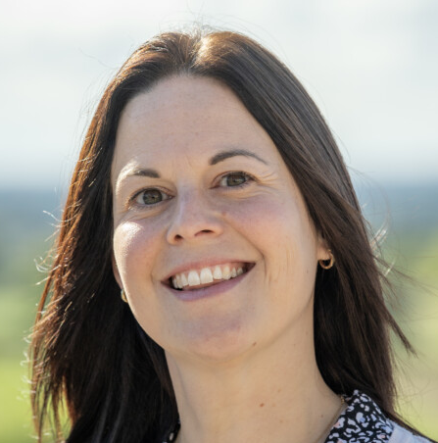
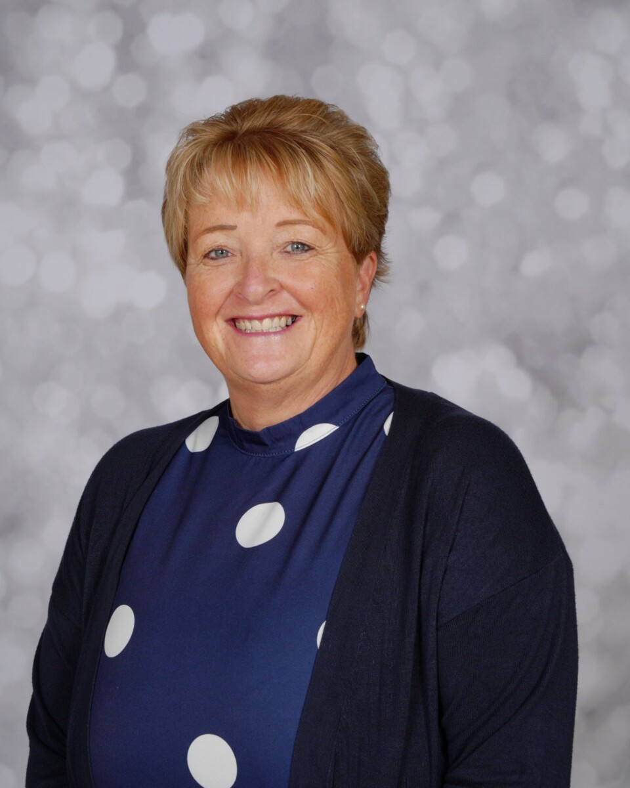
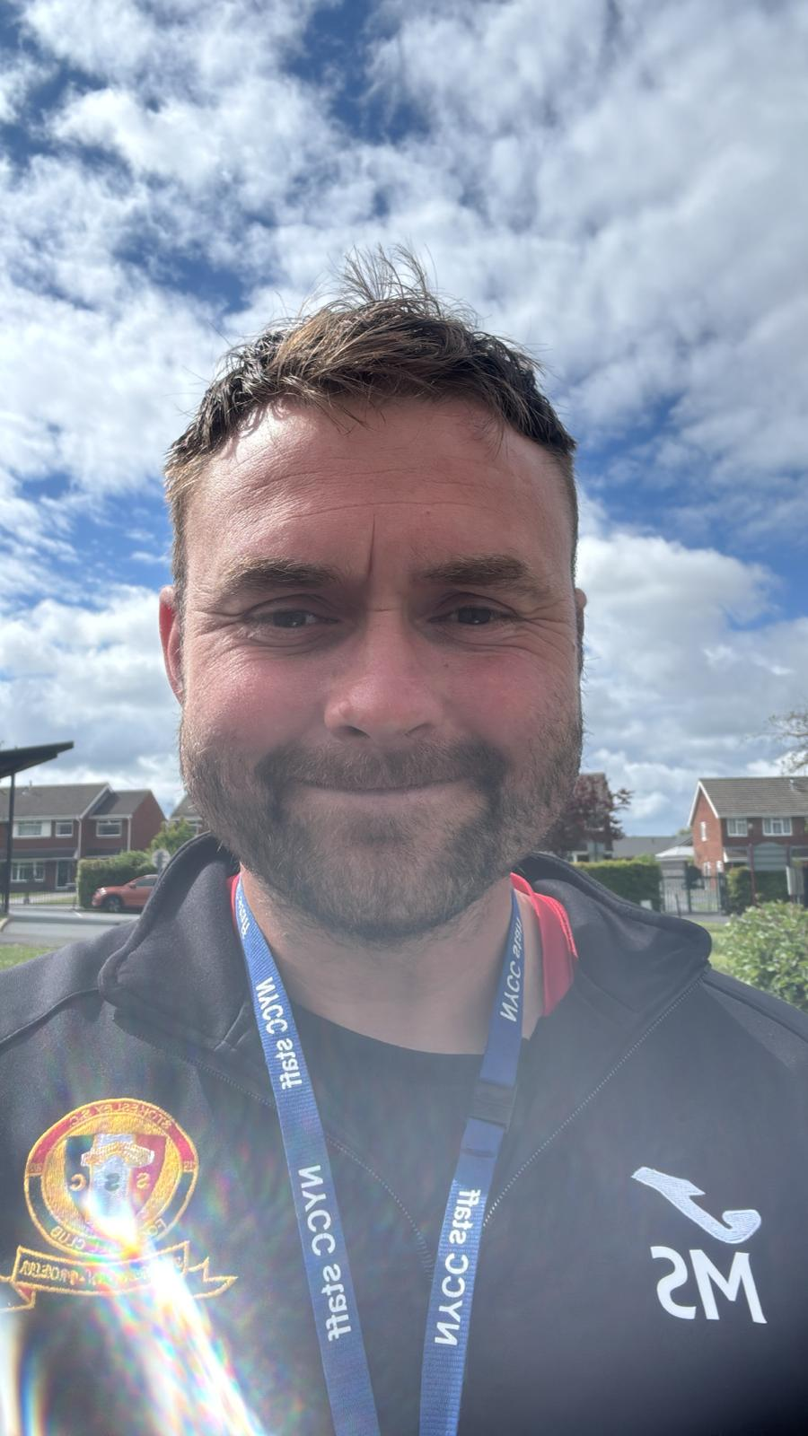
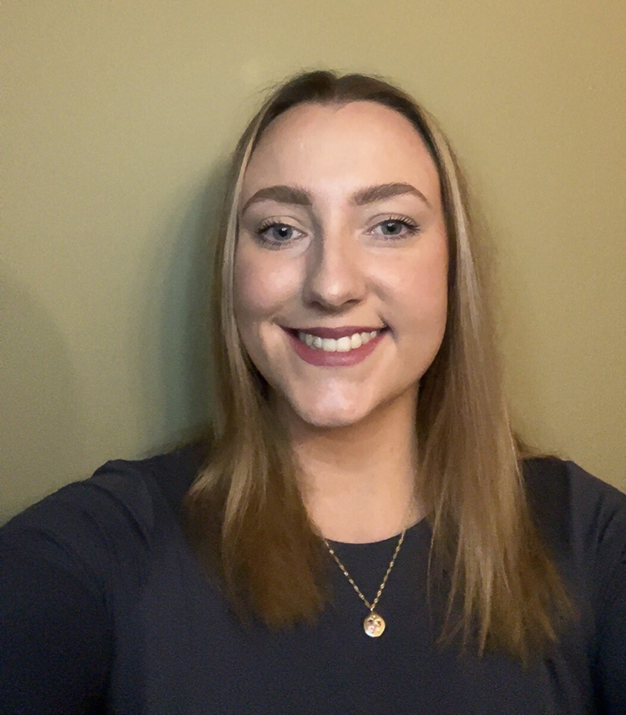
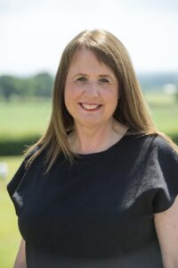
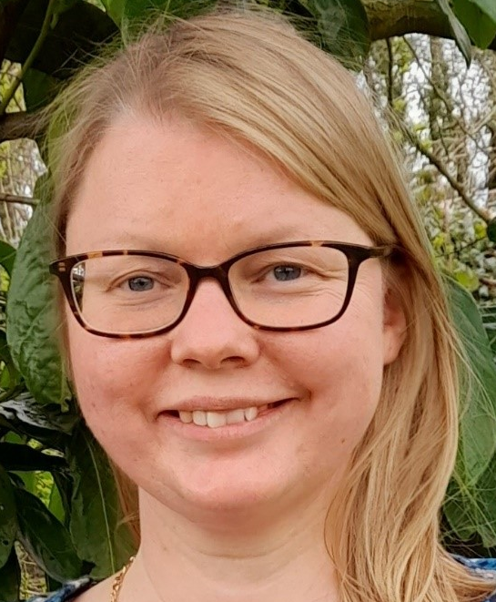
There are lots of people who work at Crayke School. You might recognise some of them. Can you spot anyone that you already know?

Slide 5

Things that you might want to know:
Buddy – An older child in year 6 will be your Buddy. They will look after you at playtimes, you will walk up to church with them when we visit.
Lunchtime – We have our lunch at 11.50am. Mrs Helfferich will stay with you until you have finished your lunch.
Home time – At 3.30pm, Mrs Helfferich will take you to the gate and hand you over to whoever is picking you up.
For the first week, Mrs Helfferich/Mrs Hetherington will be out at breaktimes to make sure you are all happy and settled.
If you have any questions, please ask us on one of your visits.
We look forward to meeting you and can’t wait for September.
Mrs Helfferich and Mrs Hetherington

